Slide 1

Democracy 2.0 Decentralized Autonomous Organization
Open Challenge
Kaan Sentürk, Jonas Hagemann, Adrian Soos, Manuel Schmuck, Martin Blapp, Philippe Hasler, Claudio Ferrari
16.12.2017

Slide 2

Our Idea
Problem
Solution
Private Key
Token
Kaan Sentürk, Jonas Hagemann, Adrian Soos, Manuel Schmuck, Martin Blapp, Philippe Hasler, Claudio Ferrari
16.02.2018
Notes:
Our Project Idea
What is the social/econimic/environmental challenge we want to solve?
- Legacy voting system relies on trusted authority
- Possibility to entrust one's vote to others (Liquid Democracy)
- Simplify petition process
What is our approach to the solution?
Create verifiable, secret, integrated, resistent voting system on (ethereum) blockchain (decentralized trust)
Tokenization of voting rights
Forward permission to use one's voting token
Automated creation of voting for successful petitions

Slide 3
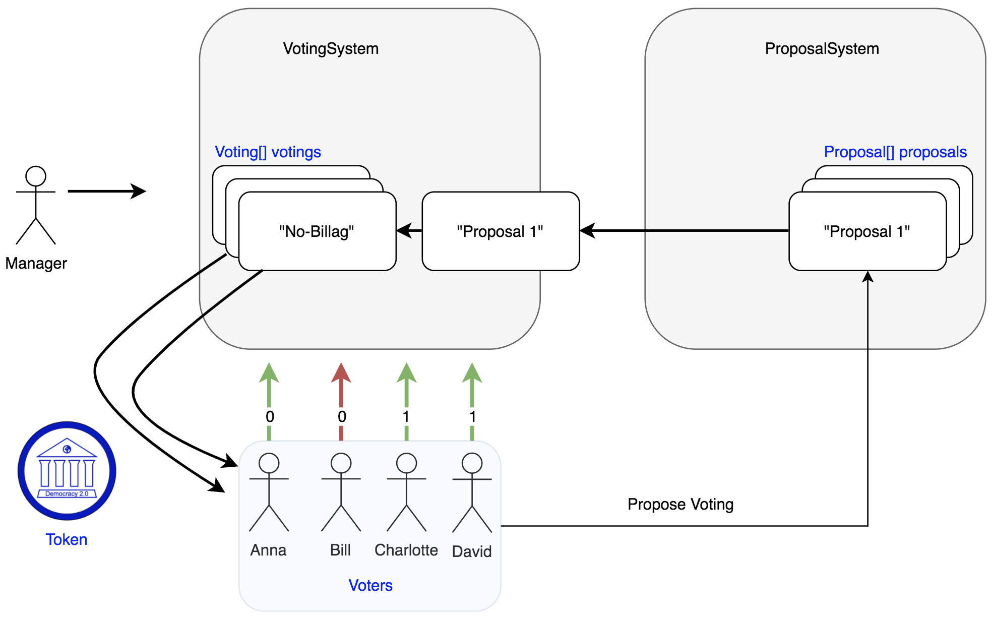
Solution Design
Kaan Sentürk, Jonas Hagemann, Adrian Soos, Manuel Schmuck, Martin Blapp, Philippe Hasler, Claudio Ferrari
16.02.2018
Notes:
How voting work:
Manager creates VotingSystem (container for aribitrary many votings), needs to fund it such that voters don’t have to pay for voting themselves
Manager creates vote and with it as many tokens as eligible voters
Upon request eligible voters obtain exactly one token with which they can cast their vote
Voting rights can be given to another trusted voter (liquid democracy)
Voters can change their vote up until the deadline (for example if you don’t agree with what your trusted party voted)
How proposals work:
Anybody can submit a proposal which he/she wants the voters to vote on
People can express their support for a proposal
After enough people support a proposal it can be put to a vote (see above for how that works)

Slide 4
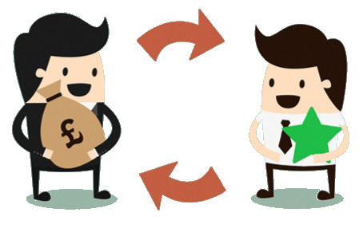
Conclusion
Potential Problems
Outlook
Vote Token Market
Private Key Storage
Internet Access
Incentivise people to vote
Incentivise elected to hold their promise
Outputs & Community
- DAO Democracy 2.0 Voting System
NPM Module: npm install --save eth-token-create
create, compile and deploy custom ERC20-Token with single function call
Kaan Sentürk, Jonas Hagemann, Adrian Soos, Manuel Schmuck, Martin Blapp, Philippe Hasler, Claudio Ferrari
16.02.2018
Notes:
Difficulties We Experienced
Where could we identify potential negative outcomes?
- Rise of vote market
- Need for internet access
- Secure storing of private key
Which questions remain to be solved?
Incentivize people to vote ->increase voter participation
vote token
Incentivize voted (person) to hold promises
elected token

Slide 5

Thank you for your attention
Groupe 47 Rober Bütler, Jonas Hagemann, Jakob Rempell, Jürg Käser
8.12.2017

Slide 6
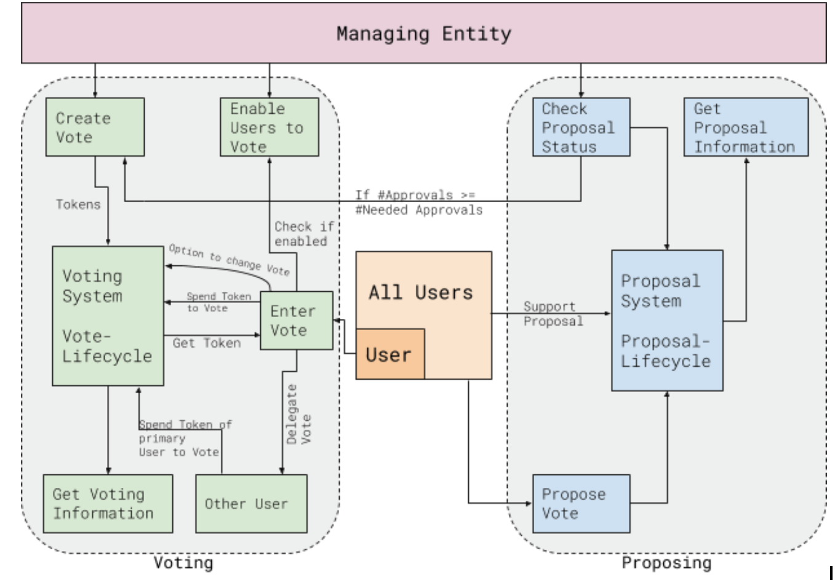
Design in a little more detail

Slide 7
List of features
Delegate votes to other people
Incentivize people to vote by paying them (also to cover their gas)
Change your vote if you change your mind or disagree with what your delegate voted on your behalf
Proposal System that allows people to put their issues to a vote
Provided we know the number of eligible voters voting fraud can be detected
Groupe 47 Rober Bütler, Jonas Hagemann, Jakob Rempell, Jürg Käser
8.12.2017

