Slide 1
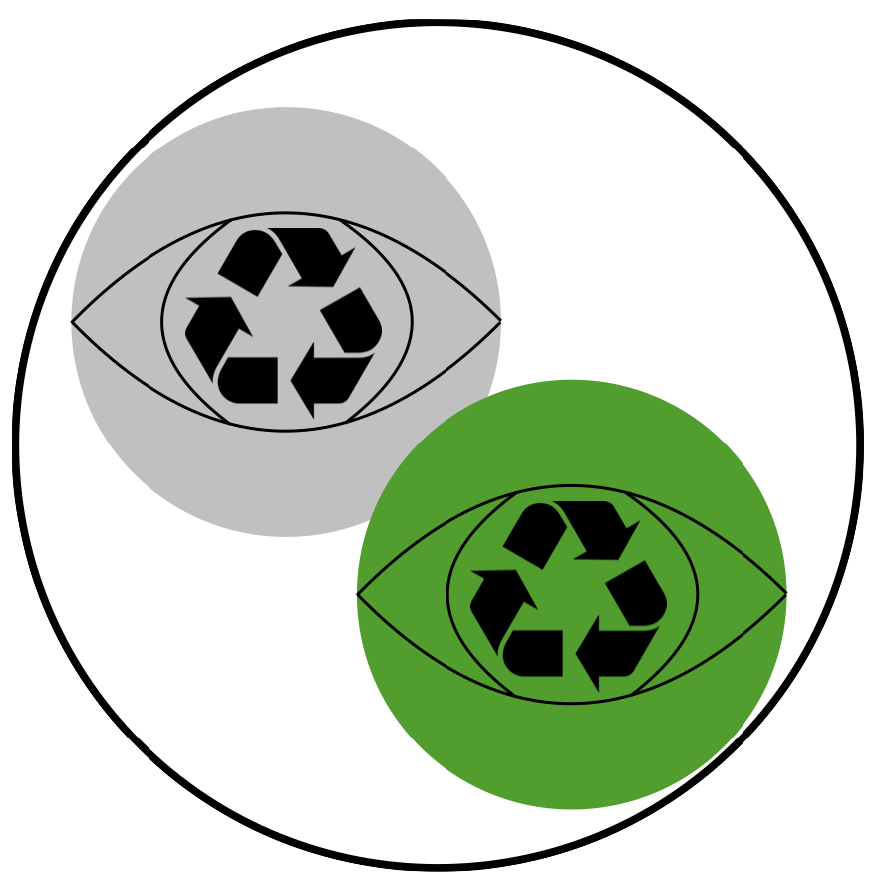
ReusibiliToken
Reduction of Plastic Waste
Claudio Cannizzaro, Prashanth Chandran, Silvano Cortesi, Philipp Fischer, Tatu Lindroos, Tobias Rohner
Notes:
Societal problem: We produce way too much waste from food product packages.
Justification: Incentivise people to use their own cups and plates at coffee shops and restaurants instead of store-provided new plastics.

Slide 2



Concept
ReusibiliToken
Smart Contract
Value
Reputation
🔥
Customer
Store
Market
Reputation
Value
Notes:
Concept: When a customer buys a coffee with a reusable cup, two types of token get generated.
Tokens: Value token is an ERC-20 token that can later be sold to the market or any participating store (e.g. for a coffee or other products). The other, Reputation token, is unique to each store franchise and provide benefit for shopping at the store repeatedly i.e. gaining more value tokens. However, reputation tokens are not tradable and diminish over time.
Fee: Each month, the participating stores must pay a fee in tokens to a smart contract where the tokens get destroyed. The reason is to provide motivate shops to collect tokens by providing customers coffee etc. in exchange of their Value tokens. More popular shops (total amount of reputation produced there) have to pay higher fees.

Slide 3

Economy system
On one fine day…
15
16
M
Recycles at
M
Has to go shopping
Tokens get created
Store M
M
34
36
A few days later…
16
16
M
Wants free stuff
Pays in
M
Store R
30
36
6
Reputation
Value
Notes:
Example: A customer has 15 reputation tokens that are specific to a store M, and 34 value tokens. The customer goes to store M to buy a coffee with a reusable cup. Value tokens get generated and even more than normally because the customer had so many reputation tokens for this store. The customer now has 36 value tokens and 16 reputation tokens – and a coffee.
Sometime later, the customer goes to a different store and purchases another coffee, this time using 30 of the 36 value tokens.
Economy: We made a simulation in Python with a limited number of customers, stores etc. to see how we could set the parameters. We embedded a video link in the slide.

Slide 4
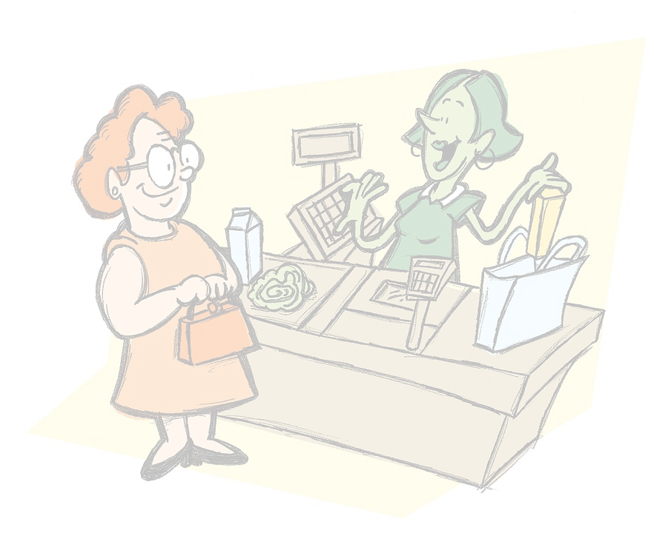
Implementation
Customer
Store
- Action type
Address
→ create QR - Code
QR
- Create Action type instance
- Store Shop ID
- Generate Signature for Hash
- Shop ID
Signature
→ create QR - Code
QR
- Add Store ID to Action
- Combine with Signature to get a valid claim
Background image license:
CC0 Creative Common
Notes:
We also implemented an operation to obtain the token:
Authentication:
Customer wants to buy coffee with a reusable cup
Customer shows a claim (“I want to reuse a cup”) and an account address as QR-code to the store cashier.
Store cashier scans the QR-code.
Store cashier generates another QR-code with its address and key.
Customer scans proved data and submits to Blockchain, claiming the tokens.
Blockchain checks if the key is valid, and if valid, gives tokens to Customer.

