Slide 1

Sustainable Phone Contract Recycle Token
Name: SPCRT
Anja Ulrich, Benjamin Parellada, Lukas Tobler, Philippe Götschmann, Raphael Koch, Tomohiro Shibata
Challenge: Recycling phones

Slide 2
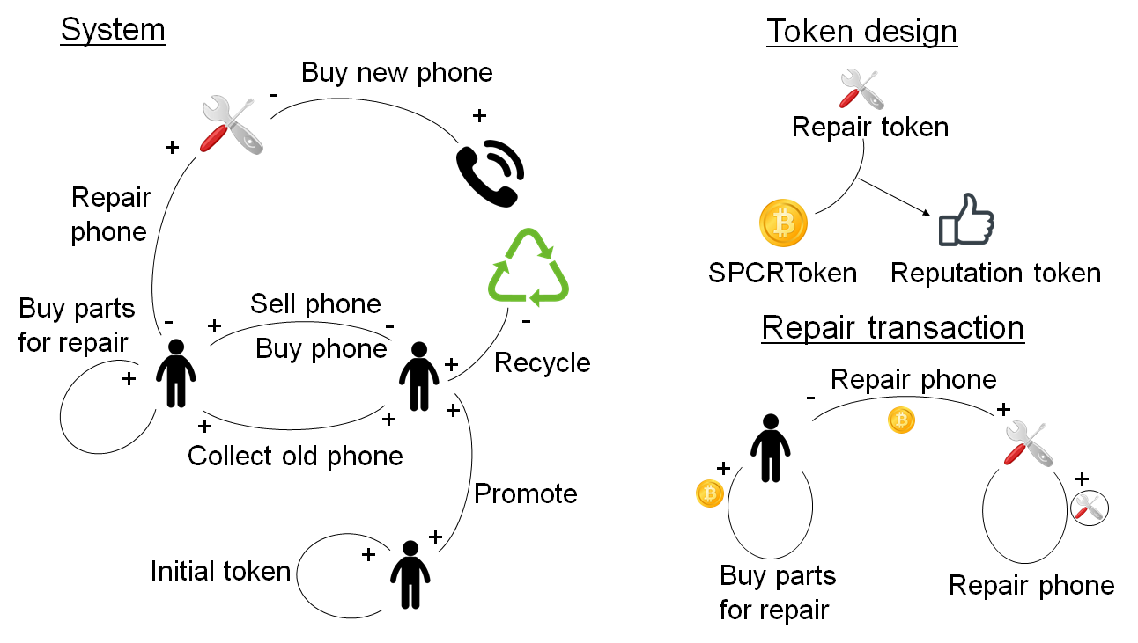
Problem & Solution system
recycling fee included in price 20% of phones recycled waste of resources
Notes:
Problem: only 20% of phones recycled and a lot of valuable resources lost for circular production although recycling fee already included.
System: There are different ways the tokens can be generated or used. In the beginning when you register for the platform you get a certain amount of SPCR Tokens. Then a prosumer can get SPCR Tokens by inviting new members to the network which helps the network expanding and reaching more people. Another way is by recycling his old phone or by collecting phones for recycling or reselling. The prosumer also gets SPCR Tokens when he buys repairing parts (not with SPCRT) which he then gives with his mobile phone to a Repairing Guy.
So how can this different Tokens now be used within the system: A prosumer can offer his phone for selling in exchange to an individually defined amount of SPCRT’s to another Prosumer. So, the SPCRT Price gets transferred from one prosumer to the other. The selling prosumer of course can be a Repairing Guy who bought older phones beforehand and then repaired them or renewed them himself and now sells them. If a prosumer wants his phone to be repaired or renewed he gives it to a repair guy with the repair parts and transferes him the asked amount of SPCRT’s. The prosumer buys the repairing parts (not with SPCRT’s) himself or organizes them. This generates him some additional SPCRT’s. The Repair Guy receives apart from the SPCRT additionally also Repair Tokens. With this Repair Tokens and some SPCR Tokens he can create a Reputation Token which in return hopefully brings him more clients. With the SPCRT’s it is also possible to get a discount on subscription from the telecommunication company. This should be an incentive for the Repairing Guy for offering his repairing skills. The last process is the collecting phones from others and recycling them. In this process a prosumer gives away his phone to another prosumer who collects them and already gets a Token for this. When the collector recycles the mobile phones the prosumer who gave away the phone only gets half of the SPCRT’s he would have gotten for recycling, and the other half goes to the collector and this for each phone he recycles. If the mobile phones are resold the prosumer who gave away the phone gets a quarter and three quarter are for the collector. If the phone is from a person not registered to the network the collector gets all the SPCRT’s.

Slide 3
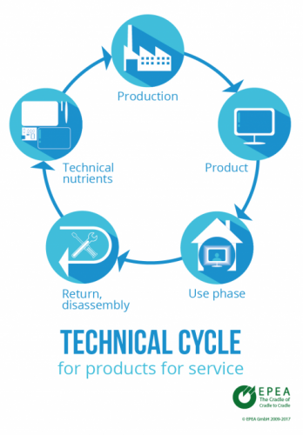
Change
more mobile phones get recycled & used longer
mobile phones get upcycled
more circularity of resources & less waste
demand of phones/materials stagnates/decreases
offered free repairing/recycling service
Notes:
Technical Cycle: http://www.epea.com/de/cradle-2-cradle/

Slide 4
Difficulties/open Questions
number of volunteers with technical skills?
cooperation of telecommunication companies?
some cheating possibilities - is trust enough?

Slide 5
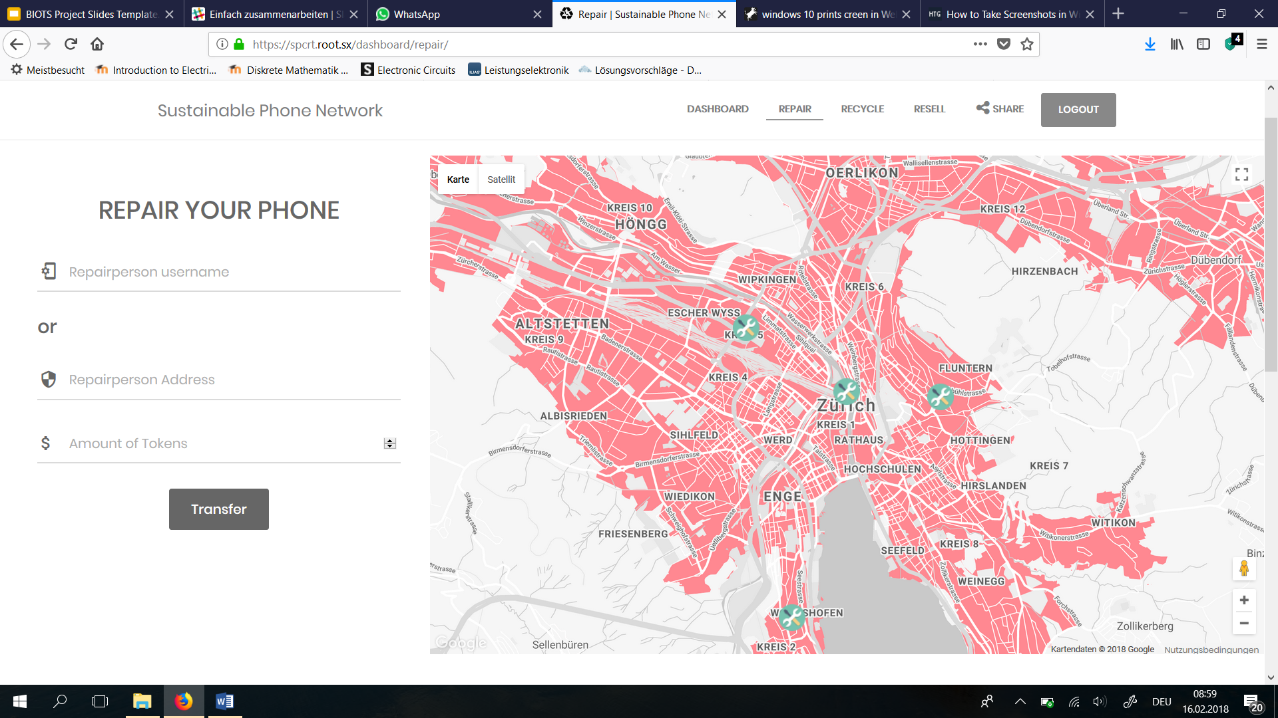
Demo (https://spcrt.root.sx/)
use a random login name and password to access!

