Slide 1

weShare
a project by
Philip Jost, Roman Gruber, Noé Heim, Tobias Buner, Jonas Wyss, Irfan Bunjaku

Slide 2

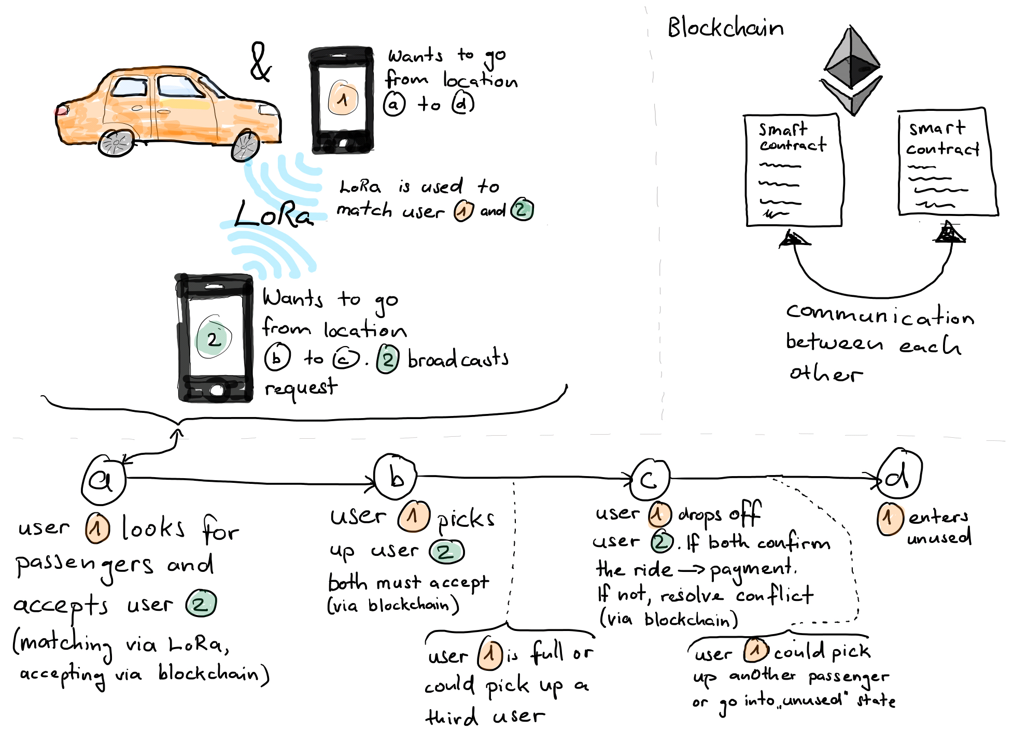

Slide 3
The Potential
with ‘smart’ car sharing we aim to reduce:
amount of traffic
amount of greenhouse gas emissions
using smart contracts P2P for increased trust (no third party)
-> completely decentralised
own payment system (tokens) with an intrinsic value
can be extended:
different tokens (reputation)
token exchange
add new types of users who share their car to the system

Slide 4
The Difficulties
very reliant on a big and active user base
users must trust other users and the system
starting a circular system/token currency (market)
complete P2P system (not yet ready - android client)

Slide 5
a short software demo

