Slide 1
OPENFOAM MEETING 05/07/2012
Bercan Siyahhan

Slide 2
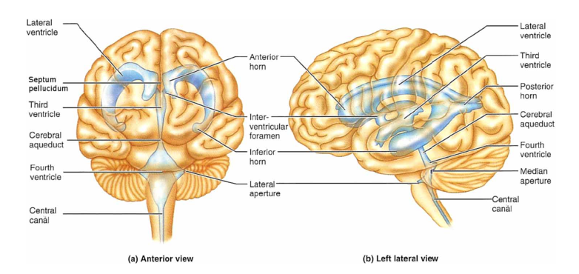
GEOMETRY

Slide 3
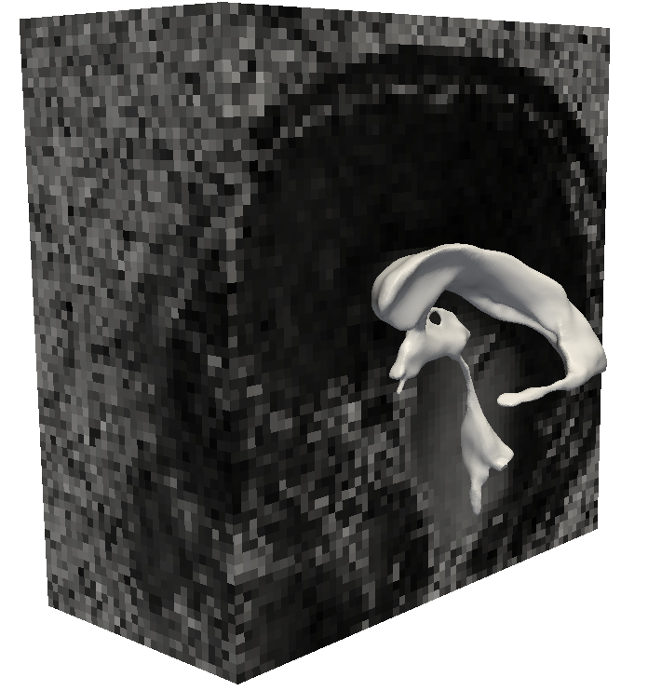
MRI MEASUREMENT OF BRAIN DISPLACEMENT
Raw data:

Slide 4
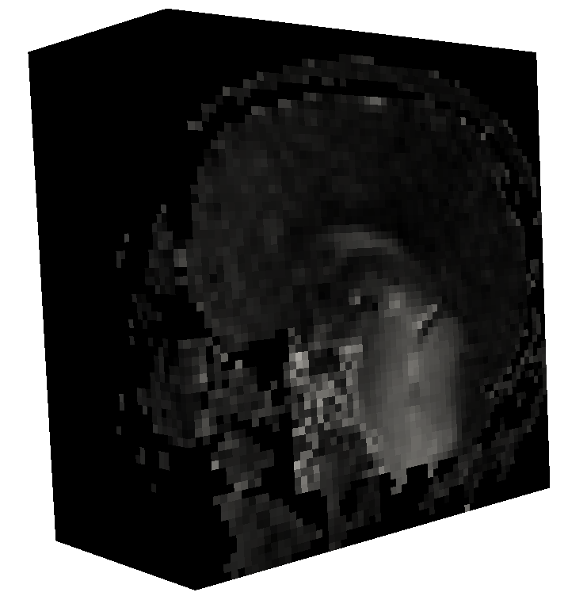
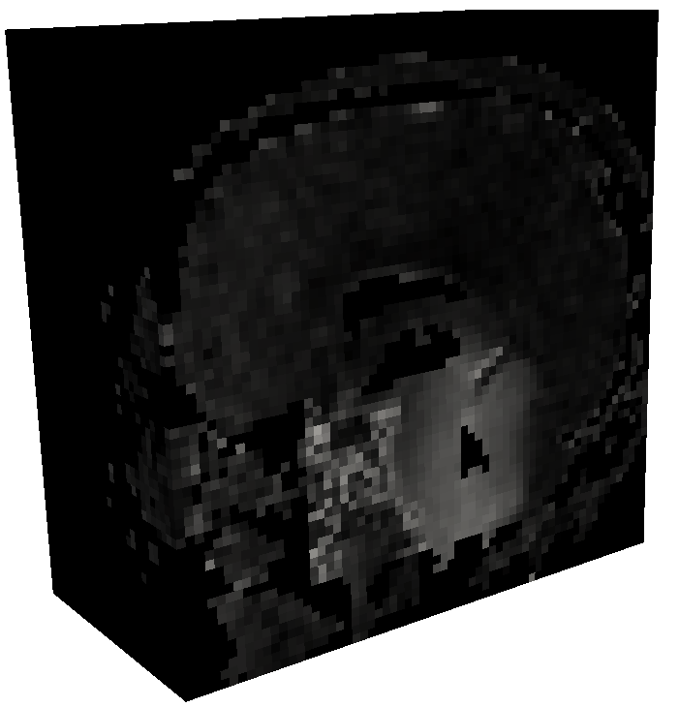
DATA POST PROCESSING
Filter noise outside skull, eliminate fluid region

Slide 5
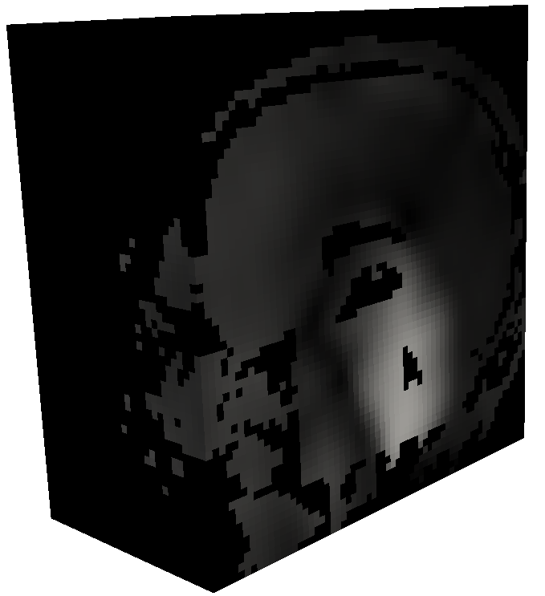
DATA POST PROCESSING
Low pass filter:

Slide 6
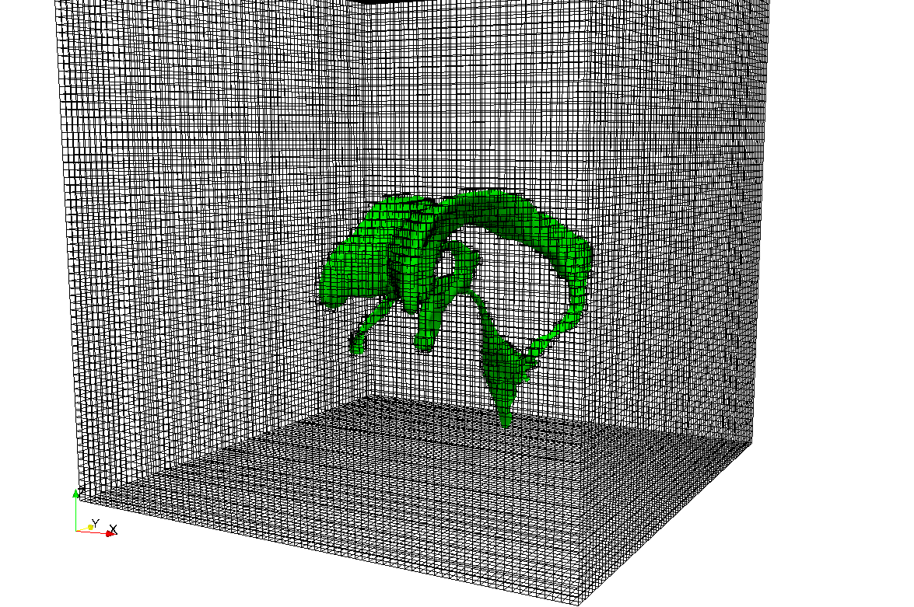
INTERPOLATION
Interpolate from MRI voxel mesh to surface centers of the computational mesh:

Slide 7
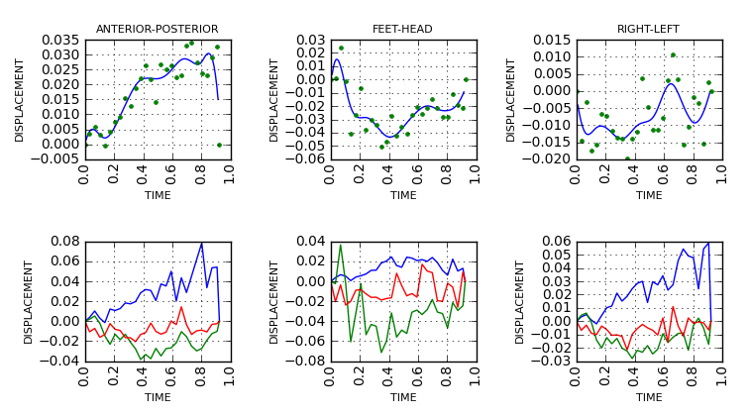
SPLINE APPROXIMATION / INTERPOLATION

Slide 8
SPLINE APPROXIMATION OPENFOAM
Create a folder in the solver for approximation:
spline1DApproximation
        cubicSplineApp.H
        cubicSplineApp.H
Modify Make/files
wallMotionFoam.C
spline1DApproximation/cubicSplineApp.C
splineInterpolation/splineInterpolation.C
cellInformation/cellInformation.C
choroidBoundaryFlow/choroidBoundaryFlow.C
EXE = $(FOAM_USER_APPBIN)/wallMotionFoam

Slide 9
SPLINE APPROXIMATION OPENFOAM
Modify Make/options
EXE_INC = \
-I$(LIB_SRC)/finiteVolume/lnInclude \
-I$(LIB_SRC)/dynamicMesh/dynamicFvMesh/lnInclude \
-I$(LIB_SRC)/dynamicMesh/dynamicMesh/lnInclude \
$(WM_DECOMP_INC) \
-I$(LIB_SRC)/tetDecompositionFiniteElement/lnInclude \
-I$(LIB_SRC)/tetDecompositionMotionSolver/lnInclude \
-I/home/bercan/lsmg-1.1/include \
-I/usr/include/gsl \
-I$(LIB_SRC)/meshTools/lnInclude \
-I$(LIB_SRC)/sampling/lnInclude \
-I$(LIB_SRC)/surfMesh/lnInclude \
-I$(LIB_SRC)/triSurface/lnInclude \
-I$(LIB_SRC)/lagrangian/basic/lnInclude \
EXE_LIBS = \
-L/home/bercan/lsmg-1.1/lib \
-lfiniteVolume \
-ldynamicFvMesh \
-ldynamicMesh \
$(WM_DECOMP_LIBS) \
-lcellDecompositionMotionSolver \
-llduSolvers \
-llsmg-1.1_opt \
-lgsl \
-lgslcblas \
-lmeshTools \
-lsampling \
-lsurfMesh \
-ltriSurface \
-llagrangian \

Slide 10
SPLINE APPROXIMATION OPENFOAM
cubicSplineApp.H
#ifndef cubicSplineApproximation_H
#define cubicSplineApproximation_H
#include <iostream>
#include <math.h>
#include <vector> STL od C++
#include <gsl_bspline.h>
#include <gsl_multifit.h>
#include <gsl_rng.h> GSL libraries required
#include <gsl_randist.h>
#include <gsl_statistics.h>
namespace Foam
{
class cubicSplineApproximation
{
public:
std::vector<double> cubicSplineApp(std::vector<double> eval,double *xi,double *yi,int N);
};
}
#endif Return an STL vector Values to evaluate Input data to for approximation

Slide 11
SPLINE APPROXIMATION OPENFOAM
cubicSplineApp.C
#include "cubicSplineApp.H"
std::vector<double> Foam::cubicSplineApproximation::cubicSplineApp(std::vector<double> eval,double *xi,double*yi,int N)
{
const size_t n=N;
const size_t ncoeffs=10;
const size_t nbreak=ncoeffs-2;
size_t i, j;
gsl_bspline_workspace *bw;
gsl_vector *B;
double dy,yerr;
gsl_rng *r;
gsl_vector *c, *w;
gsl_vector *x, *y;
gsl_matrix *X, *cov;
gsl_multifit_linear_workspace *mw;
double chisq, Rsq, dof, tss;
std::vector<double> val; The return STL vector
gsl_rng_env_setup();
r = gsl_rng_alloc(gsl_rng_default);

Slide 12
SPLINE APPROXIMATION OPENFOAM
cubicSplineApp.C
/* allocate a cubic bspline workspace (k = 4) */
bw = gsl_bspline_alloc(4, nbreak);
B = gsl_vector_alloc(ncoeffs);
x = gsl_vector_alloc(n);
y = gsl_vector_alloc(n);
X = gsl_matrix_alloc(n, ncoeffs);
c = gsl_vector_alloc(ncoeffs);
w = gsl_vector_alloc(n);
cov = gsl_matrix_alloc(ncoeffs, ncoeffs);
mw = gsl_multifit_linear_alloc(n, ncoeffs);
for (i = 0; i < n; ++i)
{
gsl_vector_set(x, i, xi[i]);
gsl_vector_set(y, i, yi[i]);
gsl_vector_set(w, i, 1.0);
}
gsl_bspline_knots_uniform(xi[0], xi[N-1], bw);
/* construct the fit matrix X */
for (i = 0; i < n; ++i)
{
double xin = gsl_vector_get(x, i);
/* compute B_j(xi) for all j */
gsl_bspline_eval(xin, B, bw);
/* fill in row i of X */
for (j = 0; j < ncoeffs; ++j)
{
double Bj = gsl_vector_get(B, j);
gsl_matrix_set(X, i, j, Bj);
}
}
/* do the fit */
gsl_multifit_wlinear(X, w, y, c, cov, &chisq, mw);

Slide 13
SPLINE APPROXIMATION OPENFOAM
cubicSplineApp.C
for(int p=0;p<eval.size();p++)
{
double value;
gsl_bspline_eval(eval[p], B, bw); Loop to evaluate at values specified
gsl_multifit_linear_est(B, c, cov, &value, &yerr);
val.push_back(value);
}
gsl_bspline_free(bw);
gsl_vector_free(B);
gsl_rng_free(r);
gsl_vector_free(c);
gsl_vector_free(x);
gsl_matrix_free(X);
gsl_vector_free(w);
gsl_vector_free(y);
gsl_matrix_free(cov);
gsl_multifit_linear_free(mw);
return val;
}

Slide 14
STANDARD TEMPLATE LIBRARY (STL)
Sequence containers
  vector: rapid insertion deletion at back direct access to elements
  list: doubly linked list, rapid insertion and deletion anywhere
Associative containers
  set: rapid lookup, no duplicates allowed
  multiset: rapid lookup, no duplicates allowed

