Slide 1
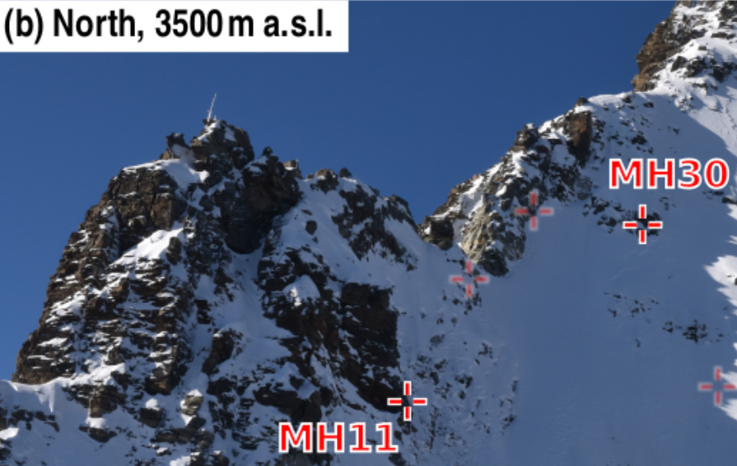
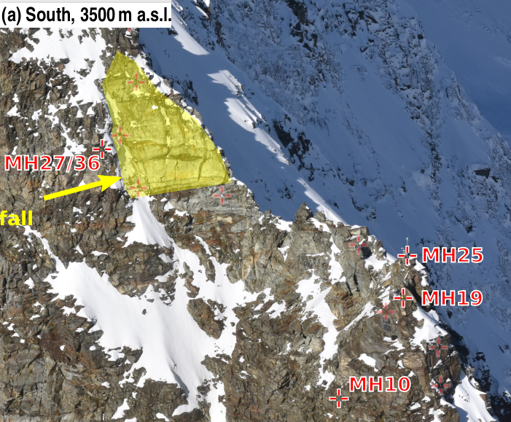
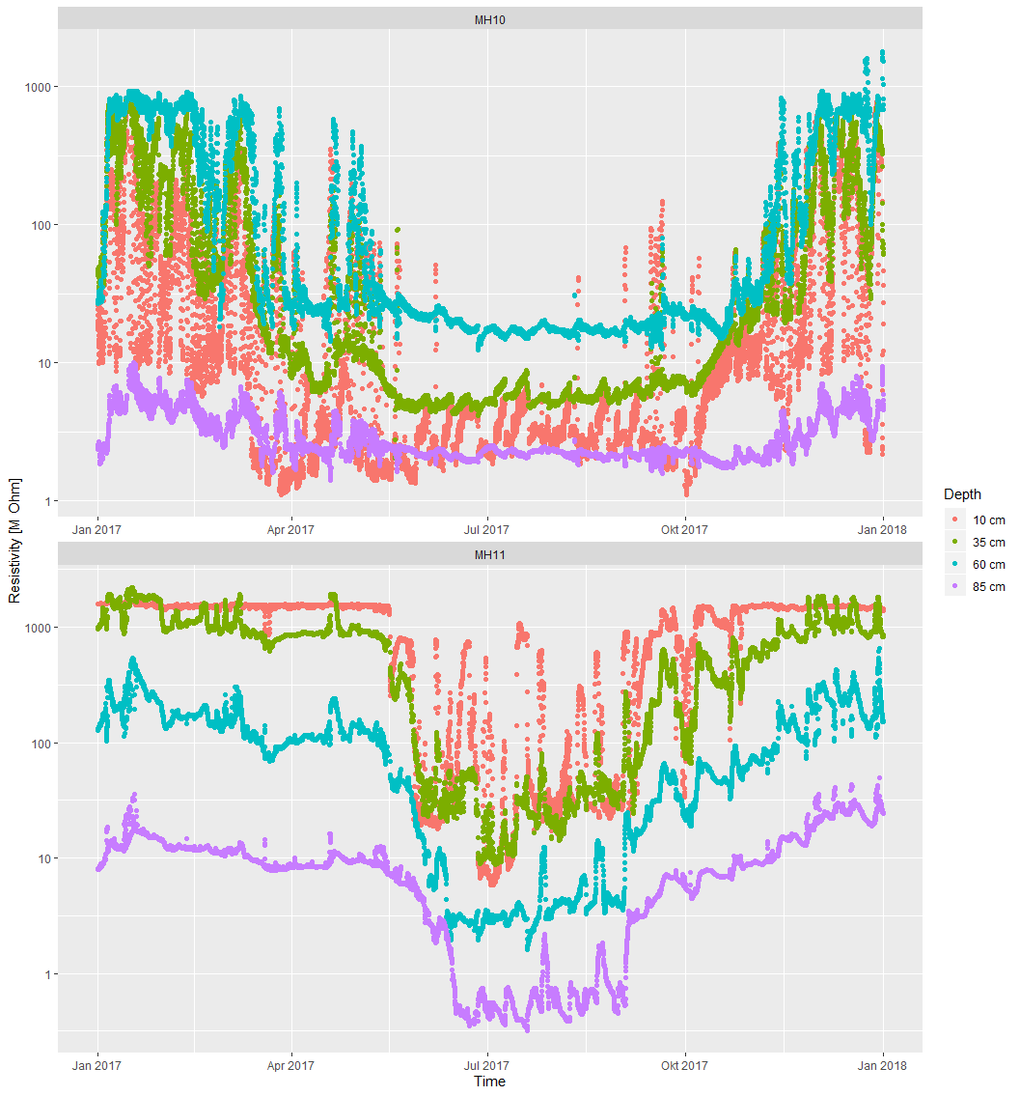
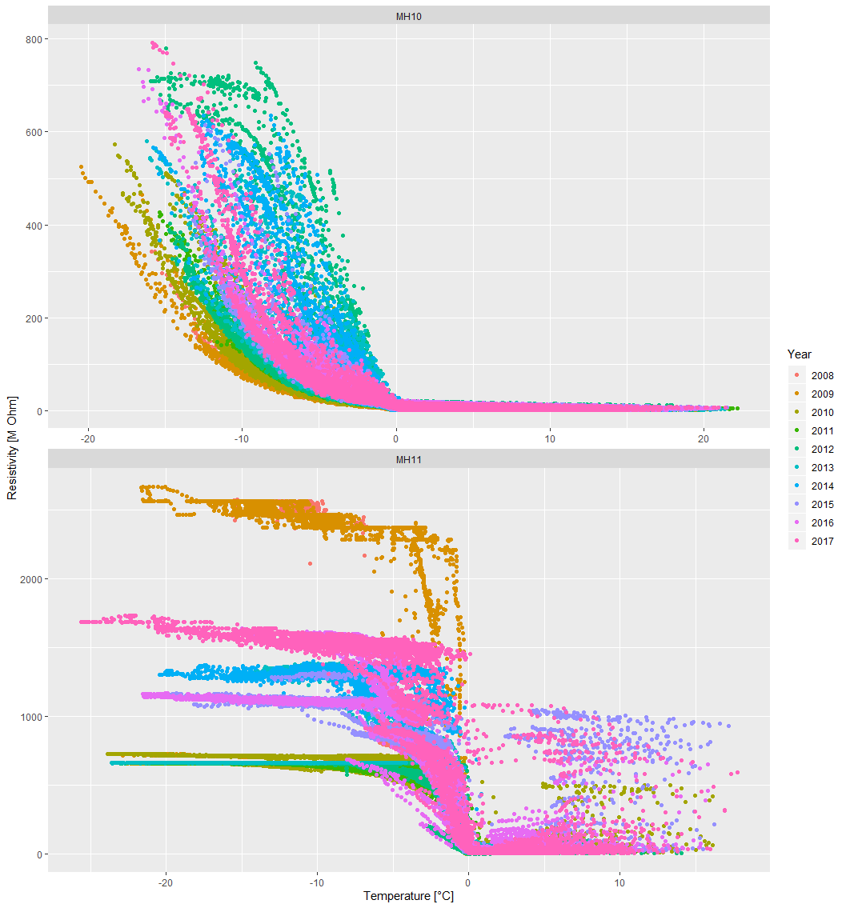

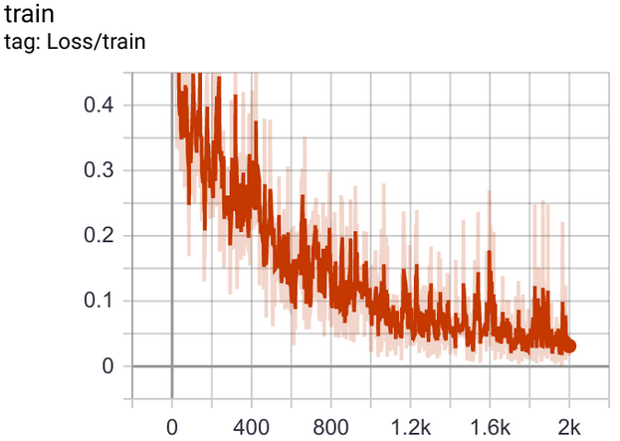
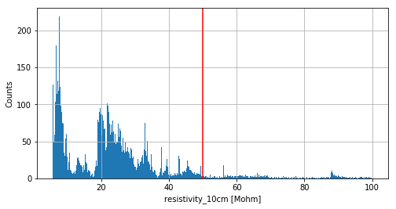
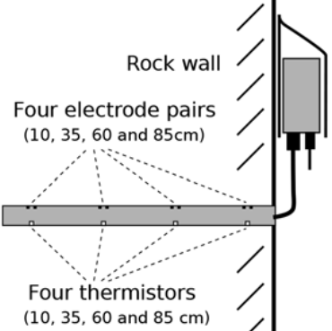
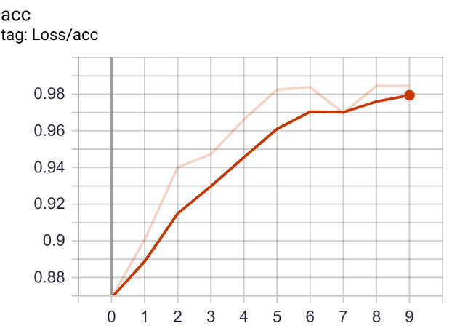
Detecting Water on Images
Jim Buffat
Bastian Buman
Ivan Ovinnikov
Nik Dennlker
Objective: Train image classifier based on sensory inputs
Location: Sensor Data: Classifying:
Sensors:
CNN
MH11
Jun/Jul 2017
THRESHOLD

