Slide 1
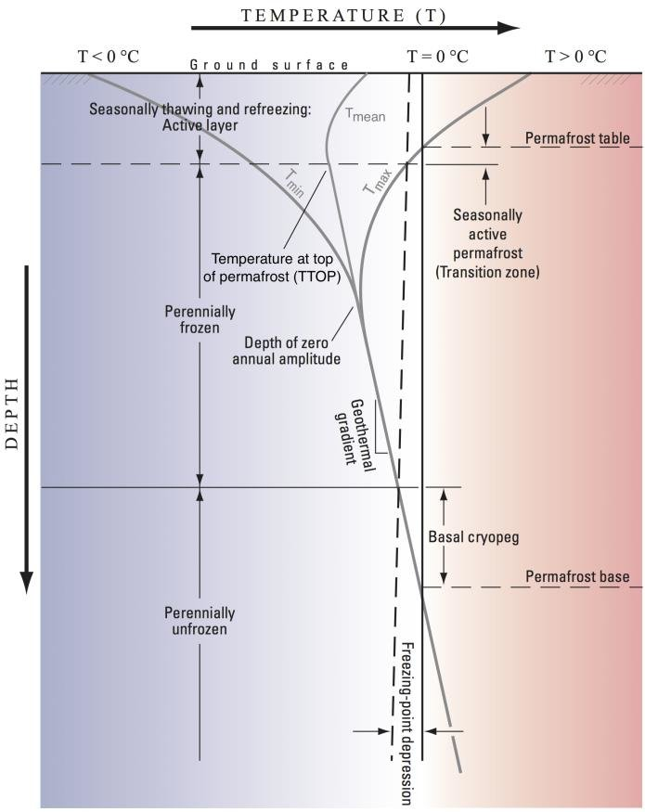
Recogn.Ice @ PermaHack
Reconstruct sensor outage values
Connection to sensors might get lost due to ground movements
Build a model to reconstruct NaN values
Use the reconstructed values to model the permafrost temperature curve

Slide 2
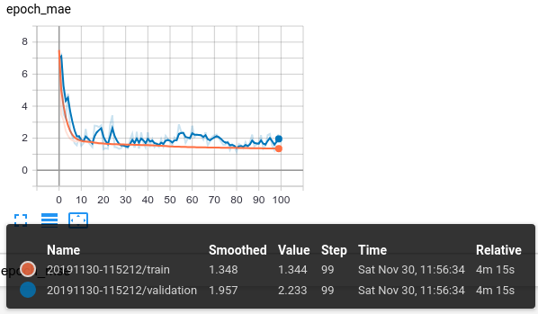
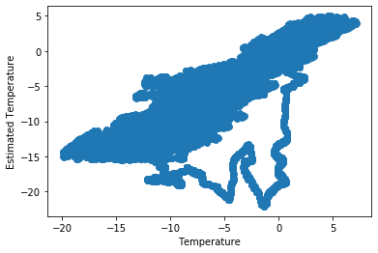
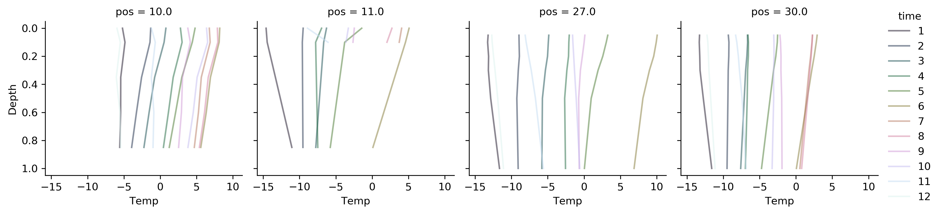
Recogn.Ice @ PermaHack

