Slide 1
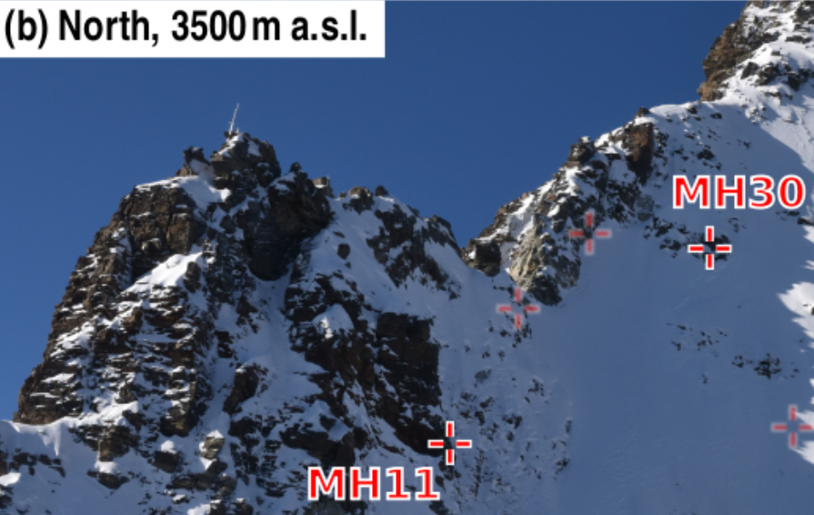
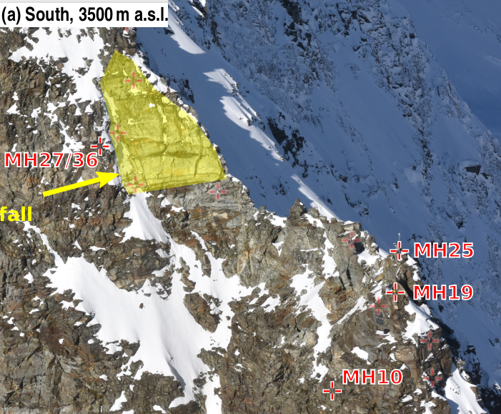
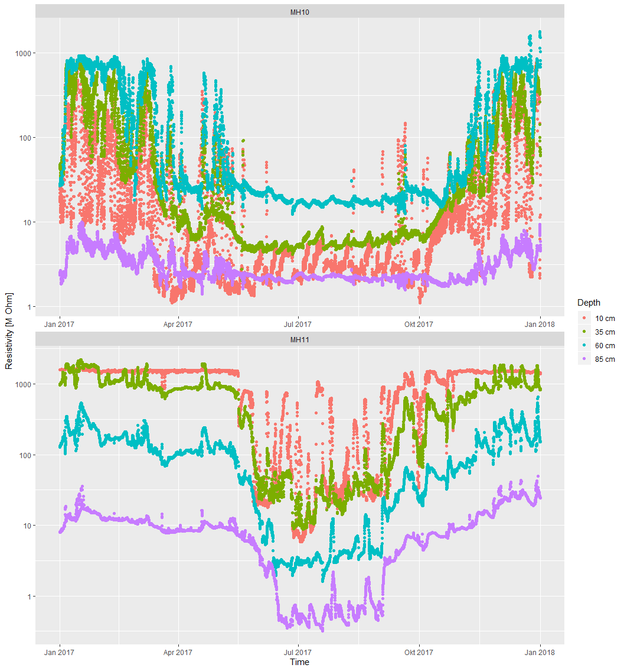
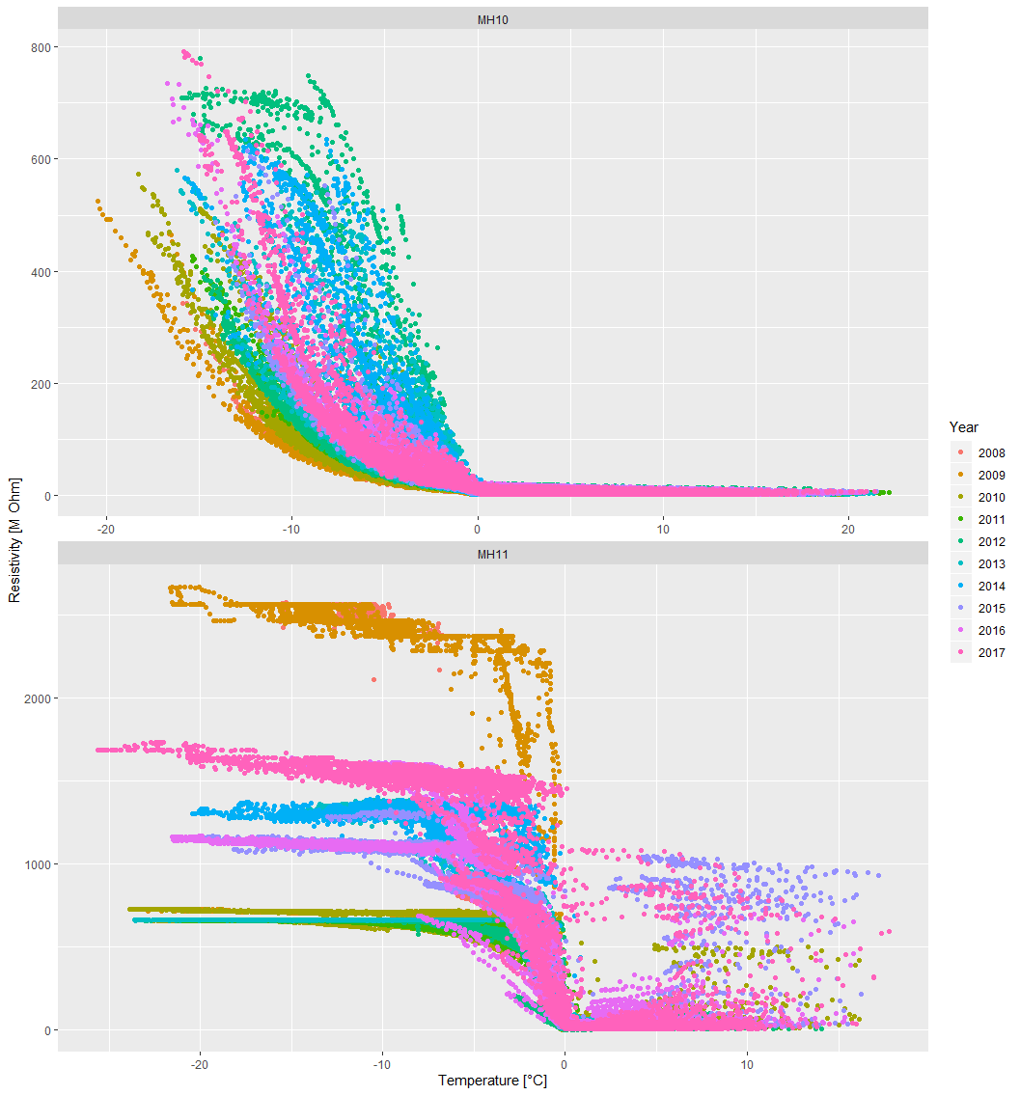
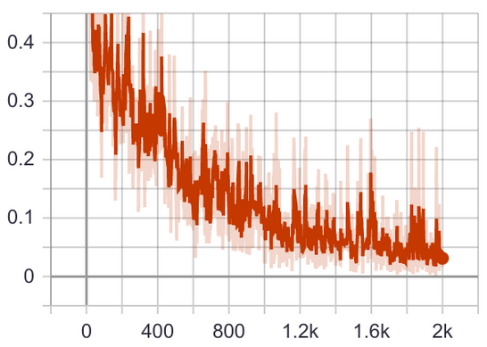
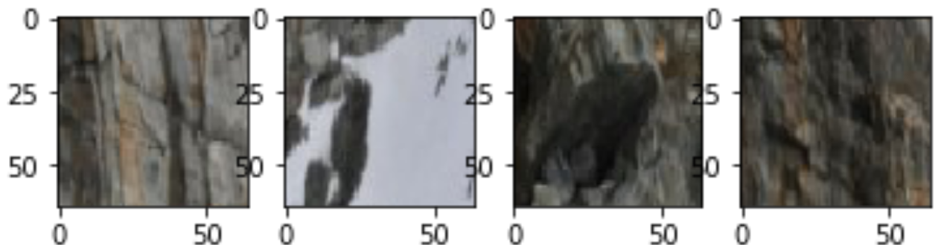
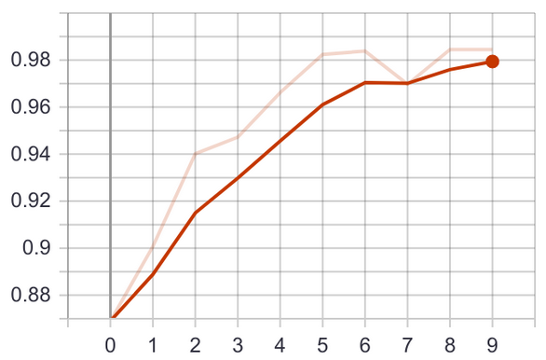
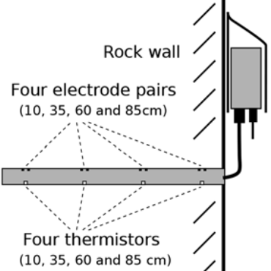
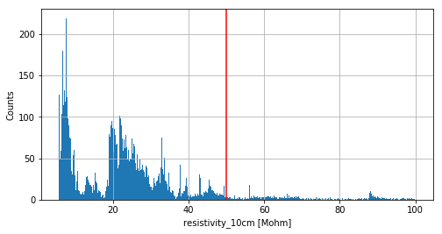
Detecting Water on Images
Jim Buffat
Bastian Buman
Ivan Ovinnikov
Nik Dennlker
Objective: Train image classifier based on sensory inputs
Location: Sensor Data: Classifying:
Sensors:
CNN
Train Loss
Test
Test Accuracy
MH11
Jun/Jul 2017
98% !
THRESHOLD
BUT:
Really big bias problem. Train and test set are sampled from the same days, thus similarity between data pairs extremely large → Test accuracy is not representative.
Running more experiments, training and testing on different years.
Image Reference: S. Weber et al., A decade of permafrost observations on Matterhorn,
Earth Syst. Sci. Data, 11, 1203–1237, 2019

