Slide 1
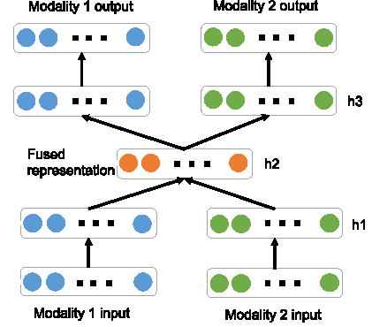

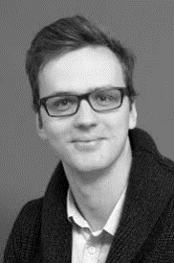


ParmaWarp
Simulating the Matterhorn Environment
Problem
  Heterogeneous multi-modal data
  Few labelled data
  Detection of very rare events
Multi-modal autoencoder
  Get higher-level representation
  From non-labelled data
  Capturing correlations

Slide 2
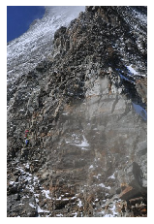
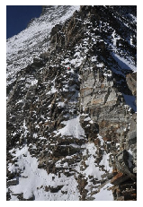
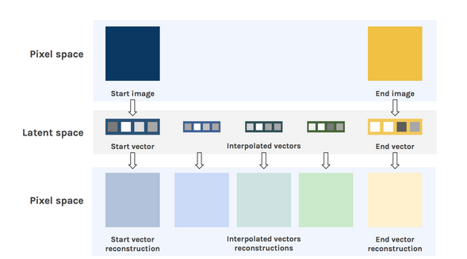
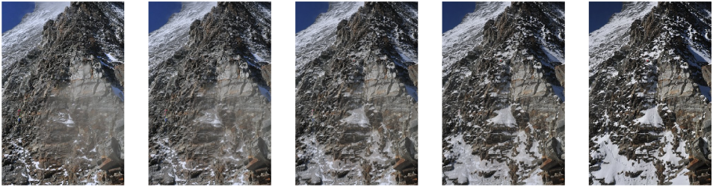
ParmaWarp
Simulating the Matterhorn Environment
Problem
  Heterogeneous multi-modal data
  Few labelled data
  Detection of very rare events
Multi-modal autoencoder
  Get higher-level representation
  From non-labelled data
  Capturing correlations
Useful for
  Data exploration/cluster
  Label propagation
  Data augmentation

