Slide 1

Pré-étude
Projet n°2126
Affichage Matriciel Nom Etudiant
Ricardo Crespo
15 décembre 2021

Slide 2
Table des matières
But
Schémas bloc
Choix des technologies
Estimation des coûts
Conclusion
Questions

Slide 3

But du projet
Afficher le nom des élèves de première année
Affichage connecté avec juste un câble USB
Détection du nom automatique avec le compte de l’élève
Contraintes de consommation

Slide 4
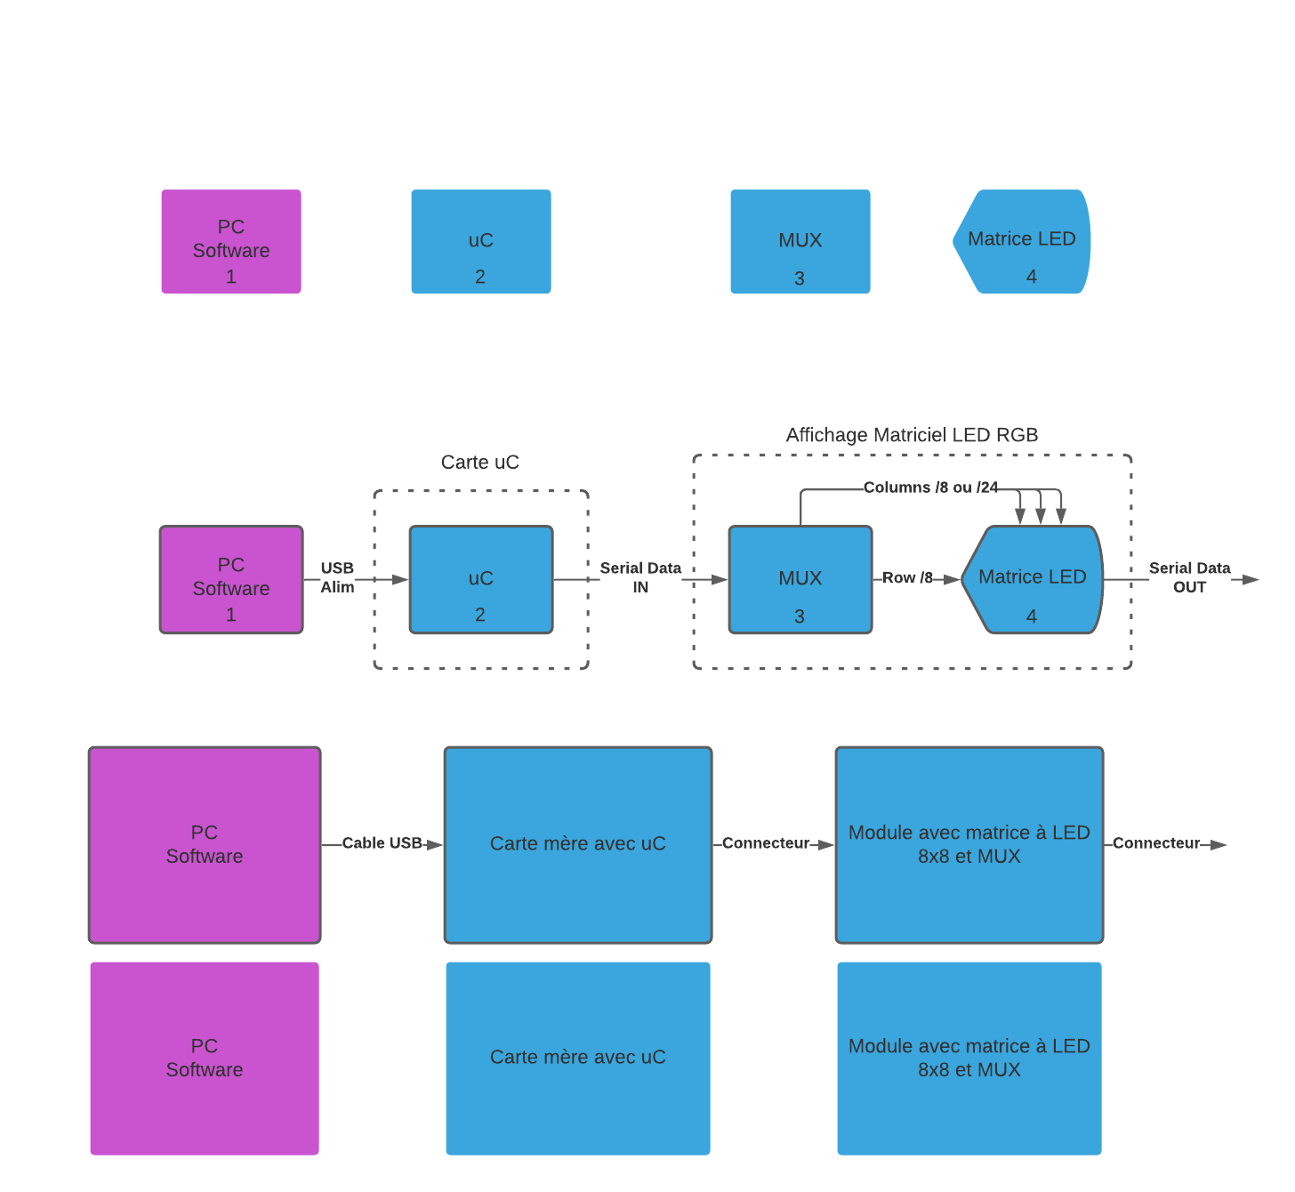
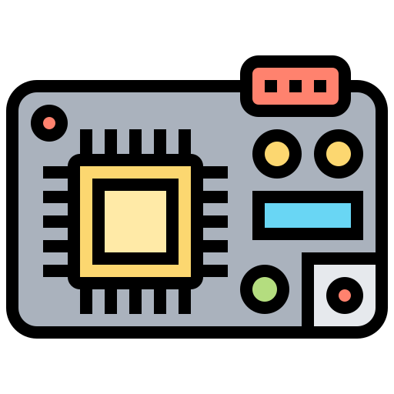


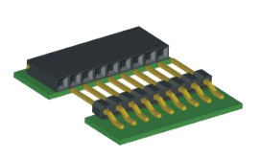
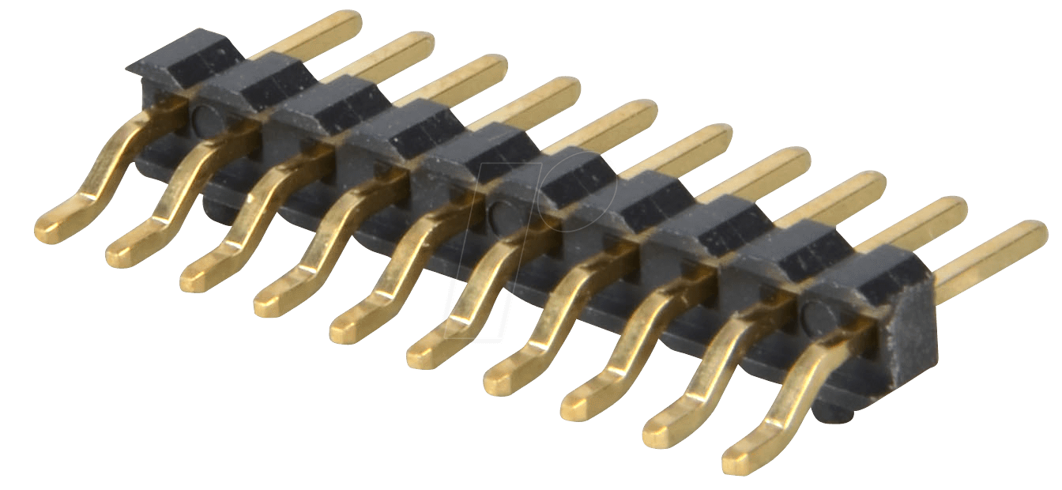
Schéma bloc général

Slide 5

Schéma bloc général

Slide 6
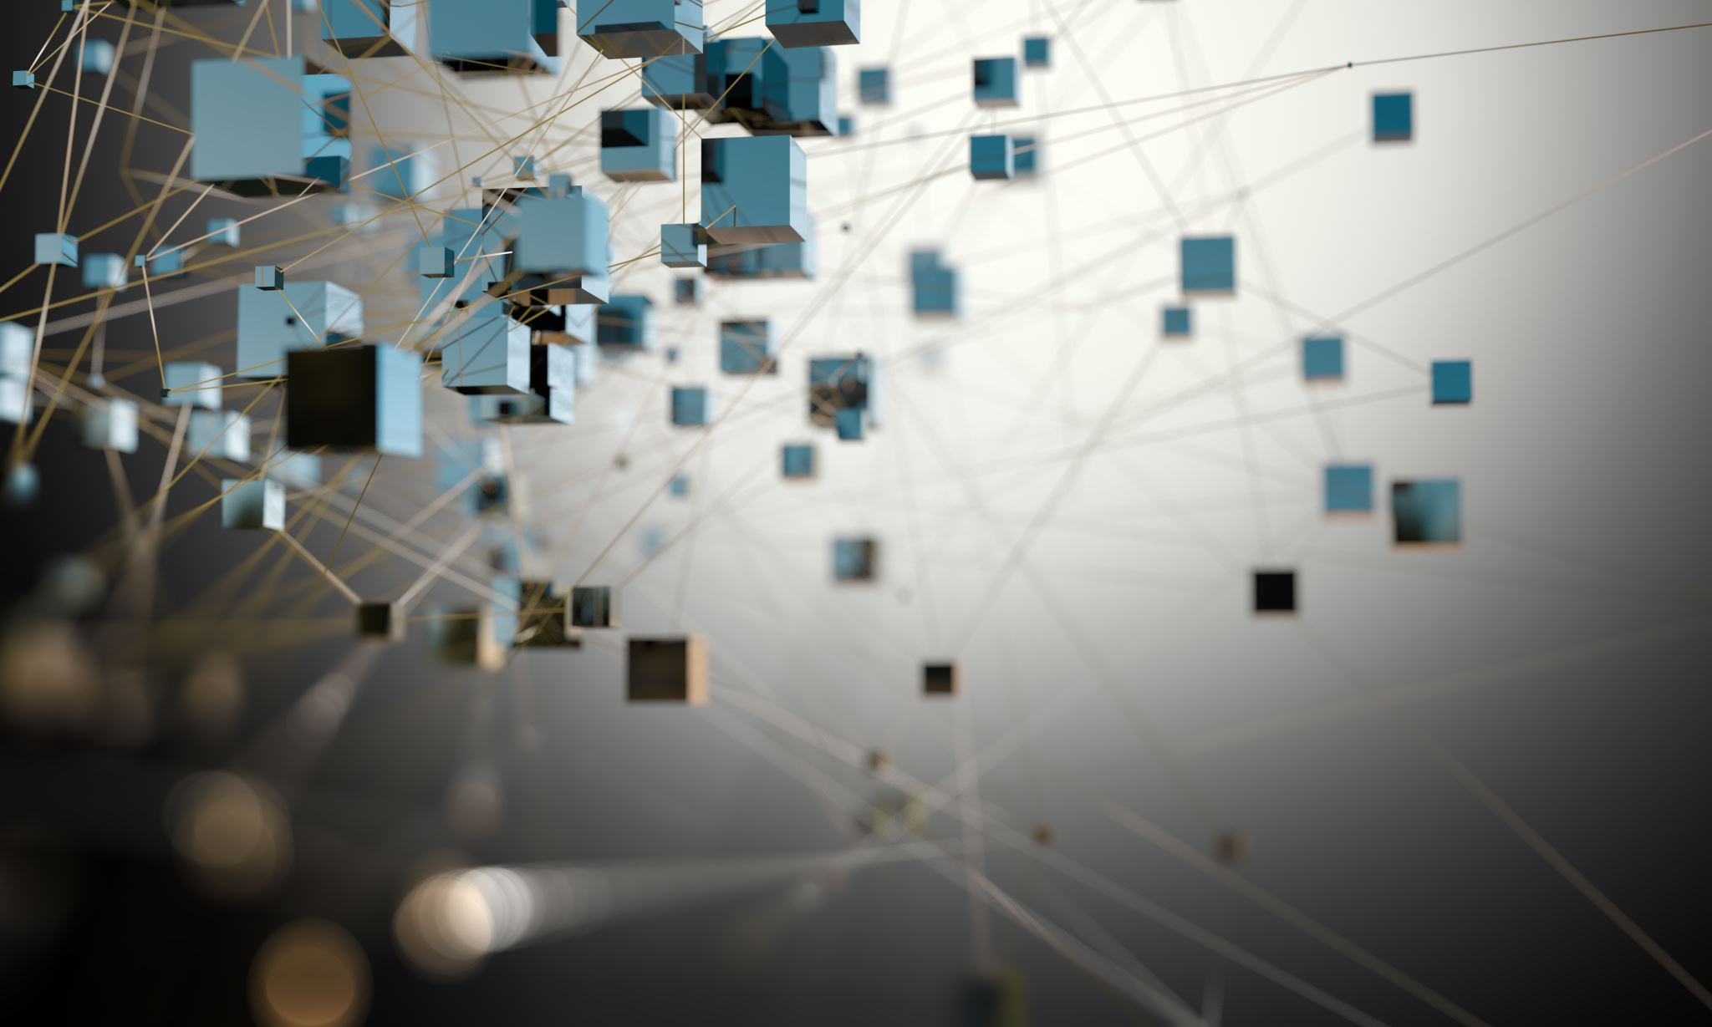
Choix des technologies

Slide 7
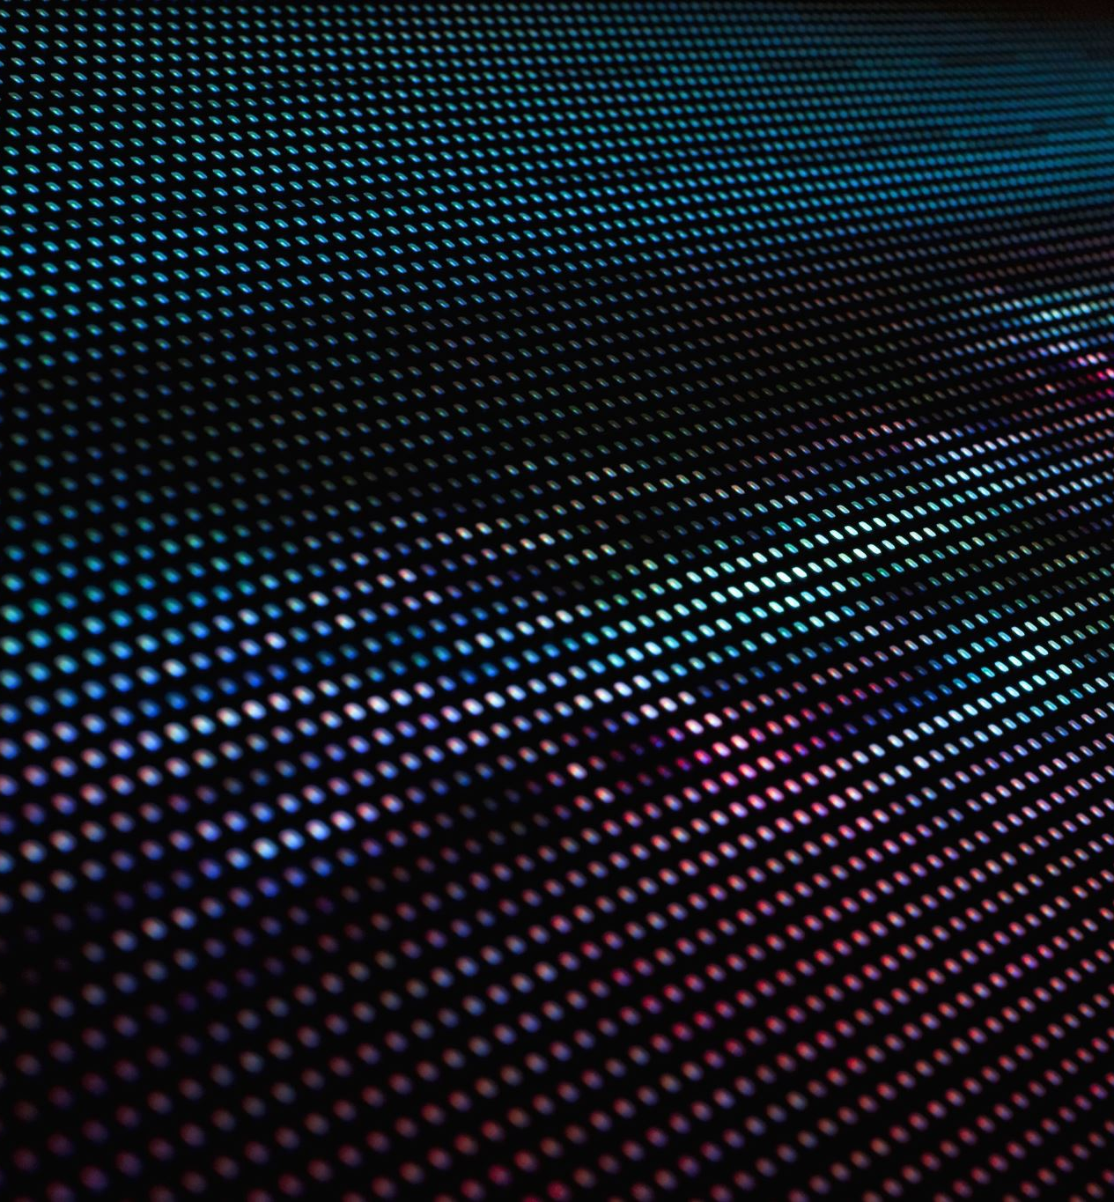
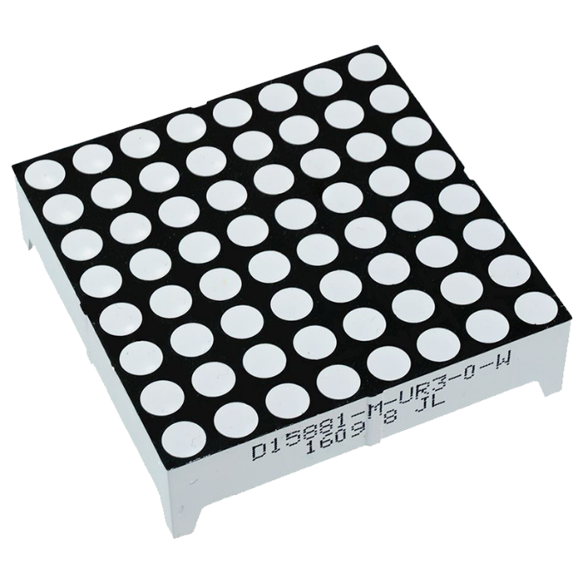
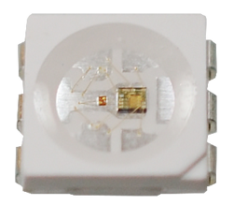
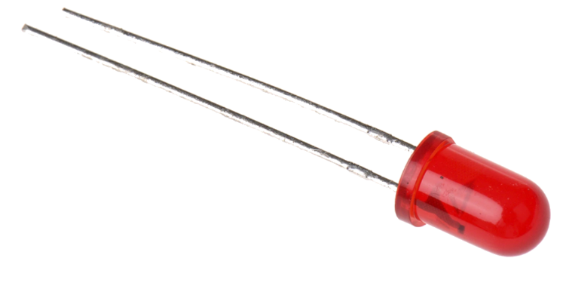
LEDs
320mA
128mA

Slide 8
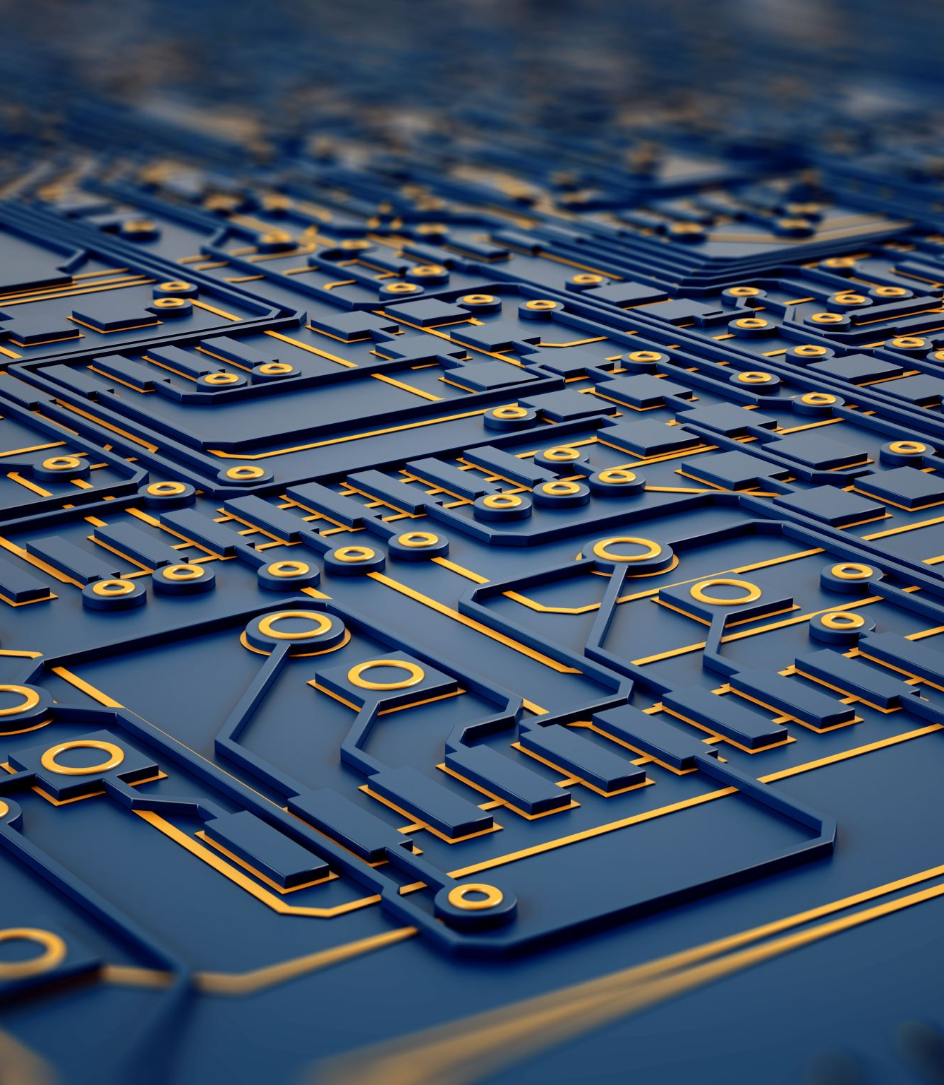
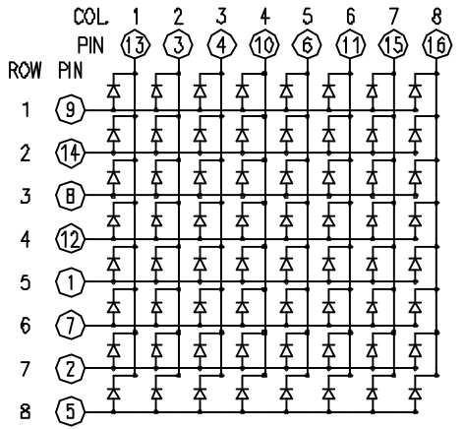
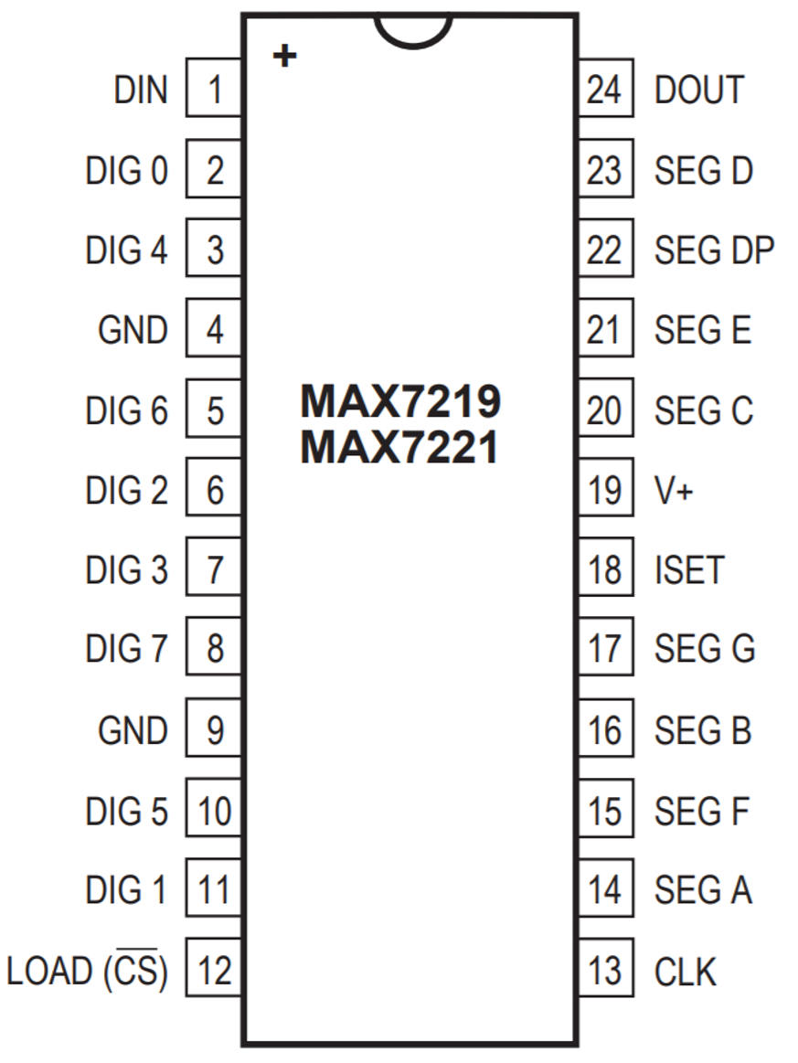
Multiplexing

Slide 9
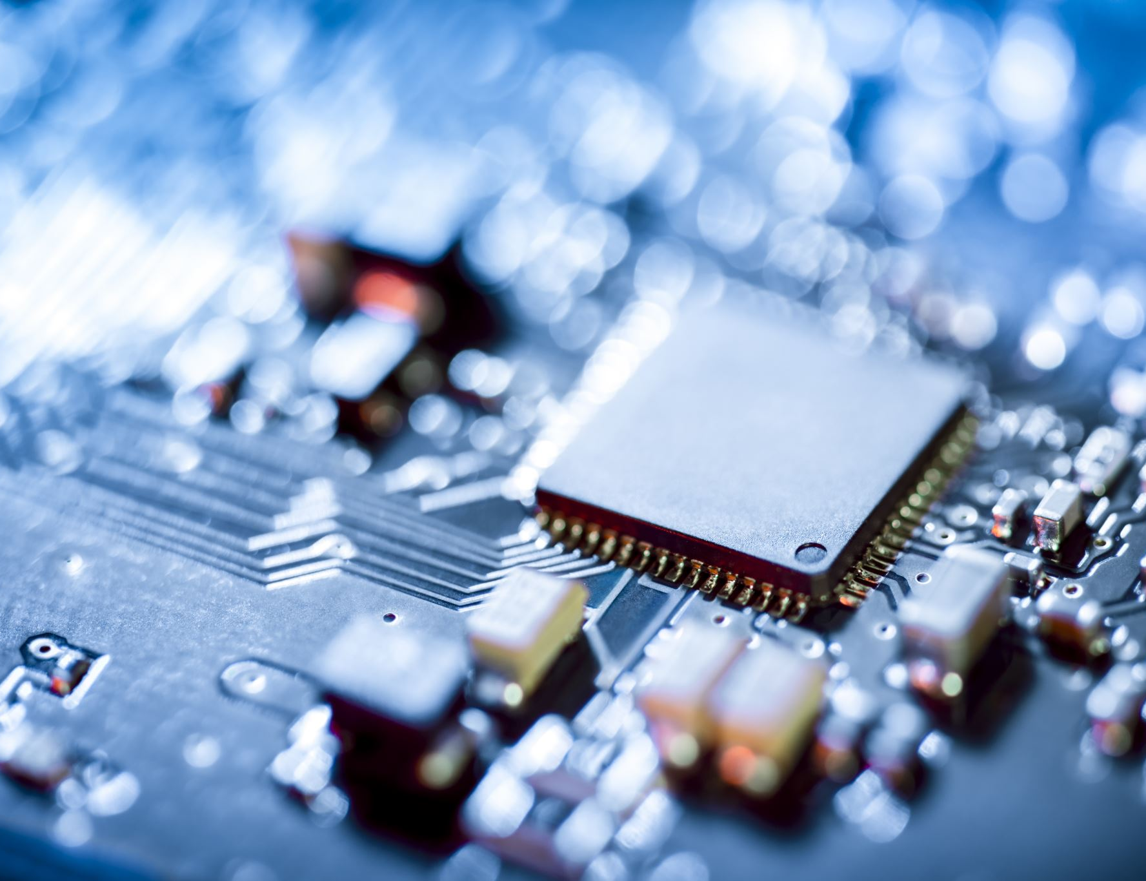
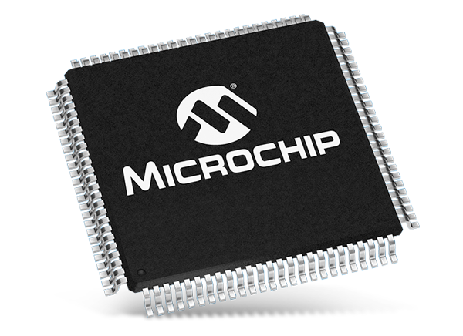
MCU
PIC32MK0512MFC064

Slide 10
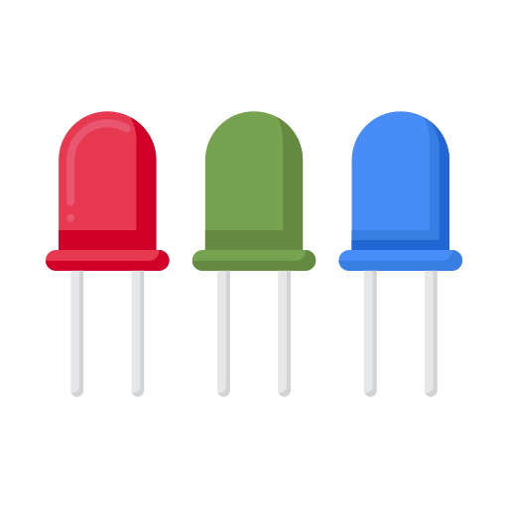

Estimation des coûts
UNIE | Quantité | Description | Supplier | Price unit | CHF | Price | CHF
 | 144 | MAX7221 Serially Interfaced, 8-Digit LED Display Drivers | Aliexpress | 0,67 | CHF | 96,48 | CHF
 | 10000 | LED RED DIFFUSED 5MM T/H | DigiKey | 0,10323 | CHF | 1032,3 | CHF
 | 18 | PIC32MK0512MCF064T-I/PT | DigiKey | 7,79 | CHF | 140,22 | CHF
 | 144 | PCB Matrix | Eurocircuit | 3 | CHF | 432 | CHF
 | 18 | PCB MainBoard uC | Eurocircuit | 4 | CHF | 72 | CHF
 |  |  |  | Total |  | 1773 | CHF
 |  |  |  | Unitaire |  | 98,5 | CHF
880,66 CHF
RGB | Quantité | Description | Supplier | Price unit | CHF | Price | CHF
 | 432 | MAX7221 Serially Interfaced, 8-Digit LED Display Drivers | Aliexpress | 0,67 | CHF | 289,44 | CHF
 | 10000 | LED standard - CMS RGB LED OSIRE E3635 | Mouser | 0,172 | CHF | 1720 | CHF
 | 18 | PIC32MK0512MCF064T-I/PT | DigiKey | 7,79 | CHF | 140,22 | CHF
 | 144 | PCB Matrix | Eurocircuit | 3 | CHF | 432 | CHF
 | 18 | PCB MainBoard uC | Eurocircuit | 4 | CHF | 72 | CHF
 |  |  |  | Total |  | 2653,66 | CHF
 |  |  |  | Unitaire |  | 147,43 | CHF

Slide 11

Conclusion

Slide 12

Questions ?

Slide 13
Sources
https://www.flaticon.com/free-icon/pc_2292038?related_id=2292038&origin=search
https://icon-library.com/icon/usb-port-icon-0.html
https://www.flaticon.com/free-icon/microcontroller_2752878
https://usefulicons.com/useful/dot-matrix-display
https://www.alibaba.com/product-detail/8-position-90-180-degree-male_60619529074.html
https://www.reichelt.com/de/en/10-pin-smd-pin-header-angled-pitch-2-54-sl-1x10w-smd2-54-p51754.html
https://wikidownload.com/wiki/boss-thank-you-letter-templates/
https://www.olelectronics.in/product/88-mini-dot-matrix-led-display/
https://www.digikey.ch/fr/products/detail/vishay-semiconductor-opto-division/TLLR5401/4074719?utm_campaign=buynow&utm_medium=aggregator&WT.z_cid=ref_oemstrade_standard&utm_source=oemstrade
https://www.mouser.ch/new/lumex/lumex-sml-lx-smd-lx-leds/
https://www.tertiaryrobotics.com/led-bulbs.html
https://www.google.com/url?sa=i&url=https%3A%2F%2Fwww.mouser.fr%2Fnew%2Fkingbright%2Fkingbright-resistor-leds%2F&psig=AOvVaw1-yeG6Rjvv0nEQ79sWpffZ&ust=1639597169469000&source=images&cd=vfe&ved=0CAwQjhxqFwoTCMithsmF5PQCFQAAAAAdAAAAABB4
https://www.flaticon.com/free-icon/rgb_4727120?term=rgb%20led&page=1&position=3&page=1&position=3&related_id=4727120&origin=search
https://www.mouser.ch/new/microchip/microchip-pic32mz-mcus/

