Slide 1
CSE 3200 SYSTEM DEVELOPMENT PROJECT
Corruption Detection App using
K-means Clustering

Slide 2
Project supervisor Dr. M.M.A. Hashem Professor Dept. of Computer Science and Engineering Khulna University of Engineering and Technology Khulna, Bangladesh.
Presented by :
Nahin Kumar Dey Md. Fazle Rasul
Roll : 1507019 Roll: 1507029

Slide 3
Motivation
Mass people often fear to testify against corrupted ones.
Corrupted people often do not face punishment due to lack of proper evidence.
Corrupted people often try to harm who testify against them.
Government employees are often callous about their responsibilities due to insufficient accountability.
We are worn-out with bribery, embezzlement, favoritism.
All our development plans fail due to corruption.

Slide 4
What this app does …
Lets users to give opinion about service providers.
Hides identity of opinion holders.
Lets users to complain against service providers.
Forces users to provide evidence with their complaints.
Offers wide variety of format of evidence to choose from (video, audio, pdf or image).
Clusters employees according to their corruption level.

Slide 5
Problem Definition
Isolate general user’s opinion from internal employee’s opinion.
Keep track which opinion is for whom.
Hide complainers identity from the authority to ensure complainers safety.
At the same time it is to be ensured that complainers are not manipulating evidence and submit fake complaints.
Identity of complainers is to be visible by someone to control all sorts of situations.

Slide 6
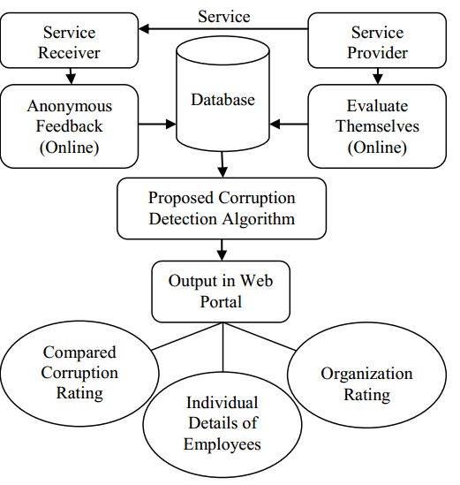
Implementation
Fig : Model to detect corruption

Slide 7
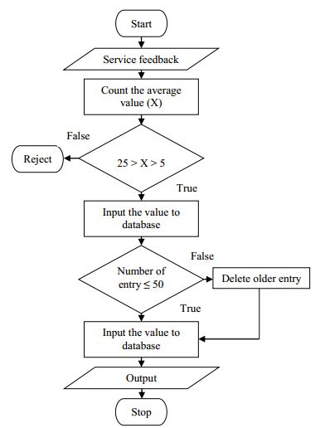
System Design
Fig : Flowchart of procedure.

Slide 8
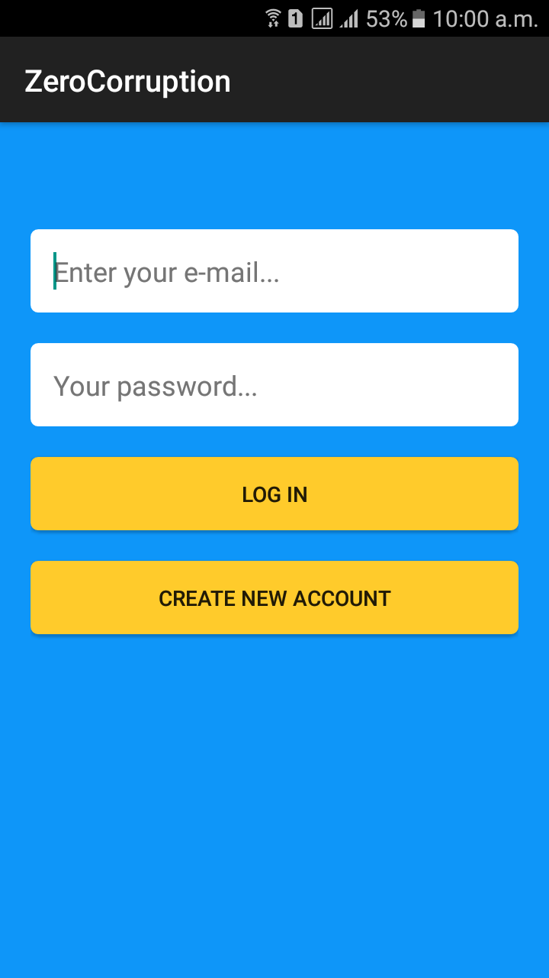
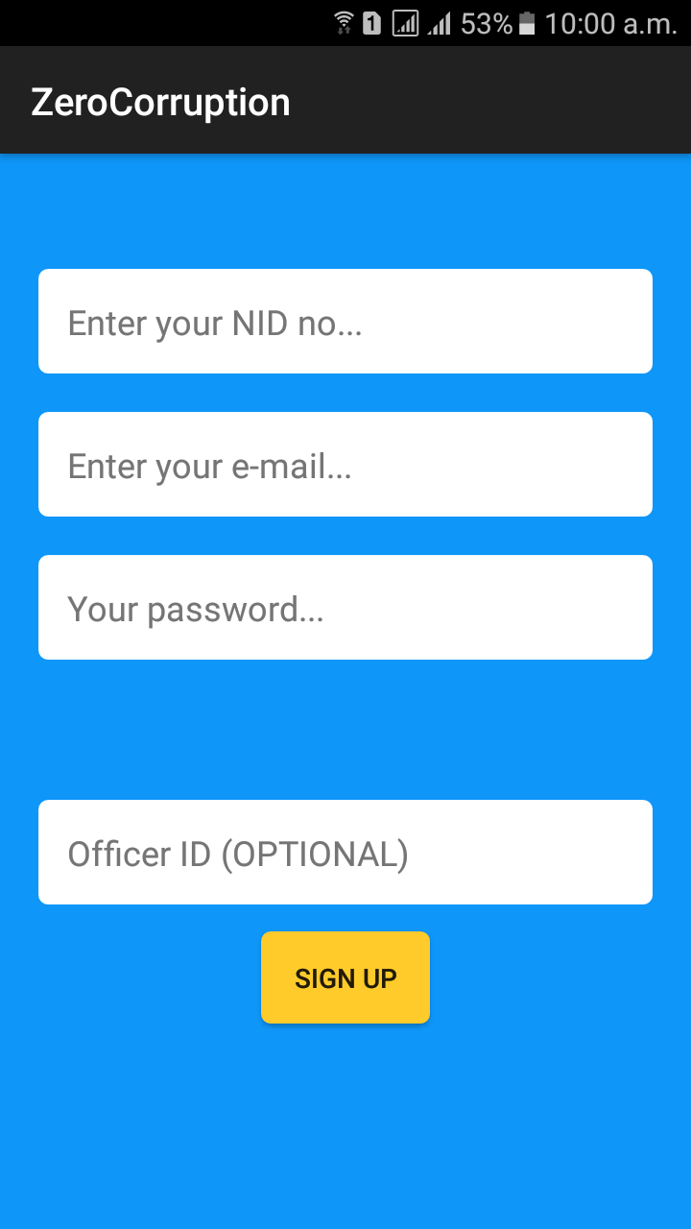
VISIT TO THE APP
Fig : Log in Fig : Sign up

Slide 9
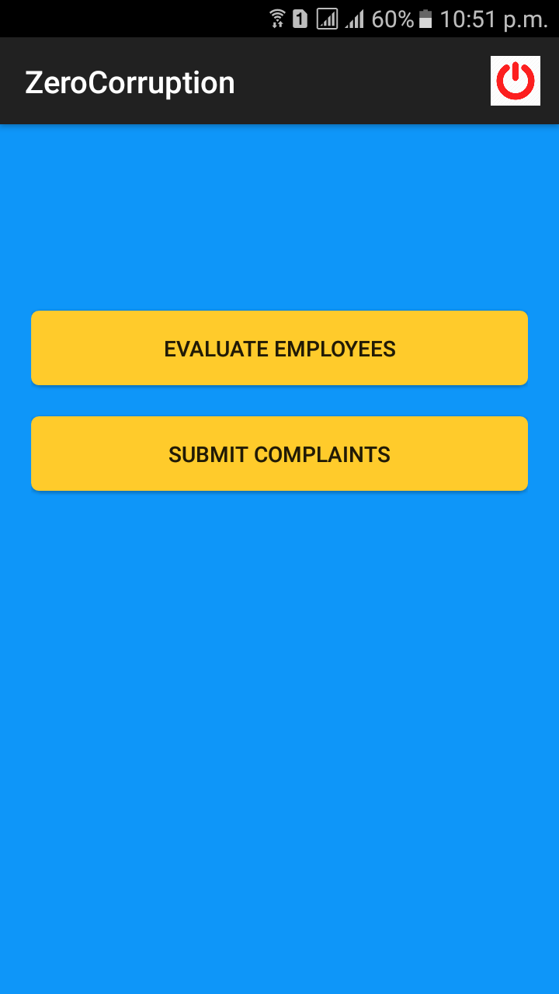
Homepage for general users
Log out Button
Button for giving opinion about employees
This button is for submitting complaints

Slide 10
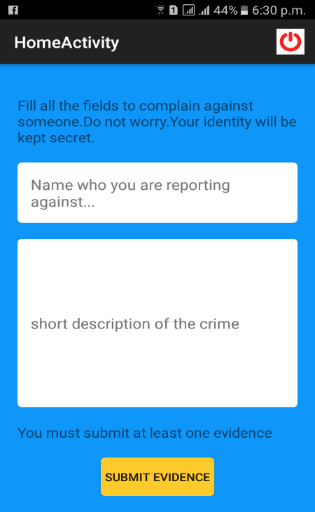
Submitting complaints
Name of the complainee
All the boxes must be filled to navigate to the next part
Description of crime
Button to navigate to evidence page

Slide 11
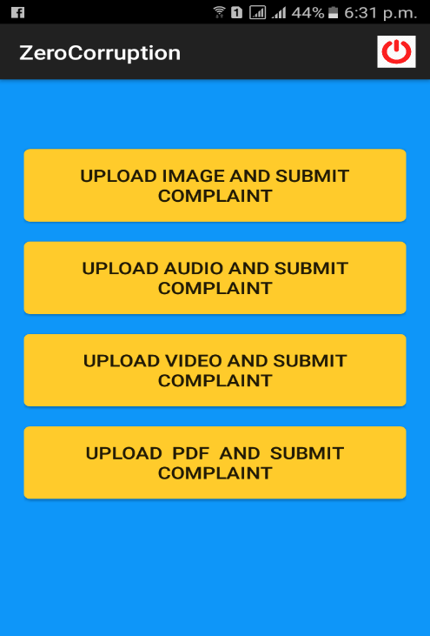
Submitting evidence
Button for uploading image
Button for uploading audio
Button for uploading video
Button for uploading pdf

Slide 12
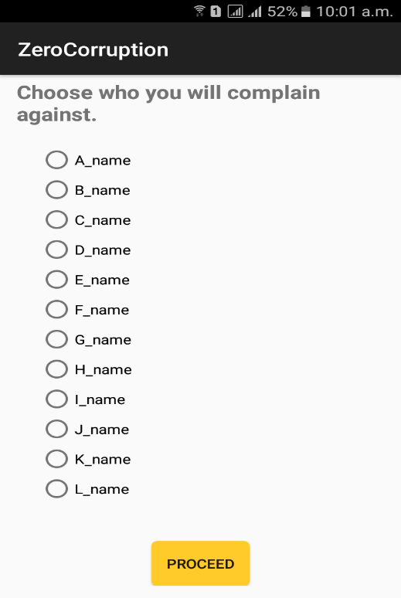
Options for choosing an employee to complain against
User must choose among employee for whom the opinion will be stored.

Slide 13
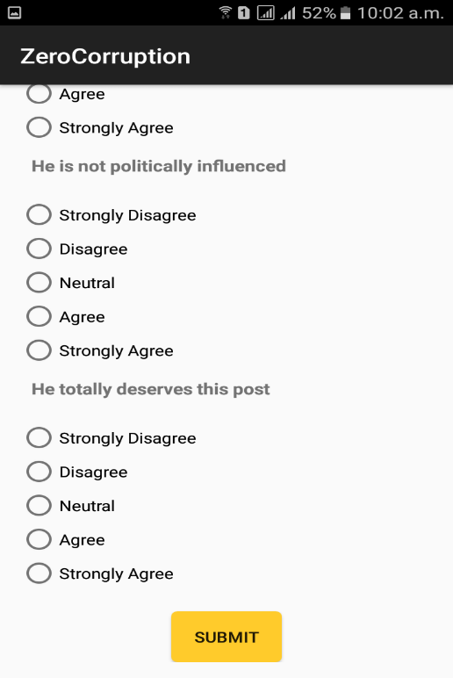
Questionnaires to evaluate employees
Users will have to answer all the questions and then submit.
Tap on Submit button will finally submit opinions to firebase database.

Slide 14
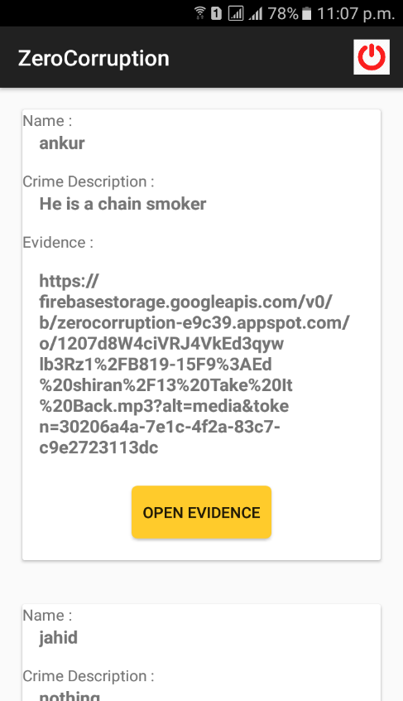
UI for officers
Complaints submitted by general users will be shown in this page and it is shown only to Anti-Corruption Commission authority.
Button to view evidence submitted. Evidence can be video, audio, image or pdf.

Slide 15
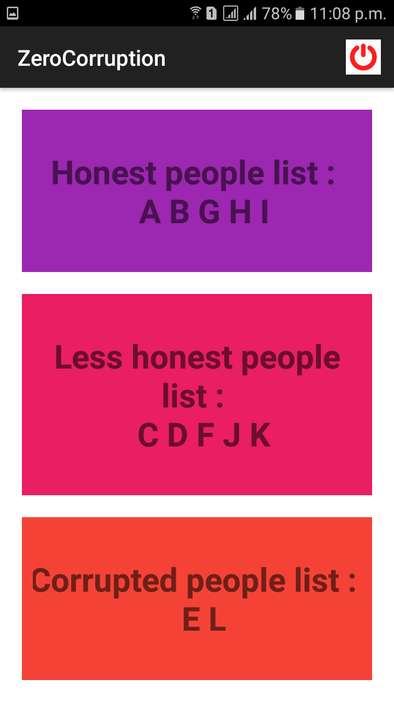
Corruption results
Employees clustered into three categories honest, average and corrupted.

Slide 16
Future Enhancement
Auto mail sending option to concerned organization after a specific time duration.
Generating a history graph to find improvement of employees.
Creating SMS based feedback system.
Digital complaint and suggestion box.

Slide 17
Conclusion
This model will be effective in society if the corrupted people are being faced punishment.
The ultimate goal of this project is to raise awareness among all against corruption. This project will increase accountability of employees and make them aware of the fact that if they get involved in corruption they will not be spared anymore.

Slide 18
THANK YOU

