Slide 1


ZEST CHAT - SOS APPLICATION

Slide 2



TEAM MEMBERS:
ARCHIT DASH (6135)
ABHUDAY SHUKLA (6134)
OMPRAKASH HIVRE (6138)
NAHID AKHTAR (6131)
NOAH FEDRICH (6125)
NAVEEN SHARMA (6137)

Slide 3
OVERVIEW :-
S.O.S. (which stands for Save Our Souls) used as international Morse code for distress signal.
In a S.O.S. system , a distress signal is generated when the S.O.S. button is pressed, or a gesture is made
The distress signal consist of a text message consisting of the sender's location. This message is sent to the cops and close relatives whose contacts are saved by the user as guardians.
It will reduce the response time for any emergencies and the victim can be saved easily.
This app is a multipurpose utility to send messages to friends not only in danger but also can be used for chatting.

Slide 4



Technologies Used :-
Android Studio
Firebase Java

Slide 5
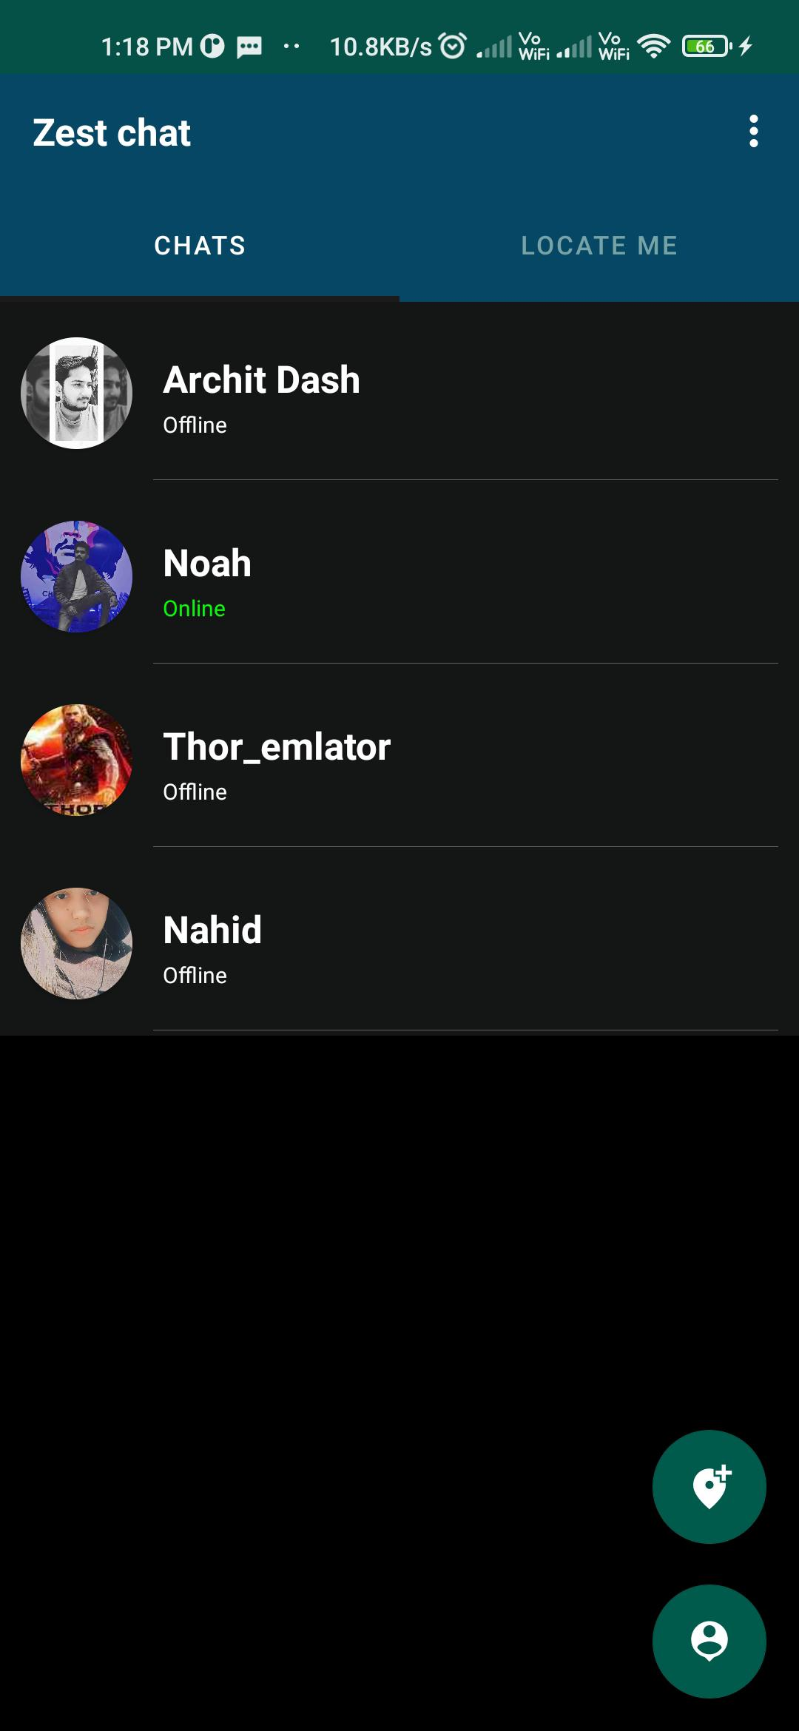
User Interface Page :-

Slide 6
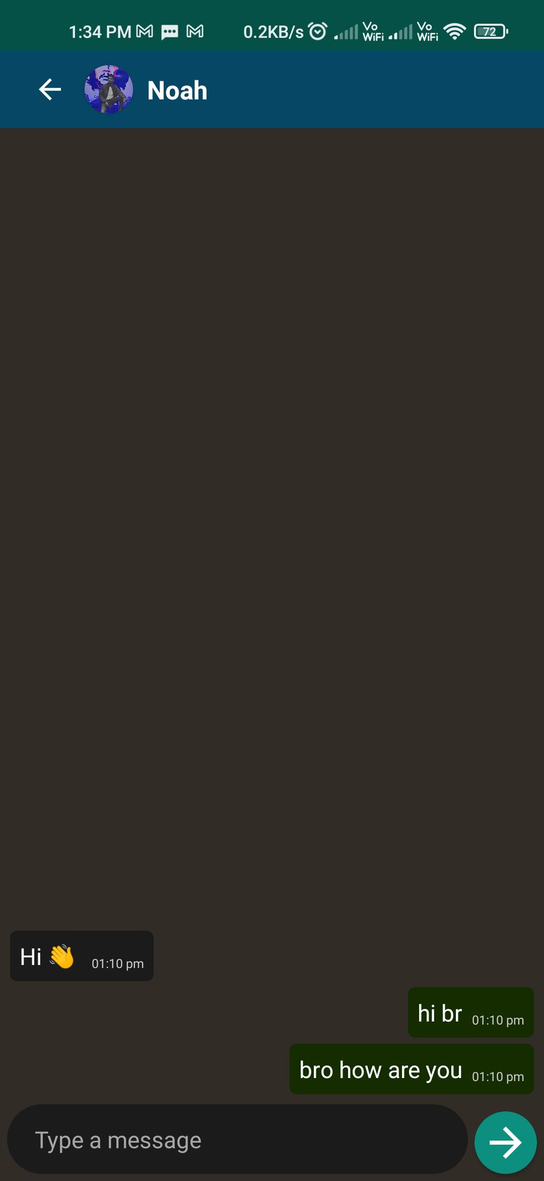
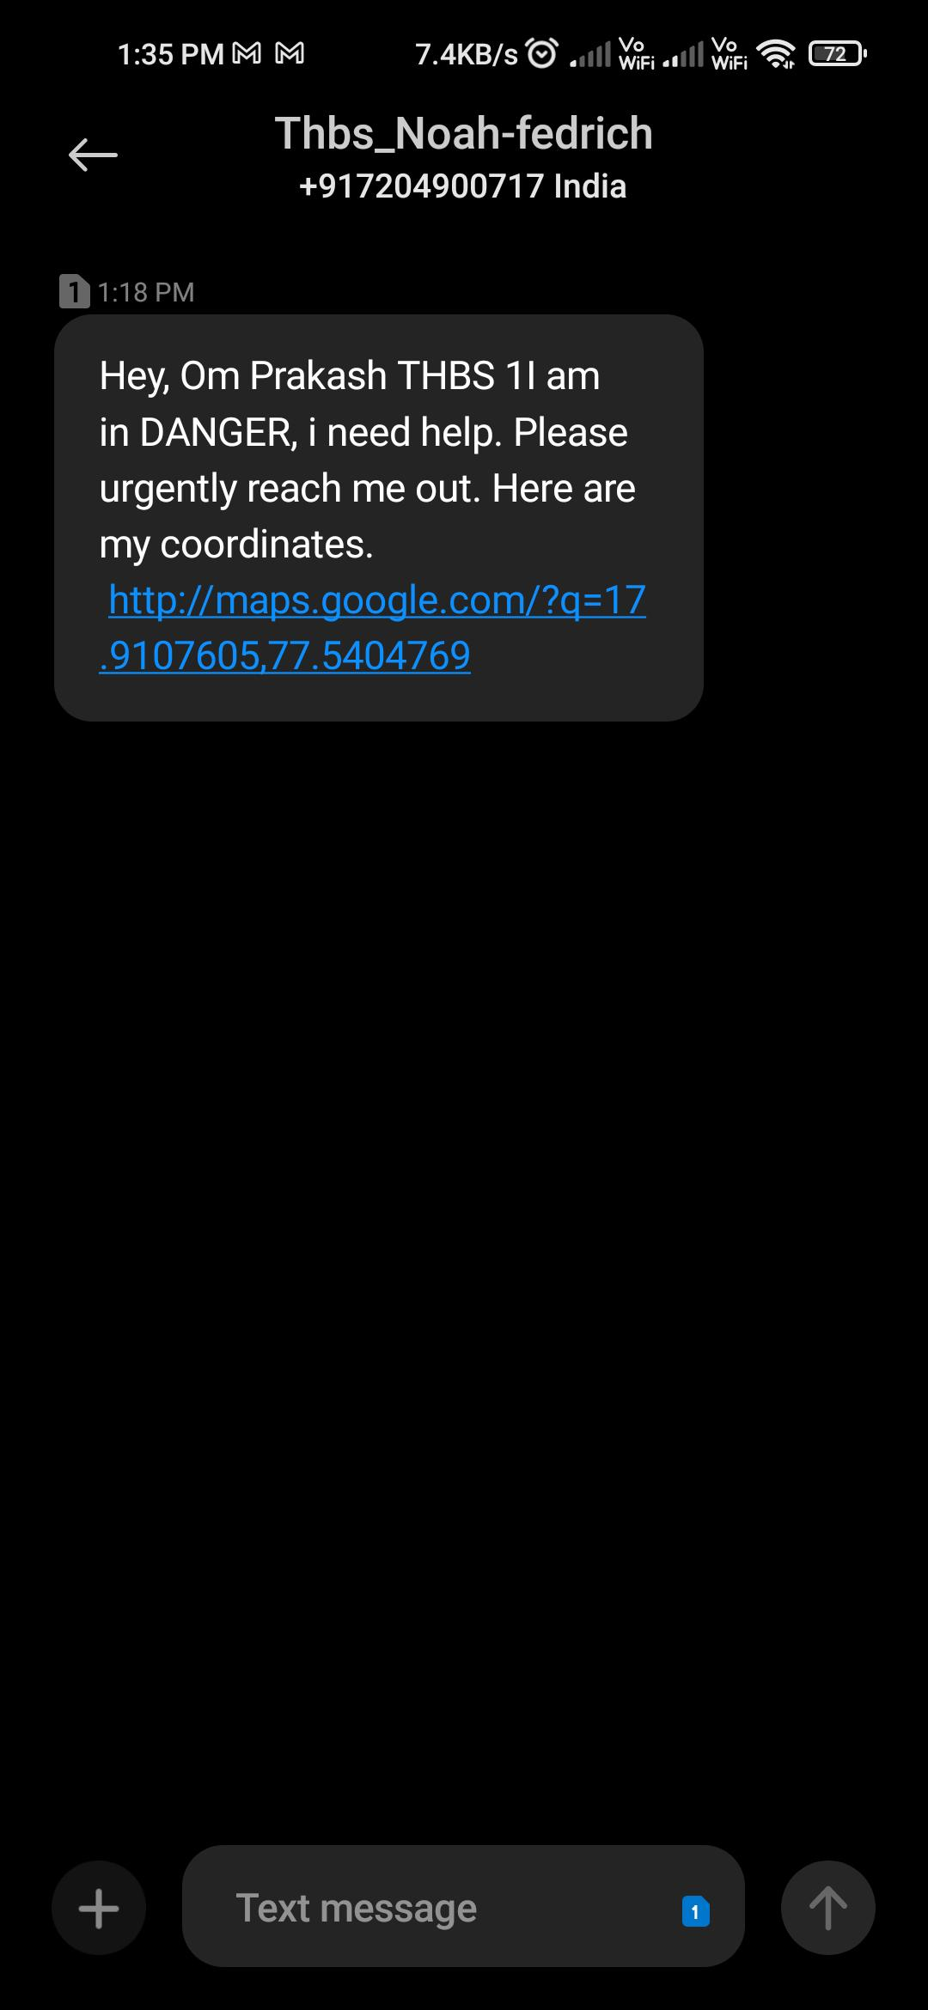
Users Chat Page :-

Slide 7
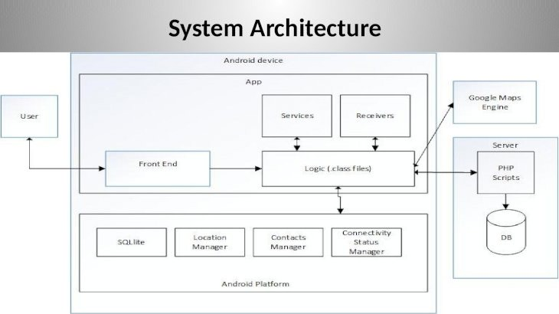
Architecture

Slide 8

FUTURE SCOPE
A home screen widget that can be used as a triggering point in panic situation.
Setting up a password to stop the application.
Live Tracking.
Voice recognition S.O.S. activation.

Slide 9

Thank you

