Slide 1
M
0
o
D
P
L
A
N
E
T
Chilka Castro, Jiahui Xia, Phuong Thanh Nguyen

Slide 2
Project Description:
Our project is a mood tacker app which used to keep a record of a person’s daily mood.
The purpose of the tool is to help look for patterns in how moods vary over time and due to different situations and circumstances.

Slide 3
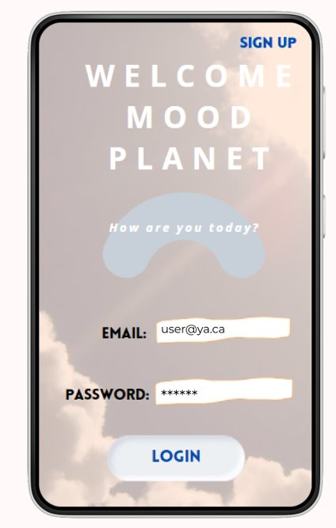
Login Page

Slide 4
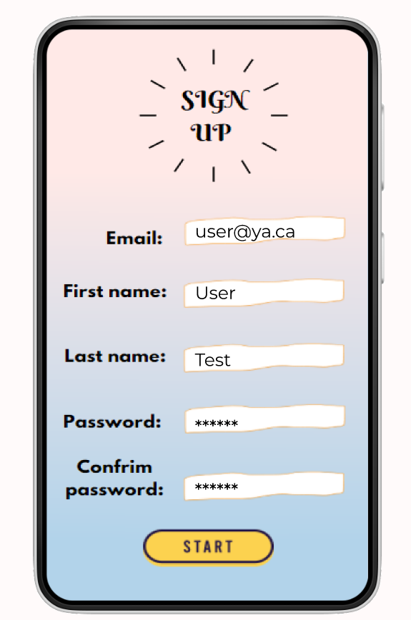





Sign Up Screen

Slide 5
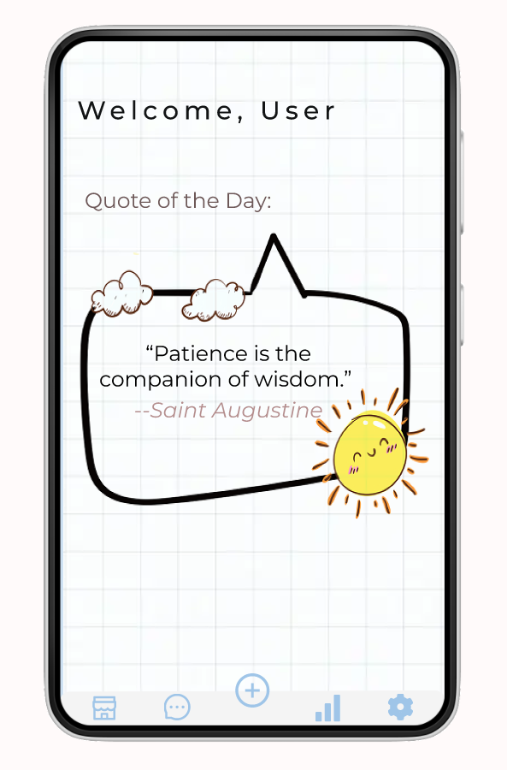
Quote Screen(A quote when user opens the app)
API quotes

Slide 6
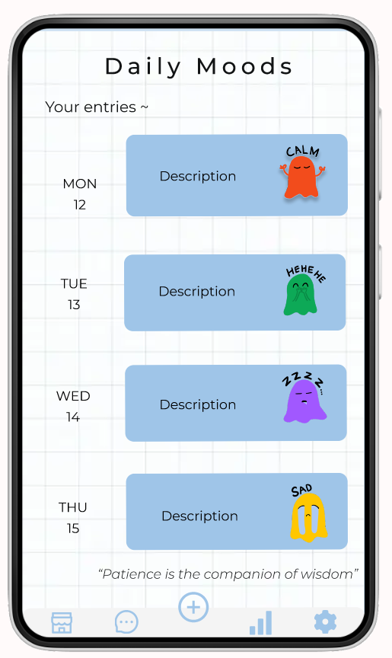

Home/Mood Entries Screen

Slide 7
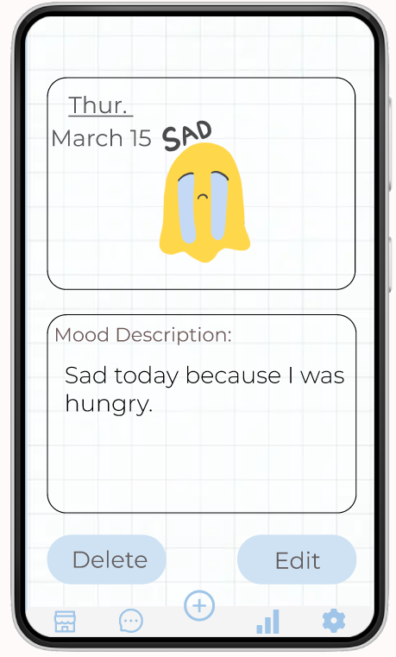
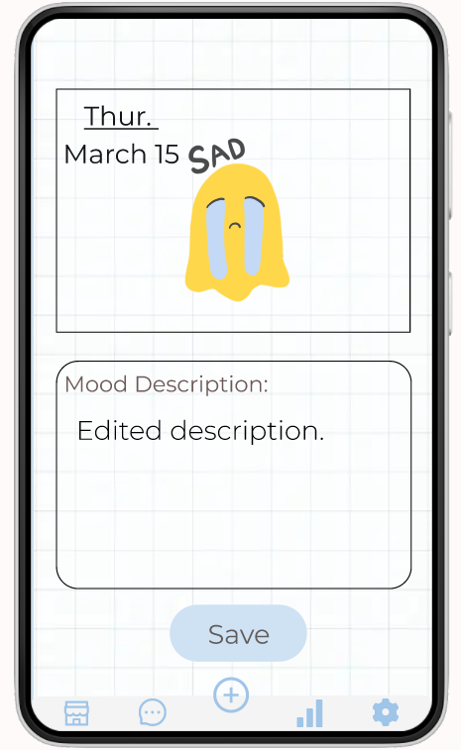


View Specific Mood Entry Screen

Slide 8
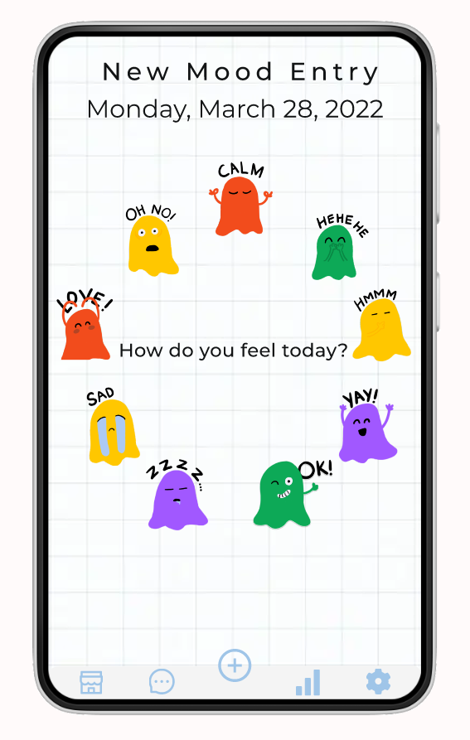
Add Entry Page Screen: Choose Emoticon

Slide 9
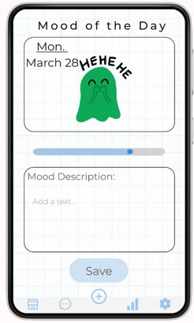
Add Entry Page Screen: Enter Mood Description
Notes:
https://www.ypppt.com/

Slide 10
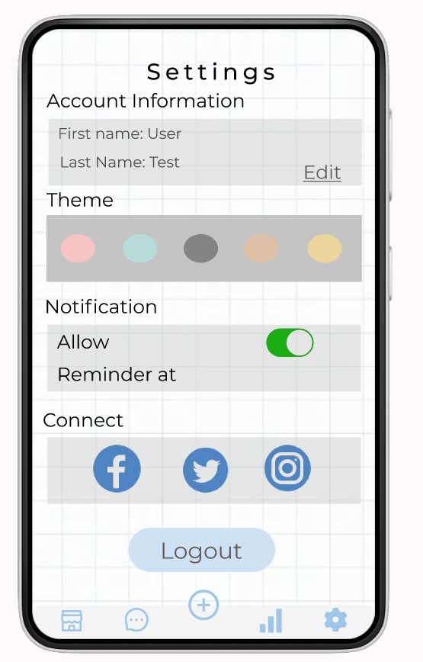
Settings: Main Screen

Slide 11
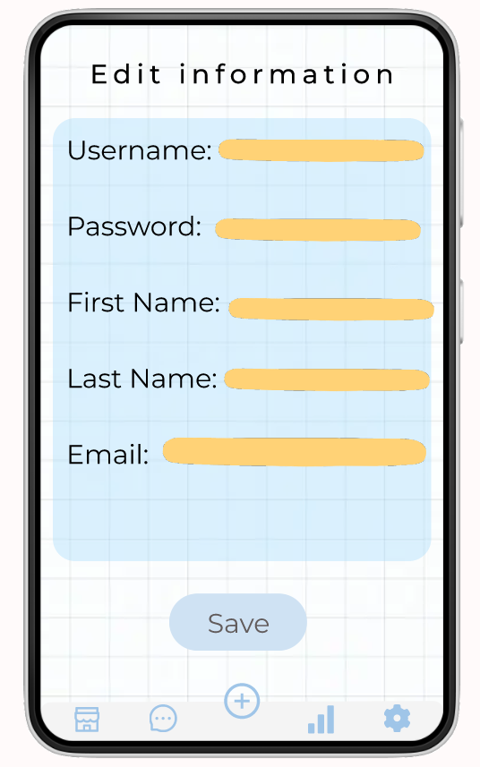
Settings: Edit Account Information Screen

Slide 12
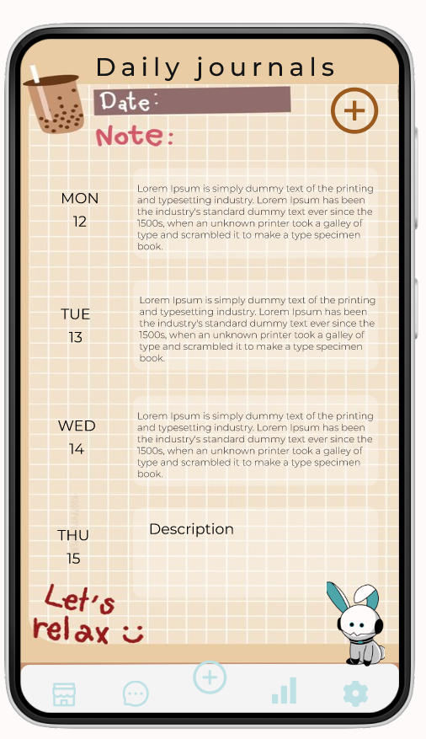

Mood Journals Screen

Slide 13
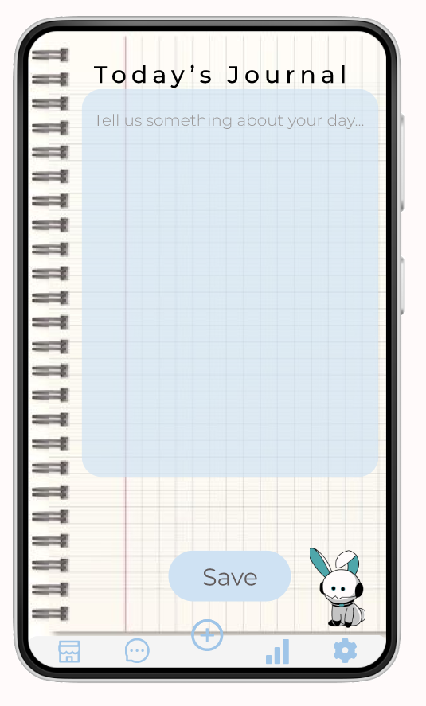
Add Journal Entry Screen

Slide 14
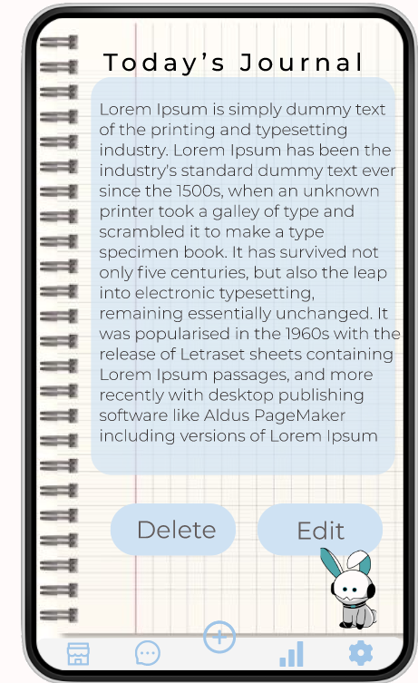
View Journal Entry Screen

Slide 15
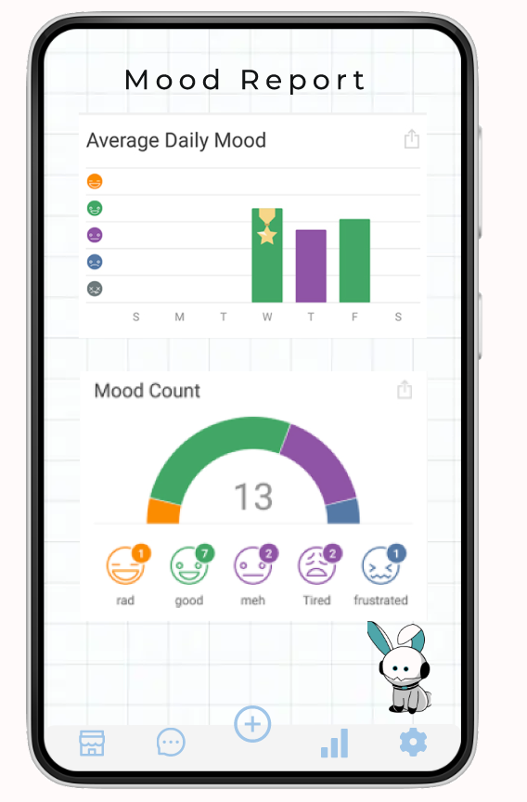
Mood Report Screen

Slide 16
Links
Figma: Mood Planet
GitHub
Database: Firebase

Slide 17
You
Thank

