Slide 1

Avoider
By Kyrsten Kelly & Taylor McCaslin

Slide 2
You are a penguin…

Slide 3

Lost in the ice!

Slide 4
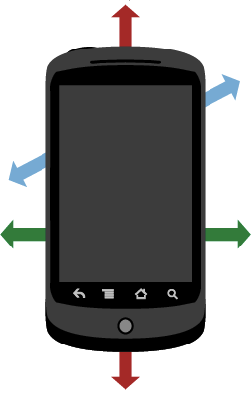
Tilt the phone to move

Slide 5


Get suns to gain lives! Avoid rain clouds!

Slide 6
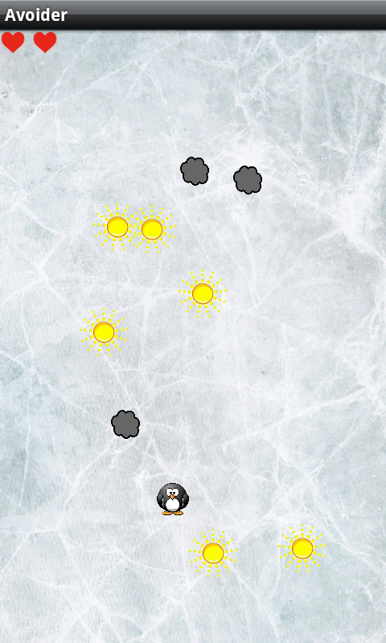


2 = 1 =

Slide 7
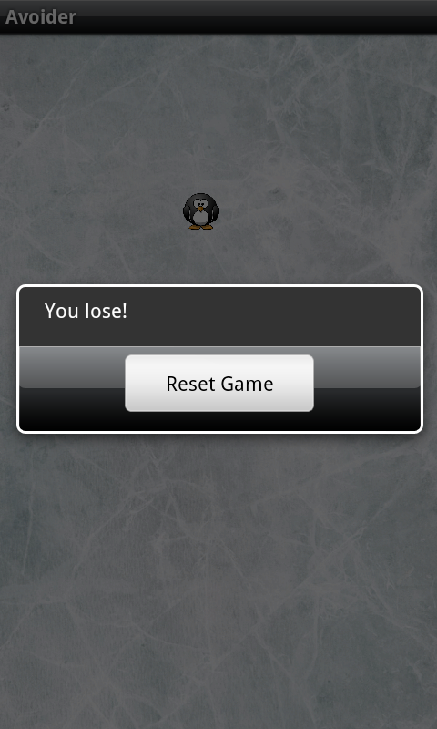
Lose your lives and you lose the game.

Slide 8
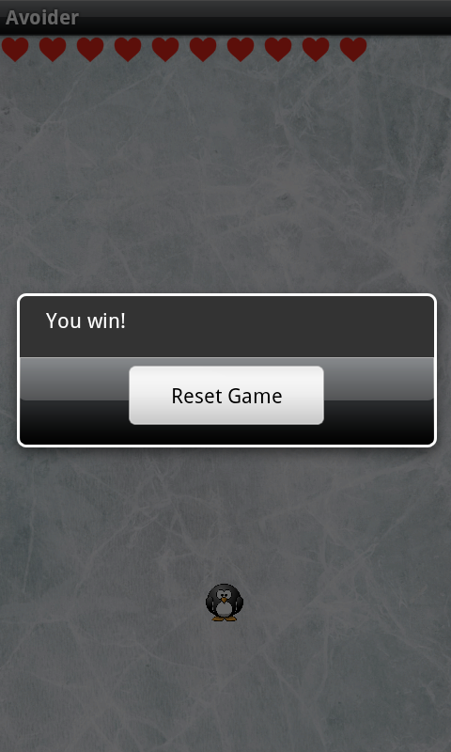
Get 10 lives and you win!

Slide 9
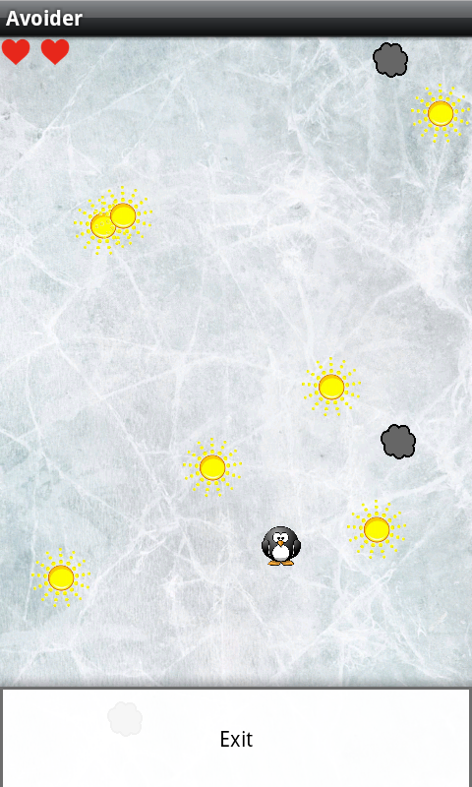
Exit using the menu button.

Slide 10
Things we learned:
Pair programming is the best!
Catch each other’s mistakes
Write better code
Decide better data structures and code format

Slide 11
To change a collection while iterating over it, you must use an iterator.

Slide 12
Iterator<Integer> iter = collection.iterator();
while(iter.hasNext()) {
int i = iter.next();
...
iter.remove();
}

Slide 13
Use handler, not timer! - Timer tasks cannot be rescheduled

Slide 14
private static Handler handler = new Handler();
run = new Runnable() {
@Override
public void run() {
// Task to run
handler.postDelayed(runA, 10000);
}
};
handler.postDelayed(run, 10000);

Slide 15
The End

