Slide 1

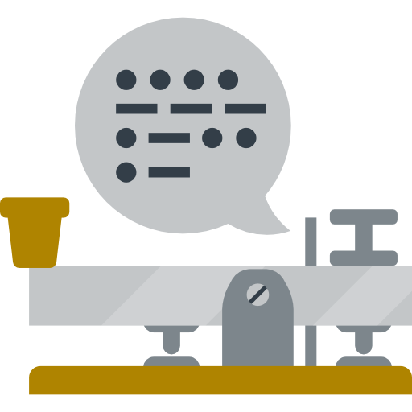
CPCS 499 (Senior Project 2)
Final Project Presentation
Spring 2021
Morse Code
Mobile Application
Section | ID | Name
XA6 | 1740166 | Mohammed Atiah Al-Zahrani (Leader)
XAG | 1740373 | Mohammed Saleh Al-Harbi
XAL | 1742589 | Omar Abdulaziz Al-Qurashi
XE | 1742403 | Hussam Adnan Shawly
-- --- .-. ... . / -.-. --- -.. . / - .-. .- -. ... .-.. .- - --- .-.
Supervisor
Dr. Asif I. Khan
Co-Supervisor
Dr. Wajdi H. Aljedaibi

Slide 2

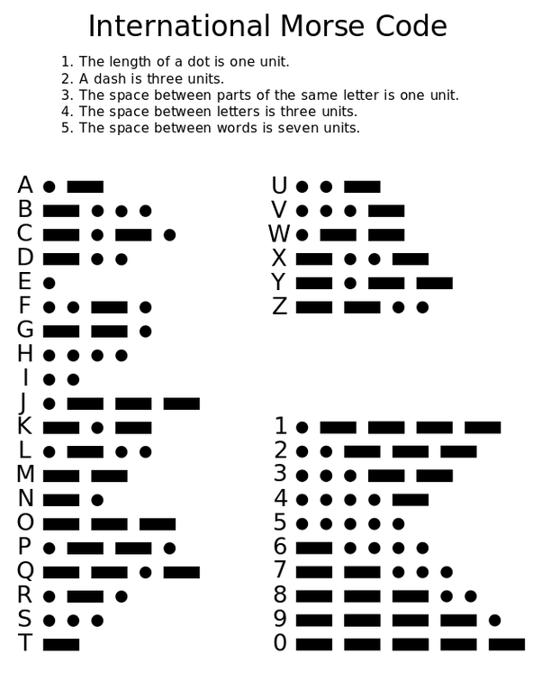
Morse Code
Created by Samuel Morse (c.1830s)
Literal codes used to send messages by sequence of pulses of two types:
Long pulse
Short pulse
Pulses can be composed of:
Sounds
Lights
Some other things
Common usage:
Signaling for help
Helping people with disabilities to communicate
2/17

Slide 3
Project Aim and Title
Project Title: An AI Based Morse Code Learning Mobile Application
Project Aim
Smartphone app
learning
Use AI
(Computer Vision)
Apply Modern Learning Techniques (Gamification)
3/17

Slide 4
outline
2. ANALYSIS STAGE
3. DESIGN STAGE
1. REQUIREMENTS SPECIFICATION
4. Implementation
5. testing
4/17

Slide 5
1 – Requirements Specification
Functional requirements
Non-Functional requirements
Data requirements
Hardware requirements
5/17

Slide 6
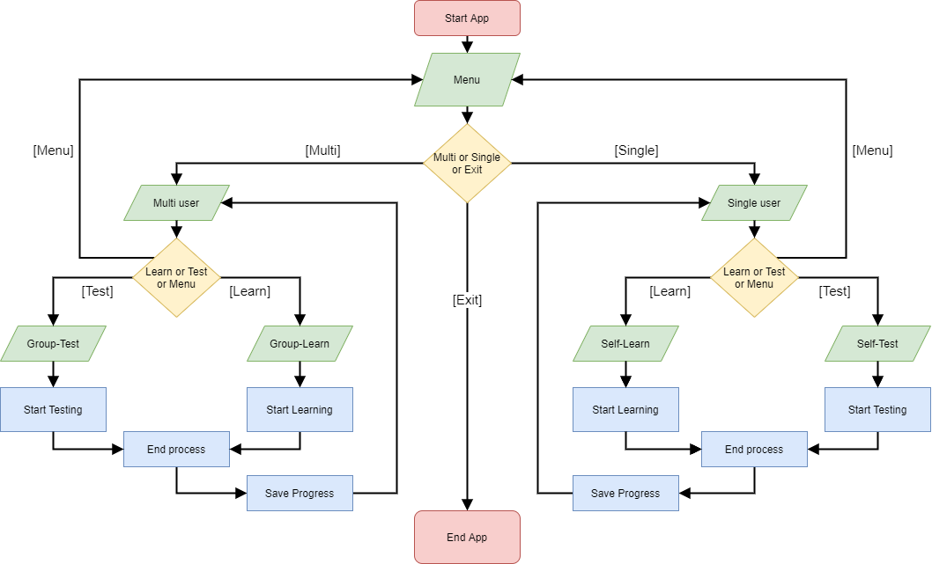
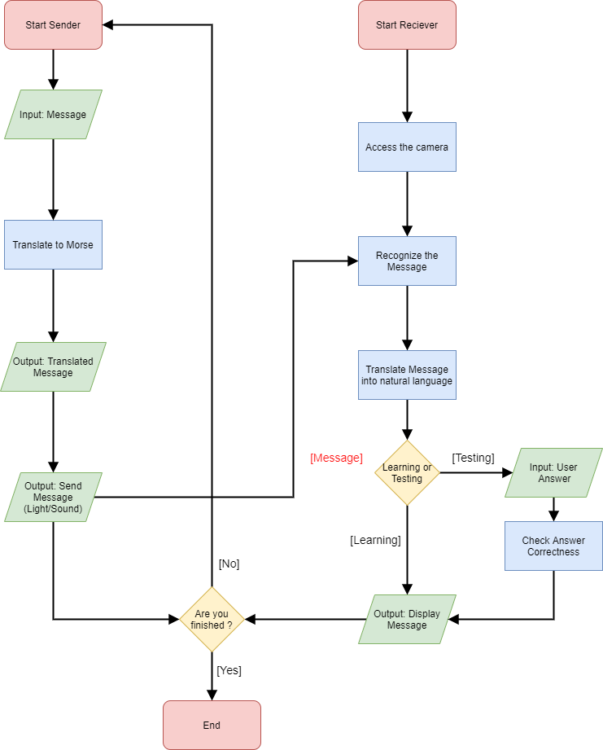
2 – Analysis Stage
6/17

Slide 8
2 – Analysis Stage
6/17

Slide 10
2 – Analysis Stage
6/17

Slide 11
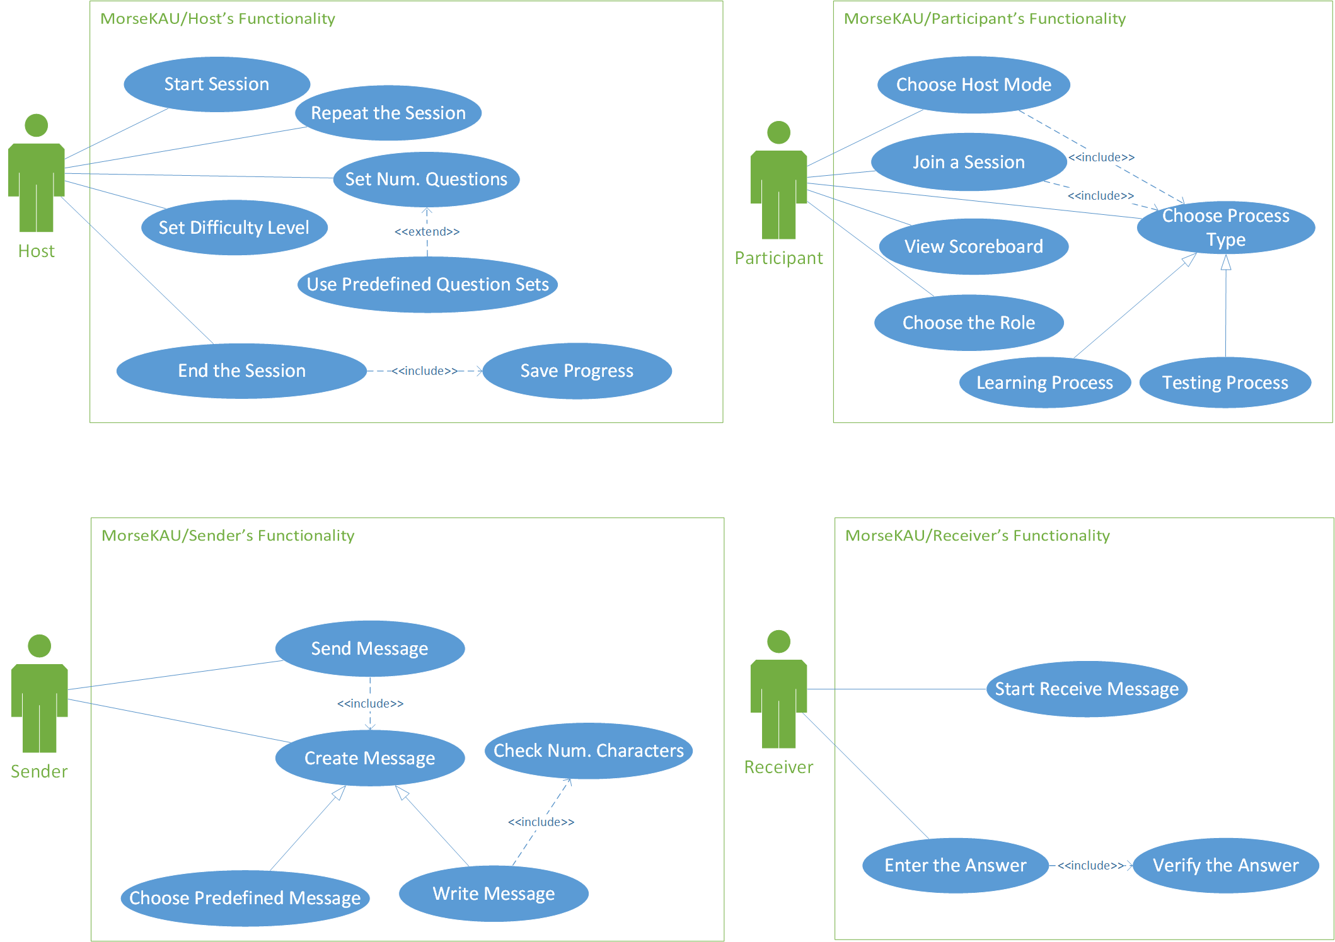
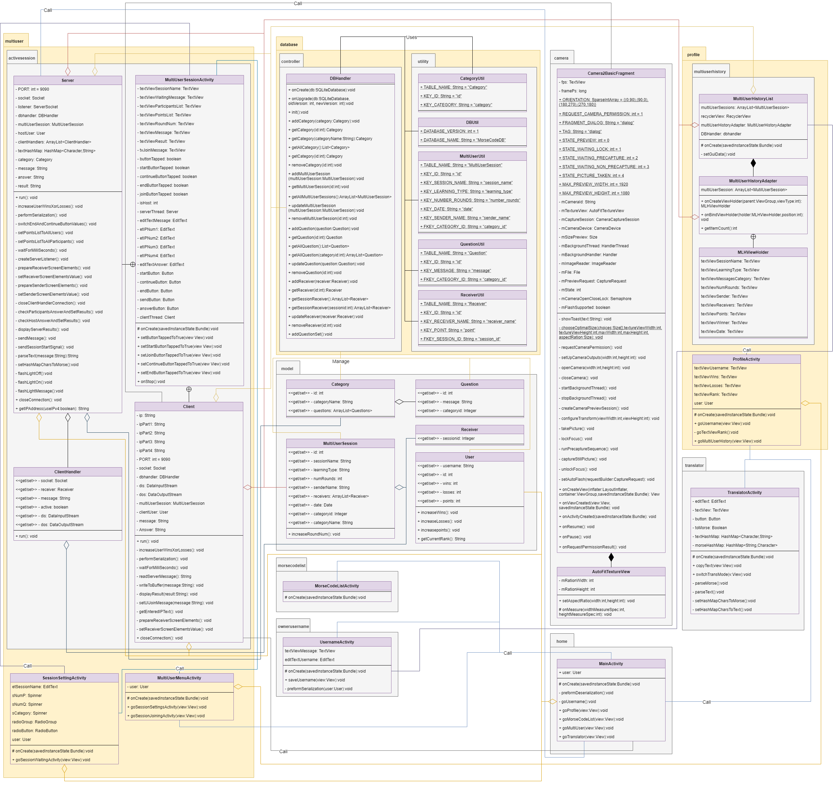
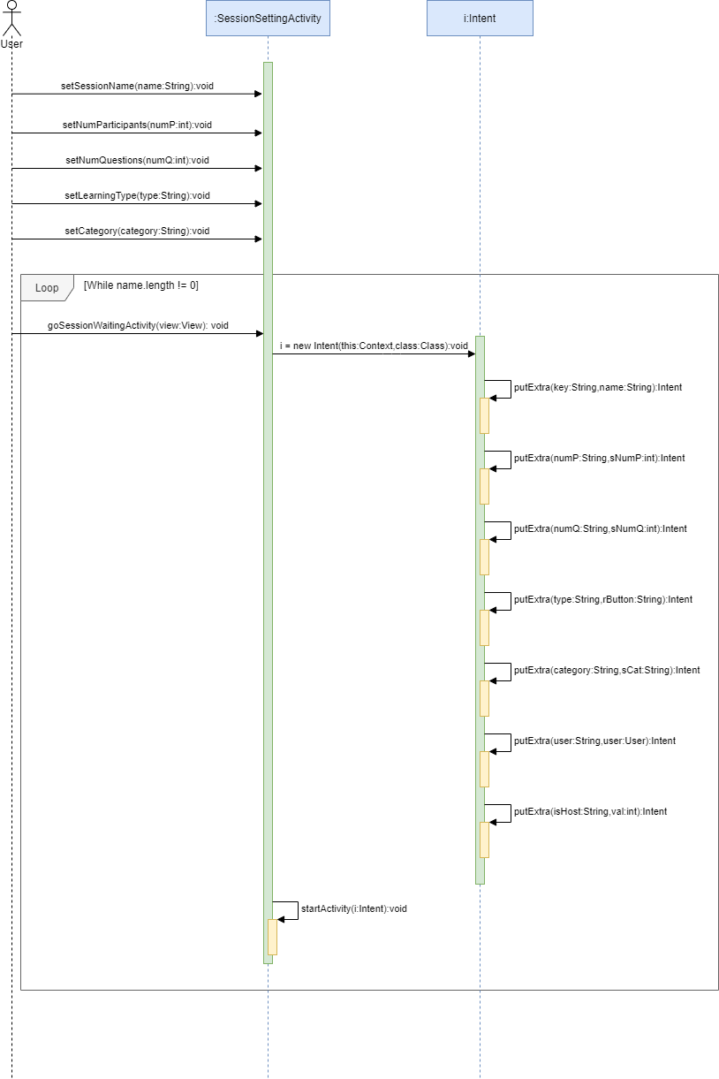
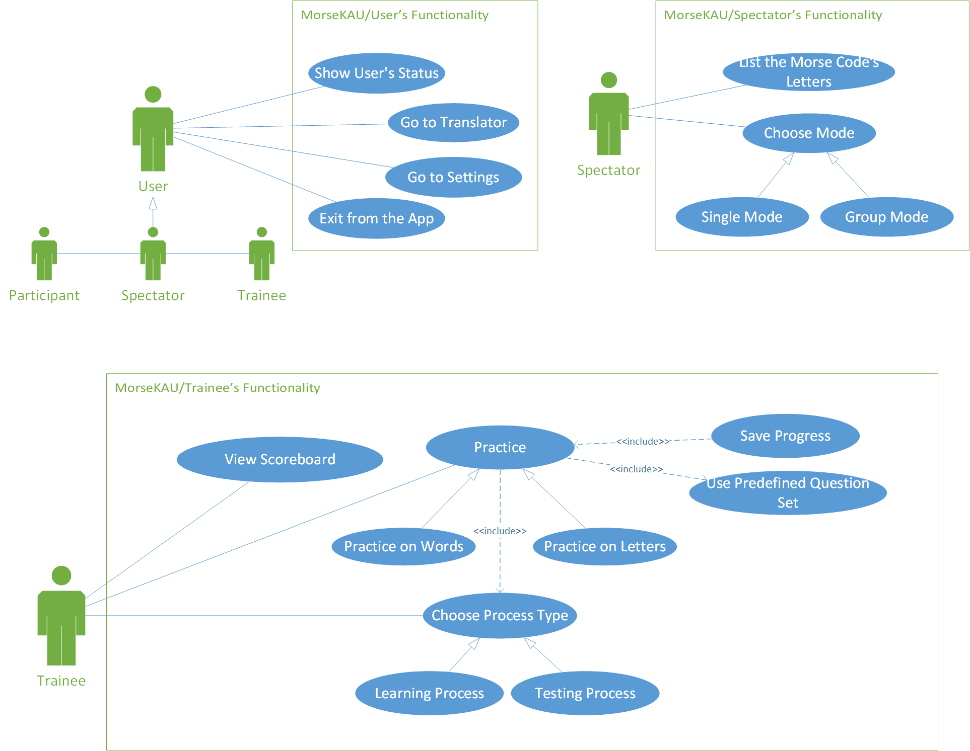
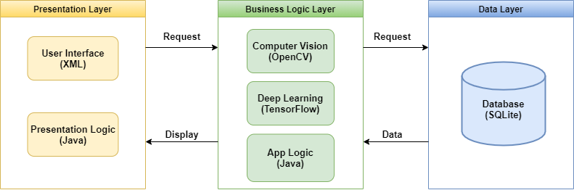
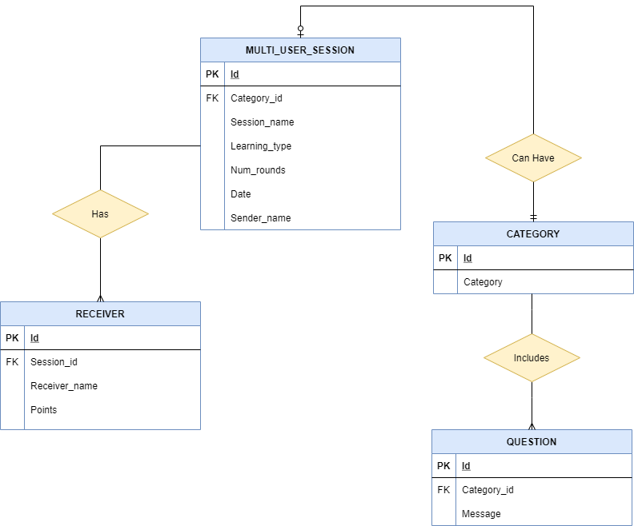
3 – Design Stage
7/17

Slide 13
3 – Design Stage
7/17

Slide 15
3 – Design Stage
7/17

Slide 17
3 – Design Stage
7/17

Slide 19
3 – Design Stage
7/17

Slide 21
3 – Design Stage
7/17

Slide 22
4 – Implementation
4.1. UI Implementation
4.2. Database
4.3. Networking
4.5. profile
4.6. Learning model
4.4. Flashlight
8/17

Slide 23
4.1 – UI Implementation
14 Screens were developed
Can be categorized:
Multi-User mode
Training
Exam
Profile
History
Translator
9/17

Slide 24
4.2 – Database
Implemented in SQLite
SQLite features:
Lightweight
Embedded
No setup required
Contains 4 tables
Can preform CRUD operations
10/17

Slide 25
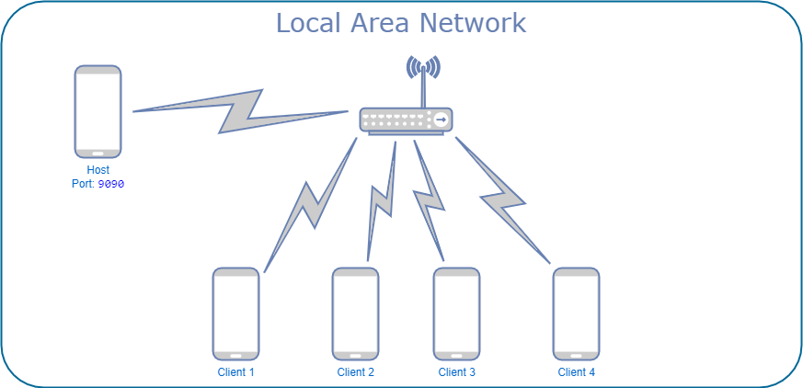
4.3 – Networking
Implemented in Multi-User mode
Client-Server architecture:
Host acts as a server
Participants act as clients
Maximum of 5 players in one session
Requires LAN network
11/17

Slide 26

4.4 – Flashlight
Flashlight is a camera service
Camera Manager:
Turn off flashlight
Turn on flashlight
0.5 seconds for dot ( . )
1.5 seconds for dash ( _ )
12/17

Slide 27
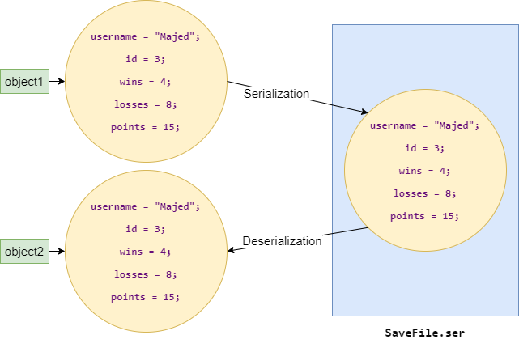
4.5 – Profile
Each user has a profile that contains:
ID
Username
Wins
Losses
Points
Uses Serialization and Deserialization
Profile is created or loaded when the app starts
The profile is updated after each session
The user can reset it
13/17

Slide 29
4.5 – Profile
Each user has a profile that contains:
ID
Username
Wins
Losses
Points
Uses Serialization and Deserialization
Profile is created or loaded when the app starts
The profile is updated after each session
The user can reset it
13/17

Slide 30
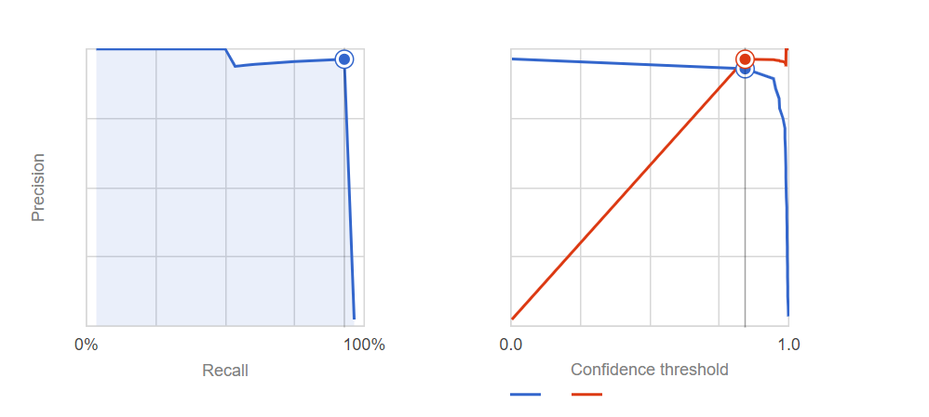
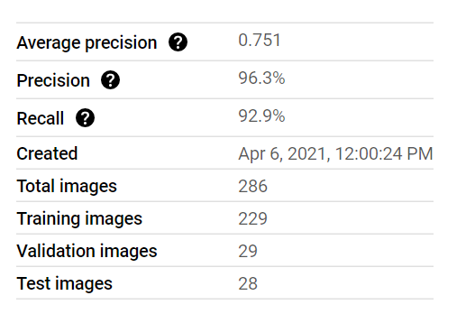
4.6 – Learning Model
Challenges
Integrating the python model
Switch to Google cloud.
Dataset
Smartphone with the flashlight on
Google cloud
Bounding boxes
Training phase
AutoML algorithm using Google cloud
Image object detection
Evaluation
Performance measures
14/17

Slide 32
4.6 – Learning Model
Challenges
Integrating the python model
Switch to Google cloud.
Dataset
Smartphone with the flashlight on
Google cloud
Bounding boxes
Training phase
AutoML algorithm using Google cloud
Image object detection
Evaluation
Performance measures
14/17

Slide 33
5 – Testing
Tested all finished functionalities.
Example of important functionalities:
FRU4. View list of natural language letters to Morse code.
FRM1. Translate between Morse code text and natural language text using a translator.
FRM8.6. Able to end the session.
FRM8.10 Send the question.
FRM8.12. Enter the answer corresponding to the Morse signals.
FRM8.2. Create a session.
15/17

Slide 34
5 – Testing (Cont.’)
Boundary Value Analysis Technique
Decision Table Technique
“Mohammed” is a valid username.
“HelloMyNameIsMohammedSalehAlharbi” Is not a valid username.
“SOS” Is a valid question.
“سؤال” Is not a valid question.
Invalid partition – valid partition Lower boundary. |  | Invalid partition – valid partition upper boundary.
Boundary value just below the boundary | Boundary value just above the boundary | Boundary value just below the boundary | Boundary value just above the boundary
0 | 1 | 15 | 16
Conditions | Test 1 | Test 2 | Test 3 | Test 4
Characters’ length < 20 | Y | N | Y | Y
Characters’ length > 0 | Y | Y | N | Y
English characters | Y | Y | _ | N
Outcome
Send question | Y | N | N | N
Message | _ | “Message is too long” | “Please enter a message” | “Not valid input”
16/17

Slide 35
5 – Testing (Cont.’)
Integration Testing:
Bottom-Up Incremental Approach.
Integrated Components:
Database
Translator
LAN Component
Camera
Training & Exam Mode in Multi-User Mode
Not Integrated Components:
AI Model
System Testing:
System testing is yet to be started.
Not all the functionalities are integrated yet.
17/17

Slide 36

Thank You For Listening
Any questions?

