Slide 1

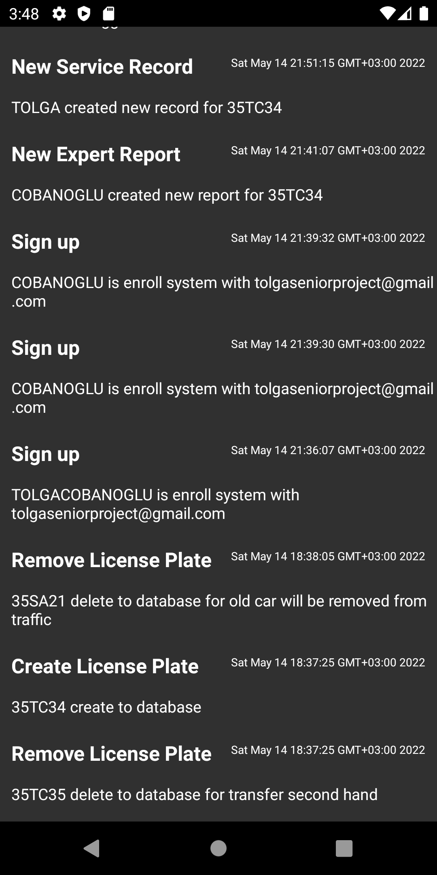
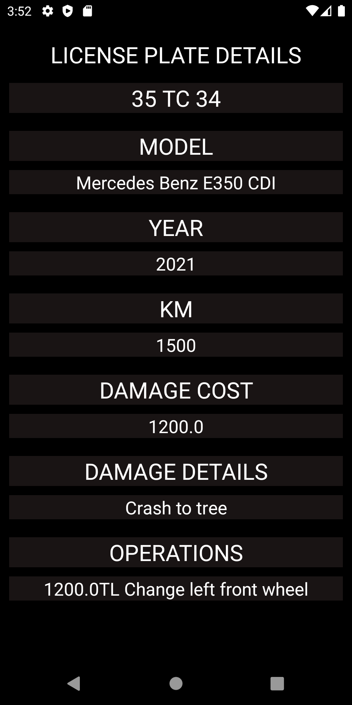
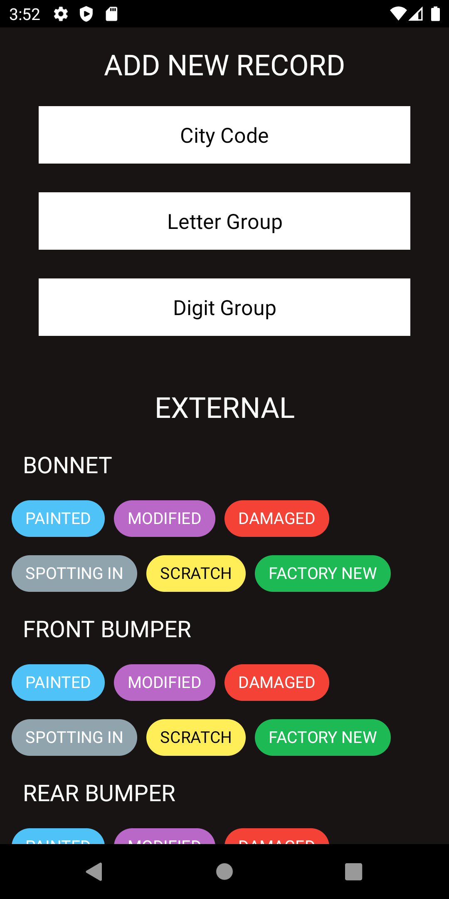
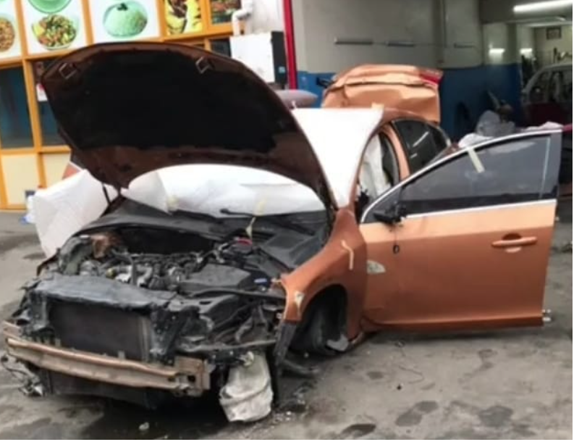
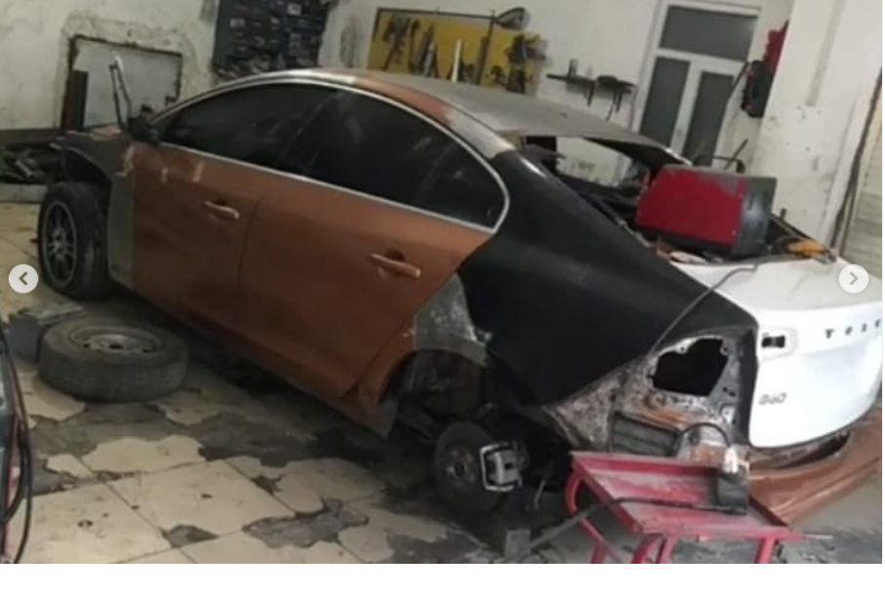
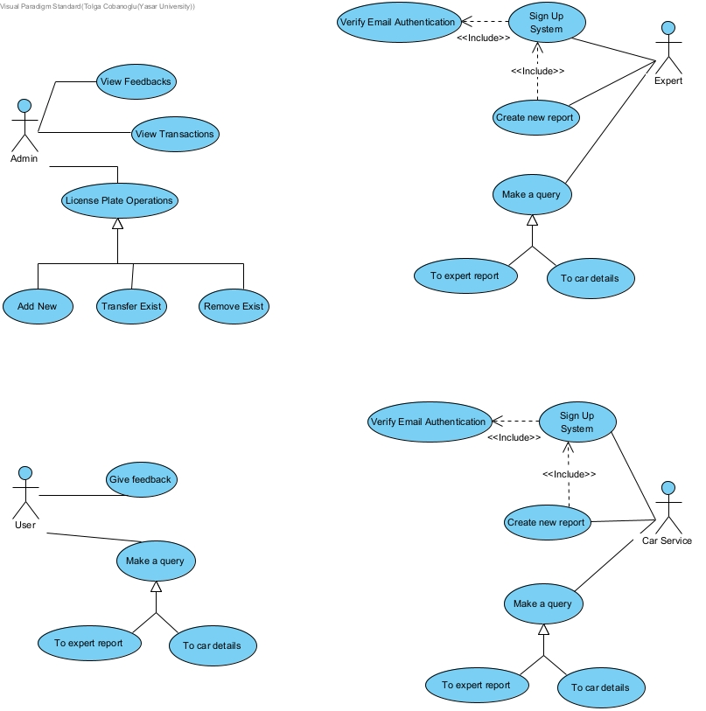
Yaşar University
CENTRAL CAR POLICY
TOLGA ÇOBANOĞLU Mentor: DINDAR OZ
INTRODUCTION
[1] “There are currently 2 million heavily damaged vehicles in traffic”.In according to Haberturk news,[2] “ 9 out of every 100 vehicles inspected in 2020 were waste car”. In according to car expert which name is Tarcanlar told that in video document,[3], "The car's airbag was stolen and replaced with rags and the resistors were tricked with tape.". For these reasons, a certain law or regulation must now be enforced, and we must minimize the negative effects of these situations in the future. In line with these purposes, the information on the second-hand vehicle market in Turkey was made available to everyone in an honest, accurate and free manner.
IMPLEMENTATION
The project is an application that keeps records of vehicles in Turkey with their license plates in general.In the project, 4 different applications were made and it was tried to dominate the general idea. Considering the project as an institution, it was designed by considering all use cases.
AIM
Aim of the project is, reducing the probability of the buyer in the secondhand car market to be victimized to a lower rate. Minimize the possibility of user's buying-selling grievance problems in the automobile market and we foresee to prevent this by keeping a record of the details about the car.
OVERVIEW OF USER MOVES
Overview of the system on users
CONCLUSION
As software, the data entered by the service and expertise of 4 different applications were processed into the database, so that the admin could see the events, add new records and delete the existing ones, and in the application that is open to the public, users can access this information free of charge at certain time intervals.

