Slide 1

ONLINE NEWS APPLICATION
Group 3

Slide 2
Member
Name | ID | Role | Work
Le Viet Anh | BI9-035 | Leader | Code Leading
Do Thanh Dat | BI9-065 | Member | Presentation Designing
Nguyen Tu Tung | BI10-187 | Member | Report Writing
Tran Bao Huy | BI10-079 | Member | Debugging
Vu Tuan Phuong Nam | BI9-022 | Member | Debugging

Slide 3

Abstract
As the world’s technology is swiftly expanding, we are so lucky to have high-speed connections and networks to directly communicate to other person.
Due to day to day use in mobile, tablet and laptop is increasing, most of the people have already got these facilities. Moreover, in this quick and information-oriented world, we also need to stay updated with every incident and news.
Our team is inspired to develop a simple news – reading application to deliver it to users in a best convenient way.

Slide 4

Content
This application will automatically update new contents from the https://newsapi.org/ in real time. More, it must have an acceptable and easy to use interface for users. Since we were testing on the Nexus 5 running on Android 7 Nougat, our project might not applicable for older Android devices.

Slide 5
General Methodologies:
Retrofit
Powerful framework for authenticating and interacting with APIs and sending network requests with OkHttp.
News API
A simple, easy-to-use REST API that returns JSON search results for current and historic news articles published by over 80,000 worldwide sources.
Java
Popular programming language that can be used in a variety of platforms
Firebase
A cloud-hosted NoSQL database that lets you store and sync data between your users in real-time

Slide 6

Overall Functionalities
Authentication: Register, using username and password of an existing account via Google account.
Search function: Look for an article with keywords.
Fetch articles from News API using retrofit.
Swipe to refresh.
Detailed page corresponding to each news headline.
Splash screen: display page while waiting for the app to boot.

Slide 7

Explanations
Adapter.java Content filler, takes 2 args: context (MainActivity.this here), List
articles object of List, or a list of Articles objects, each contains info relating to an article.
ApiInterface.java Constructs URL with appended paramenters.
ApiClient.java Implements retrofit to interact with newsapi, uses URL constructed by ApiInterface.java
Retrofit Retrofit is a type-safe REST client for Android, Java and Kotlin developed by Square. The library provides a powerful framework for authenticating and interacting with APIs and sending network requests with OkHttp.

Slide 8
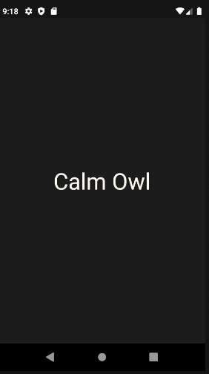
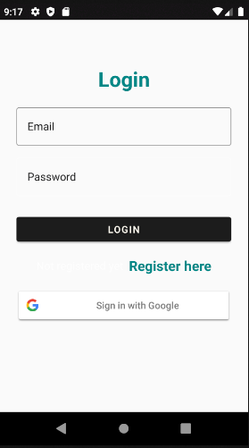
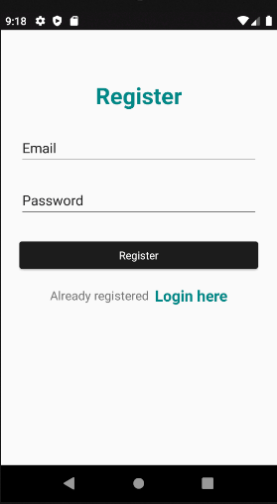
Project Overview
Fig1. Splash Screen
Fig2. Log-in screen
Fig3. Register screen

Slide 9
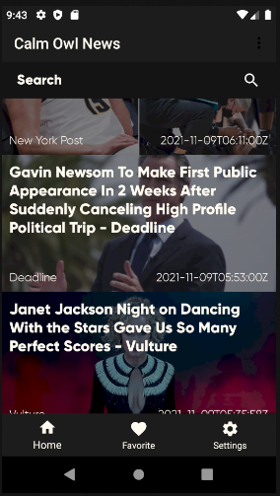
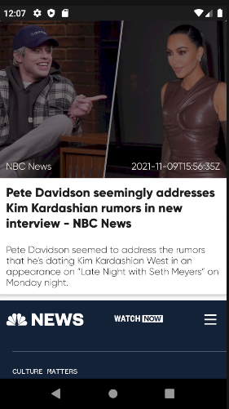
Project Overview
Fig4. Main Page
Fig5. Detail Page

Slide 10

Future Improvements
Bottom navigation with different categories
User profile page
Machine learning user experiences
Etc.

Slide 11


