Slide 1

Don Bosco Institute of Technology Information Technology Canteen Food Ordering App Members: 1.Sahil Velhal (60) 2. Amit Kumar Yadav (62) 3. Pratik Zinjurde (64)

Slide 2
Introduction
Canteens are major parts of any institution, office, hospitals, etc.
Any individual spends lot of time in queue for getting his order and on the other hand for canteen manager also it is a stressful job to manage the orders .
To solve this problem we introduced Canteen Managing App.
It will reduce time for both the canteen manager and the individual ordering for his order without having crowd and in today’s scenario we need this to maintain distance.
So, use of Android App will be a good solution.

Slide 3
Problem Statement
The current system of the canteen management is not computerized .
A solution which can efficiently reduce time for ordering and receiving food at college canteens.
Proposed application aims to provide a platform for users to order and receive food at college canteens .
Also, the user (students) will know which items are available at canteens menu.

Slide 4
Scope
Keeping track of all the ordered food and their respective collection amount.
Time saving for both Student and Canteen Owners.
Changing the food availability.
To design and develop a web application for rapid food ordering to be used by the canteen customers.

Slide 5
Tech Stack Used
Android Studio :
Integrated development environment for Google's Android operating system is used to develop this mobile application. Codebase is written in Java programming language
Firebase Realtime Database :
Document and key-value database, is used to store and retrieve users’ data. All the orders placed, order details and Items available at that particular time will be saved in this database.

Slide 6
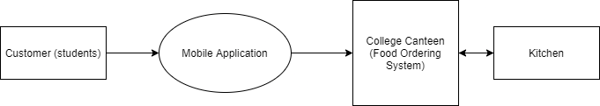
Diagram
Block Diagram

Slide 7
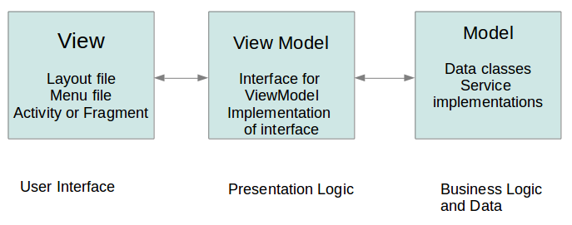
Diagram – MVVM Architecture
Model: This layer is responsible for the abstraction of the data sources. Model and ViewModel work together to get and save the data.
View: The purpose of this layer is to inform the ViewModel about the user’s action. This layer observes the ViewModel and does not contain any kind of application logic.
ViewModel: It exposes those data streams which are relevant to the View. Moreover, it servers as a link between the Model and the View.

Slide 8
Implementation
The major functionality of this divided into two roles
Customer (mainly college students)
Canteen Admin
Customer :
Customer will have access to web app by entering his credentials(email & password)
Once logged in successfully, All the available food items will be shown to customer with price and item description.
Customer can choose items of his choice and them into cart.
Once he clicks on Cart icon, all the items he selected will be shown to him along with billing details.
Once confirmed, Place Order button will be used to place the order.

Slide 9
Implementation
Canteen Admin :
Once order is received from Customer, It will be shown to Admin. He will be able to view all the orders received at that particular time and can mark them finish once food is picked from Customer.
Admin will be responsible for moderating availability of food item.
He will also be responsible for adding an item and removing it. Price and description of an item can also be changed as per wish.

Slide 10
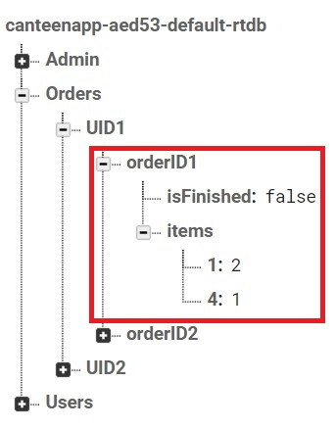
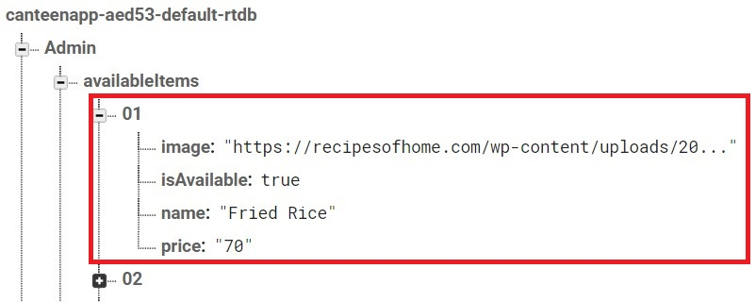
Implementation
Firebase Realtime Database:
All the data which includes Basic user info, orders placed, available items along with their price and description is stored in Realtime database .
Database:

Slide 11
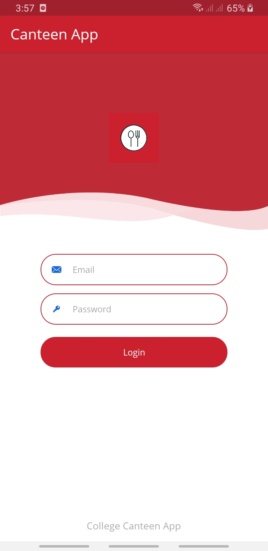
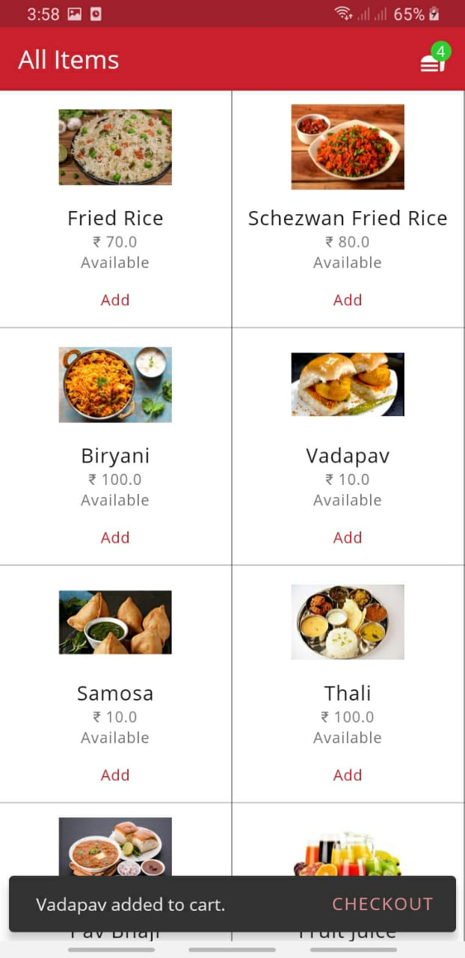
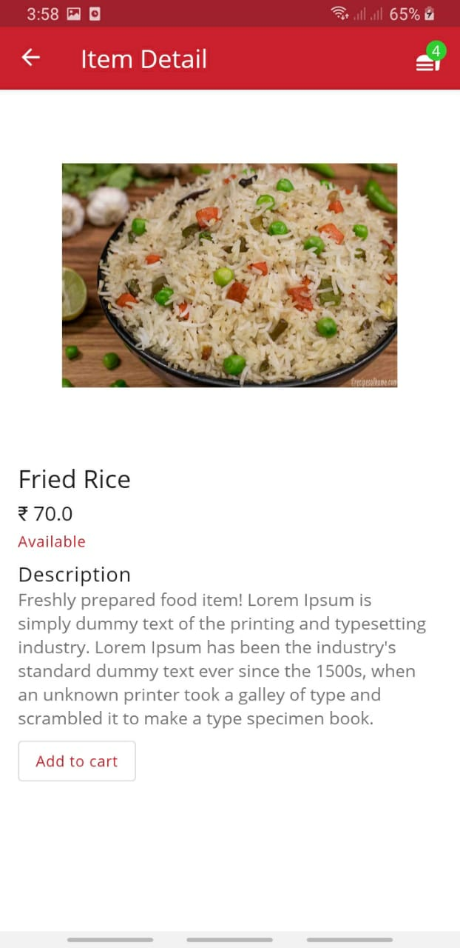
Implementation Screen Shots
Login Page Order Items Item Description

Slide 12
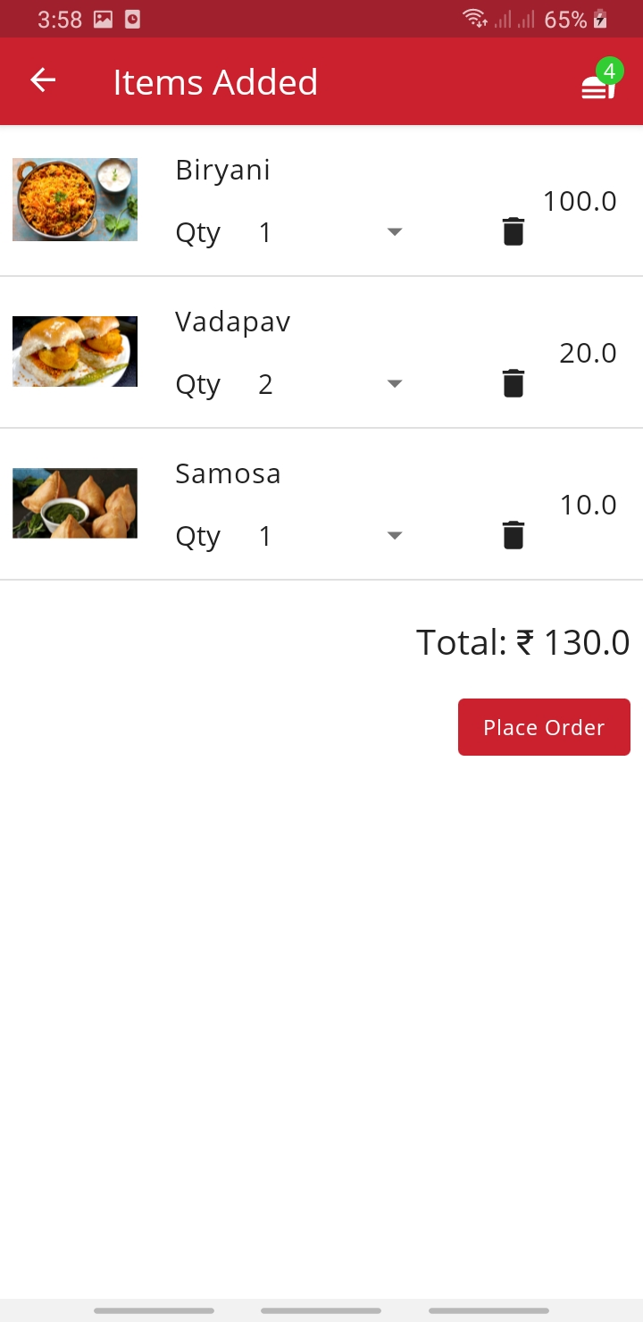
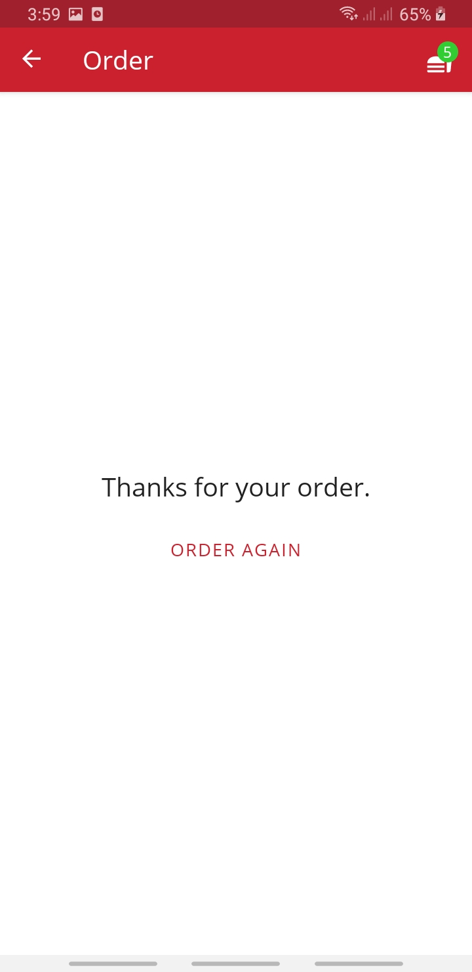
Implementation Screen Shots
Item Cart Order placed

Slide 13
Future Scope
Customers who order daily and somehow depend on Canteen meal can be opted for separate provision where they will be charged with certain interval of time (e.g. 1 month).
Payment gateway can be implemented considering full fledge product.

Slide 14
References
Tribhuvan, Aditya. (2020). A STUDY ON CONSUMERS PERCEPTION ON FOOD APPS. International Journal Of Advance Research And Innovative Ideas In Education. 6. 36. https://www.researchgate.net/publication/342765294_A_STUDY_ON_CONSUMERS_PERCEPTION_ON_FOOD_APPS
The Effect of Mobile Food Delivery Application Usage Factors on Customer Satisfaction and Intention to Reuse Ye-Eun Song , Sang-Hoon Jeon and Min-Sun Jeon
https://www.koreascience.or.kr/article/JAKO201711656710338.pdf

Slide 15
Thank You!

