Slide 1
COMP 4630 Mobile App Project Proposal
Brandon Z. and Caroline D.

Slide 2
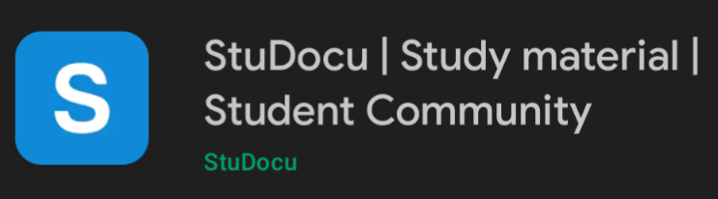
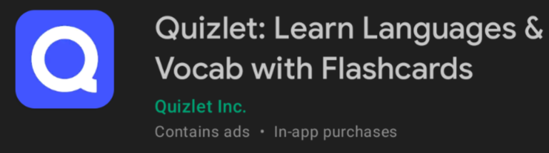
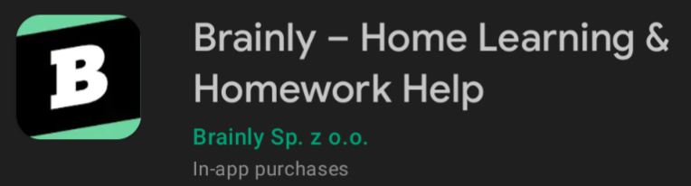
The Problem
BZ
There is currently an empty space reserved for students who could benefit from interacting with students from both within and outside of their university.
There are services that attempt to fill that space, but not to the extent that we desire.

Slide 3
The Problem
BZ
Claims to promote a student community but we were unable to reach said feature on both app and website
Has cornered themselves to really only be an online flashcard service, does not provide much more features in regards to resources
Provides tutors and Q&As, but lacks a more personalized community conversation

Slide 4

Why is this important?
CD
Many students have a hard time asking for help in person! Additionally, students taking online courses have little to no physical contact with fellow classmates or the instructor. A forum space where one can ask questions and interact with peers with less pressure is invaluable for any student.

Slide 5
The Solution
CD
We will provide students with a space to communicate with peers, get valuable resources, learn, and collaborate. Students will be able to meet with fellow classmates and interact with those who have taken the class before.

Slide 6




Technologies
BZ
Android Studio is very useful for developing apps for android devices like we will be doing and has a lot of useful documentation and guides online
GitHub is more user-friendly than something like Mercurial and makes collaboration in a group project easy
Material Design and Figma are both invaluable resources for mobile app development. They have many useful sources for designing smooth and sophisticated looking mobile apps

Slide 7
Our Plans
Schedule for the rest of the semester
Mid October
Mid November
Start of November
Start of December
BZ
Create a frame/ structure for the app’s design, implement initial navigation
Begin receiving feedback from testers and improve app accordingly
Oct | Nov | Dec
Begin to add more functional code, improve and expand design
Continue adding functionality, finish polishing up app

Slide 8
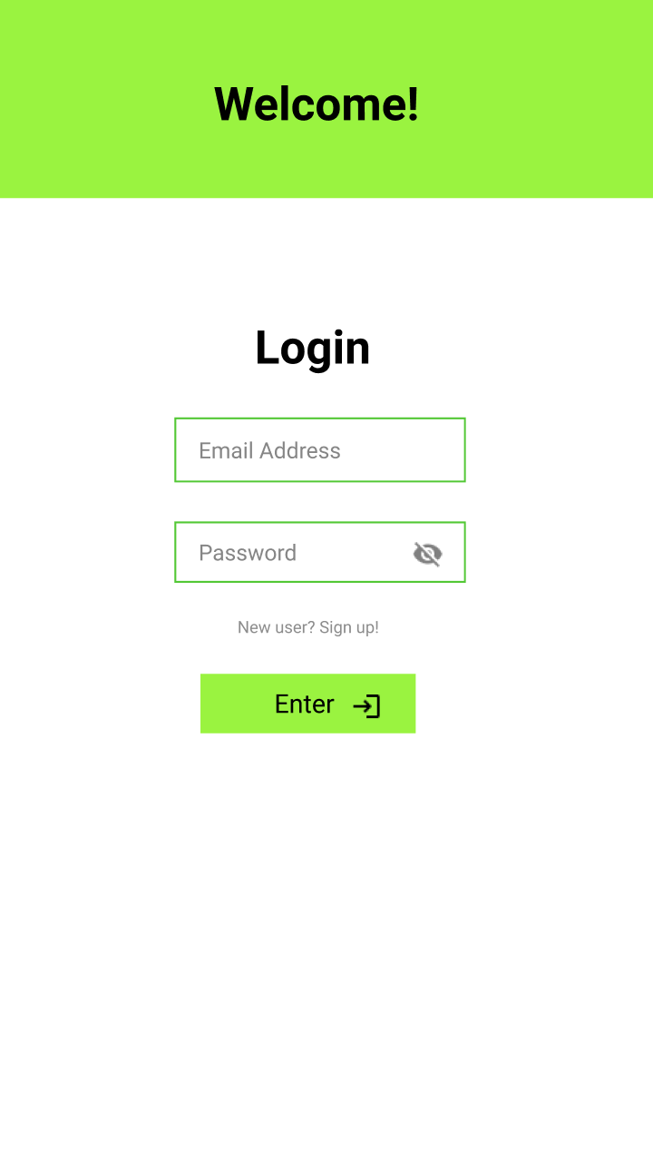
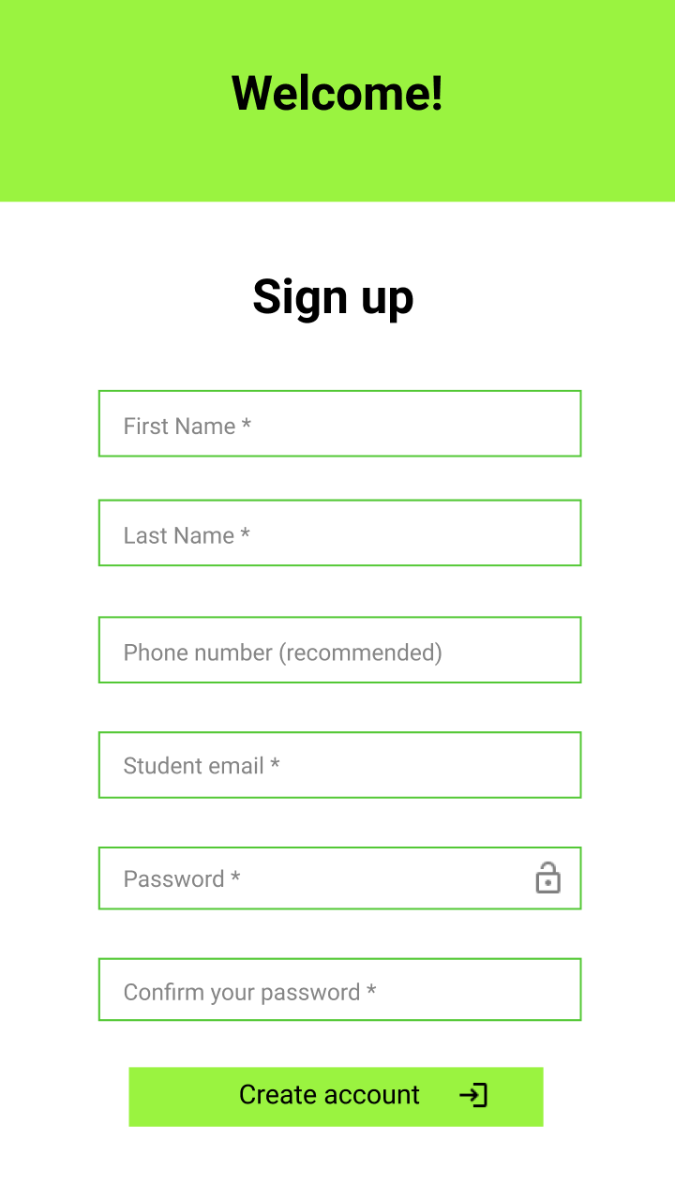
Mock Ups - Login And Sign Up Pages
CD

Slide 9
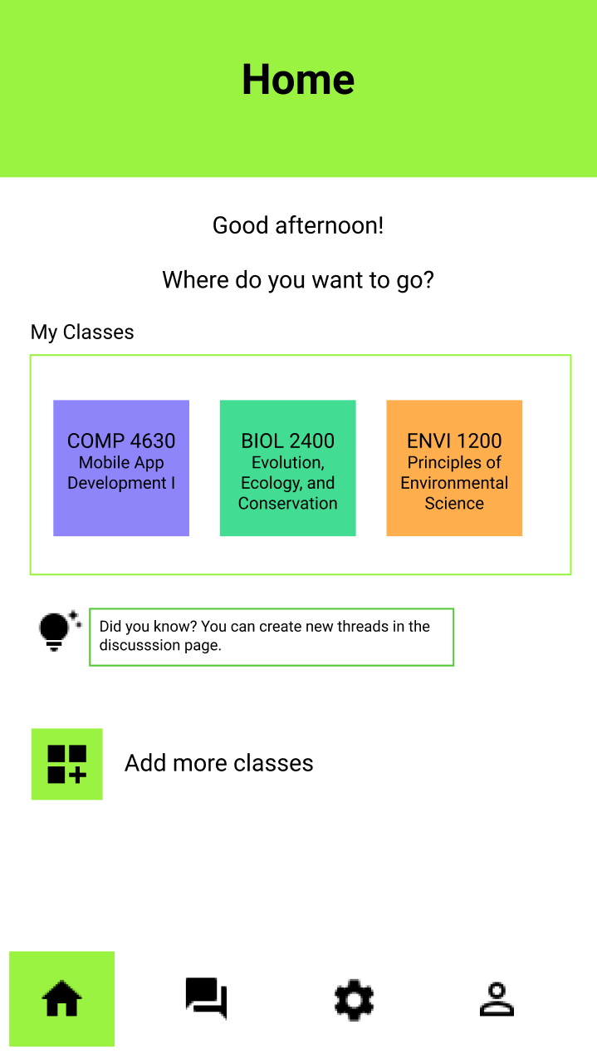
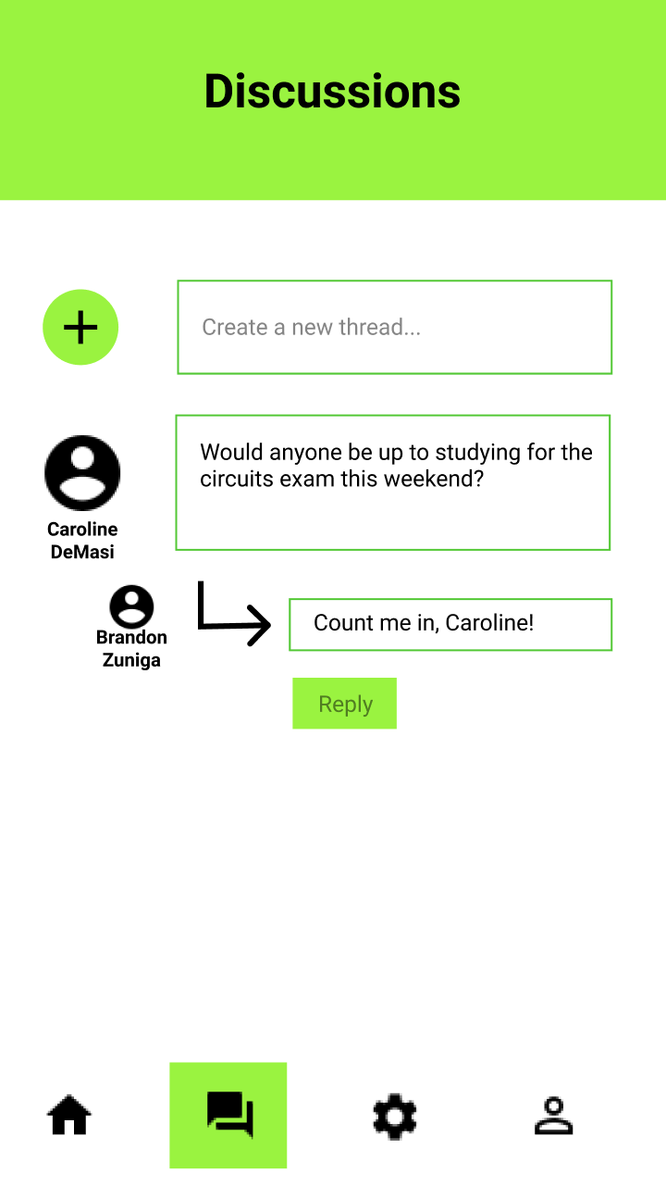
Mock Ups - Home and Discussion Pages
CD

