Slide 1
Improving Movement Direction of a road user using Compass Bearing and Orientation
Project Work
By
Vineela Pulagura
Supervised by
Mr. Johann Götz
20-05-2022

Slide 2
Outline
Introduction
Sensors
Application Specifications
Raw Measurements
Orientation Sensor
SOMDA
Orientation method
Fused Orientation
Comparison of Orientation sensor and Fused Orientation approach
Conclusion and Future Works

Slide 3
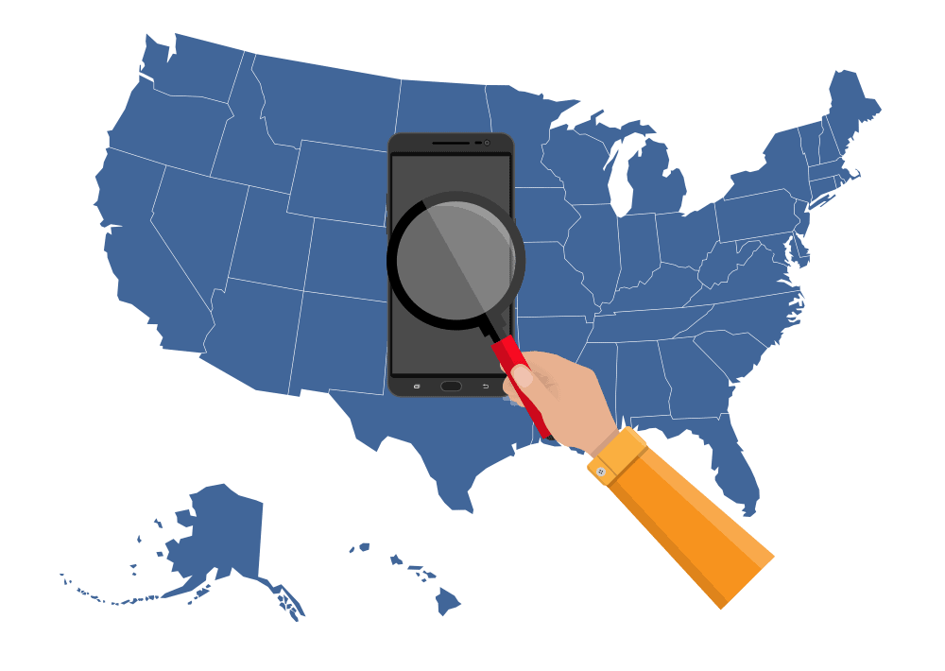
Introduction
Around 6.64 billion as of March 2022 [1].
Characteristics
Low cost
Small size
Portability
Embedded with sensors
Applications
Human activity recognition
Indoor and outdoor navigation
Augmented reality
Pedestrian collision avoidance
Fig1. Smartphones around the world [1]

Slide 4
Introduction
What is the need of movement direction detection?
Applications like pedestrian collision avoidance
Existing approaches
Global Position System (GPS) based heading estimation
Battery problem
Less accurate positioning
Movement direction estimation using visual tracking and map information
Requires the map of the location
Smartphone Orientation and Movement Direction Alignment (SOMDA)

Slide 5
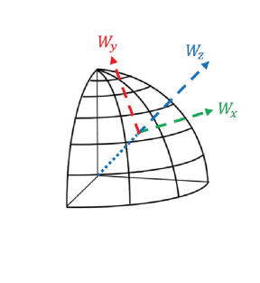
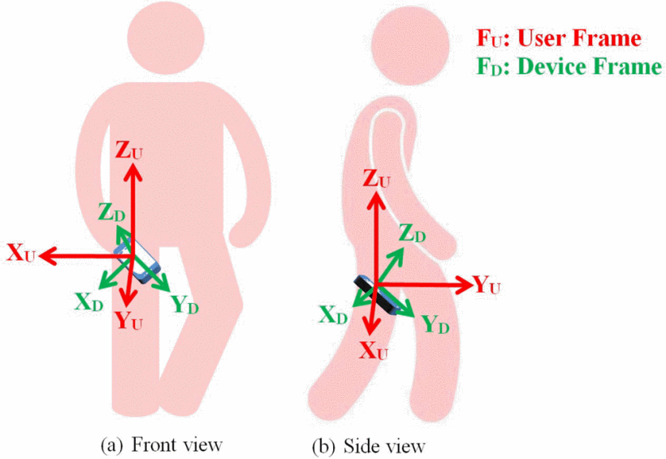
Introduction
Misalignment of user frame with the device frame
Orientation sensor deprecation
Reference Coordinate System [3]
User Frame and Device Frame [2]

Slide 6
Introduction
Goal
Improve the movement direction detection using SOMDA
Evaluation
Compare with the existing approach

Slide 7
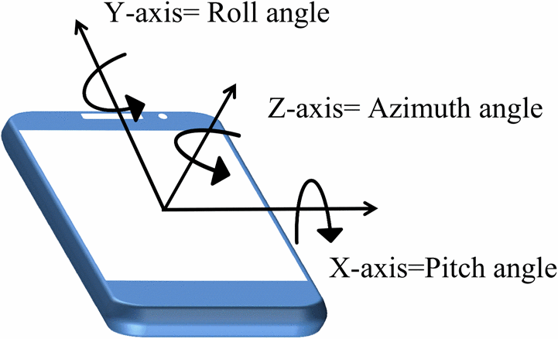
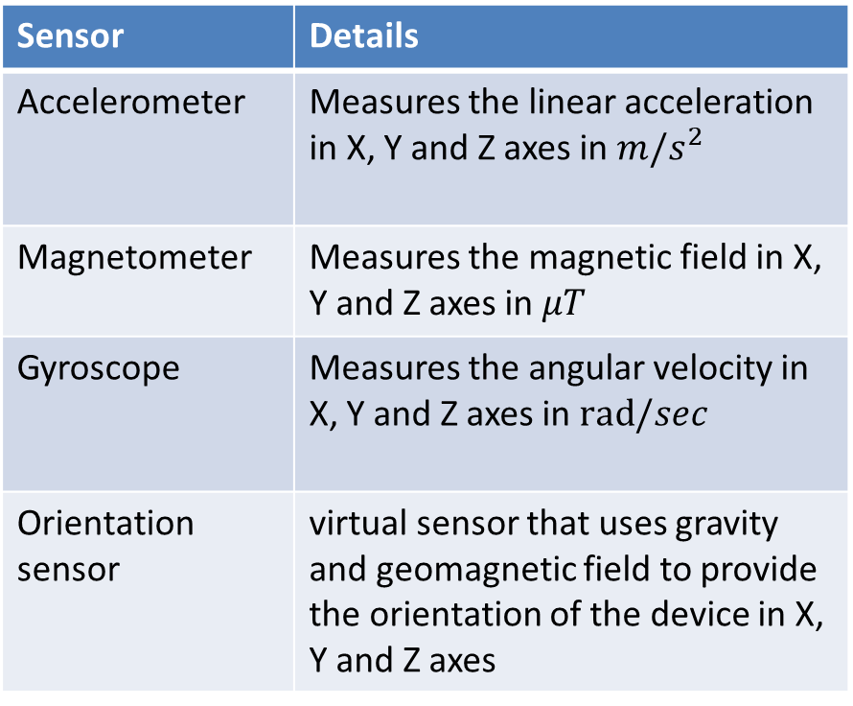
Sensors
Sensor | Details
Accelerometer | Measures the linear acceleration in X, Y and Z axes in $m/s^{2}$
Magnetometer | Measures the magnetic field in X, Y and Z axes in $μT$
Gyroscope | Measures the angular velocity in X, Y and Z axes in $rad/sec$
Orientation sensor | virtual sensor that uses gravity and geomagnetic field to provide the orientation of the device in X, Y and Z axes
Orientation Angles [2]

Slide 8
Application Specifications
Smartphone Specifications
Hardware Specifications
Orientation sensor (virtual sensor)
Tri-axial sensors
Feature | Specification
Model | Google Pixel 4a
Operating System | Android
Android Version | 12
Sensor | Specification
Accelerometer | LSM6DSR
Magnetometer | LIS2MDL
Gyroscope | LSM6DSR

Slide 9
Data Collection and Analysis
Developed an android application
Developed a function to store the data in a comma separated value format
Developed python code for plotting and evaluation

Slide 10

Raw Measurements
Data collection Specifications
Position
Trouser pocket
Shirt pocket
In hand
Distance | 100m
Sampling rate | 50Hz
Mean acceleration of one step | 1.6S
Position of the Smartphone

Slide 11
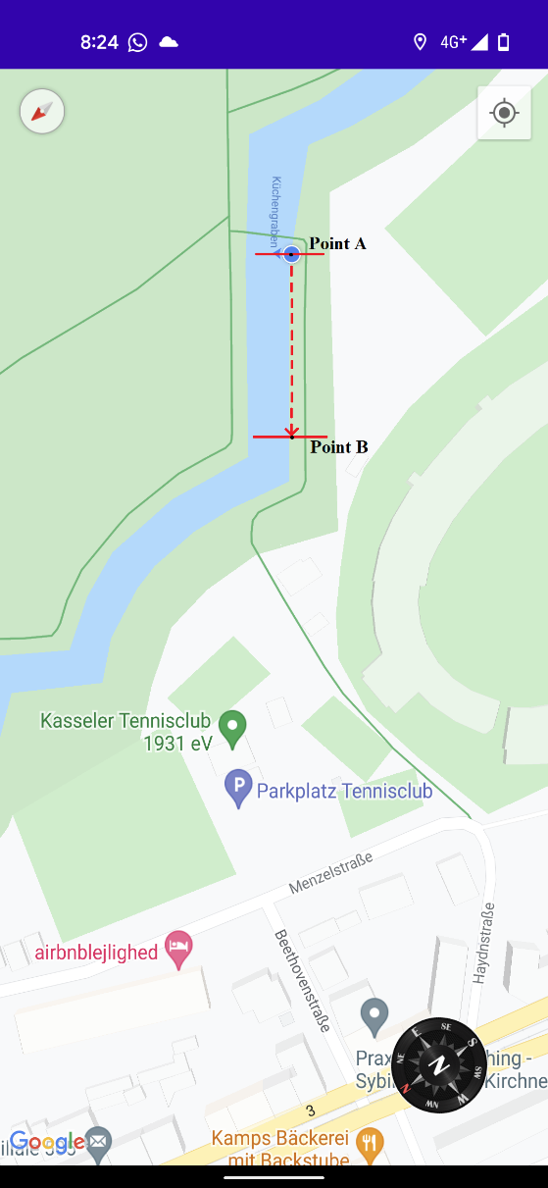
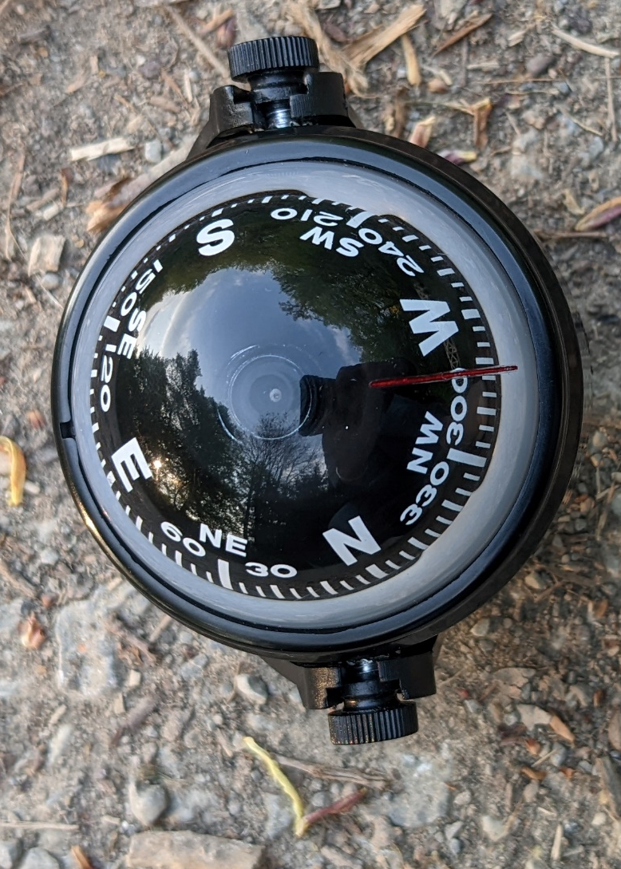
Raw Measurements
Location: Auepark near Auestadion, Angle – 290 degrees

Slide 12
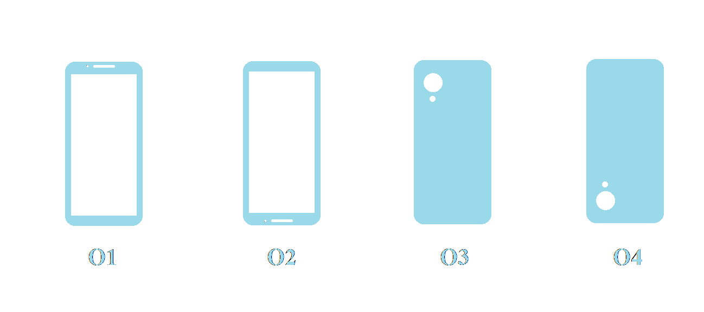
Raw Measurements
Orientation | Details
O1 | facing the screen towards the user
O2 | facing the screen towards the user and standing upside down
O3 | facing the screen away from the user
O4 | facing the screen away from the user and standing upside down
Smartphone Orientations

Slide 13
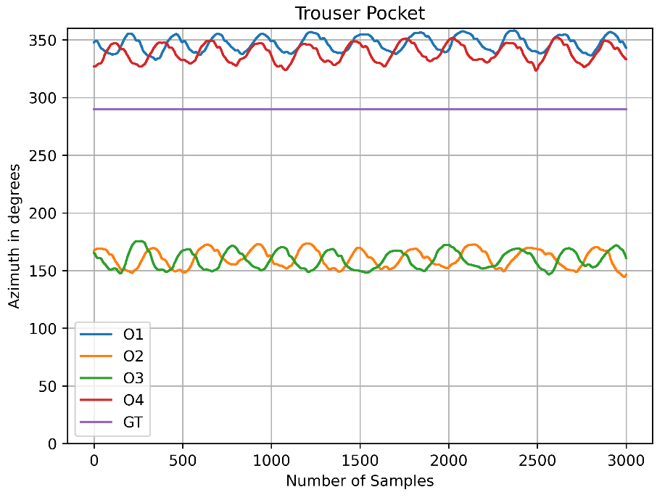
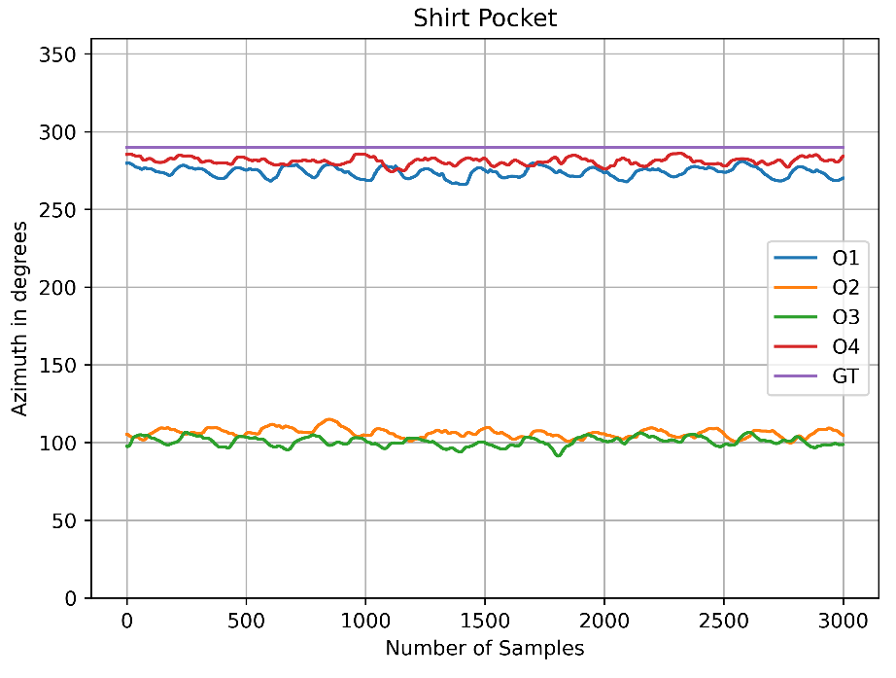
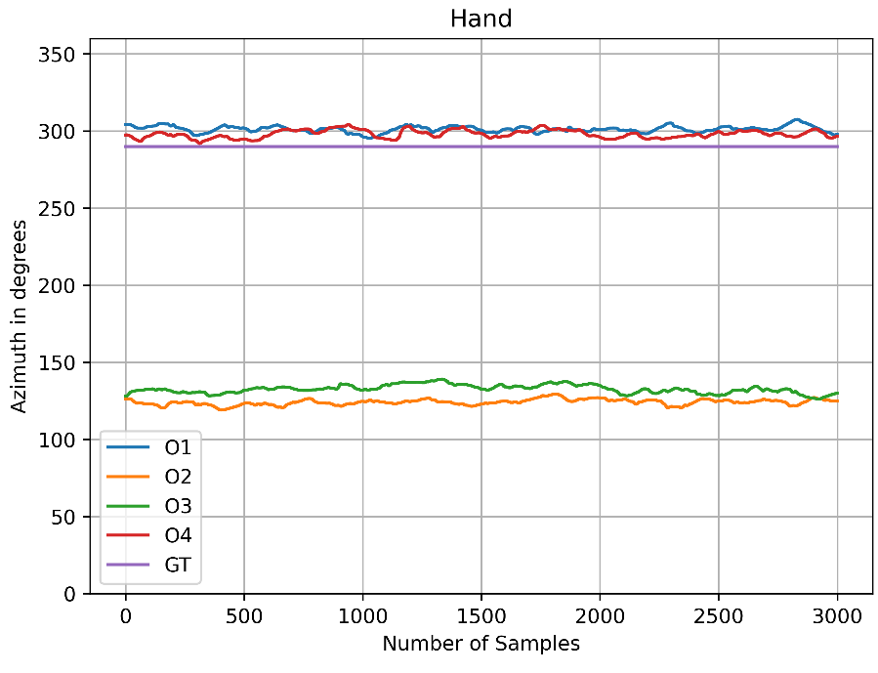
Orientation Sensor
Using virtual orientation sensor

Slide 14
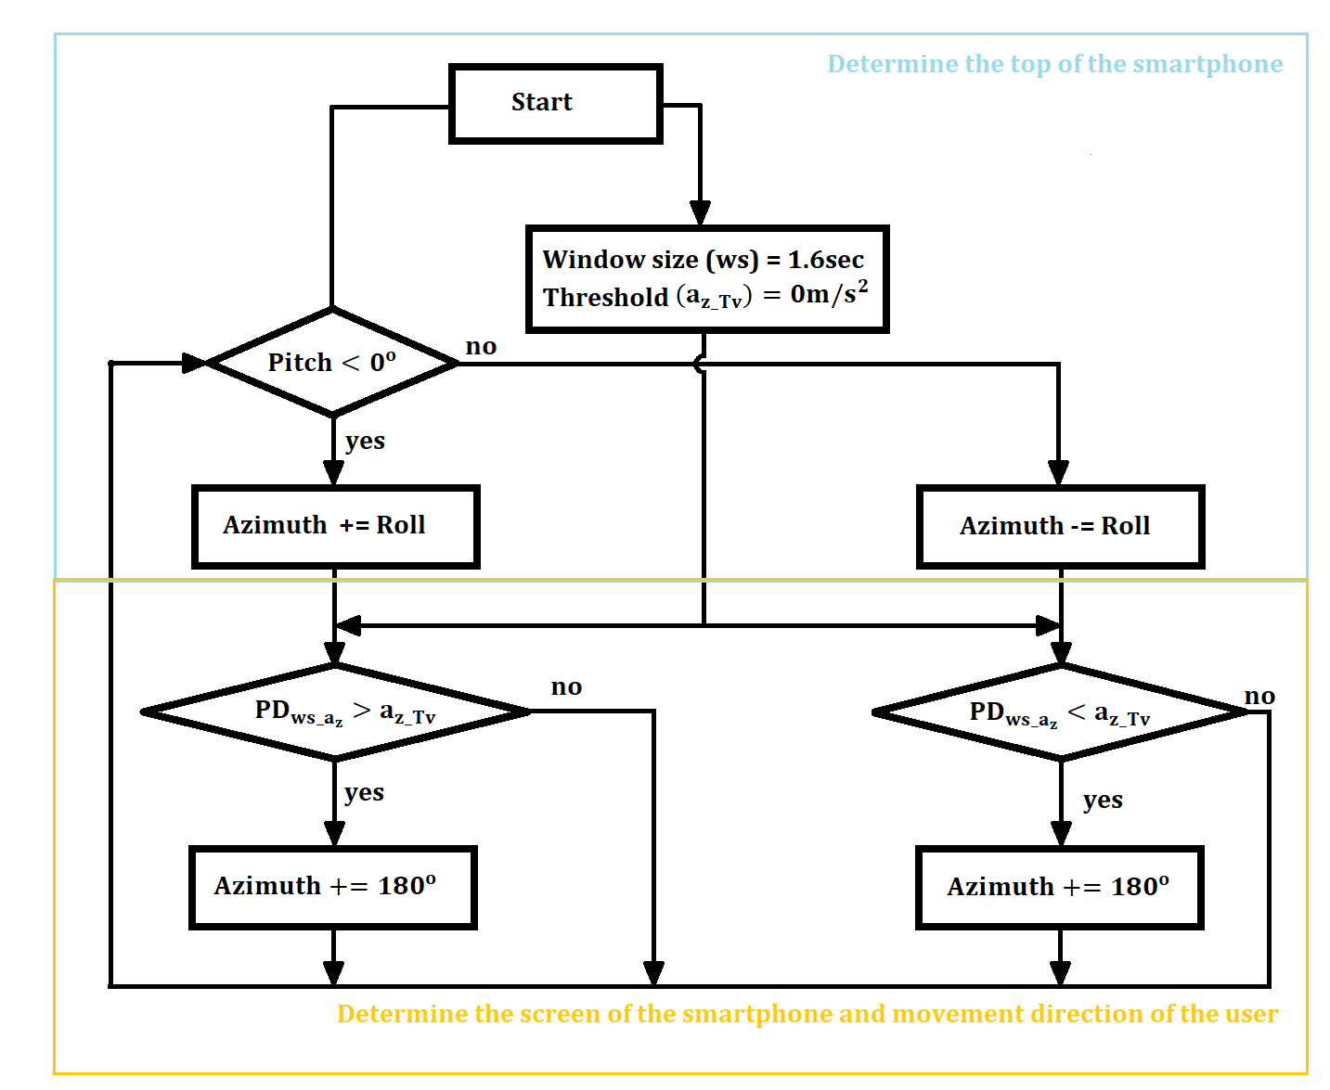
Smartphone Orientation and Movement Direction Alignment (SOMDA)
Determine the top of the smartphone
Determine the screen of the smartphone and movement direction of the user
Flowchart of SOMDA [2]

Slide 15
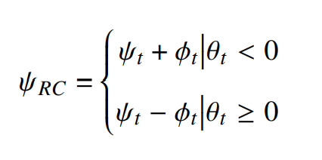



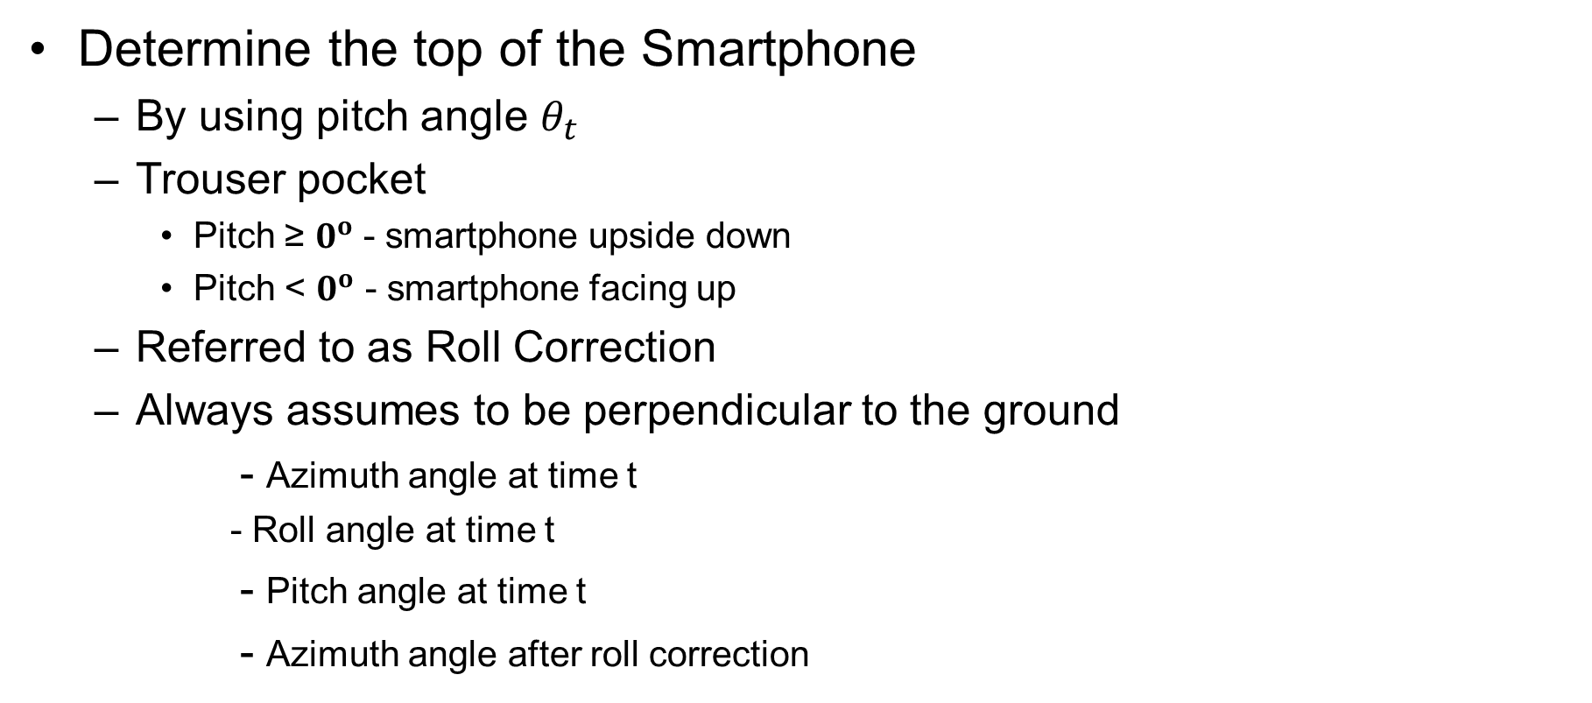
SOMDA - Trouser pocket
Determine the top of the Smartphone
By using pitch angle $θ_{t}$
Trouser pocket
Pitch ≥ $0^{o}$ - smartphone upside down
Pitch < $0^{o}$ - smartphone facing up
Referred to as Roll Correction
Always assumes to be perpendicular to the ground
- Azimuth angle at time t
- Roll angle at time t
- Pitch angle at time t
- Azimuth angle after roll correction

Slide 16
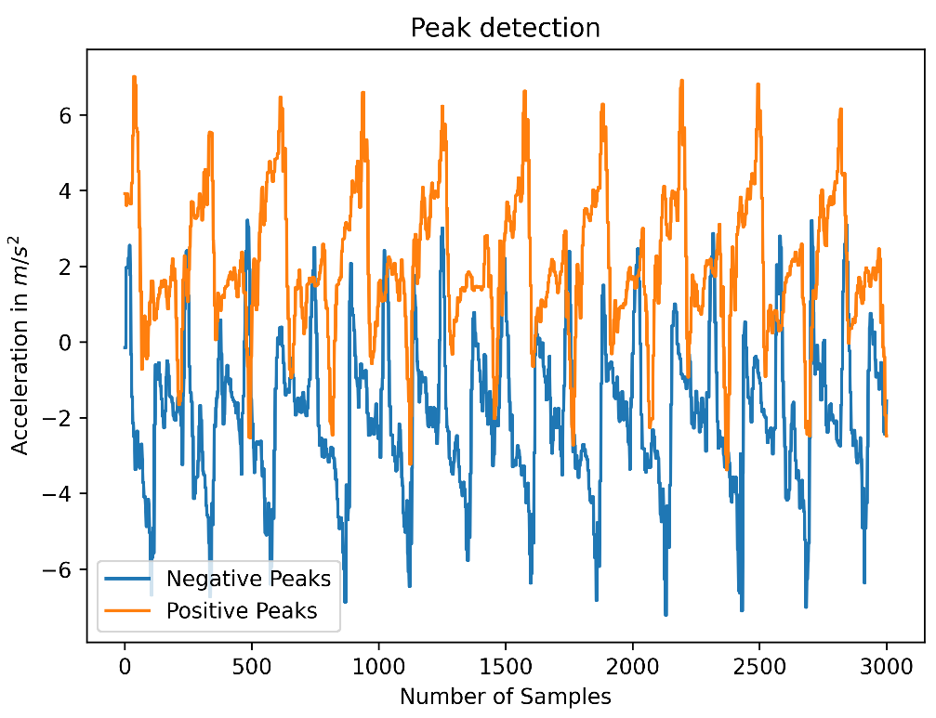
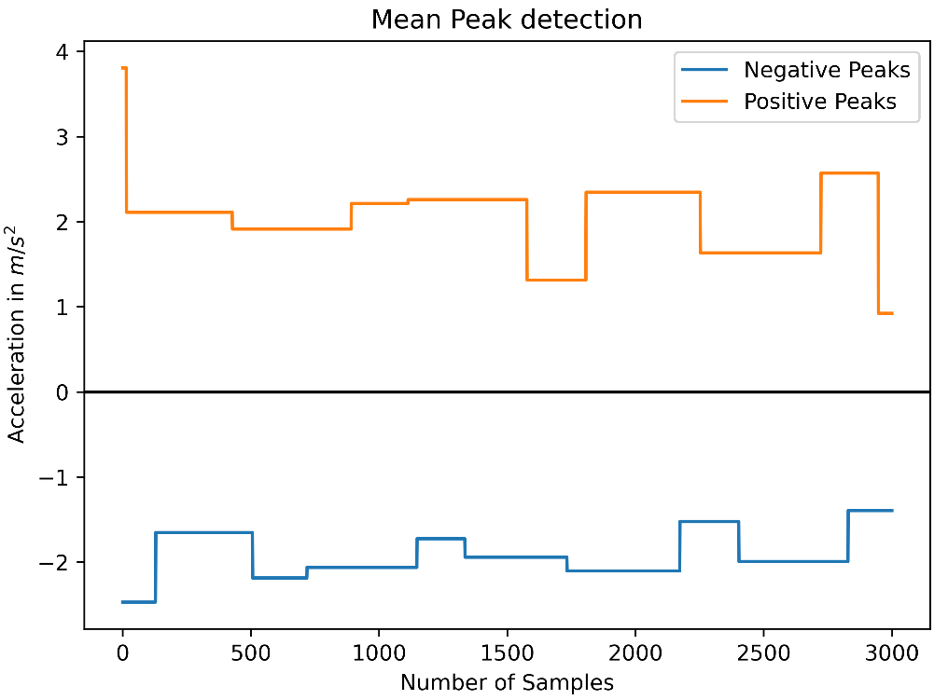

SOMDA - Trouser pocket
Determine the screen of the smartphone and movement direction of the user
By using peaks in the acceleration of the device along Z axis
Windowed peak detection of window size ws= 1.6sec
Threshold $a_{z_Tv}$ = $0m/s^{2}$

Slide 17
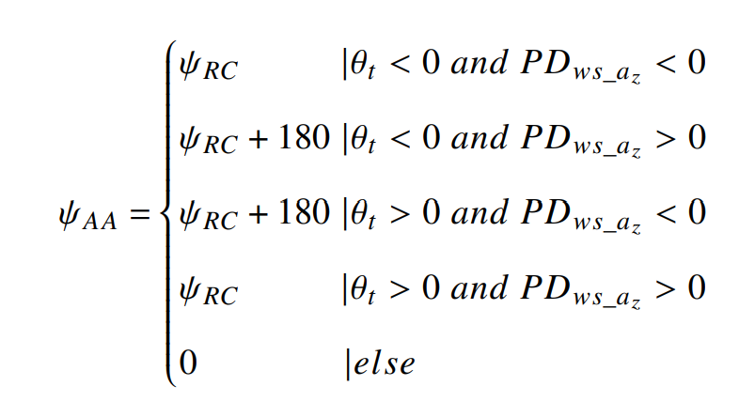

SOMDA - Trouser pocket
Determine the screen of the smartphone and movement direction of the user
SOMDA aligns the user orientation with smartphone by adding 180 degrees to azimuth angle
Information | Orientation
If the pitch angle is negative and negative peak is detected, then smartphone is facing towards the user | O1
If the pitch angle is positive and negative peak is detected, then smartphone is facing towards the user | O2
If the pitch angle is negative and positive peak is detected, then smartphone is facing away from the user | O3
If the pitch angle is positive and positive peak is detected, then smartphone is facing away the user | O4
- Compass Azimuth after smartphone orientation

Slide 18
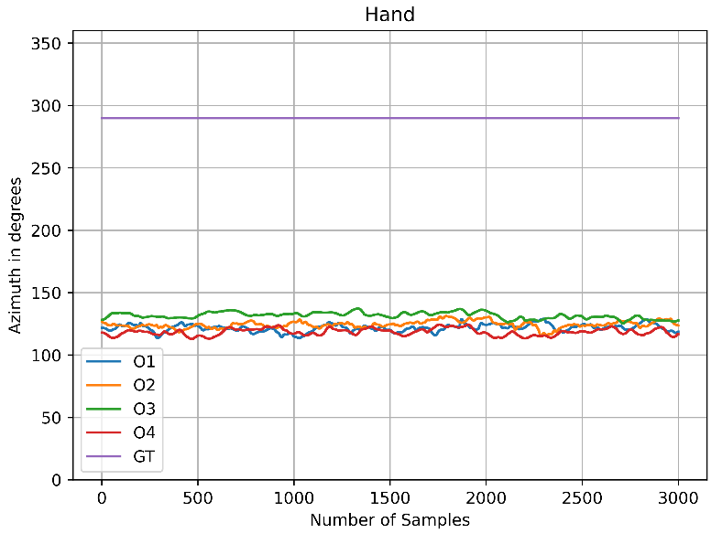
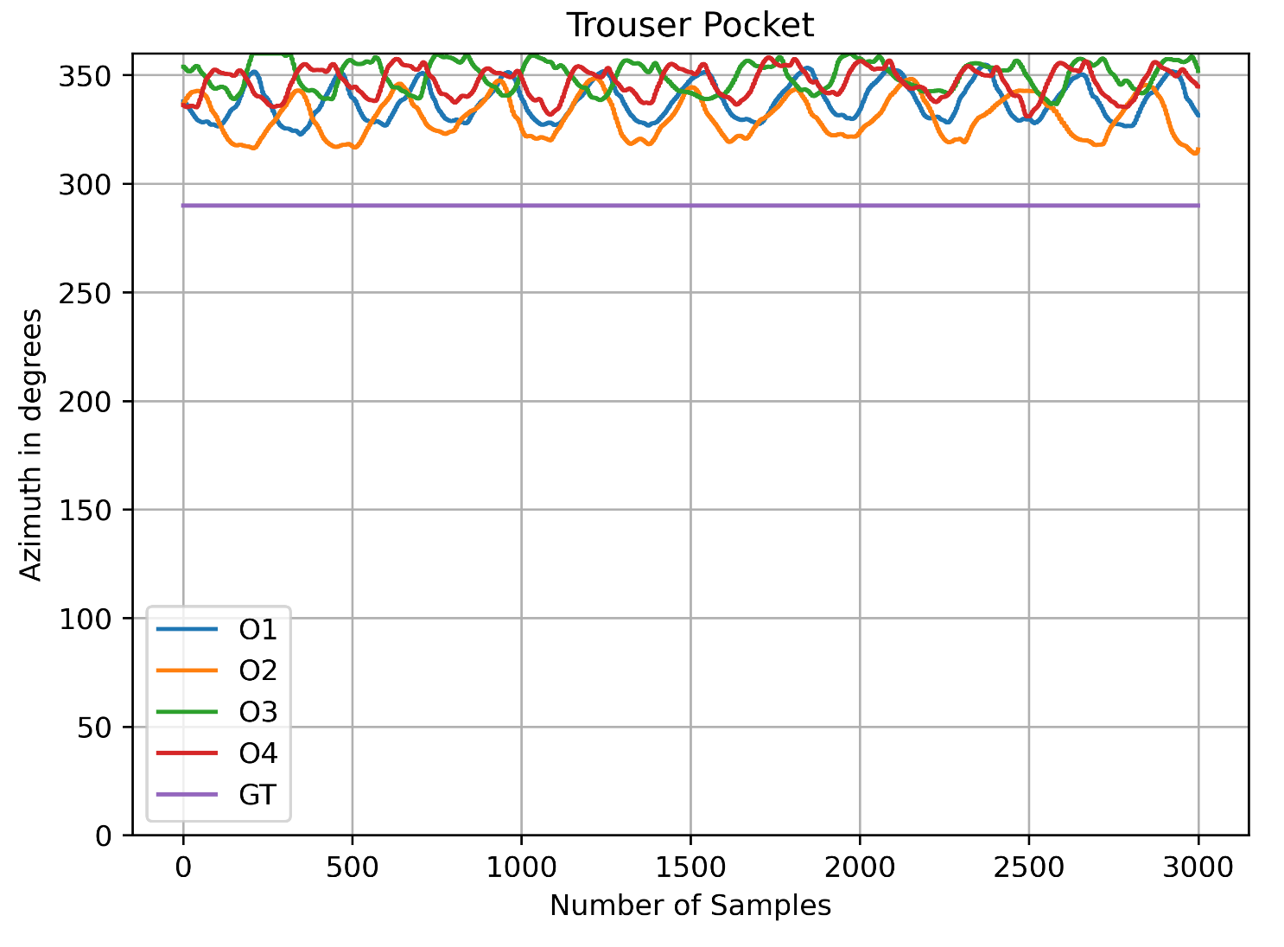
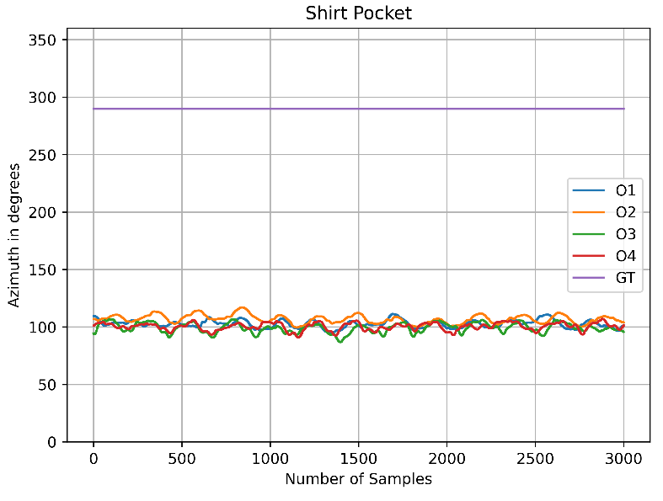
Implementing SOMDA on Orientation sensor

Slide 19
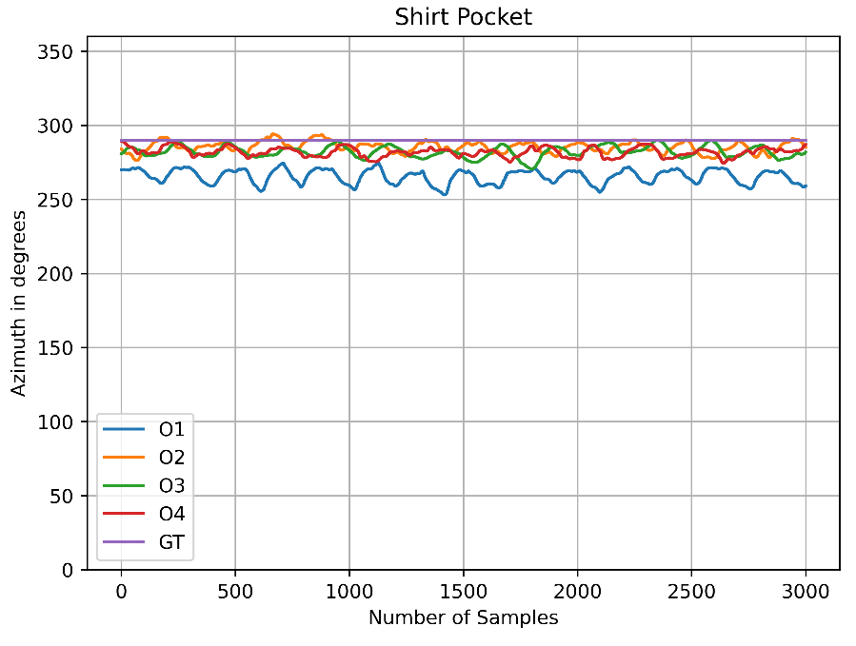
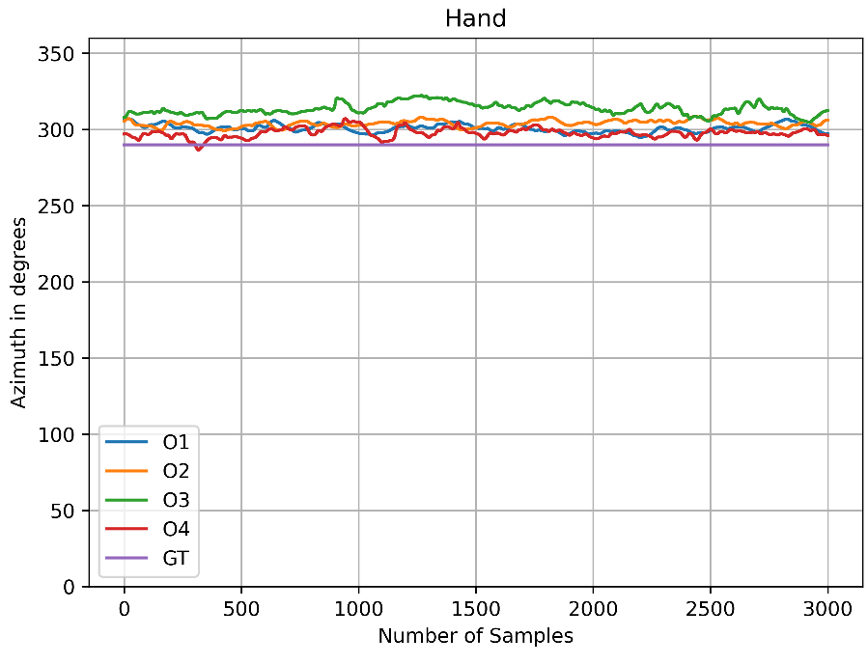
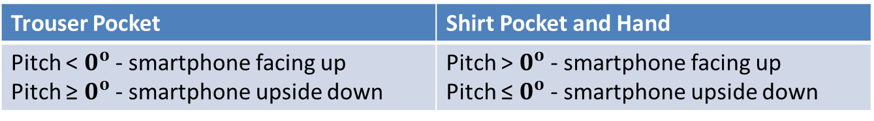
SOMDA – Shirt pocket and Hand
Shirt Pocket and Hand
Pitch angle gives negative angle as opposed to the trouser pocket position
Trouser Pocket | Shirt Pocket and Hand
Pitch < $0^{o}$ - smartphone facing up Pitch ≥ $0^{o}$ - smartphone upside down | Pitch > $0^{o}$ - smartphone facing up Pitch ≤ $0^{o}$ - smartphone upside down

Slide 20
Evaluations – Orientation sensor
 | Mean Azimuth angle in degrees
Orientation | Trouser Pocket |  | Shirt Pocket |  | Hand
 | Before SOMDA | After SOMDA | Before SOMDA | After SOMDA | Before SOMDA | After SOMDA
O1 | 345 | 334 | 274 | 266 | 301 | 301
O2 | 160 | 331 | 106 | 285 | 124 | 304
O3 | 160 | 349 | 101 | 282 | 132 | 314
O4 | 339 | 347 | 281 | 282 | 298 | 297
Max Misalignment | 185 | 18 | 180 | 19 | 177 | 17

Slide 21


Evaluations – Orientation Sensor
Accuracy evaluation – Ground Truth 290 degrees
No orientation aligned with reference for trouser pocket at tolerance ${20}^{0}$
Orientation | Accuracy Score at different tolerances with ground truth angle 290 degrees
 | Shirt Pocket |  |  |  | Hand
 | $$5^{0}$$ | $${10}^{0}$$ | $${15}^{0}$$ | $${20}^{0}$$ | $$5^{0}$$ | $${10}^{0}$$ | $${15}^{0}$$ | $${20}^{0}$$
O1 | 0 | 0 | 0 | 0.2 | 0 | 0.4 | 0.93 | 1
O2 | 0.55 | 0.93 | 1 | 1 | 0 | 0 | 0.67 | 1
O3 | 0.25 | 0.68 | 0.97 | 1 | 0 | 0 | 0 | 0.13
O4 | 0.17 | 0.72 | 0.99 | 1 | 0.2 | 0.8 | 0.98 | 1
Overall Accuracy (%) | 24.2 | 58.2 | 74 | 80 | 5 | 30 | 64.5 | 78.2

Slide 22
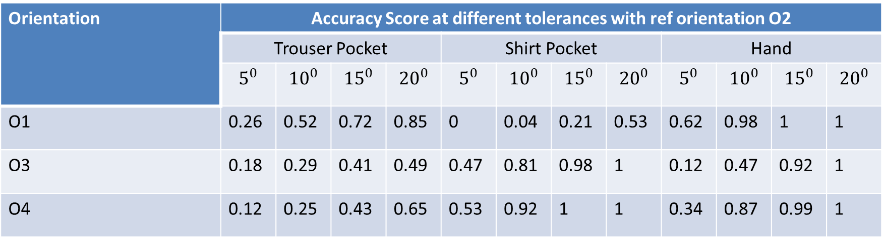
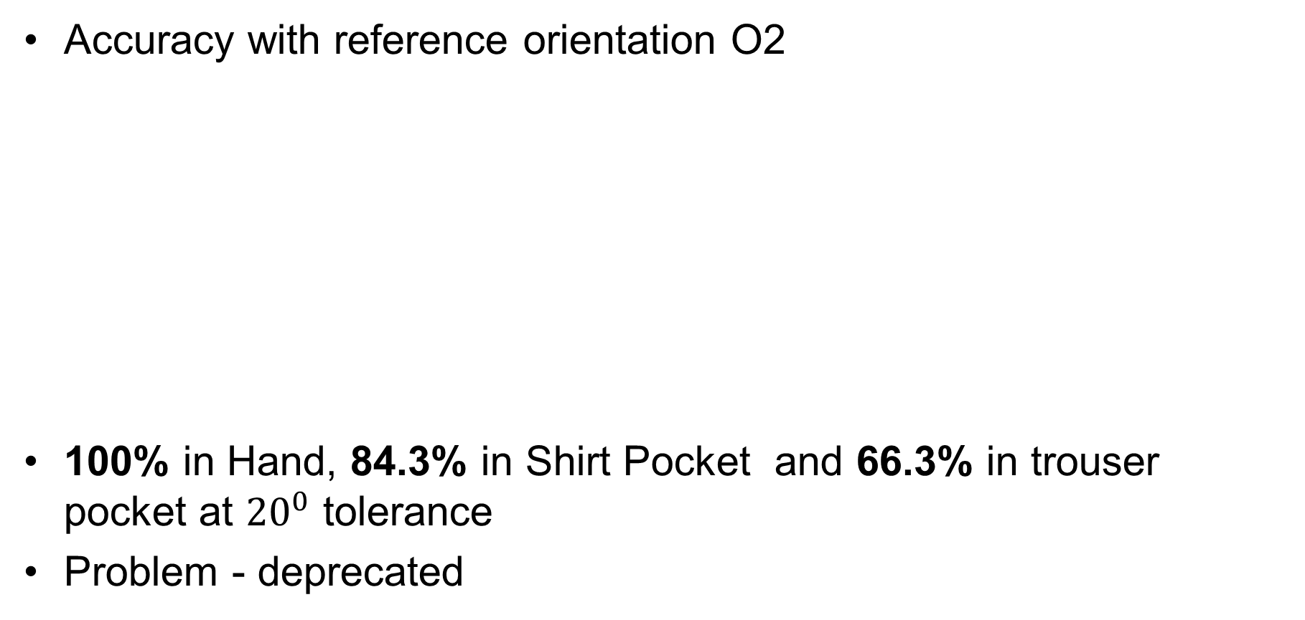
Evaluations – Orientation Sensor
Accuracy with reference orientation O2
100% in Hand, 84.3% in Shirt Pocket and 66.3% in trouser pocket at ${20}^{0}$ tolerance
Problem - deprecated
Orientation | Accuracy Score at different tolerances with ref orientation O2
 | Trouser Pocket |  |  |  | Shirt Pocket |  |  |  | Hand
 | $$5^{0}$$ | $${10}^{0}$$ | $${15}^{0}$$ | $${20}^{0}$$ | $$5^{0}$$ | $${10}^{0}$$ | $${15}^{0}$$ | $${20}^{0}$$ | $$5^{0}$$ | $${10}^{0}$$ | $${15}^{0}$$ | $${20}^{0}$$
O1 | 0.26 | 0.52 | 0.72 | 0.85 | 0 | 0.04 | 0.21 | 0.53 | 0.62 | 0.98 | 1 | 1
O3 | 0.18 | 0.29 | 0.41 | 0.49 | 0.47 | 0.81 | 0.98 | 1 | 0.12 | 0.47 | 0.92 | 1
O4 | 0.12 | 0.25 | 0.43 | 0.65 | 0.53 | 0.92 | 1 | 1 | 0.34 | 0.87 | 0.99 | 1

Slide 23
Accelerometer and Magnetometer Orientation
Using Accelerometer and Magnetometer sensors
With rotation matrix in conjunction with orientation method
Parameter | Orientation sensor | Orientation Method
Angle | Measured in degrees | Measured in radians
Azimuth | Ranges between 0 and 360 degrees North :0, South :180, East :90, West :270 | Ranges between -π to +π North :0, South :π, East :π/2, West :-π/2
Pitch | Ranges between -180 to 180 | Ranges between –π/2 to π/2
Roll | Ranges between -90 to 90 | Ranges between -π to π

Slide 24
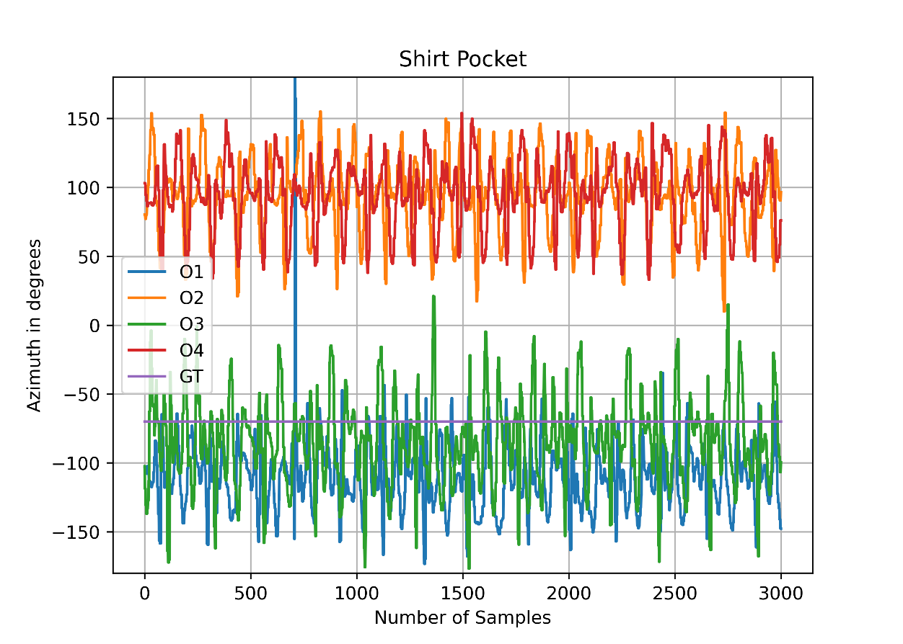
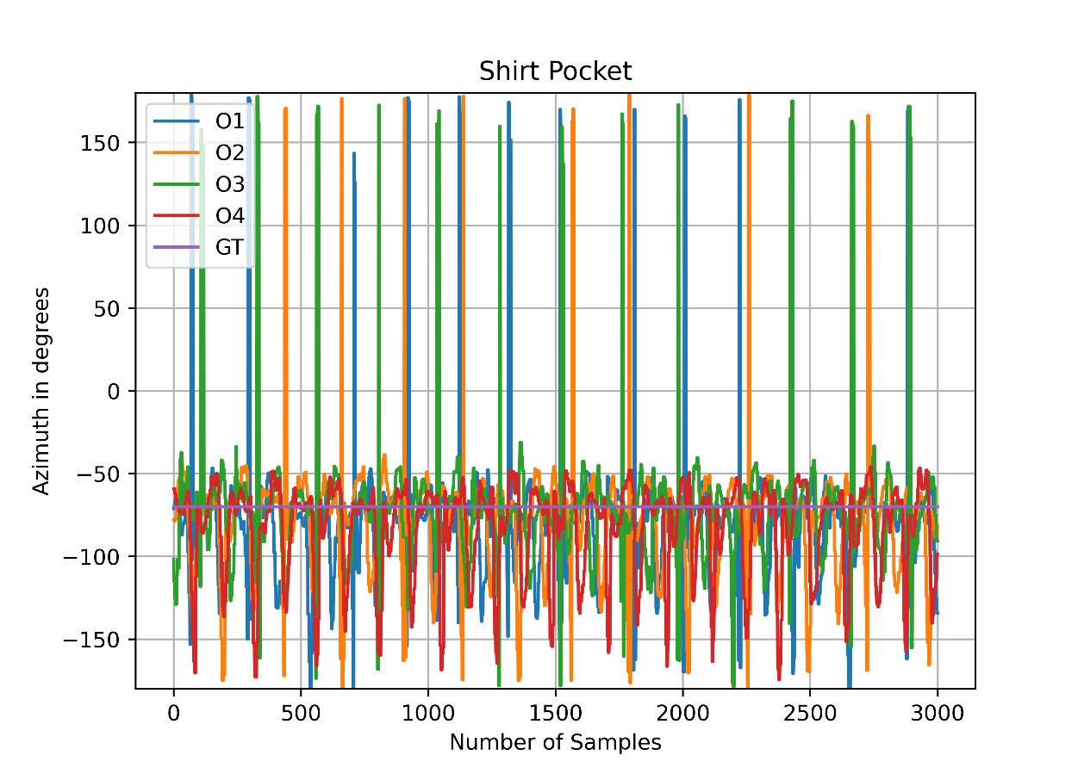
Orientation Method
Raw Measurements
A lot of noise from compass
True direction is not possible
Requires filtering

Slide 25
Fused Orientation
Gyroscope minimizes errors from accelerometer and Magnetometer
Induces drift over time
Using sensor fusion with gyroscope and orientation method
Complementary filter
High pass filtering the drift accumulated in gyroscope
Low pass filtering the accelerometer and magnetometer noise

Slide 26
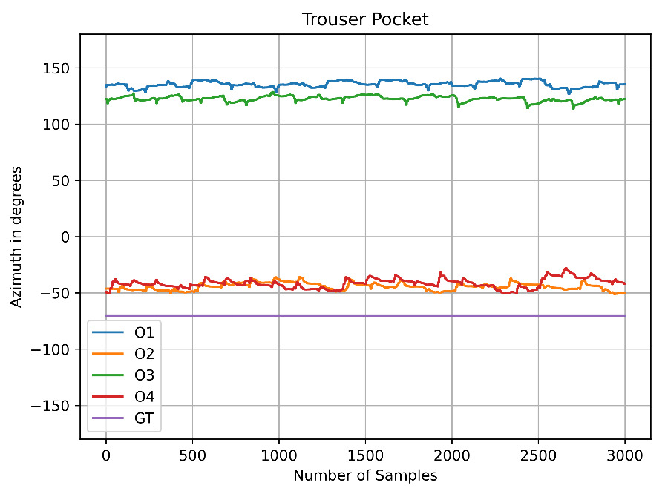
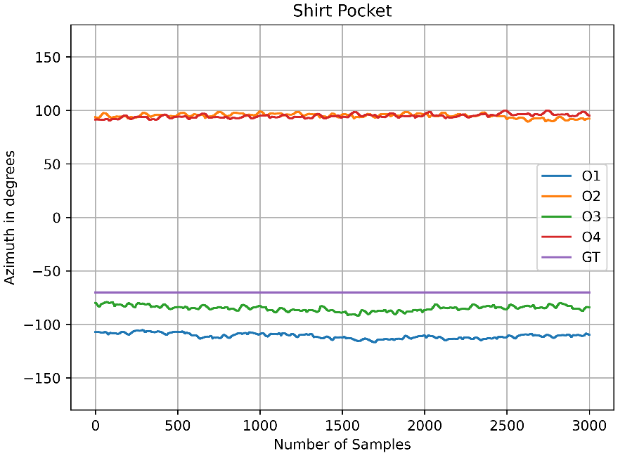
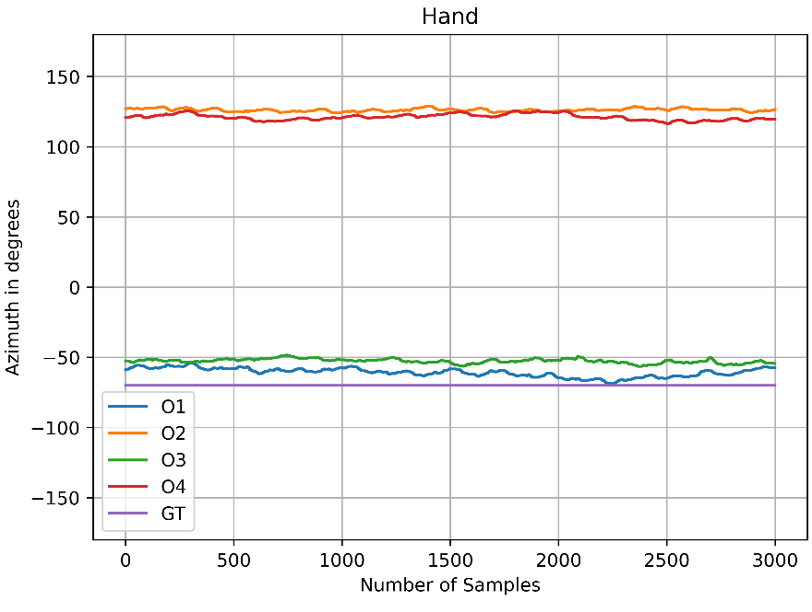
Fused Orientation
Raw Measurements

Slide 27
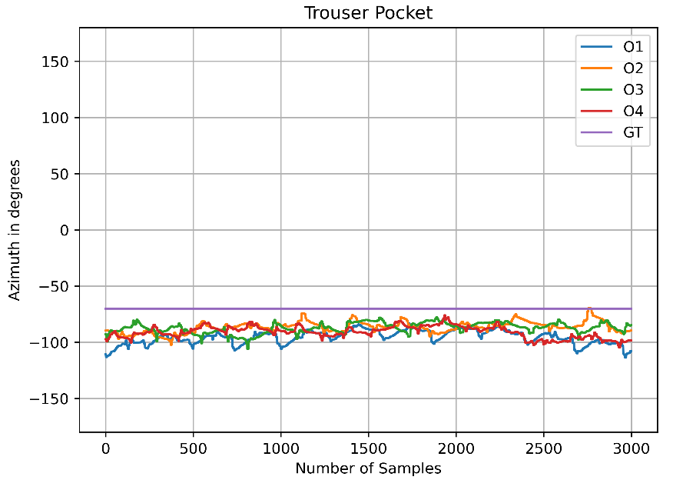
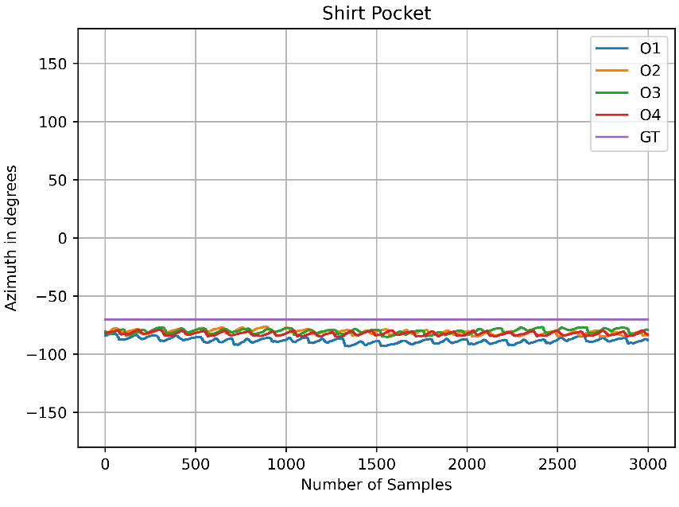
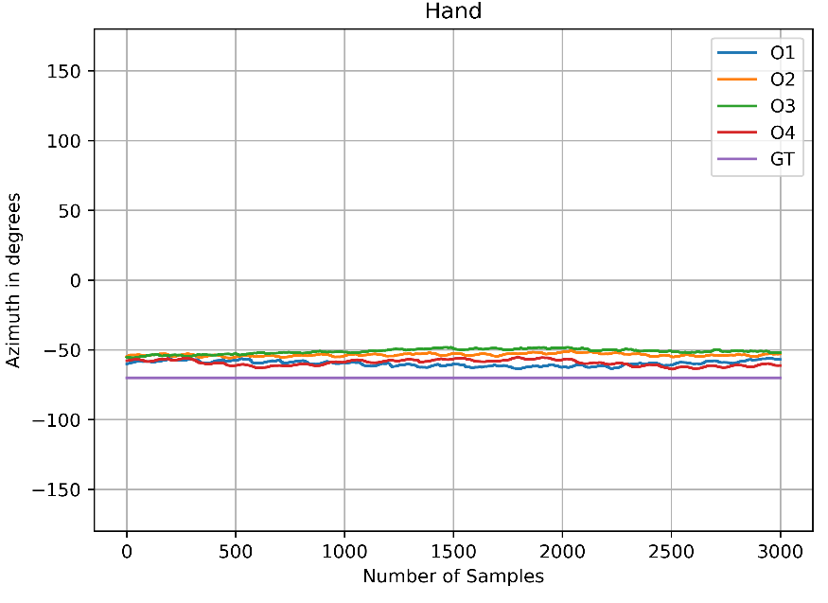
Implementing SOMDA on Fused Orientation

Slide 28
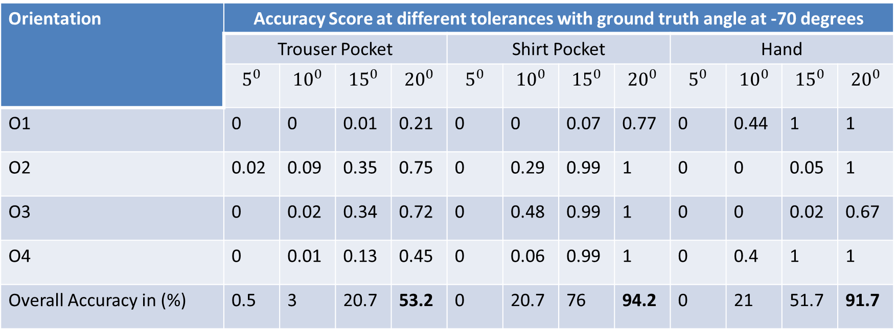
Evaluations – Fused Orientation
Accuracy evaluation
Orientation | Accuracy Score at different tolerances with ground truth angle at -70 degrees
 | Trouser Pocket |  |  |  | Shirt Pocket |  |  |  | Hand
 | $$5^{0}$$ | $${10}^{0}$$ | $${15}^{0}$$ | $${20}^{0}$$ | $$5^{0}$$ | $${10}^{0}$$ | $${15}^{0}$$ | $${20}^{0}$$ | $$5^{0}$$ | $${10}^{0}$$ | $${15}^{0}$$ | $${20}^{0}$$
O1 | 0 | 0 | 0.01 | 0.21 | 0 | 0 | 0.07 | 0.77 | 0 | 0.44 | 1 | 1
O2 | 0.02 | 0.09 | 0.35 | 0.75 | 0 | 0.29 | 0.99 | 1 | 0 | 0 | 0.05 | 1
O3 | 0 | 0.02 | 0.34 | 0.72 | 0 | 0.48 | 0.99 | 1 | 0 | 0 | 0.02 | 0.67
O4 | 0 | 0.01 | 0.13 | 0.45 | 0 | 0.06 | 0.99 | 1 | 0 | 0.4 | 1 | 1
Overall Accuracy in (%) | 0.5 | 3 | 20.7 | 53.2 | 0 | 20.7 | 76 | 94.2 | 0 | 21 | 51.7 | 91.7

Slide 29
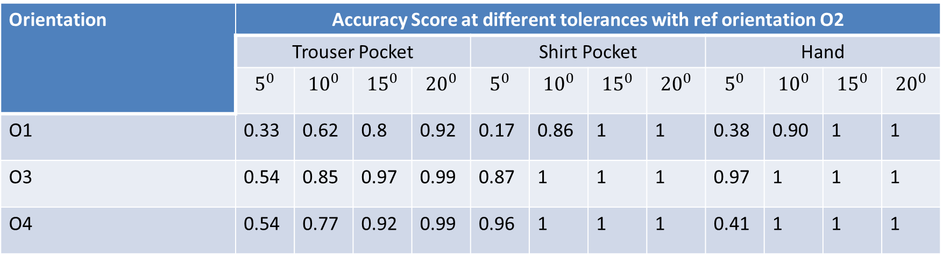

Evaluations – Fused Orientation
Accuracy with reference orientation O2
100% in Hand, 100% in Shirt Pocket and 96.6% in trouser pocket at ${20}^{0}$ tolerance
Orientation | Accuracy Score at different tolerances with ref orientation O2
 | Trouser Pocket |  |  |  | Shirt Pocket |  |  |  | Hand
 | $$5^{0}$$ | $${10}^{0}$$ | $${15}^{0}$$ | $${20}^{0}$$ | $$5^{0}$$ | $${10}^{0}$$ | $${15}^{0}$$ | $${20}^{0}$$ | $$5^{0}$$ | $${10}^{0}$$ | $${15}^{0}$$ | $${20}^{0}$$
O1 | 0.33 | 0.62 | 0.8 | 0.92 | 0.17 | 0.86 | 1 | 1 | 0.38 | 0.90 | 1 | 1
O3 | 0.54 | 0.85 | 0.97 | 0.99 | 0.87 | 1 | 1 | 1 | 0.97 | 1 | 1 | 1
O4 | 0.54 | 0.77 | 0.92 | 0.99 | 0.96 | 1 | 1 | 1 | 0.41 | 1 | 1 | 1

Slide 30
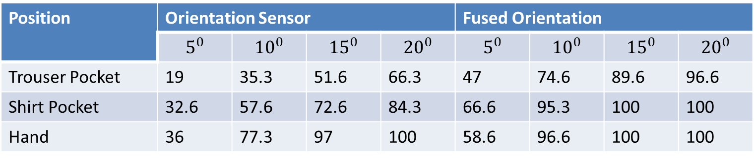
Comparison of Orientation Sensor and Fused Orientation approach
Comparing overall accuracy in percentage with reference orientation O2 for the two approaches
Position | Orientation Sensor |  |  |  | Fused Orientation
 | $$5^{0}$$ | $${10}^{0}$$ | $${15}^{0}$$ | $${20}^{0}$$ | $$5^{0}$$ | $${10}^{0}$$ | $${15}^{0}$$ | $${20}^{0}$$
Trouser Pocket | 19 | 35.3 | 51.6 | 66.3 | 47 | 74.6 | 89.6 | 96.6
Shirt Pocket | 32.6 | 57.6 | 72.6 | 84.3 | 66.6 | 95.3 | 100 | 100
Hand | 36 | 77.3 | 97 | 100 | 58.6 | 96.6 | 100 | 100

Slide 31
Conclusions & Future Work
Implemented existing orientation approach.
SOMDA implementation
Implemented new orientation approach
Comparison of the two approaches
Fused Orientation approach performing better for all the three positions
Smartphone position in hand is better, then comes the shirt pocket and least in the trouser pocket
Future work:
A way to classify the position of the smartphone
Machine Learning

Slide 32
References
[1] bankmycell.com. “HOW MANY SMARTPHONES ARE IN THE WORLD”. 2022. url: https://www.bankmycell.com/blog/how-many-phones-are-inthe-world (visited on 04/01/2022).
[2] Rico Kusber et al. “Direction Detection of Users Independent of Smartphone Orientations”. In: 2015 IEEE 82nd Vehicular Technology Conference (VTC2015- Fall). 2015, pp. 1–6. doi: 10.1109/VTCFall.2015.7390890.
[3] Takumi Matsumoto and Masahiro Fujii. “A study on estimation of traveling direction for pedestrian dead reckoning by using inertial sensors”. In: 2020 27 IEEE 9th Global Conference on Consumer Electronics (GCCE). 2020, pp. 465– 466. doi: 10.1109/GCCE50665.2020.9291953.

