Slide 1
INTRODUCING ANDROID & ANDROID STUDIO
Università di Modena e Reggio Emilia

Slide 2
Index
Android timeline
Android OS and Internal architecture
Why to choose Android?
Android Studio basic guide
Create new project
AVD manager
Graphic tool
Application structure
AndroidManifest
Java code folder
Res folder
Layout
Drawable
Values
Strings
Colors
Themes
Gradle Scripts
Build.gradle (Project: ProjectName)
Build.gradle (Module: ProjectName.app)

Slide 5
ANDROID STUDIO BASIC GUIDE
Download Android Studio: https://developer.android.com/studio
WHAT IS ANDROID STUDIO?
Android Studio is official android IDE, it’s a ‘special’ version of IntelliJ
IS THE ONLY ANDROID IDE?
No, you can use IntelliJ or Eclipse, but with Android Studio create yuor app is easier

Slide 6
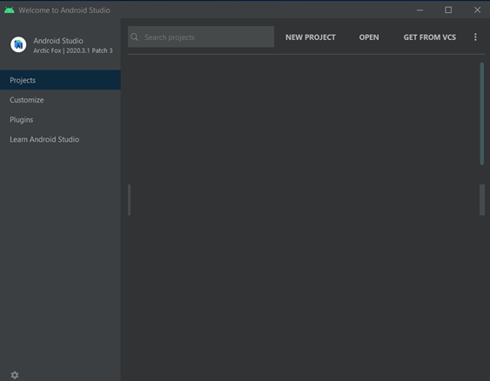
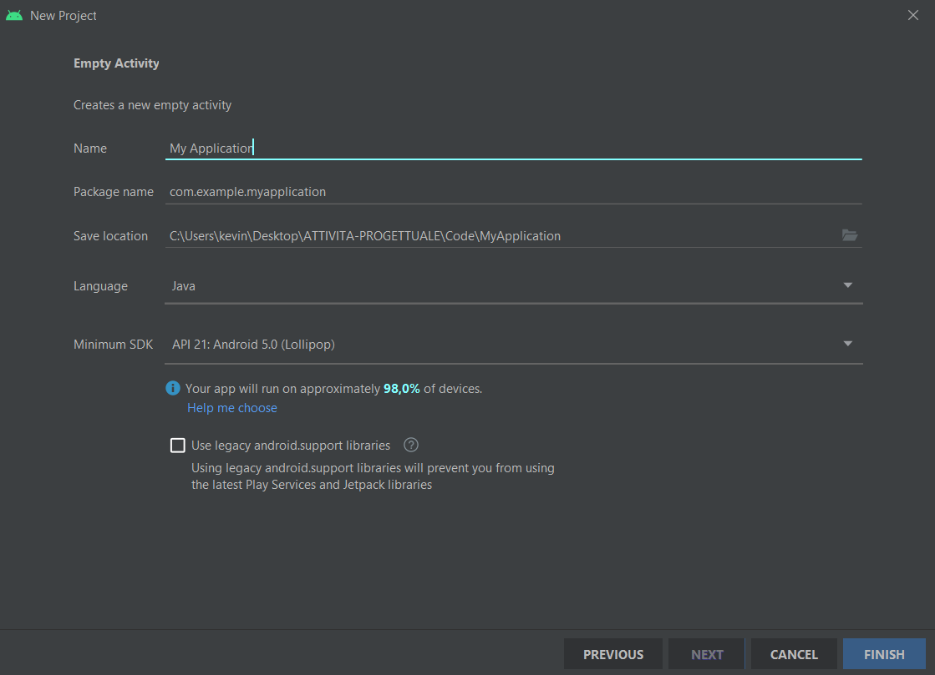
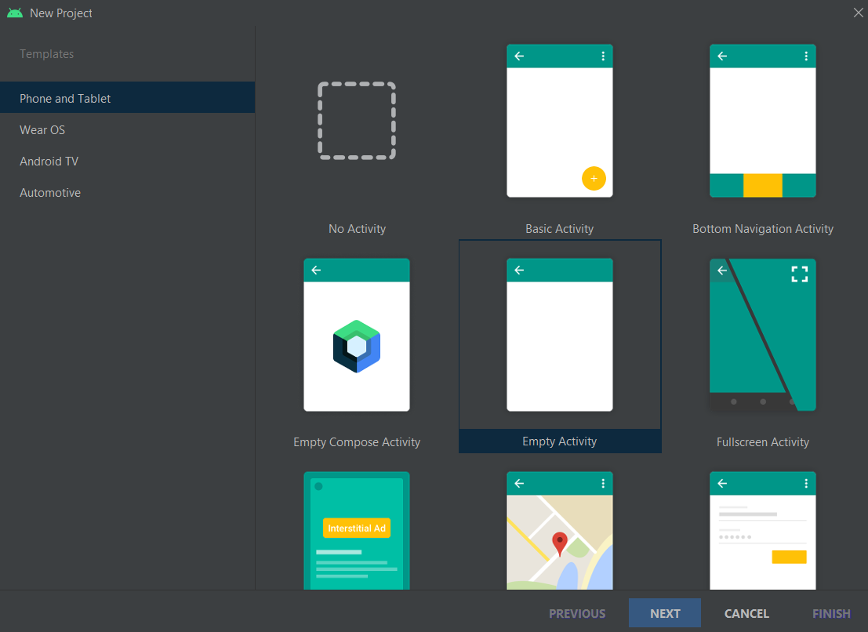

Slide 7
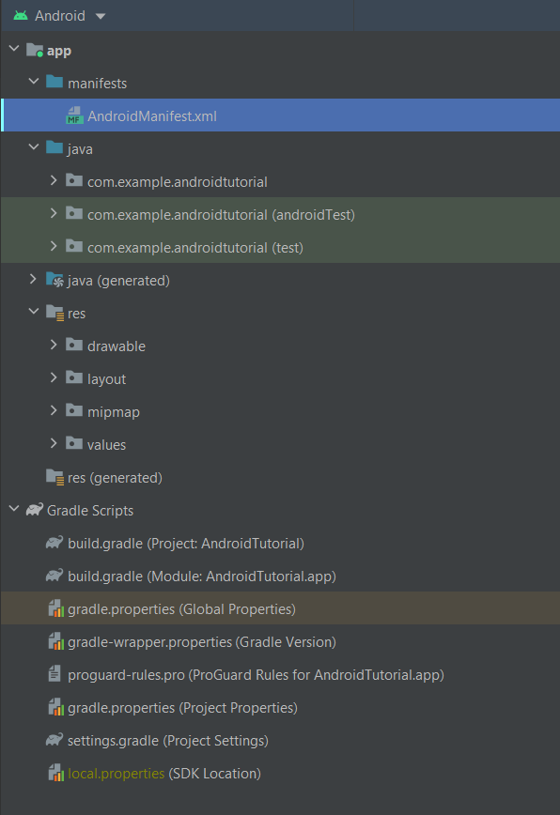
APPLICATION STRUCTURE
When you create new project, Android Studio create a new application structure for you
DON’T PANIC!
You’ll see more about that after

Slide 8

AndroidManifest.xml
Package of your app
<?xml version="1.0" encoding="utf-8"?> <manifest xmlns:android="http://schemas.android.com/apk/res/android" package="com.example.androidtutorial"> <application android:allowBackup="true" android:fullBackupOnly="true" android:icon="@mipmap/ic_launcher" android:label="@string/app_name" android:roundIcon="@mipmap/ic_launcher_round" android:supportsRtl="true" android:theme="@style/Theme.AndroidTutorial"> <activity android:name=".IntroActivity" android:exported="true"> <intent-filter> <action android:name="android.intent.action.MAIN" /> <category android:name="android.intent.category.LAUNCHER" /> </intent-filter> </activity> </application> </manifest>
App
information
App’s theme
Activity info
Lines which identify launcer activity (the first ‘page’ of your app)

Slide 9
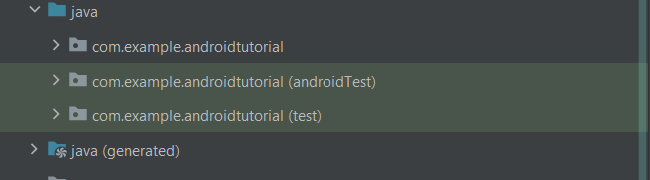

Java code folder
Where is my code?
Contains ‘’real’’ java cOde (class, interface …)

Slide 10







Res folder
Contains resources (image, string, layout, ecc…) that you could use in your app
Contains image (.png, .jpg) and more useful things
Contains layouts of your app
Contains string, colors and themes
Contains your app logo

Slide 11
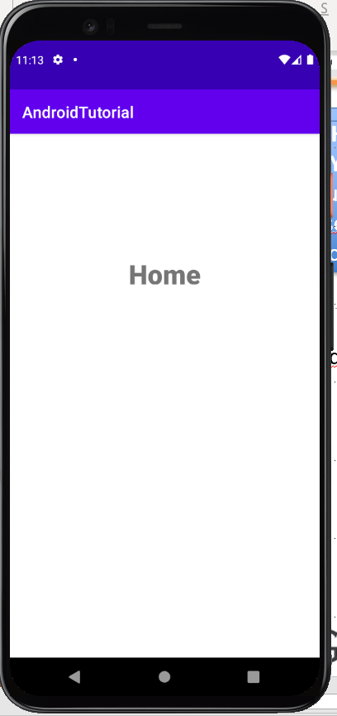



Layout folder
WHAT IS LAYOUT?
Layout is what user see on the screen
Layout type (yes there are many other different layout)
An example:
<?xml version="1.0" encoding="utf-8"?> <androidx.constraintlayout.widget.ConstraintLayout xmlns:android="http://schemas.android.com/apk/res/android" xmlns:app="http://schemas.android.com/apk/res-auto" xmlns:tools="http://schemas.android.com/tools" android:layout_width="match_parent" android:layout_height="match_parent" tools:context=".HomeActivity"> <TextView android:id="@+id/tv_title_home_activity" android:layout_width="0dp" android:layout_height="wrap_content" android:text="Home" android:textAlignment="center" android:textSize="34sp" android:textStyle="bold" app:layout_constraintBottom_toBottomOf="parent" app:layout_constraintEnd_toEndOf="parent" app:layout_constraintStart_toStartOf="parent" app:layout_constraintTop_toTopOf="parent" app:layout_constraintVertical_bias="0.25" /> </androidx.constraintlayout.widget.ConstraintLayout>
Layout dimension
Activity binded to this layout
Graphic element id
Graphic element dimension
Graphic element
Element properties
Where graphic element is placed on the screen

Slide 12
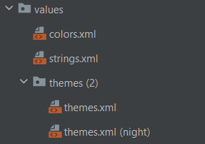




Values folder
<?xml version="1.0" encoding="utf-8"?> <resources> <color name="purple_200">#FFBB86FC</color> <color name="purple_500">#FF6200EE</color> <color name="purple_700">#FF3700B3</color> <color name="teal_200">#FF03DAC5</color> <color name="teal_700">#FF018786</color> <color name="black">#FF000000</color> <color name="white">#FFFFFFFF</color> </resources>
<resources> <string name="app_name">AndroidTutorial</string> <string-array name="week_day"> <item>Monday</item> <item>Tuesday</item> <item>Wednesday</item> <item>Thursday</item> <item>Friday</item> <item>Saturday</item> <item>Sunday</item> </string-array> </resources>
<resources xmlns:tools="http://schemas.android.com/tools"> <!-- Base application theme. --> <style name="Theme.AndroidTutorial" parent="Theme.MaterialComponents.DayNight.DarkActionBar"> <!-- Primary brand color. --> <item name="colorPrimary">@color/purple_500</item> <item name="colorPrimaryVariant">@color/purple_700</item> <item name="colorOnPrimary">@color/white</item> <!-- Secondary brand color. --> <item name="colorSecondary">@color/teal_200</item> <item name="colorSecondaryVariant">@color/teal_700</item> <item name="colorOnSecondary">@color/black</item> <!-- Status bar color. --> <item name="android:statusBarColor" tools:targetApi="l">?attr/colorPrimaryVariant</item> <!-- Customize your theme here. --> </style> </resources>

Slide 13
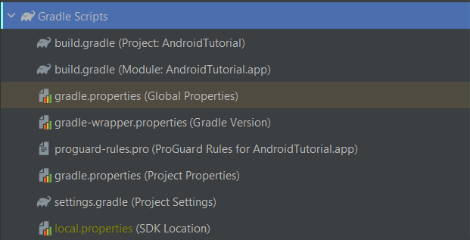


Gradle Scripts
THIS IS THE MOST IMPORTANT FILE

Slide 14
Build.gradle (Module: ProjectName.app)
plugins { id 'com.android.application' } android { compileSdk 30 defaultConfig { applicationId "com.example.androidtutorial" minSdk 21 targetSdk 30 versionCode 1 versionName "1.0" testInstrumentationRunner "androidx.test.runner.AndroidJUnitRunner" } buildTypes { release { minifyEnabled false proguardFiles getDefaultProguardFile('proguard-android-optimize.txt'), 'proguard-rules.pro' } } compileOptions { sourceCompatibility JavaVersion.VERSION_1_8 targetCompatibility JavaVersion.VERSION_1_8 } } dependencies { implementation 'androidx.appcompat:appcompat:1.3.1' implementation 'com.google.android.material:material:1.4.0' implementation 'androidx.constraintlayout:constraintlayout:2.1.1' testImplementation 'junit:junit:4.+' androidTestImplementation 'androidx.test.ext:junit:1.1.3' androidTestImplementation 'androidx.test.espresso:espresso-core:3.4.0' }
Your app id
Your app properties
Your app dependencies (third part module)

Slide 15
How to access resources?
In XML files:
@element_type/element_id
Ex: android:text=‘’@string/app_name’’
In java files:
R.id.element_id
Ex: textView.setText(R.id.app_name);

