Slide 1
outdoor
indoor
(WBGT+CAV)/RAL < 0.8
(WBGT+CAV)/RAL < 1
(WBGT+CAV)/RAL < 1.2
(WBGT+CAV)/RAL > 1.2
Small office
Large space
CAV > 0
CAV > 0
CAV > 0
Adjust clothing tips
ClimApp is designed to support appropriate thermal behavior.
The information cannot substitute for your own personal experience and using common sense.
Activity > 300W
Activity > 300W
Activity > 300W
Reschedule tips
Activity > 300W
Activity > 300W
Activity > 300W
Fan tips
WBGT: wet bulb glob temperature
CAV: clothing adjustment value
RAL: recommended alert limit
always
PHS sweat > 500g/h
PHS sweat > 500g/h
Hydration tips

Slide 2
indoor
PMV < 1
PMV < 2
PMV < 3
PMV <4
CAV > 0
CAV > 0
CAV > 0
Adjust clothing tips
ClimApp is designed to support appropriate thermal behavior.
The information cannot substitute for your own personal experience and using common sense.
Activity > 300W
Activity > 300W
Activity > 300W
Reschedule tips
Activity > 180W
Activity > 180W
Activity > 180W
Cooling vest tips
always
always
always
Fan tips
PMV: Predicted Mean Vote
always
always
always
Hydration tips

Slide 3
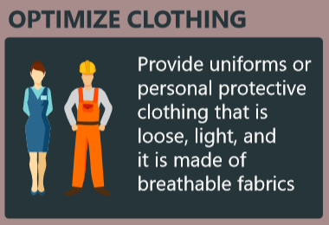
Adjust clothing tips
CAV > 0
Safe reduction in clothing insulation may lower heat stress
CAV: clothing adjustment value

Slide 4
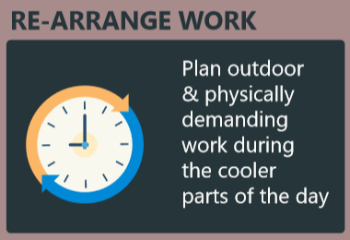
Reschedule tips
Activity > 300W
Resting may lower heat stress

Slide 5
Fan tips (outdoor)
Activity > 300W
Tair < 34°C
Increased airflow may be beneficial, even if skin is dry.
Tair < 43°C
20% <RH < 50%
Covering clothing = true
Increased airflow may be beneficial if skin is wet. Externally applied water to the skin (e.g. spray; instead of only relying on sweating) will reduce the risk of dehydration, and potentially enhance the fan benefit.
Tair < 43°C
40% <RH < 70%
Covering clothing = false
Increased airflow may be beneficial if skin is wet. Externally applied water to the skin (e.g. spray; instead of only relying on sweating) will reduce the risk of dehydration, and potentially enhance the fan benefit."
Tair < 43°C
RH < 40%
Covering clothing = false
Externally applied water to the skin (e.g. spray; instead of only relying on sweating) will reduce the risk of dehydration
Tair > 43°C
Increased airflow is not recommendend when air temperature exceeds 43°C.

Slide 6
Fan tips (indoor – small office)
always
Tair < 34°C
Increased airflow may be beneficial, even if skin is dry.
Tair < 43°C
20% <RH < 50%
Covering clothing = true
Increased airflow may be beneficial if skin is wet. Externally applied water to the skin (e.g. spray; instead of only relying on sweating) will reduce the risk of dehydration, and potentially enhance the fan benefit.
Tair < 43°C
40% <RH < 70%
Covering clothing = false
Increased airflow may be beneficial if skin is wet. Externally applied water to the skin (e.g. spray; instead of only relying on sweating) will reduce the risk of dehydration, and potentially enhance the fan benefit."
Tair < 43°C
RH < 40%
Covering clothing = false
Externally applied water to the skin (e.g. spray; instead of only relying on sweating) will reduce the risk of dehydration
Tair > 43°C
Increased airflow is not recommendend when air temperature exceeds 43°C.

Slide 7
Fan tips (indoor – large area)
always
Tair < 34°C
Increased airflow may be beneficial, even if skin is dry.
Tair < 43°C
20% <RH < 50%
Covering clothing = true
Increased airflow may be beneficial if skin is wet. Externally applied water to the skin (e.g. spray; instead of only relying on sweating) will reduce the risk of dehydration, and potentially enhance the fan benefit.
Tair < 43°C
40% <RH < 70%
Covering clothing = false
Increased airflow may be beneficial if skin is wet. Externally applied water to the skin (e.g. spray; instead of only relying on sweating) will reduce the risk of dehydration, and potentially enhance the fan benefit."
Tair < 43°C
RH < 40%
Covering clothing = false
Externally applied water to the skin (e.g. spray; instead of only relying on sweating) will reduce the risk of dehydration
Tair > 43°C
Increased airflow is not recommendend when air temperature exceeds 43°C.

Slide 8
Cooling vest tips
always
PMV < 2
High temperature phase change material (between 21°C and 24°C) may improve your comfort and lower skin temperature but will not affect core temperature
(WBGTindoor+CAV)/RAL > 1
Low temperature phase change material (between 6°C and 18°C) may be used to cool down during short breaks
A ventilated vest may be beneficial to increase the work time ->depends highly on the environmental conditions, activity level and clothing

Slide 9
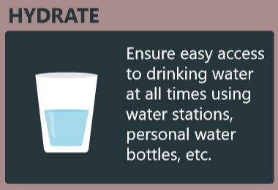
Hydration tips
Always
PHS sweat > 500g/h
Be aware to compensate your sweat loss.

