Slide 1
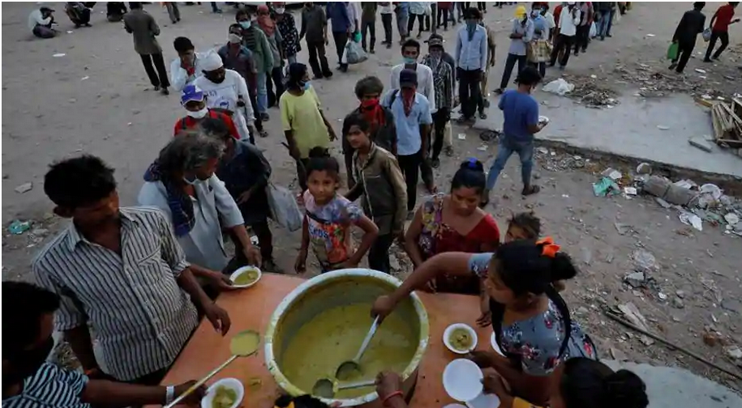
Food4Cause
Shivangi Upadhyay/India/IBM
Paridhi Agarwal2/India/IBM
Karthika M Nair/India/IBM

Slide 2
Problem Statement
Millions of workers have fled from large towns and cities after they lost their jobs during the lockdown. The local governments may be rolling out broad programs. Despite the claims of the administration,
ration and community kitchen meals are still not reaching those that need them the most.
The cooperation at the local level is usually the most effective way of getting help. In the current crisis, we have seen shortages of food, medicines, cloths and other supplies. As a solution we thought of a mobile application to coordinate residential association and voluntary organization .If they can provide food, supplies, medicines, or other essentials, they can use the mobile application and fill out a brief form that indicates what they are willing to donate and available quantities along with the location. This information is then stored in the IBM Cloud database.
A Recipient or Volunteer, who is in need of food, supplies or other essentials, can enter the details of the items in the mobile app. The mobile application will do an internal search and match the items already available in the donors list based on the location and send the notification to the donors.
If the donor or association accepts the request they can collect the items and deliver it to a common point(If its an apartment near the security gate) and update details in mobile app. The app then notify this details to the recipient /volunteer and they can collect the items from the updated location.
Notes:
W3 & Product Usage is not included in Project Opal’s scope at this time.
2

Slide 3
Solution
1) A Supplier opens the mobile application and fills out a brief form on what they can donate and there location.
2) This information is then stored in IBM Cloudant database.
3) The Recipient/Volunteer launches the mobile app and fill the form
on the requirement and the location.
4)The app tries to match the requirement against the stock based on location.
5) If the requirement matches with stock a notification will go to the supplier with the requirement.
6) If the supplier accepts the request, he can fill the details(how much he can supply, the date , location and time)
7) This information will go to the recipient as a notification.
6) The recipient can collect the items from the location on that particular time
Notes:
W3 & Product Usage is not included in Project Opal’s scope at this time.
3

Slide 4
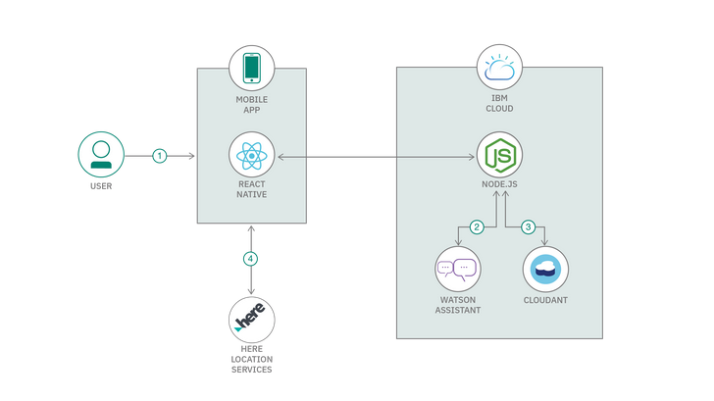
Flow
Notes:
W3 & Product Usage is not included in Project Opal’s scope at this time.
4

Slide 5
Solution Roadmap
Launch App And Market it
Extension of app in local communities and tie up with government organizations
Tie up with city taxies/swiggy for delivering it to the recipient
Notes:
W3 & Product Usage is not included in Project Opal’s scope at this time.
5

Slide 6
References
GitHub: https://github.ibm.com/kartnair/food4cause
Notes:
W3 & Product Usage is not included in Project Opal’s scope at this time.
6

Slide 7

© 2016 International Business Machines Corporation
Notes:
7

