Slide 1
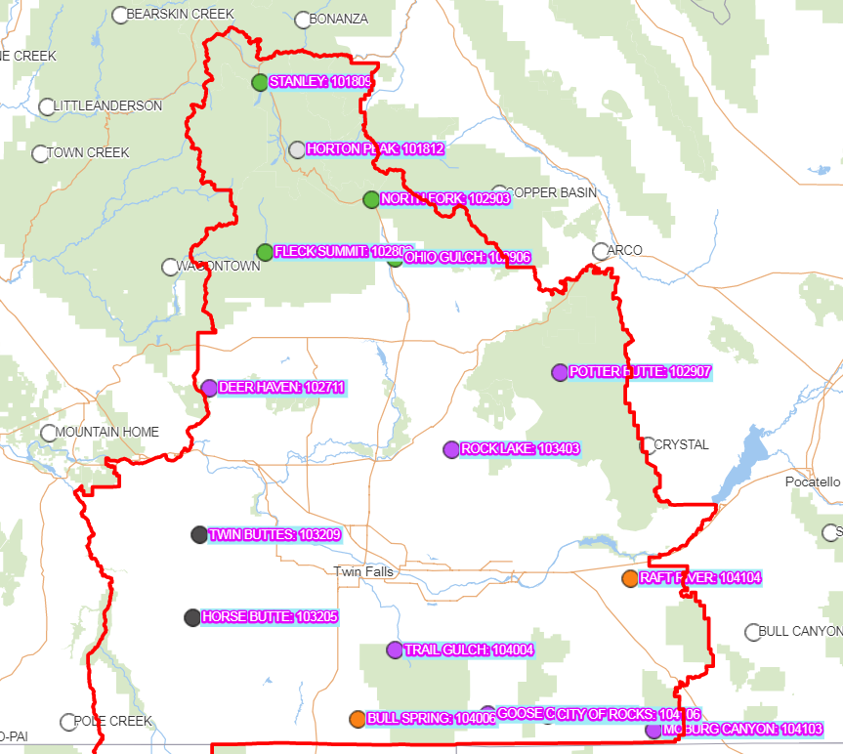
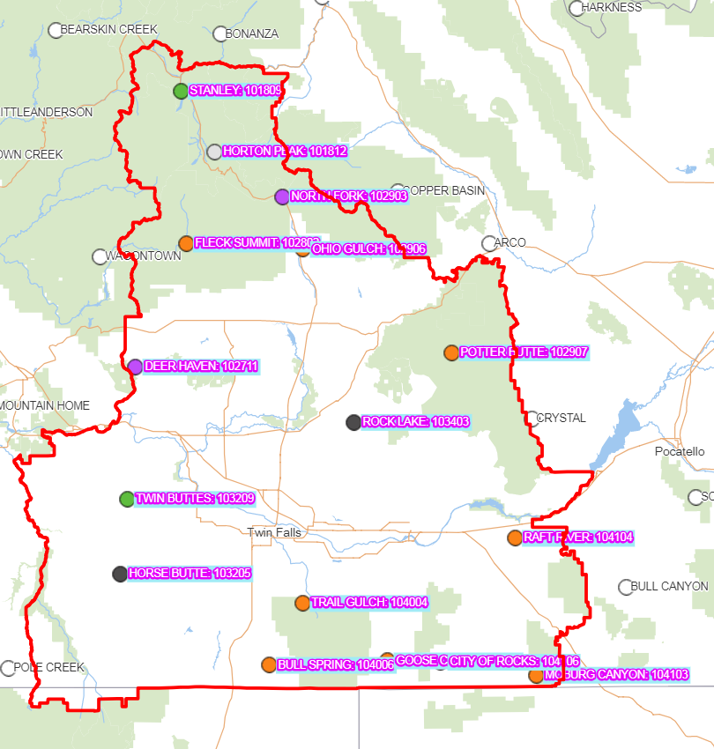
4 groups
K means w/o PCA
K means w/ PCA

Slide 2
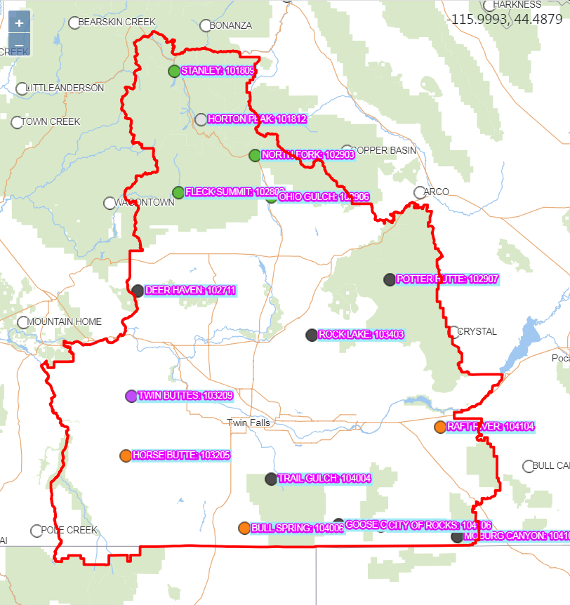
4 groups
K means w PCA unscaled
K means w/ PCA

Slide 3
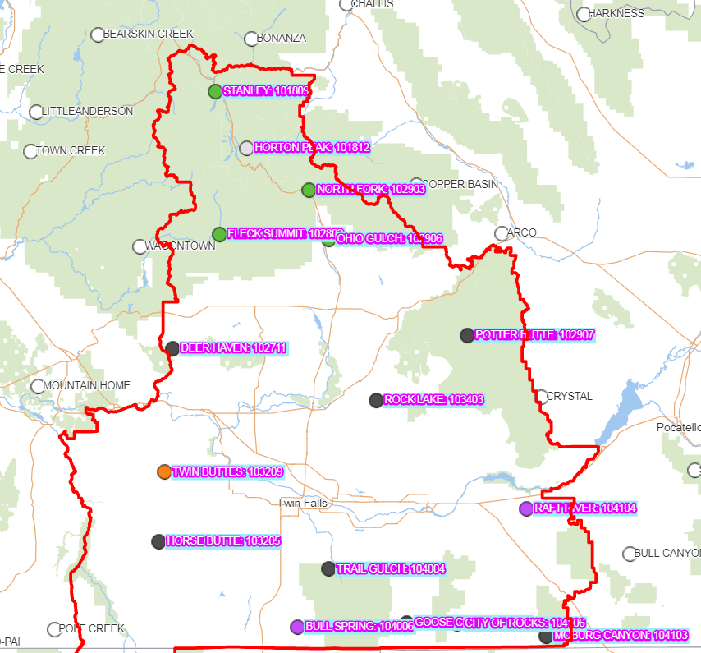
4 groups
K means w/ PCA
hierarchical
shelby

Slide 4
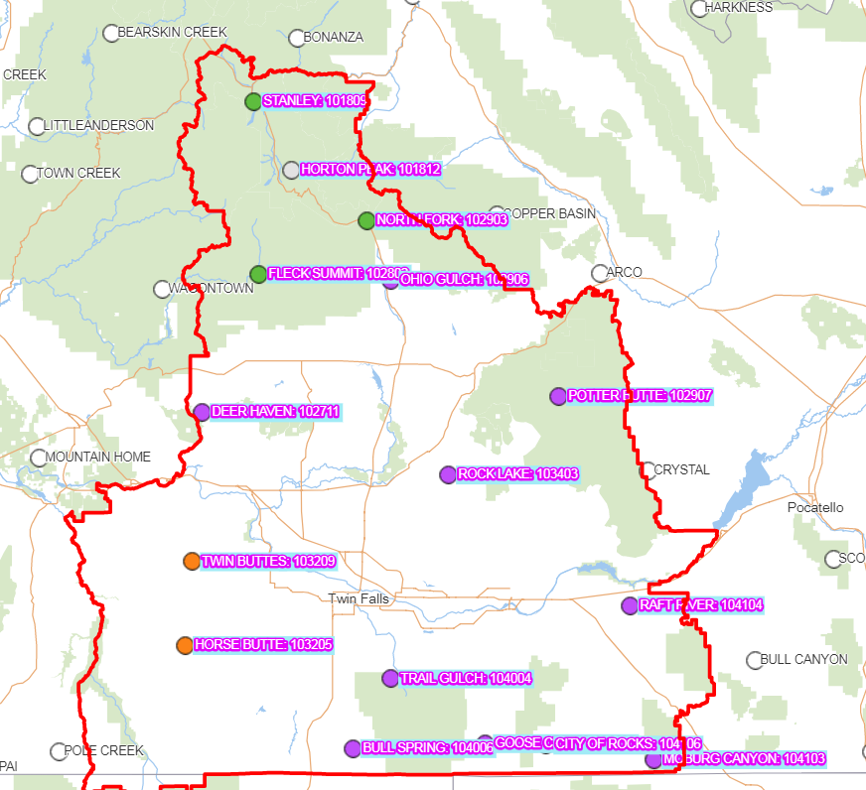
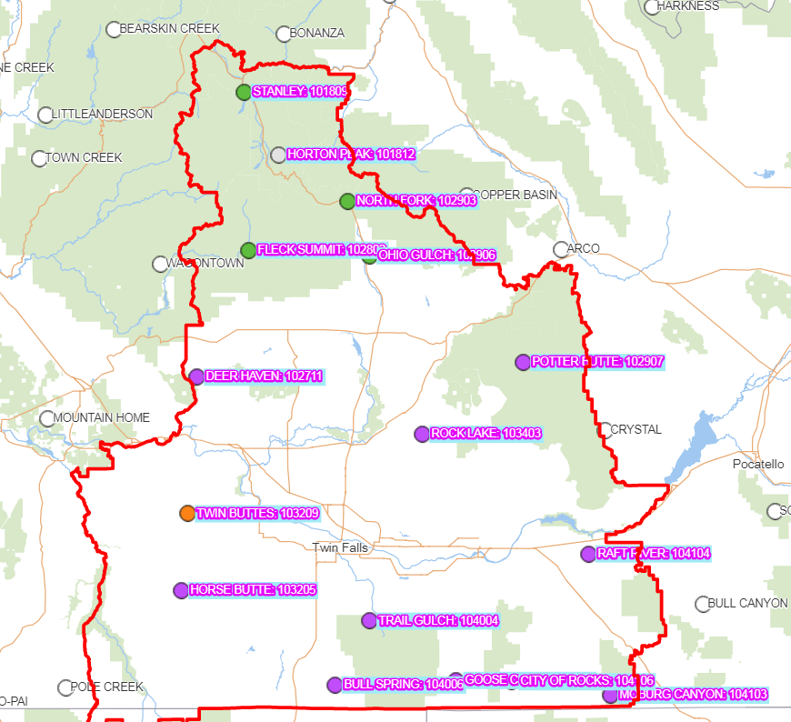
3 groups
K means w/ PCA
hierarchical
shelby

Slide 5
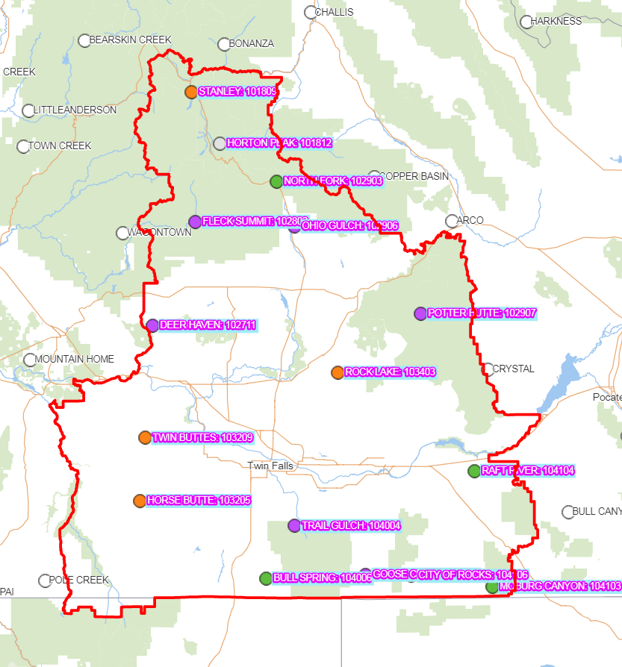
3 groups
K means w/ PCA
K means w/o PCA

Slide 6
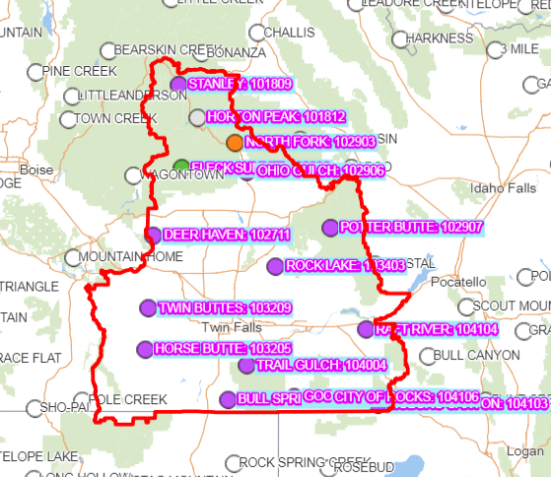
3 groups
Hierarchical w/ PCA
hierarchical
Shelby hates them both

Slide 7
3 groups
Hierarchical w/ PCA
K means with pca

