Slide 1

Mobile app for democratic music playback with a hybrid recommender system
Harry Verhoef, u1706021

Slide 2


Motivation
The Problem
People in a social setting must rely on one device to control music

Slide 3
Motivation
The Problem
People in a social setting must rely on one device to control music
The Solution
Create a mobile application that allows people to join a “lobby” and vote

Slide 4
Motivation
The Problem
People in a social setting must rely on one device to control music
How will tracks be chosen to be put up for election?
The Solution
Create a mobile application that allows people to join a “lobby” and vote

Slide 5
Motivation
The Problem
People in a social setting must rely on one device to control music
How will tracks be chosen to be put up for election?
The Solution
Create a mobile application that allows people to join a “lobby” and vote
Create a recommender system that considers the whole lobby’s preference

Slide 6
Motivation
The Problem
People in a social setting must rely on one device to control music
How will tracks be chosen to be put up for election?
What if lots of users dislike the currently playing track?
The Solution
Create a mobile application that allows people to join a “lobby” and vote
Create a recommender system that considers the whole lobby’s preference

Slide 7
Motivation
The Problem
People in a social setting must rely on one device to control music
How will tracks be chosen to be put up for election?
What if lots of users dislike the currently playing track?
The Solution
Create a mobile application that allows people to join a “lobby” and vote
Create a recommender system that considers the whole lobby’s preference
All users in the lobby will be able to upvote and downvote tracks, and users who vote for disliked tracks will have their credibility scaled proportionately

Slide 8



Existing Solutions
Outloud lets users vote for tracks but does not use an ML-based recommender nor does it consider user credibility.
Spotify introduced a social listening system that lets users join a party and from there have complete control over the queue.

Slide 9
Design Choices
React-Native Frontend

Slide 10
Design Choices
React-Native Frontend
Will eventually allow the app to be used cross-platform

Slide 11
Design Choices
React-Native Frontend
Will eventually allow the app to be used cross-platform
Spotify (To control music playback)

Slide 12
Design Choices
React-Native Frontend
Will eventually allow the app to be used cross-platform
Spotify (To control music playback)
Most extensive Web API out of Apple Music, Amazon Music, Youtube Music, etc.

Slide 13
Design Choices
React-Native Frontend
Will eventually allow the app to be used cross-platform
Spotify (To control music playback)
Most extensive Web API out of Apple Music, Amazon Music, Youtube Music, etc.
AWS Backend

Slide 14
Design Choices
React-Native Frontend
Will eventually allow the app to be used cross-platform
Spotify (To control music playback)
Most extensive Web API out of Apple Music, Amazon Music, Youtube Music, etc.
AWS Backend
Easy SSL Certificate support for ATS

Slide 15
Design Choices
React-Native Frontend
Will eventually allow the app to be used cross-platform
Spotify (To control music playback)
Most extensive Web API out of Apple Music, Amazon Music, Youtube Music, etc.
AWS Backend
Easy SSL Certificate support for ATS
Very well modularised

Slide 16
Design Choices
React-Native Frontend
Will eventually allow the app to be used cross-platform
Spotify (To control music playback)
Most extensive Web API out of Apple Music, Amazon Music, Youtube Music, etc.
AWS Backend
Easy SSL Certificate support for ATS
Very well modularised
Lots of documentation and good support for hosted ML models

Slide 17

Methodology
An agile approach was used to develop this application
Test driven development of backend API (Mostly utilising Postman)
Development of User Interface based on user feedback
Timetable altered at point of progress report
Requirements changed (Development for android or lyrics support removed from scope)
Most core requirements met

Slide 18

Core Requirements
Users can create and join lobbies
All users have 1 vote (Although votes may be worth than 1)
Tracks deemed suitable by a recommender system will be recommended
The recommender system will act as a tie-breaker

Slide 19
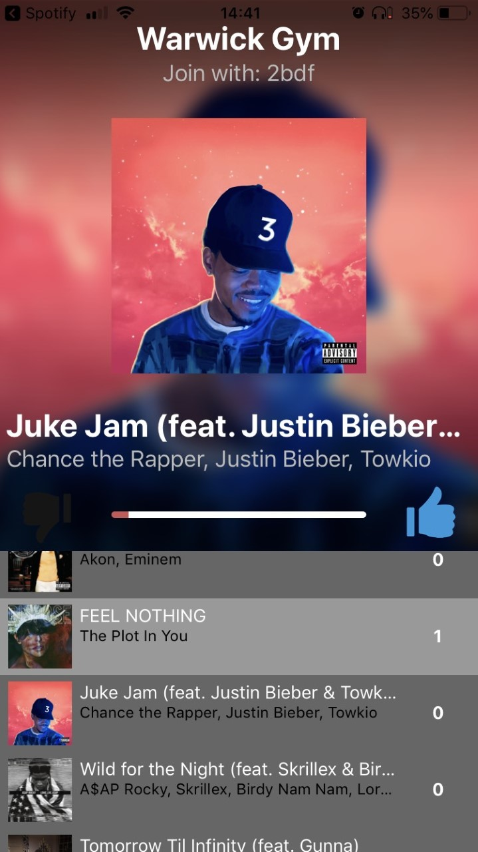

Abstract Component Map
Native Bridging Module
API Gateway
WS
REST
Client
DynamoDB
Spotify Web API
SageMaker
Lambda Functions

Slide 20
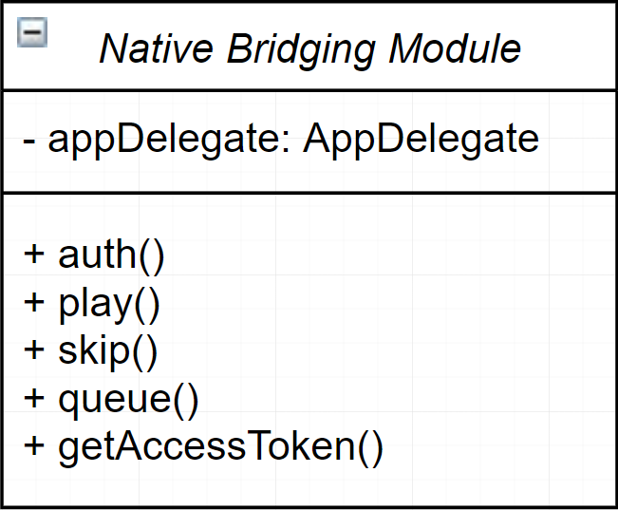
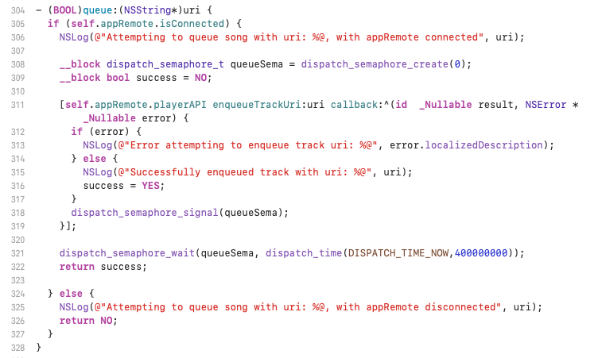
Native Bridging Module
The native bridging module acts as an intermediary interface between the iOS SDK and the react-native application
The module exports Objective-C macros which can be invoked passing a react-native callback, allowing Spotify SDK features to be utilised within the react-native application

Slide 21
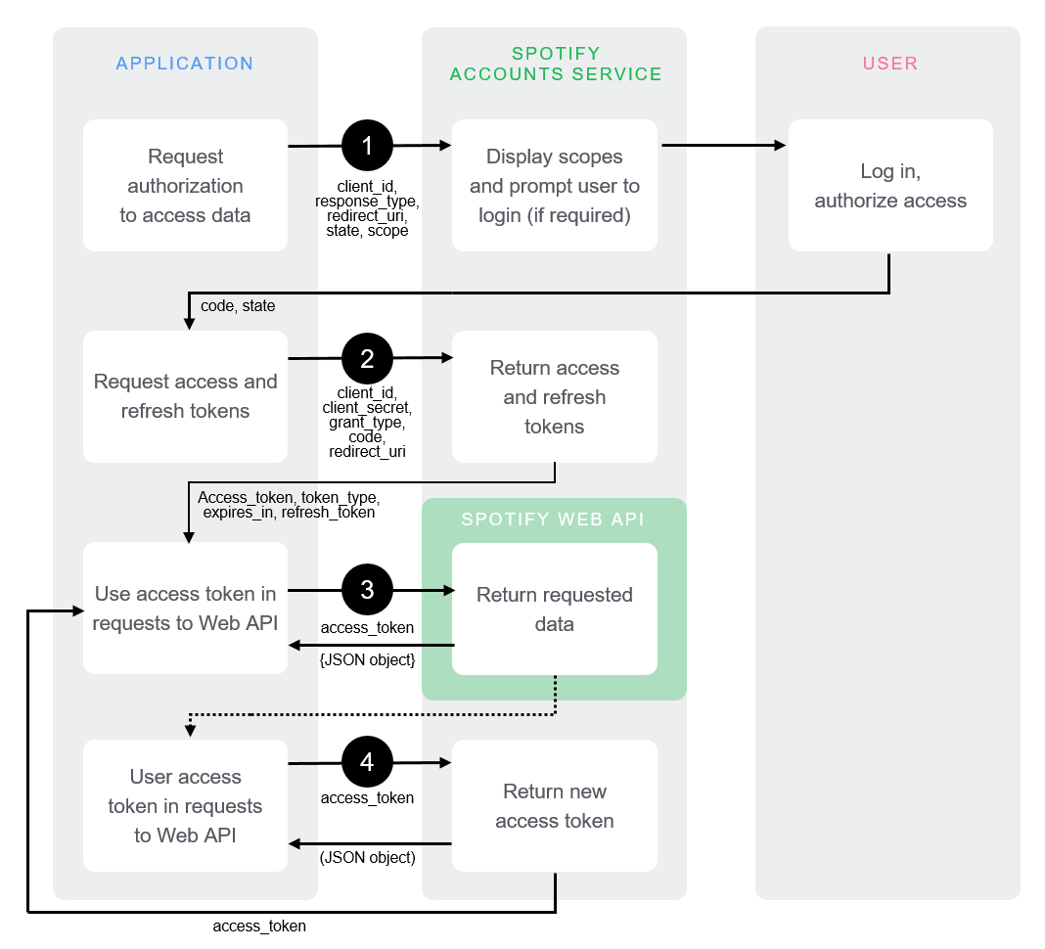
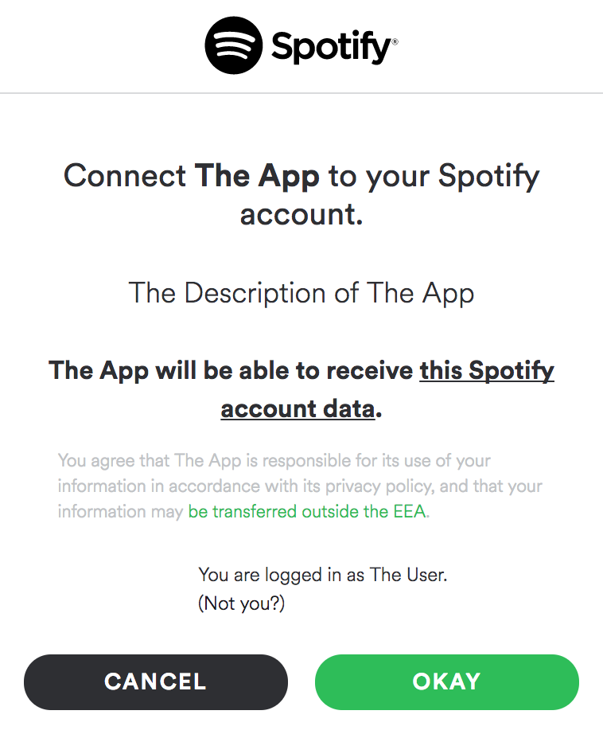
Spotify Authorisation

Slide 22
REST API
}
/delete_lobby
/get_artists
/get_current_song
/get_description
/get_next_song
/get_playlists
/get_stored_recommendations
/join_lobby
/set_track
/thumbs
/get_genre
/get_recommendations
/swap
/refresh
General lobby functions
}
Recommendations
}
Spotify Authorisation

Slide 23
WebSocket API
$connect
$disconnect
$default
next
vote
}
Must-have routes, enabling the persistence of connections
}
Routes enabling the persistence of dynamic lobby state, sent to all connections in a lobby

Slide 24
No
Lobby Length = 0?
Yes
Load genre inferences and lobby preference
Yes
Lobby Length <= 3 ?
No
Load lobby preferences
Load pickled tokenizer
Slice inferred genres based on lobby length
Calculate and store new lobby preference
Tokenize lobby name
Calculate and store new lobby preference
Get track features and OHE artist ID
Infer genre OHEs
Get track features and OHE artist ID
Infer and decode artist IDs
Decode OHEs
Infer and decode artist IDs
Query Spotify recommendations with just inferred artists
Store inferred genres
Query Spotify recommendations with inferred genres & artists
Mix 10 random recommendations with 10 random base tracks
Query Spotify recommendations with just inferred genres
Store result

Slide 25
NLP for genre inference
Only used in cold-start situations
After 3 tracks have been played, the inference made by the NLP is forgotten
Takes ~8 seconds to return prediction upon API Gateway invocation
Particularly accurate when an artist is included in lobby name
Capable of inferring user language
“Yeehaw”
Tokeniser
4153
Model
“Country”

Slide 26
NLP for genre inference
Only used in cold-start situations
After 3 tracks have been played, the inference made by the NLP is forgotten
Takes ~8 seconds to return prediction upon API Gateway invocation
Particularly accurate when an artist is included in playlist name
Capable of inferring user language
“Yeehaw”
Tokeniser
4153
Model
“Country”
“I love Eminem”
Tokeniser
13284
Model
“Hip-Hop”

Slide 27
NLP for genre inference
Only used in cold-start situations
After 3 tracks have been played, the inference made by the NLP is forgotten
Takes ~8 seconds to return prediction upon API Gateway invocation
Particularly accurate when an artist is included in playlist name
Capable of inferring user language
“Yeehaw”
Tokeniser
4153
Model
“Country”
“I love Eminem”
Tokeniser
13284
Model
“Hip-Hop”
“Classique”
Tokeniser
790
Model
“Classical”

Slide 28






RNN for artist inference
Takes as input 5 track objects consisting of
One-Hot-Encoded Artist ID (Only takes primary artist of track)
8 numerical track features (Acousticness, Danceability, Valence, etc.)
Infers the next artist to be played
~85000 class labels
$$\left[\begin{matrix}Beethoven \\ Bizet \\ Tchaikovsky \\ Mozart \\ Bach\end{matrix}\right]$$
$$\left[\begin{matrix}Eminem \\ Drake \\ 50 Cent \\ The Weeknd \\ The Weeknd\end{matrix}\right]$$
$$\left[\begin{matrix}Verdi \\ Debussy \\ Wagner\end{matrix}\right]$$
$$\left[\begin{matrix}The Weeknd \\ Kanye West \\ Post Malone\end{matrix}\right]$$
$$\left[\begin{matrix}0.51, …0.99 \\ 0.04, …0.14 \\ 0.93, …0.10 \\ 0.50, …0.32 \\ 0.82, …0.07\end{matrix}\right]$$
$$\left[\begin{matrix}0.31, …0.53 \\ 0.39 …0.59 \\ 0.41, …0.61 \\ 0.43, …0.67 \\ 0.51, …0.71\end{matrix}\right]$$

Slide 29





Calculating Lobby Preference
$$w_{i}= w_{i}+ \frac{1}{n}\sum_{i=0}^{n}{r_{i}}$$
is the weight adjustment applied to each user who voted for the elected track, once /set_track is invoked
$\vec{w}= \left[\begin{matrix}1.04 \\ 1.11 \\ \begin{aligned}0.98 \\ 0.80 \\ 1.50 \\ 1.00\end{aligned}\end{matrix}\right]$, $\vec{r}= \left[\begin{matrix}1 \\ 0 \\ −1 \\ −1 \\ 1 \\ 1\end{matrix}\right]$
${\vec{r}}^{T}⋅ \vec{w}=1.76= x_{i}=$Track weighted-ranking
$\vec{a}=\left[\begin{matrix}a_{i} \\ a_{j} \\ a_{k} \\ a_{l} \\ a_{m}\end{matrix}\right], \vec{f}=\left[\begin{matrix}f_{i} \\ f_{j} \\ f_{k} \\ f_{l} \\ f_{m}\end{matrix}\right]$
}
In ascending order of weighted-ranking
$$\left[\vec{a}, \vec{f}\right]$$
$$\hat{\vec{a}}$$
Artist Inference Runtime

Slide 30
Bumps in the road
Genius cannot legally let lyrics be publicly accessible through their API
Solution: Use track and artist insights instead of lyrics
No public dataset with unhashed spotify data
Solution: Python scripts propagating through Spotify Web API
Spotify sessions cannot be initiated unless a track is already playing in the background
Solution: During the authorisation phase, play the last track the user was listening to

Slide 31
Known Bugs
Sometimes the map of votes does not refresh for the elected track after /set_track invoked
The description fetched from the genius API may sometimes be erroneous
The app can crash if the user is creating a lobby and doesn’t any have Spotify data in memory

Slide 32
Evaluation
Successes
API endpoints function as desired
Recommender System recommends suitable tracks, especially as lobby length increases
Most core requirements met
Learned a variety of new technologies
Failures
Didn’t have time to implement features like chat room or QR code lobby-joining
High latency for recommendations system
NLP model could be more accurate
There are still some minor bugs

Slide 33
Future Work
Writing a new WebSocket route enabling chat room functionality
More hyper-parameter tuning on both models
Increasing size of model datasets
Using QR Codes to join lobbies
Eradicate bugs

Slide 34
Demo

Slide 35
Demo
Backup screen recording

