Slide 1
React Navigation

Slide 2
Installation
npm install @react-navigation/native
expo install react-native-screens react-native-safe-area-context

Slide 3
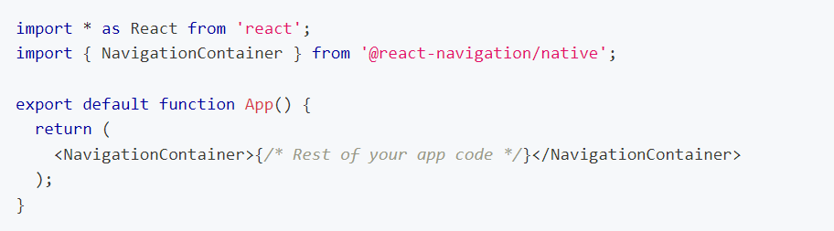
Usage
Wrapping your app in NavigationContainer
Note: In a typical React Native app, the NavigationContainer should be only used once in your app at the root.

Slide 4
Usage
In a web browser, you can link to different pages using an anchor (<a>) tag.
On back button, the browser pops the item from the top of the history stack.
React Native doesn't have a built-in idea of a global history stack like a web browser
React Navigation's native stack navigator provides a way for your app to transition between screens and manage navigation history.

Slide 5
Native Stack
Installation:
npm install @react-navigation/native-stack
createNativeStackNavigator
A function that returns an object containing 2 properties: Screen and Navigator.
NavigationContainer is a component which manages our navigation tree and contains the navigation state.

Slide 6
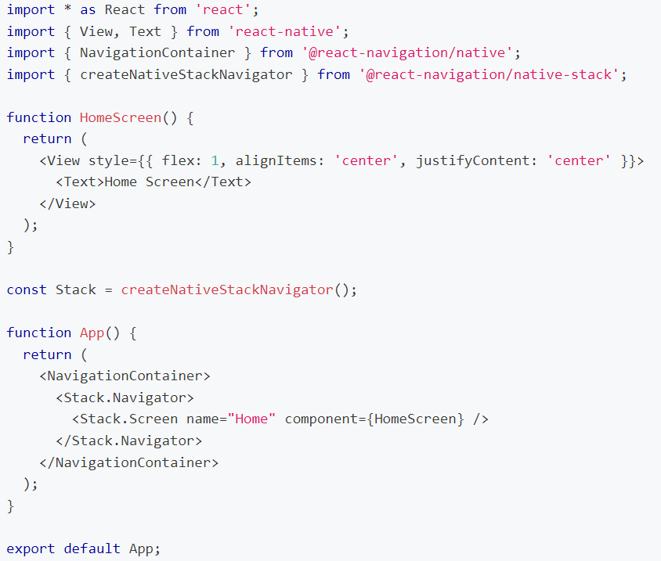

Slide 7
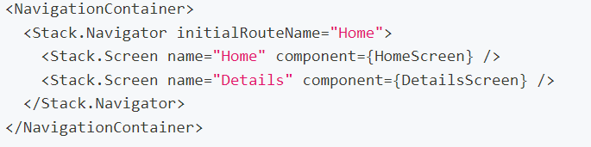
Configuring the navigator
All of the route configuration is specified as props to our navigator.
The Screen component accepts a name prop which corresponds to the name of the route we will use to navigate, and a component prop which corresponds to the component it'll render.

Slide 8
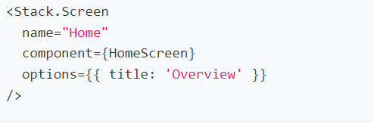
Configuring the navigator
Specifying options
title

Slide 9
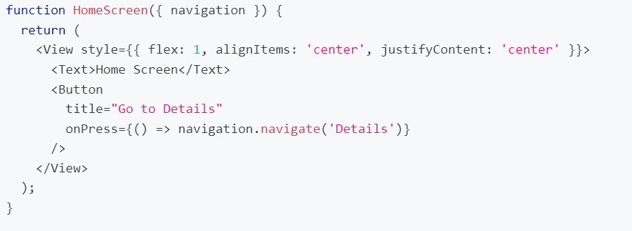
Moving between Screens
navigation - passed in to every screen component (definition) in the native stack navigator
navigate(‘ScreenName') - call the navigate function (on the navigation prop ) with the name of the route that we'd like to move the user to.

Slide 10
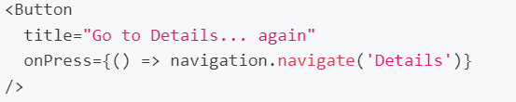
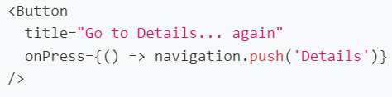
Moving between Screens
What would happen if we navigated to the Details route again, from the Details screen?

Slide 11
Moving between Screens
Going back
native stack navigator will automatically include a back button when it is possible to go back from the active screen
navigation.goBack(); to trigger the behaviour programmatically
navigation.popToTop() to go back to the first screen

Slide 12
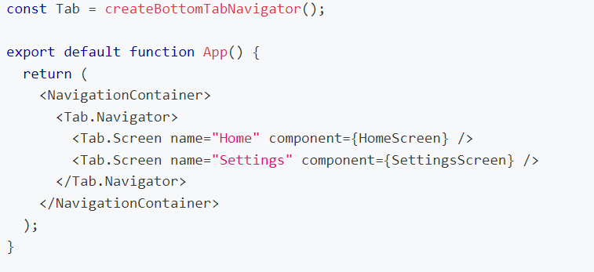
Tab Navigation
Possibly the most common style of navigation in mobile apps is tab-based navigation
npm install @react-navigation/bottom-tabs

Slide 13
Tab Navigation
Options:
These can be specified under screenOptions prop of Tab.navigator or options prop of Tab.Screen
Title:Generic title that can be used as a fallback for headerTitle and tabBarLabel.
tabBarLabel:Title string of a tab displayed in the tab bar or a function that given { focused: boolean, color: string } returns a React.Node, to display in tab bar. When undefined, scene title is used.
tabBarShowLabel​:Whether the tab label should be visible. Defaults to true.
tabBarLabelPosition: Whether the label is shown below the icon or beside the icon.
Below-icon
Beside-icon

Slide 14
Tab Navigation
Options:
tabBarLabelStyle: Style object for the tab label.
tabBarIcon: Function that given { focused: boolean, color: string, size: number } returns a React.Node, to display in the tab bar.
tabBarBadge: Text to show in a badge on the tab icon. Accepts a string or a number.
tabBarBadgeStyle: Style for the badge on the tab icon.

Slide 15
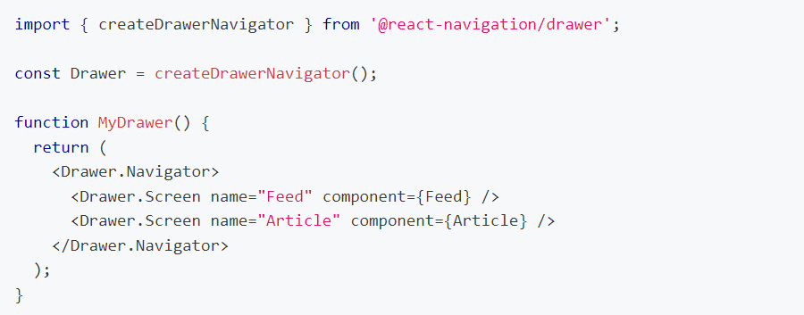
Drawer Navigation
npm install @react-navigation/drawer
expo install react-native-gesture-handler react-native-reanimated

Slide 16
Drawer Navigation
At very top import 'react-native-gesture-handler';
To use this drawer navigator, import it from @react-navigation/drawer:
Props​ (Drawer.Navigator)
Id: Optional unique ID for the navigator. This can be used with navigation.getParent to refer to this navigator in a child navigator.
initialRouteName​: The name of the route to render on first load of the navigator.
screenOptions​:Default options to use for the screens in the navigator

Slide 17
Drawer Navigation
Props​ (Drawer.Navigator)
screenOptions​:Default options to use for the screens in the navigator.
backBehavior​:This controls how going back in the navigator is handled.

Slide 18
References
[1] https://reactnavigation.org/docs/getting-started/

