Slide 1
TripLap
Planning application for travellers
LAPD 2019/2020
Grupo F
MIEIC
Amadeu Pereira - up201605646@fe.up.pt
João Ferreira - up201605330@fe.up.pt
Nuno Lopes - 201605337@fe.up.pt

Slide 2
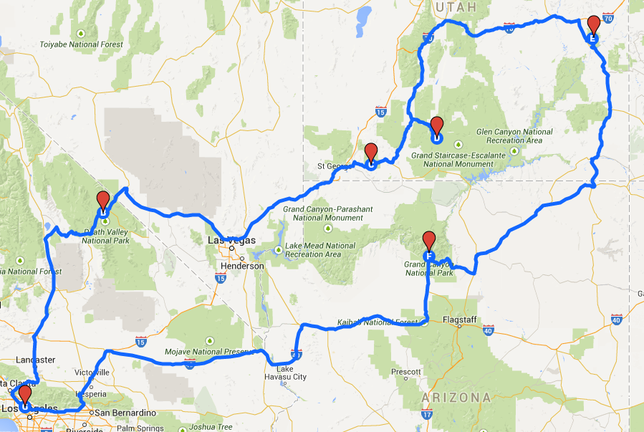
Context
Travel and Tourism sector has been growing globally.
There are already some apps in the market that do what we are proposing to do.
The competitor apps always lack some important features.

Slide 3



The Problem and our Motivation
Increasing number of travelers
User focused only
The need to have all the features in one unique app

Slide 4



State-of-the-art

Slide 5






Our Mobile Application
Data Sources
Mobile Position Sensors
Weather API (OpenWeatherMap)
Restaurants API (Zomato)
Point of Interests API (Foursquare)
Shops API (Foursquare)
Hotels API (Amadeus)
Images API (SerpWow)
Location API (MapQuest)
Goals
Planning trips
Suggest the best POIs and Restaurants close to the user

Slide 6
User Stories
US01 - Search city: As a user, I want to search for a city so that I can select my trip destination.
US02 - Select the trip date: As a user, I want to select dates so that I can select my trip start date and end date.
US03 - Homepage: As a user, I want to see the homepage with access to features like points of interest, restaurants, shops and hotels, so that I can search in each of these features and see my trip plan.
US06 - Trip plan: As a user, I want to see a plan for each trip so that I see what is scheduled for each day of the trip.
US16 - Add place: As a user, I want to add a place to visit on a specific day of my trip so that I can add it to my plan.
US20 - Weather prediction: As a user, I want to see a weather prediction for the selected city during the selected days so that I can choose the most appropriate places to visit.

Slide 7
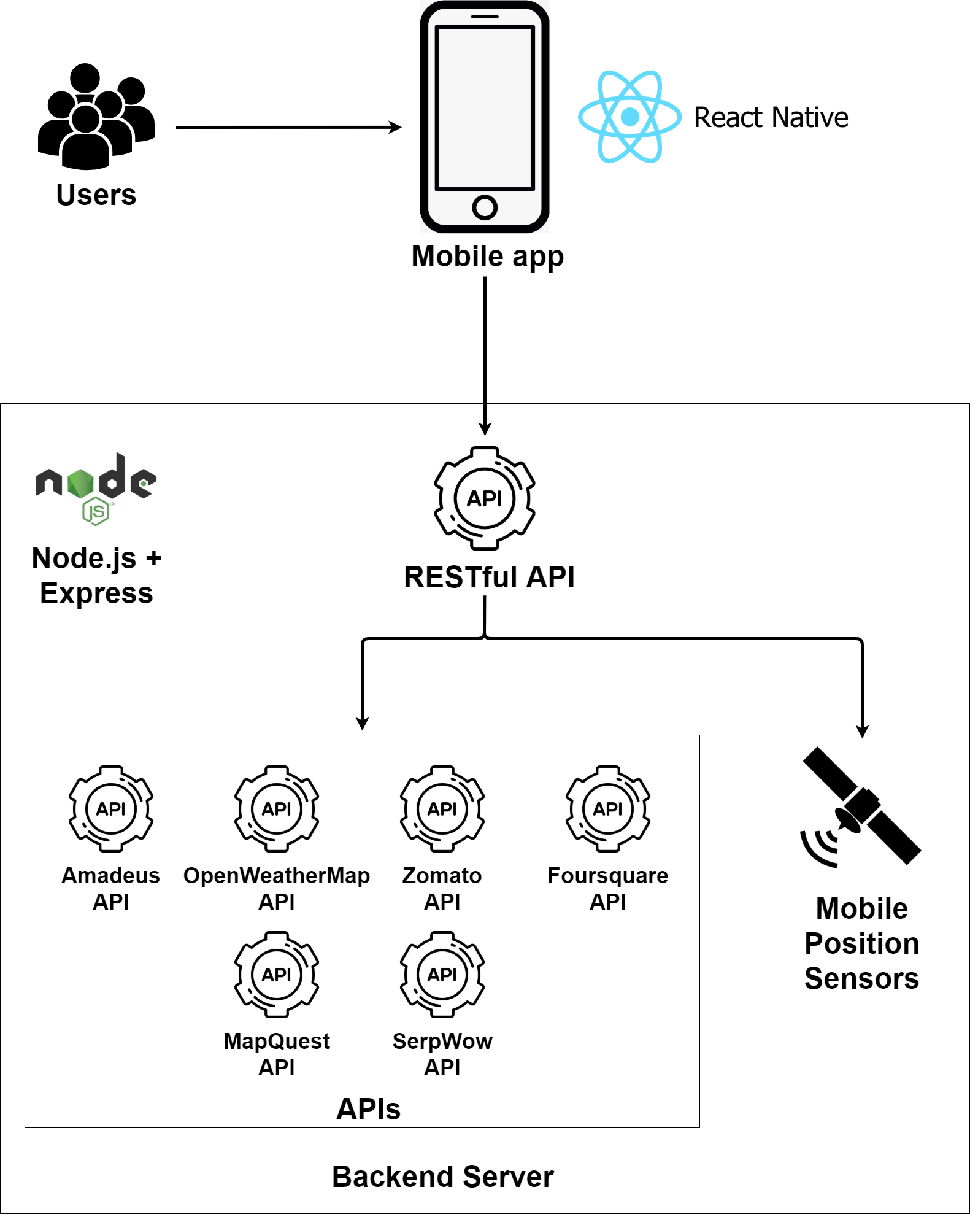
Architecture

Slide 8
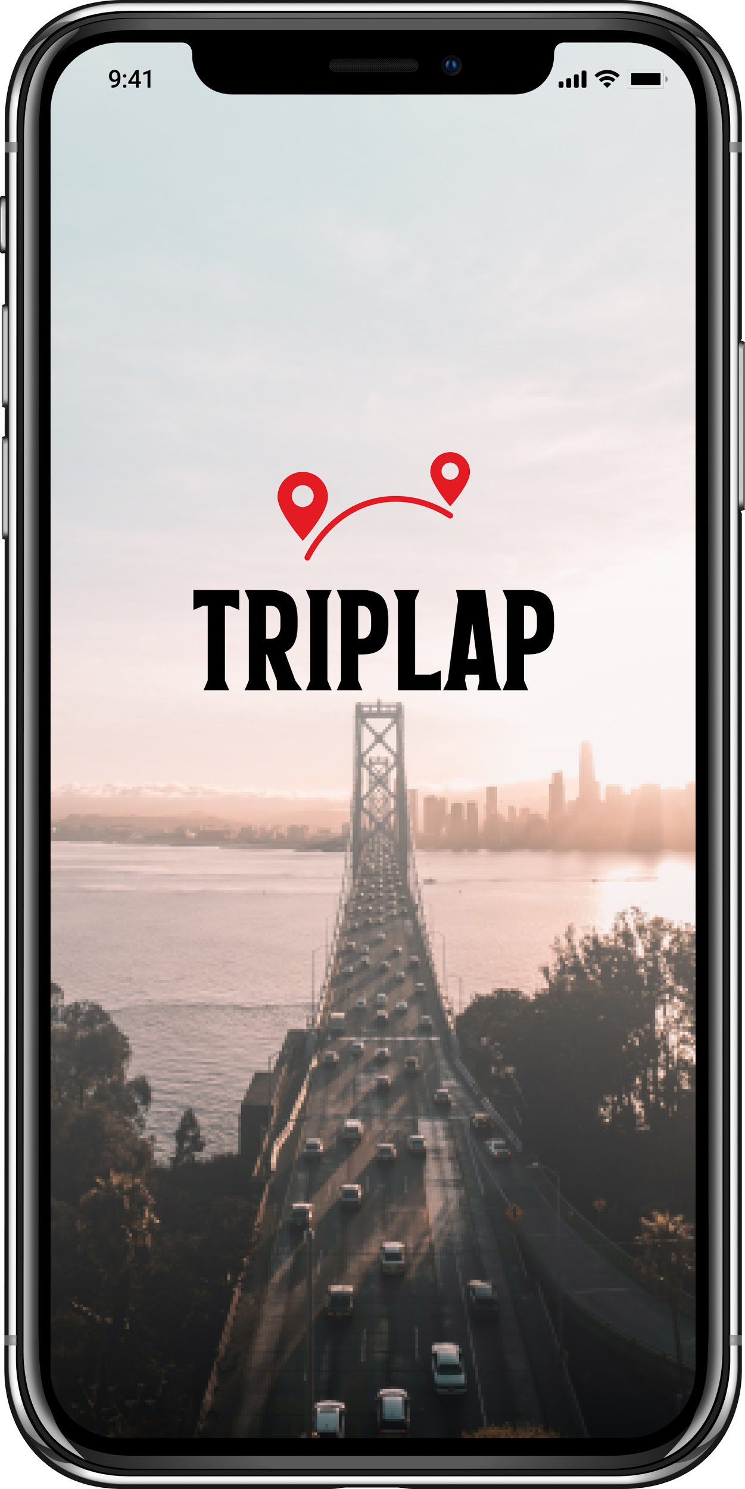
Live Demo

Slide 9
Problems faced
Find APIs that actually provide us with the data we need and that are free to use.
All of the APIs that we are currently using have a quota limit.
Find new APIs during the application development to achieve the expected functionalities.
Lack of information in hotels API due to the situation we are facing now.
Same code with different behaviours in IOS and Android

Slide 10

Thank You

