Slide 1
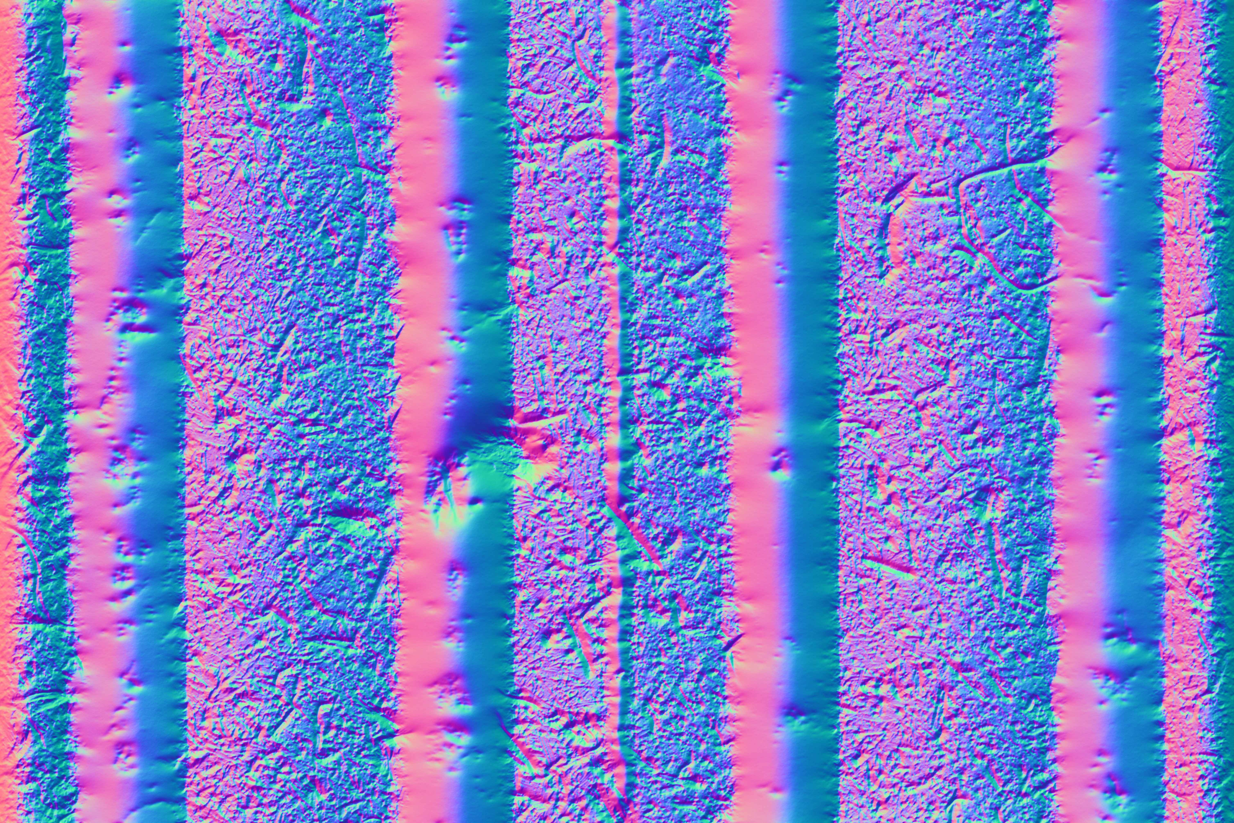
Distance: 0 mm

Slide 2
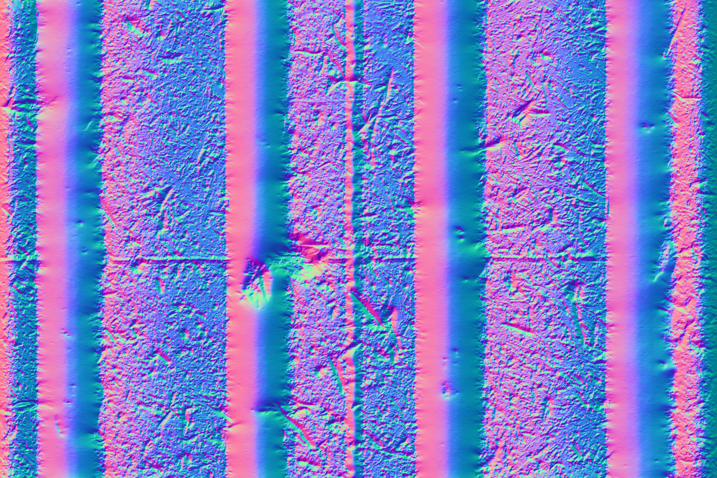
Distance: 150 mm

