Slide 1
Microbiome Data Analysis
Levi Waldron, CUNY School of Public Health
Susan Holmes, Stanford University
Paul J. McMurdie, University of Washington
Edoardo Pasolli, University of Trento
Joseph N. Paulson, Dana-Farber Cancer Institute
Lucas Schiffer, CUNY School of Public Health
Justin Wagner, University of Maryland
July 27th, 2017
Boston, BioC 2017: Where Software and Biology Connect

Slide 2

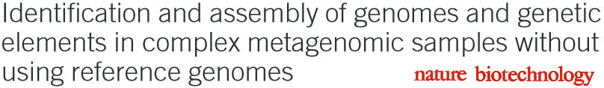
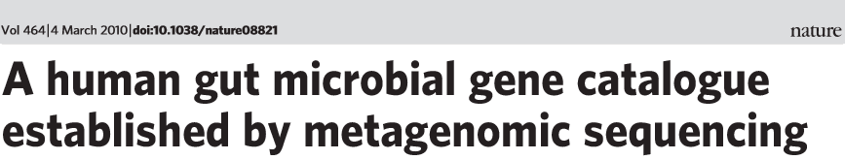
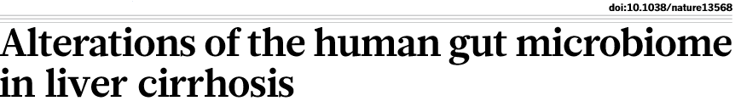
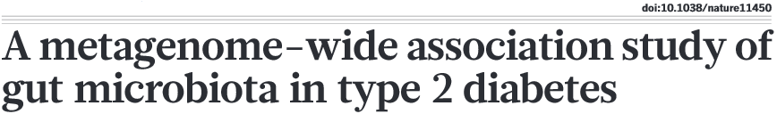
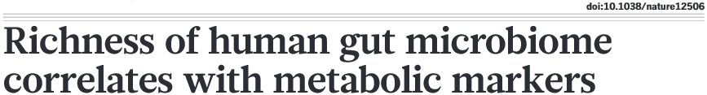
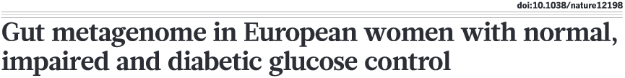



The human microbiome in health and disease
We developed MetAML, a tool for systematic analysis of
large metagenomic datasets and applied it on available data
Pasolli et al., “Meta-analysis of large metagenomics datasets: tools and biological insights”, PLOS Computational Biology 2016

Slide 3
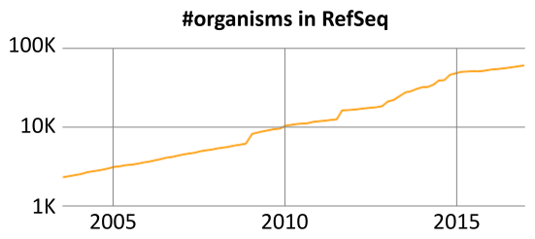
Motivation for curatedMetagenomicData
Increasing amount of public data
Can be fast and free, but hard to use:
Fastq files from NCBI, EBI, …
Bioinformatic expertise
Computational resources
Manual curation / standardization
Wanted to make acquisition of curated, ready-to-use public data easy and reproducible
We developed the curatedMetagenomicData data package for distribution through the Bioconductor ExperimentHub platform

Slide 4
ExperimentHub
Robust, user-friendly distribution of experimental data from the Cloud to Bioconductor
Data stored in Amazon S3 buckets
Software package of documentation and functions
SQL database for dataset-wide metadata
Convenience functions provide ready-to-analyze Bioconductor data classes
Local caching

Slide 5
curatedMetagenomicData
Pasolli, Schiffer, Manghi et al., bioRxiv 103085
~ 25 new datasets
~ 10K new samples
by the end of the year
- 26 datasets
- 5716 samples
Mandatory metadata
dataset_name sampleID subjectID body_site
study_condition disease
age
gender
country
sequencing_platform
pubmedID number_reads
median_read_length
70
Automatic
syntax checking
Code, data, tutorials, and scripts: https://waldronlab.github.io/curatedMetagenomicData/

Slide 6
curatedMetagenomicData
Pasolli, Schiffer, Manghi et al., bioRxiv 103085
One dataset:
R: > curatedMetagenomicData("HMP_2012.metaphlan_bugs_list.stool")
Many datasets:
R: > curatedMetagenomicData("HMP_2012.metaphlan_bugs_list.*")
Other data products:
R: > curatedMetagenomicData("HMP_2012.pathabundance_relab.*")
Or from command-line:
CLI: $ curatedMetagenomicData -p "HMP_2012. pathabundance_relab.*"

Slide 7
curatedMetagenomicData
Pasolli, Schiffer, Manghi et al., bioRxiv 103085
~ 25 new datasets
~ 10K new samples
by the end of the year
- 26 datasets
- 5716 samples
Mandatory metadata
dataset_name sampleID subjectID body_site
study_condition disease
age
gender
country
sequencing_platform
pubmedID number_reads
median_read_length
70
Automatic
syntax checking
Code, data, tutorials, and scripts: https://waldronlab.github.io/curatedMetagenomicData/

Slide 8
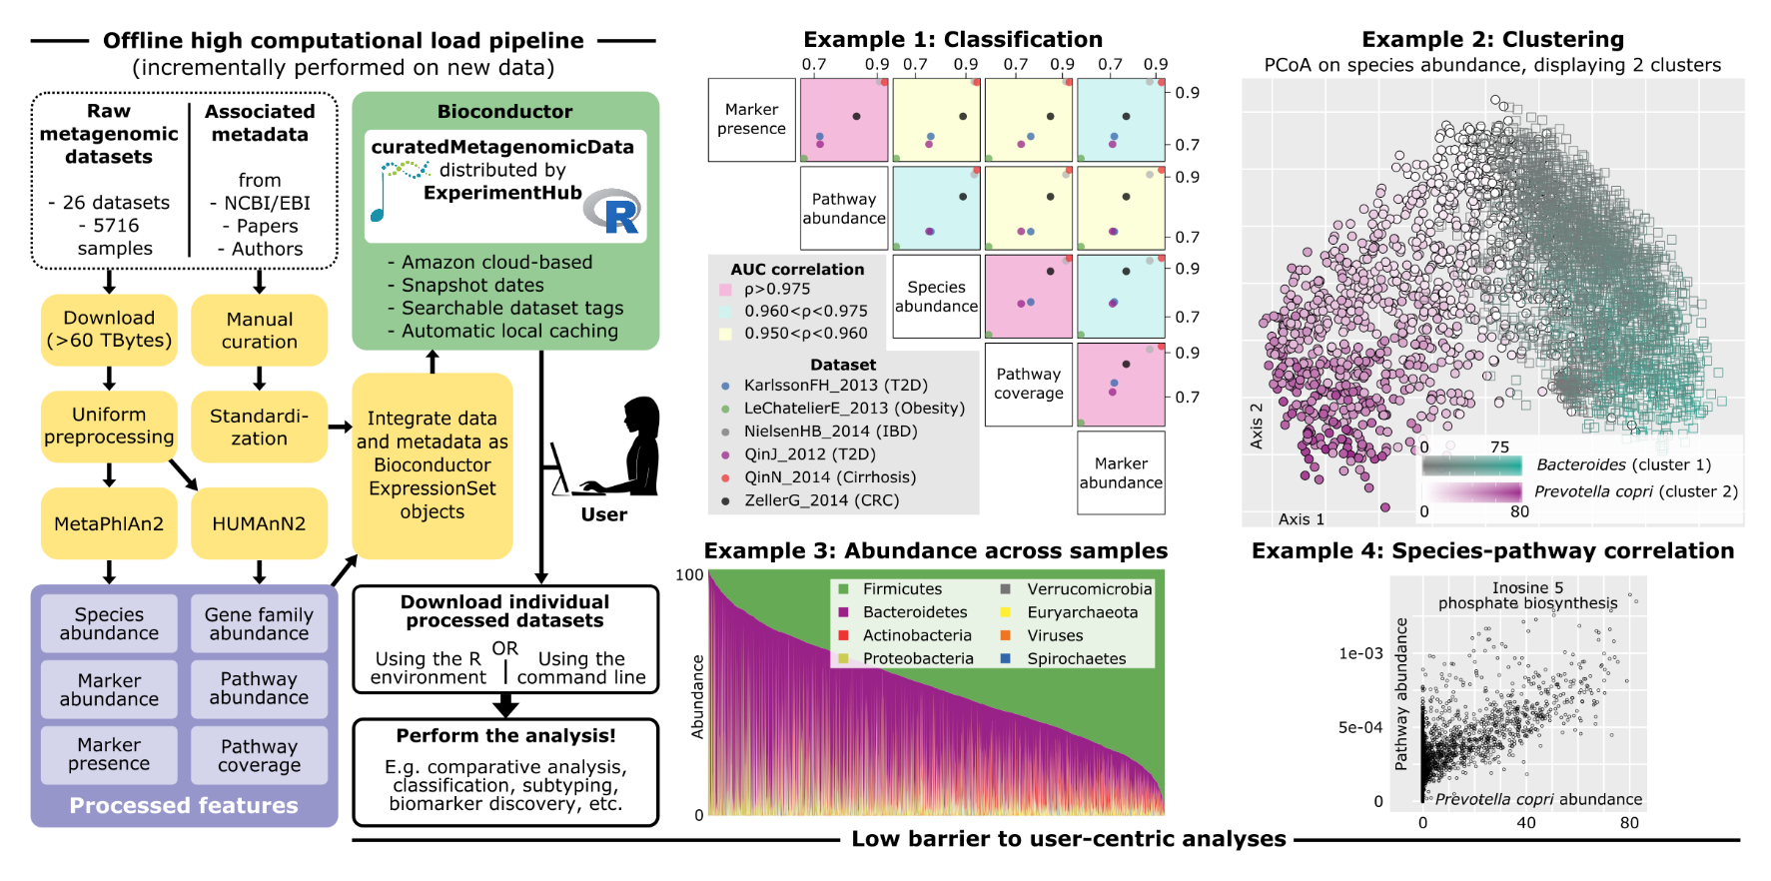
Examples of enabled analysis
Pasolli, Schiffer, Manghi et al., bioRxiv 103085

Slide 9
Integration with Bioc packages
Analyze with other Bioconductor packages:
ExpressionSet2phyloseq(): phyloseq
ExpressionSet2MRExperiment(): metagenomeSeq, metavizr
Today’s 2-part workshop covers these packages:
AMI: “Packages” -> MicrobiomeWorkshop
Vignettes: MicrobiomeWorkshopI and II
Source code: github.com/waldronlab/MicrobiomeWorkshop

Slide 10
Metaviz

Slide 11
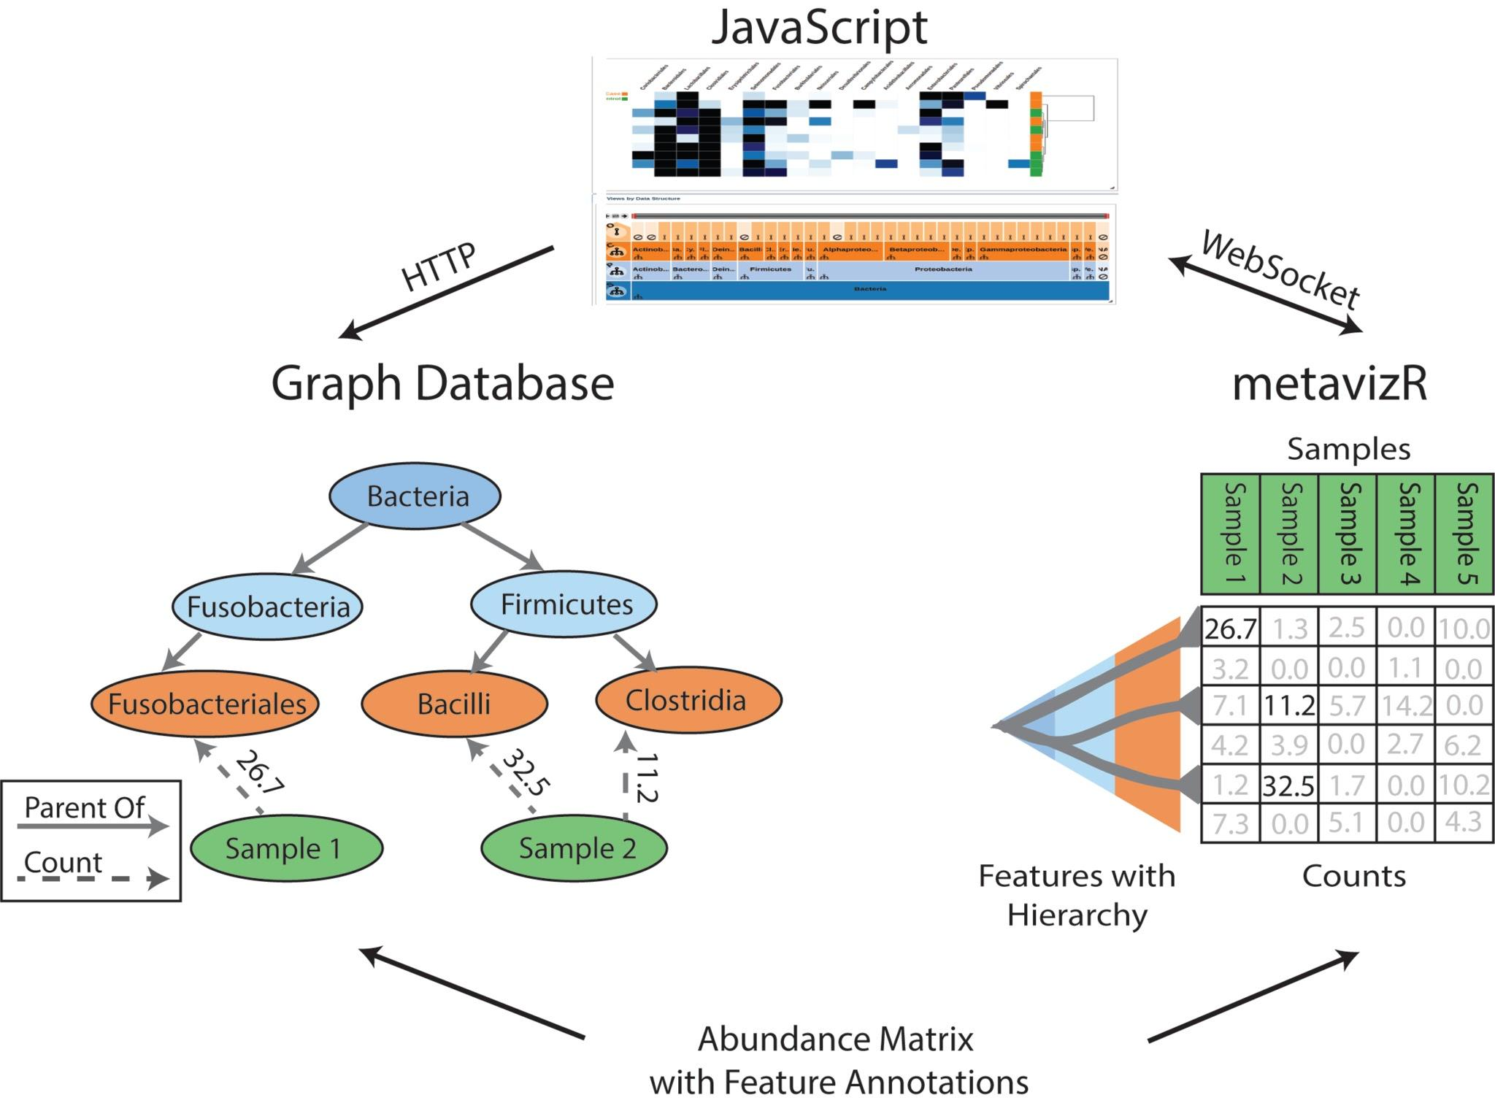
Metaviz architecture

Slide 12
Integration with metagenomeSeq
Compute differential abundance
Explore results through interactive visualization

Slide 13
metavizr workshop vignette section
metavizr data input format – MRexperiment from metagenomeSeq
Using ExpressionSet2MRexperiment from curatedMetagenomicData
Workshop specific issues:
Need to call app$service() to process UI requests
Issue with Rstudio Server version < 1.123 with R event loop processing
Vignette Update – Run at Rstudio R command prompt
> source(http://epiviz.github.io/bioc2017/update.R)

