Slide 1



MultiAssayExperiment Software for the integration of multi-omics experiments in Bioconductor
U24CA180996 (PI: Martin Morgan)
Co-investigators: Levi Waldron, Vincent Carey, Kasper Hansen
Notes:
Hi. I’d like to introduce you to MultiAssayExperiment, a framework for the representation and analysis of multi-omics experiments in Bioconductor.

Slide 2
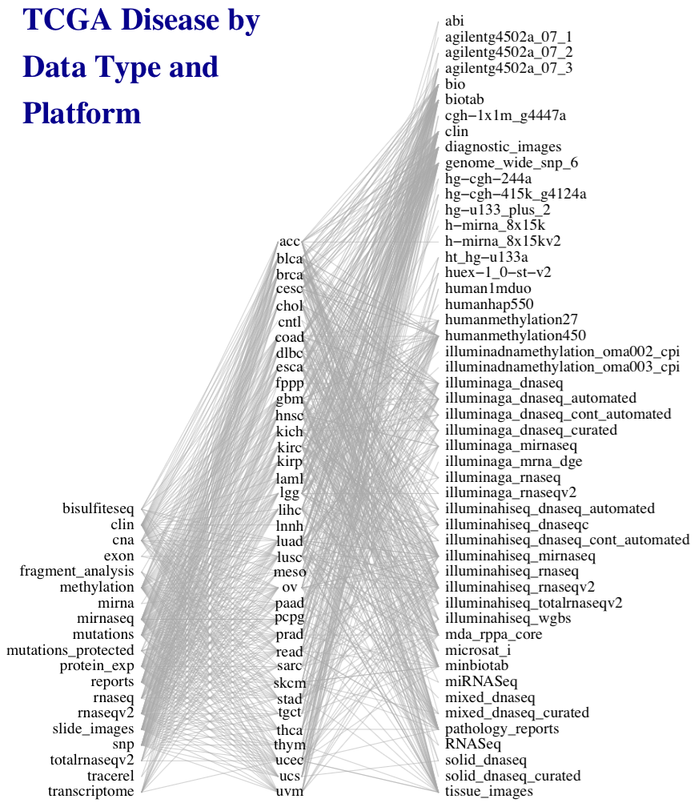
Multi-assay experiments can be complex
50 platforms
33 diseases
Diseases, platforms, and data types of
The TCGA
19 data types
Credit: Marcel Ramos
Notes:
This work was motivated by the need to simplify general statistical analysis and development of bioinformatic tools for a study as complex as the Cancer Genome Atlas, where 33 cancers were assayed on many platforms to generate different types of data, but also to provide a simplified framework for more easily reproducible and less error-prone analysis of simpler experiments involving just a couple of complementary assays and clinical data.

Slide 3
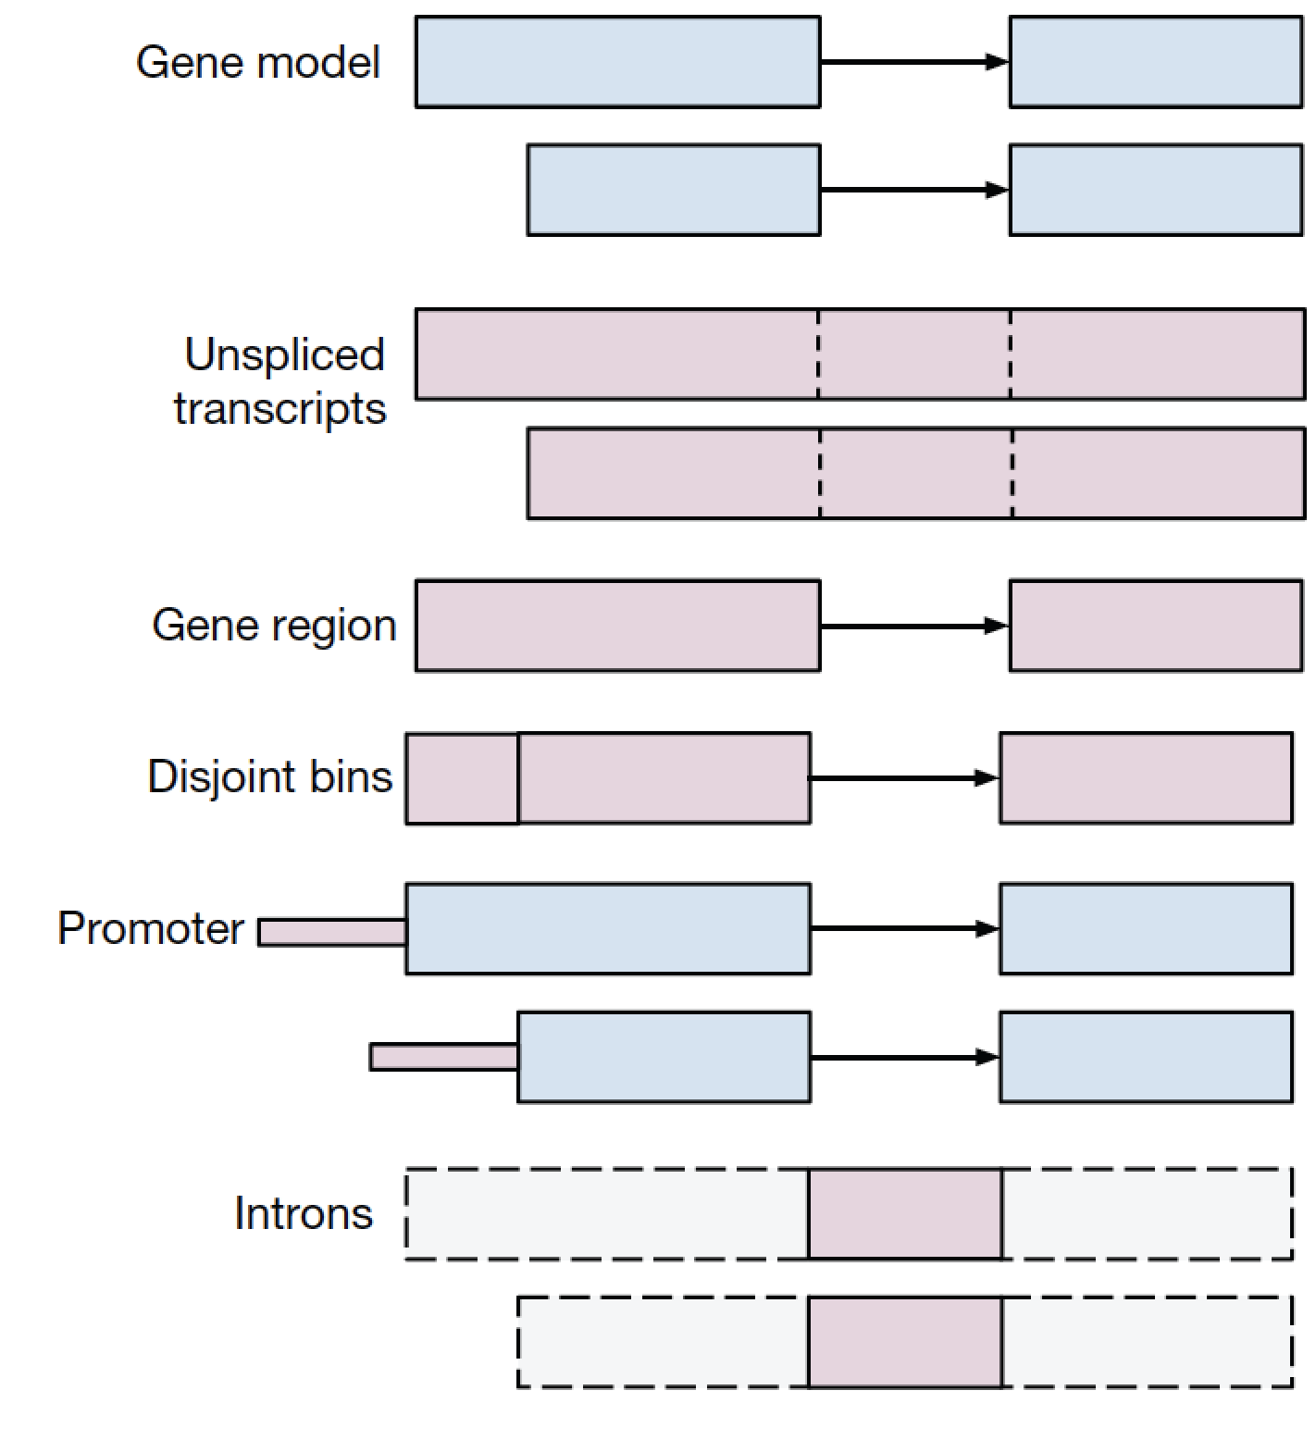
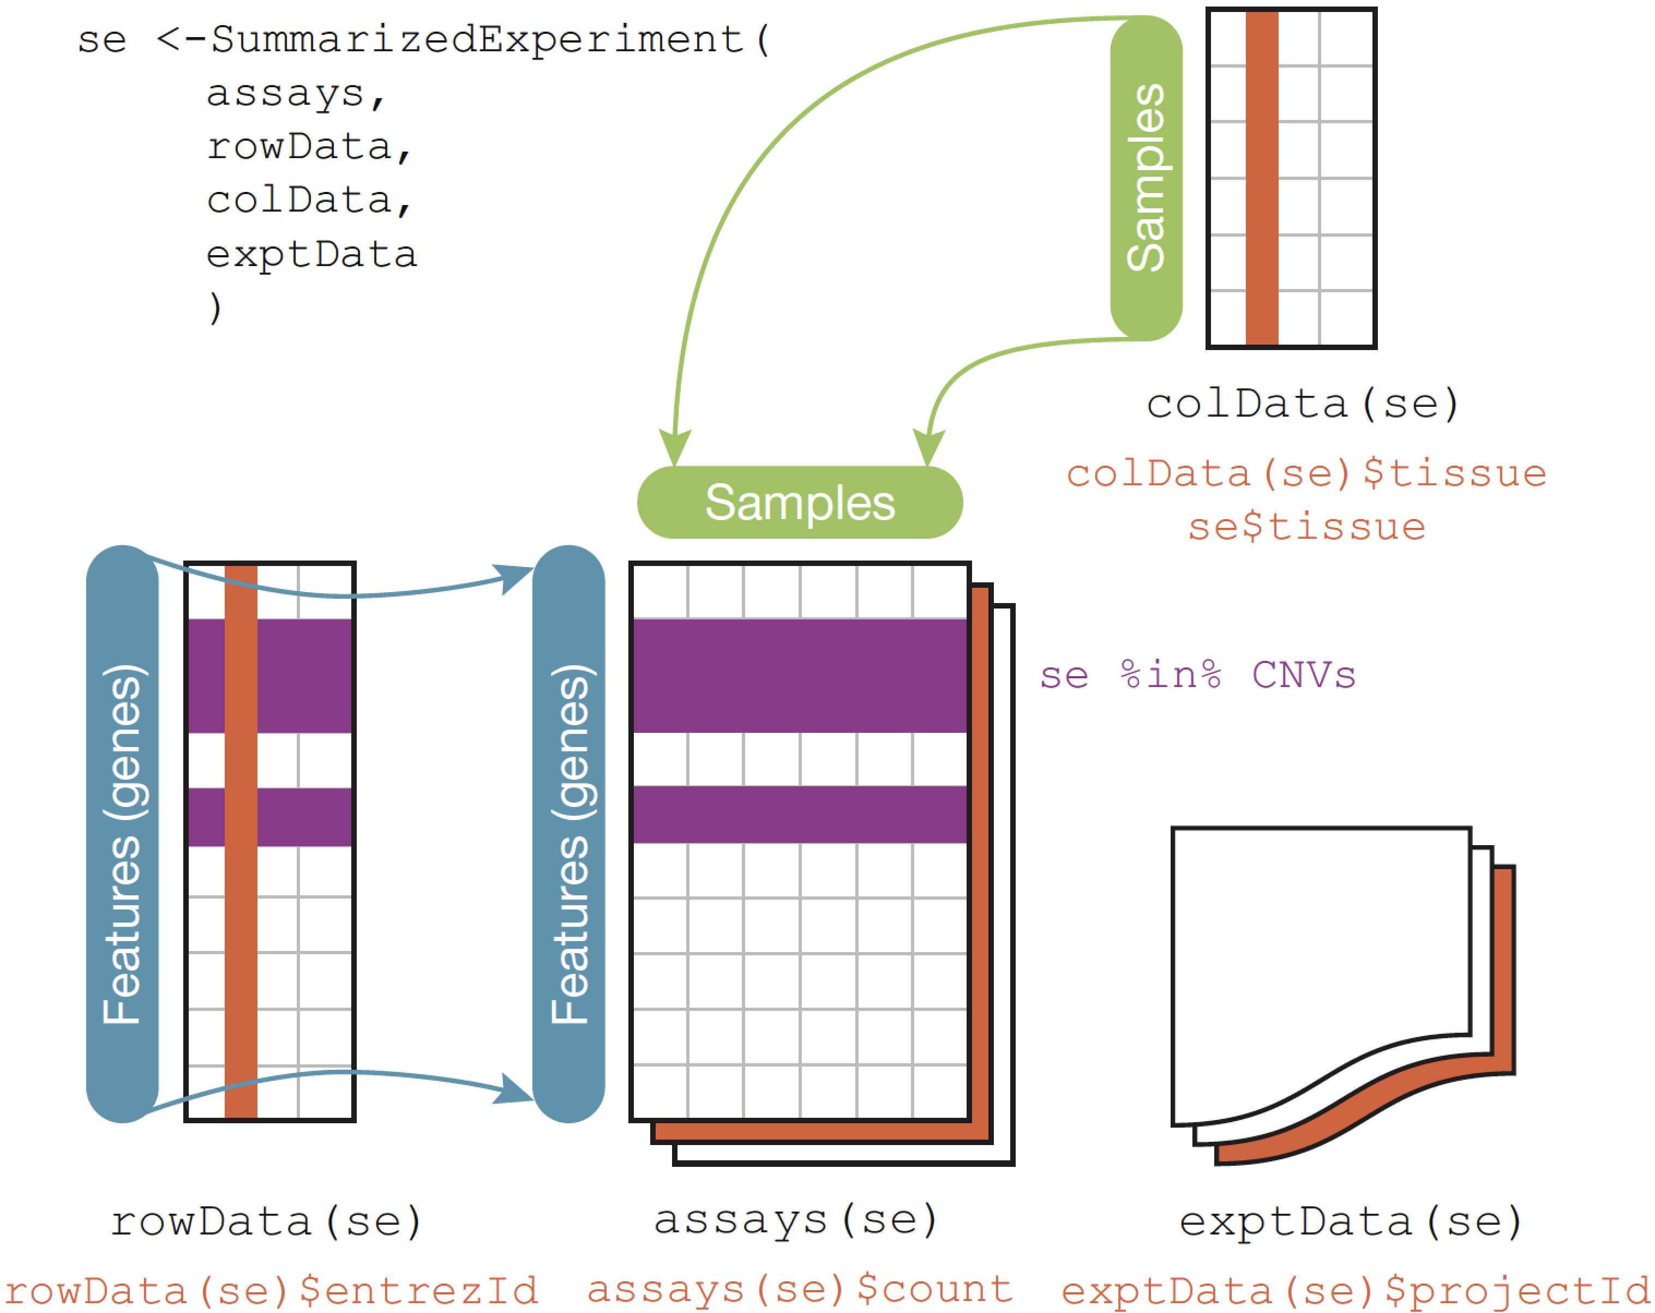
Why Bioconductor?
1,400 packages on a backbone of data structures
The Genomic Ranges algebra
The integrative data container SummarizedExperiment
Huber, W. et al. Orchestrating high-throughput genomic analysis with Bioconductor. Nat. Methods 12, 115–121 (2015).
Notes:
For anyone unfamiliar with Bioconductor, it is a suite of over a thousand packages for statistical analysis and visualization of high-throughput biological data, accessible via the R programming language and unified by a backbone of core data structures designed for the requirements of specific genomic data types.
* Core developers provide this key set of data structures that are efficient and well tested, and contributed packages are expected to use these where applicable
For example, the Genomic Ranges system provides a representation and algebra for any data associated with genomic coordinates. Efficient in-memory and on-disk representations
Integrative data containers such as SummarizedExperiment, integrate high-throughput data with, for example, gene annotations, sample data such as clinical information, experimental metadata, and can even represent multiple assays. In this case, however, the assays must be matrix-like and of identical dimensions
Until now, Bioconductor was lacking in a core data structure to provide a framework for analysis and development of tools for multi-omics experiments

Slide 4
The need for MultiAssayExperiment
Need a core data structure to:
harmonize single-assay data structures
relate multiple assays & clinical data
handle missing and replicate observations
accommodate ID-based and range-based data
support on-disk representations of big data
Notes:
A core data structure was needed to
* harmonize existing structures for different types of data,
* relate assays with each other and clinical data
* handle the reality that such experiments are often incomplete and missing observations on some assays, and also may contain replicates, time series, or matched normal,
* accommodate data that are indexed by IDs such as genes and data indexed by genomic ranges,
* and support on-disk representations for big data

Slide 5
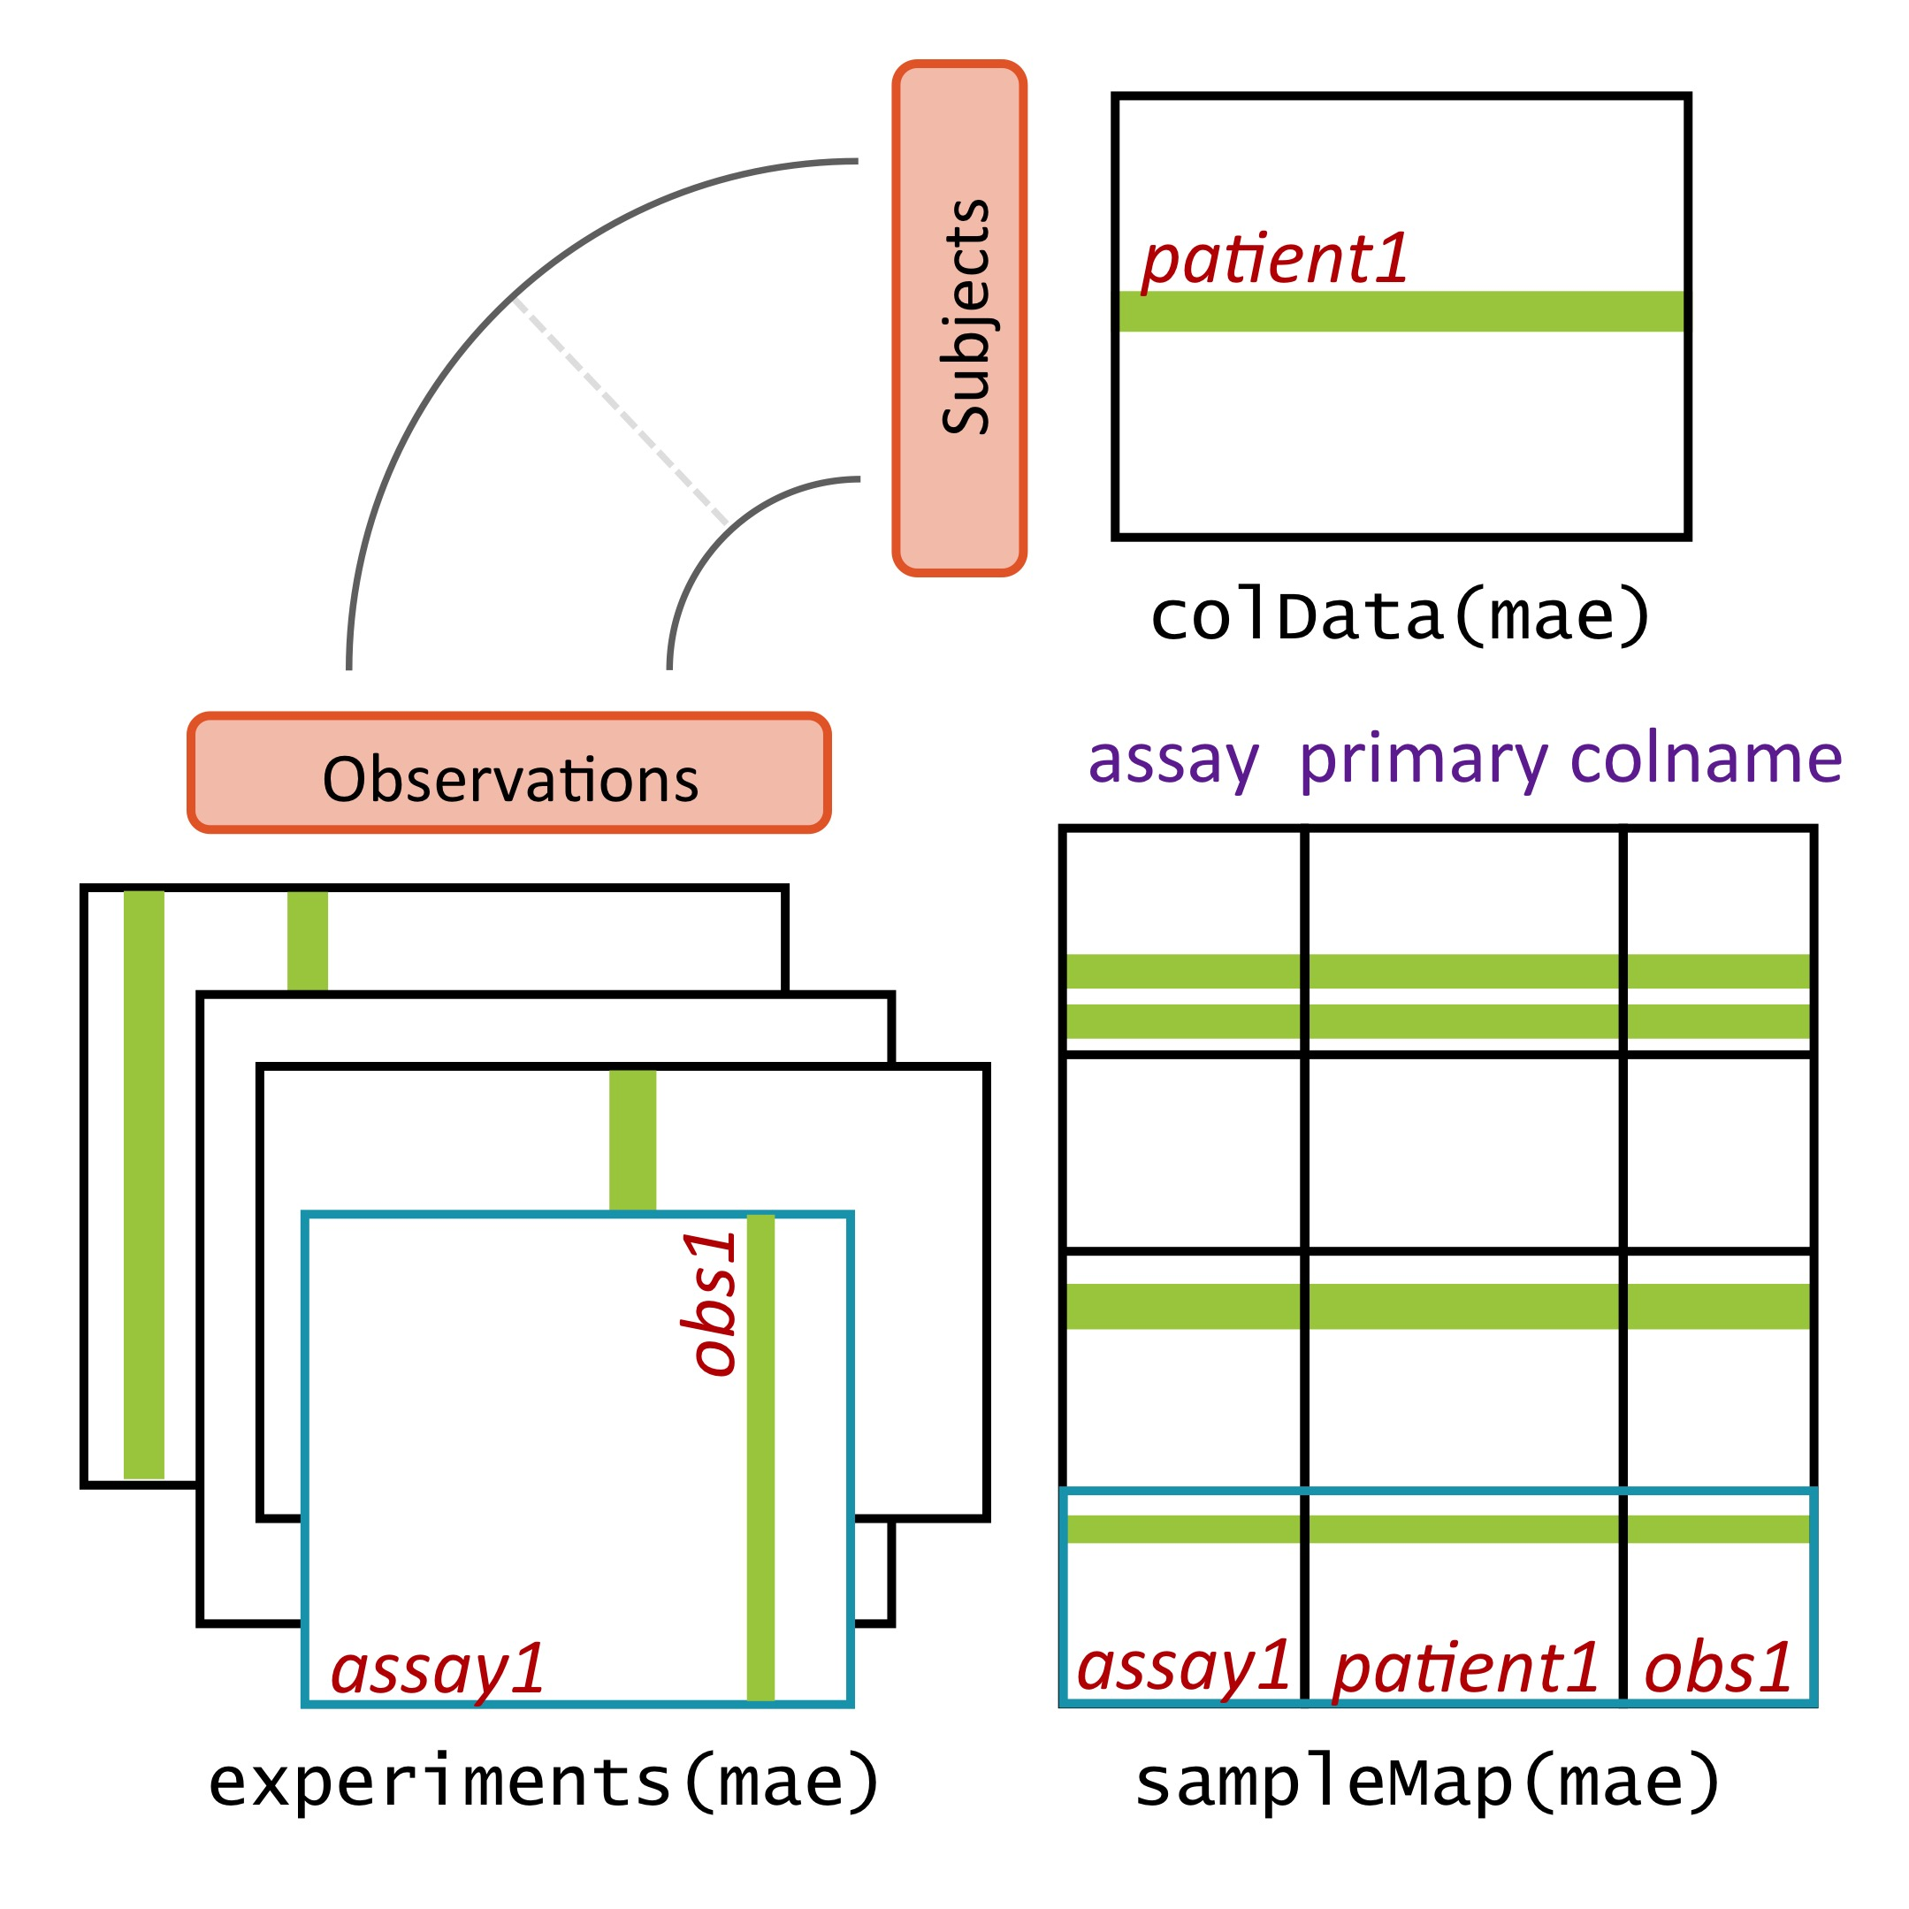
MultiAssayExperiment design
Credit: Marcel Ramos
Notes:
MultiAssayExperiment addresses these challenges by relating a table of information about subjects, say clinical and pathological data, to a series of genomic data sets of arbitrary shape and even non-tabular data, via a map or a network relating these. This sounds complex and it can be, but from the analyst’s perspective, there is an API that will be familiar to users of R, and that abstracts this complexity from the user. Constructing, accessing, subsetting, data management or manipulation, and combining and reshaping into forms usable by standard tools become straightforward.

Slide 6
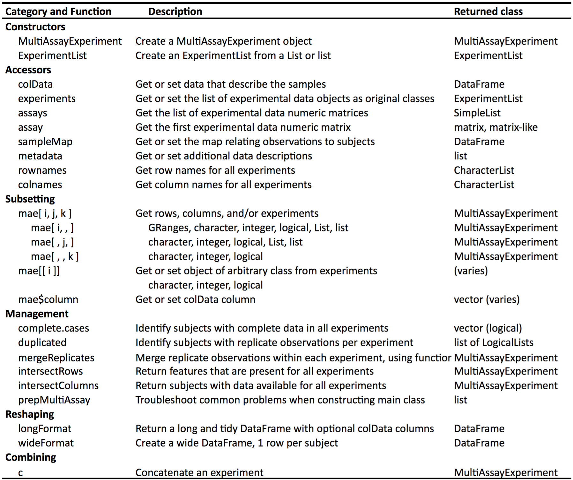
The MultiAssayExperiment API
Credit:
Marcel Ramos
Notes:
To help those wanting to analyze TCGA data, we’ve constructed MultiAssayExperiments for 33 cancer types. Each cancer type is represented by a single object containing all the most commonly used, unrestricted data. These objects are immediately usable, even on most laptops, with the API shown on the previous page.

Slide 7
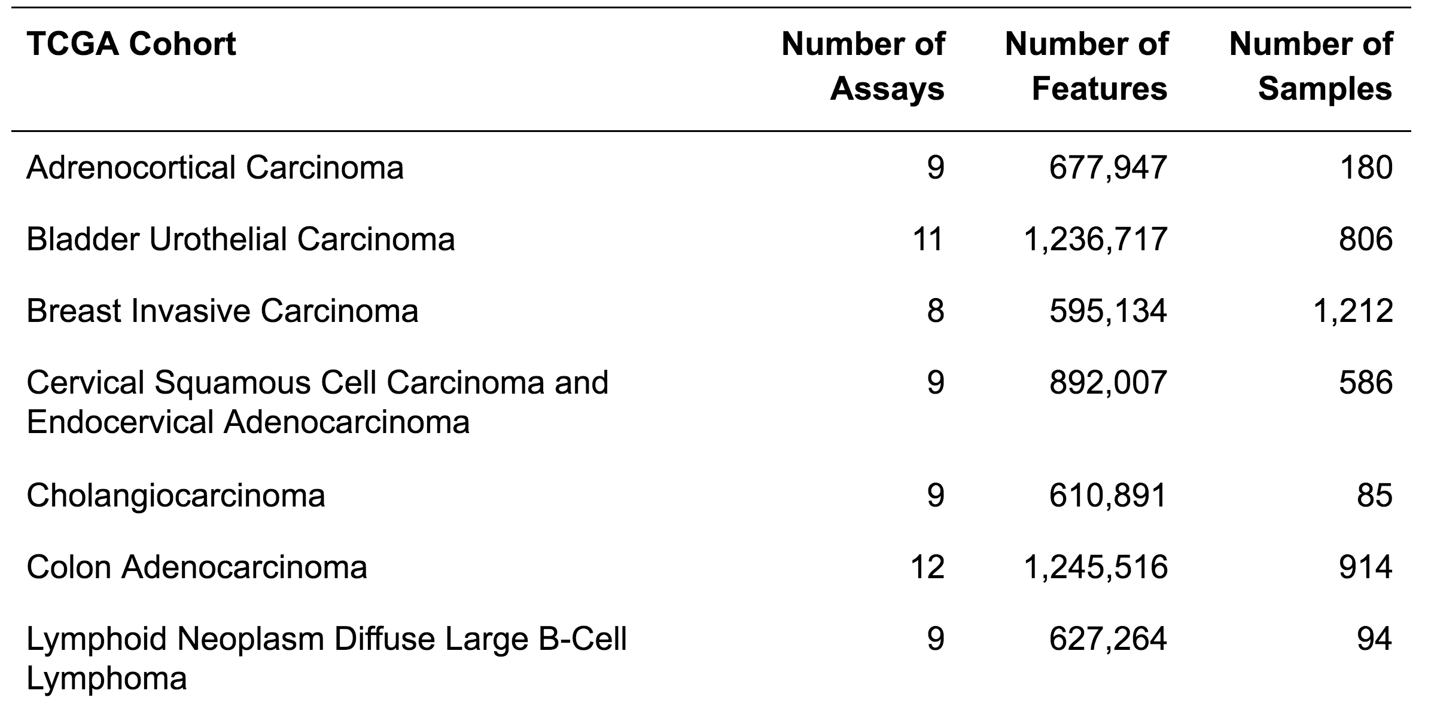
TCGA as MultiAssayExperiments
…... 33 cancer types
Access from www.github.com/waldronlab/MultiAssayExperiment

Slide 8
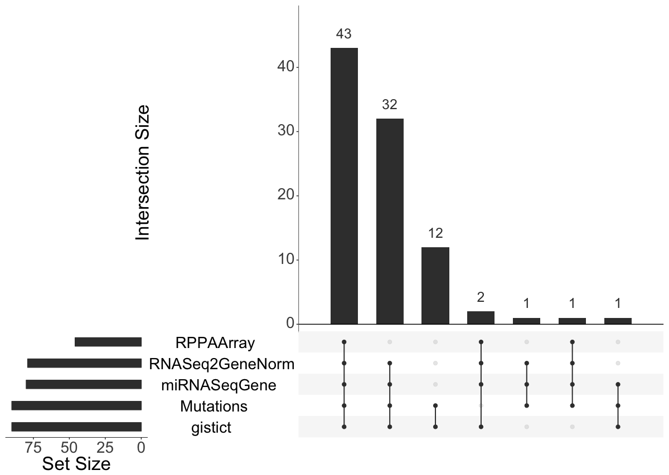
For building visualizations
Upset Venn diagram for adrenocortical carcinoma TCGA
> data(miniACC)
> upsetSamples(miniACC)
Ramos et al., Software for the integration of multi-omics experiments in Bioconductor (submitted).
Notes:
To give you an idea of what this looks like, here is a sort of complex Venn Diagram of just four of the assays for GBM. Although GISTIC copy number and microRNA are assayed on about 600 samples each, but only a fraction of these cases have data available for both, and an even smaller fraction have data for all four of GISTIC, microRNA, methylation, and RNA-seq data.

Slide 9
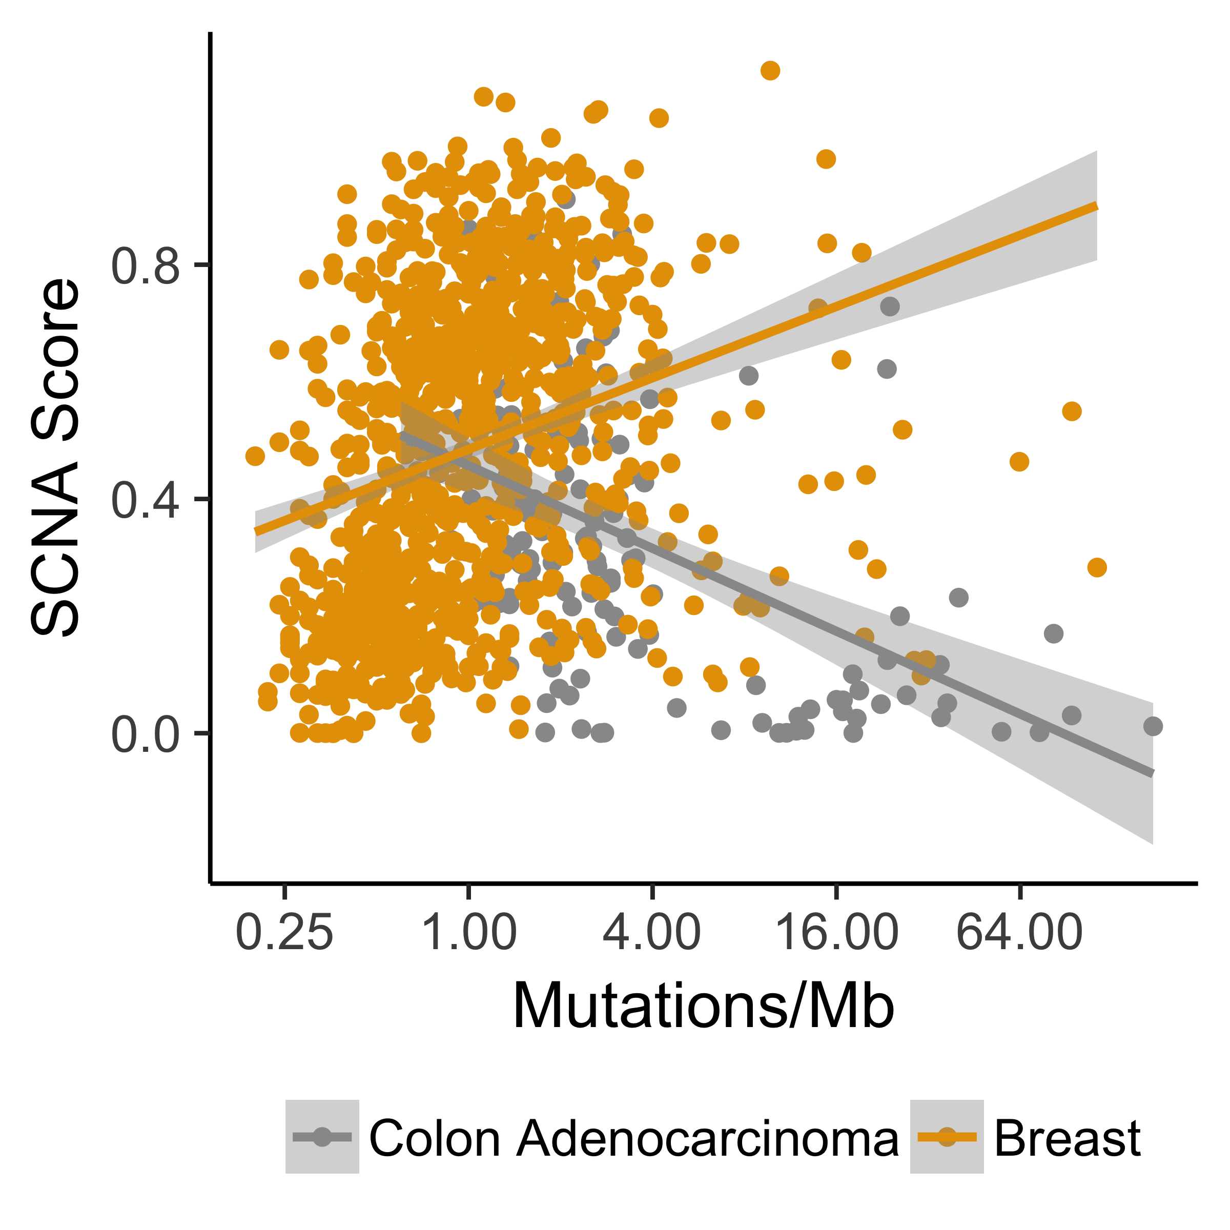
For multi-omics analysis
Davoli et al. Tumor aneuploidy correlates with markers of immune evasion and
with reduced response to immunotherapy. Science 355, (2017).
> mae <- mae[, , c("Mutations", "gistict")]
> mae <- intersectColumns(mae)
> mae$cnload <- colMeans(abs(assay(mae[["gistict"]])))
Ramos et al., Software for the integration of multi-omics experiments in Bioconductor (submitted).
Notes:
Analyses of a single assay or that combine assays, such as this reproduction of the result from Davoli et al. that cancer types with high levels of aneuploidy often show a positive correlation of mutation load and chromosomal instability, perhaps due to a higher tolerance of deleterious mutations, as shown here in orange for breast cancer. Whereas, tumors with a hypermutator phenotype rarely display extensive chromosomal instability, resulting in a negative correlation of mutation load and chromosomal instability in cancer types where hypermutation is common (shown in grey for colon adenocarcinoma).

Slide 10
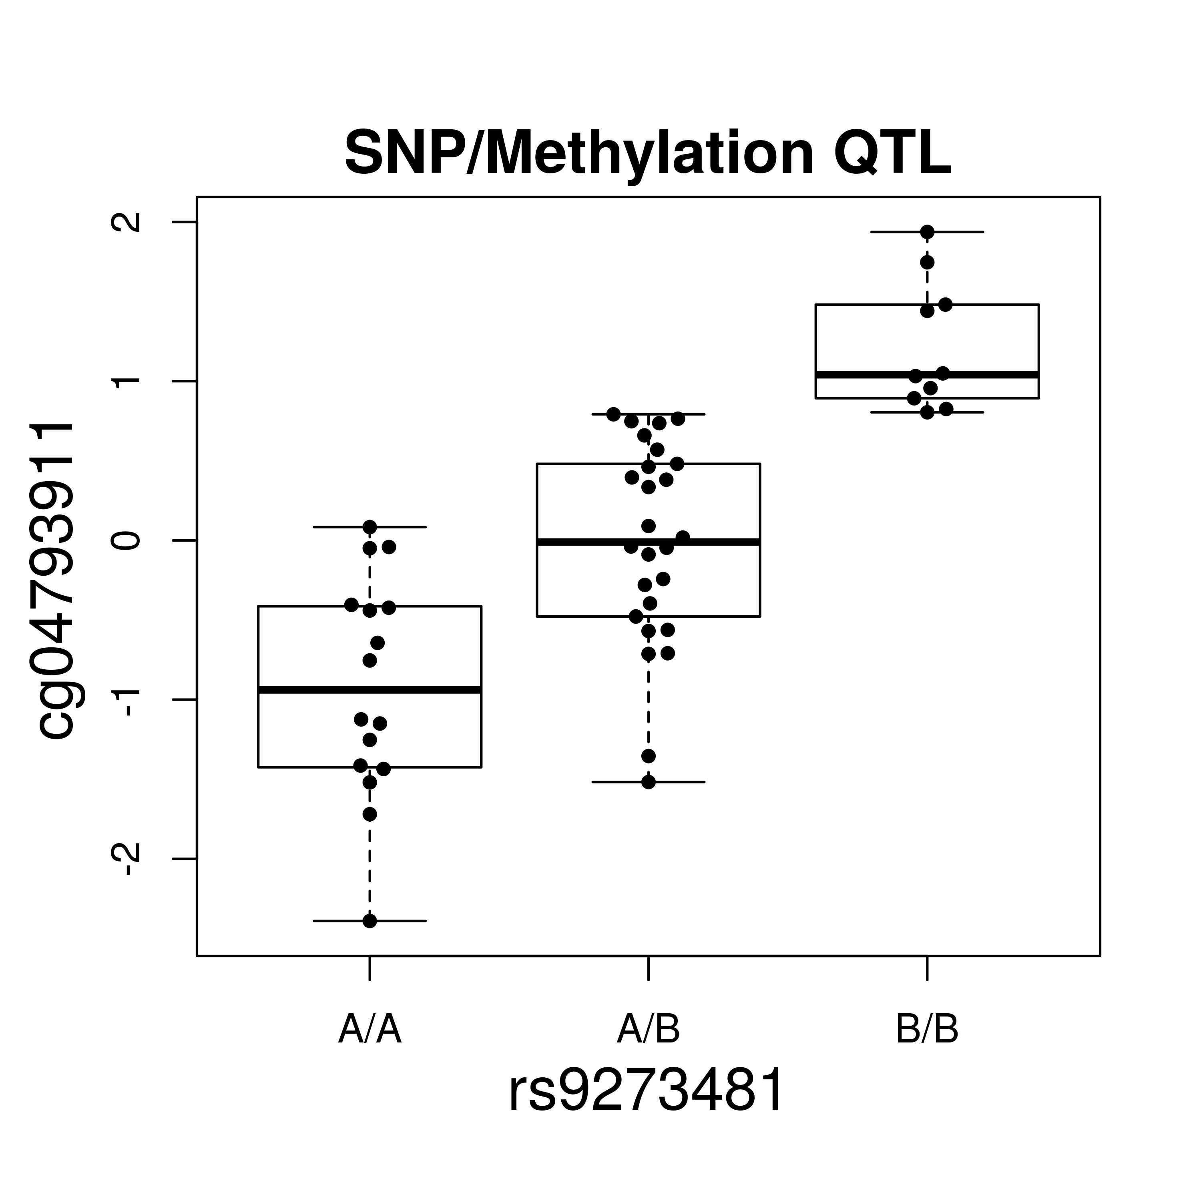
For integrating remotely stored data
Using tabix-indexed SNP VCFs from 1000 genomes
on Amazon S3
credit: Vince Carey
> st <- ldblock::stack1kg() #Create a URL referencing 1000 genomes content in AWS S3
> multiban <- MultiAssayExperiment(
list(meth = banovichSE, snp = st),
colData = colData(banovichSE))
> multibanfocus <- multiban[rowRanges(banovichSE)[“cg04793911”], ]
> assoc <- cisAssoc(multibanfocus[[“meth”]],
TabixFile(files(multibanfocus[[“snp”]])))
Ramos et al., Software for the integration of multi-omics experiments in Bioconductor (submitted).
Notes:
Larger files, such as SNPs in VCF format, demonstrated here from the 1000 genomes project because this is unrestricted data, can be analyzed for example in this SNP/methylation association study, in chunks from an on-disk representation. This data format, by the way, was supported by default without any modification of MultiAssayExperiment, as is any data class meeting a few minimum requirements.

Slide 11
Demo video
https://youtu.be/XziAMLf_AYI

Slide 12
Future work
Distribute TCGA, cBioPortal through ExperimentHub
integrating clinical data and supplemental data in MAE
Recognize relationships between:
genomic ranges – gene IDs – microRNAs – proteins
regulatory elements

Slide 13
THANK YOU
Lab (www.waldronlab.org)
Marcel Ramos, Lucas Schiffer, Andy Samedy, Abzal Bacchus, Carmen Rodriguez, Audrey Renson, Ludwig Geistlinger
U24 CA180996 Collaborators
Martin Morgan, Vincent Carey, Kasper Hansen
CUNY high-performance computing center

