Slide 1



MultiAssayExperiment Software for the integration of multi-omics experiments in Bioconductor
U24CA180996 (PI: Martin Morgan)
Co-investigators: Levi Waldron, Vincent Carey, Kasper Hansen
Video demo: https://youtu.be/XziAMLf_AYI
Workshop: https://ww.github.com/waldronlab/MultiAssayExperimentWorkshop

Slide 2
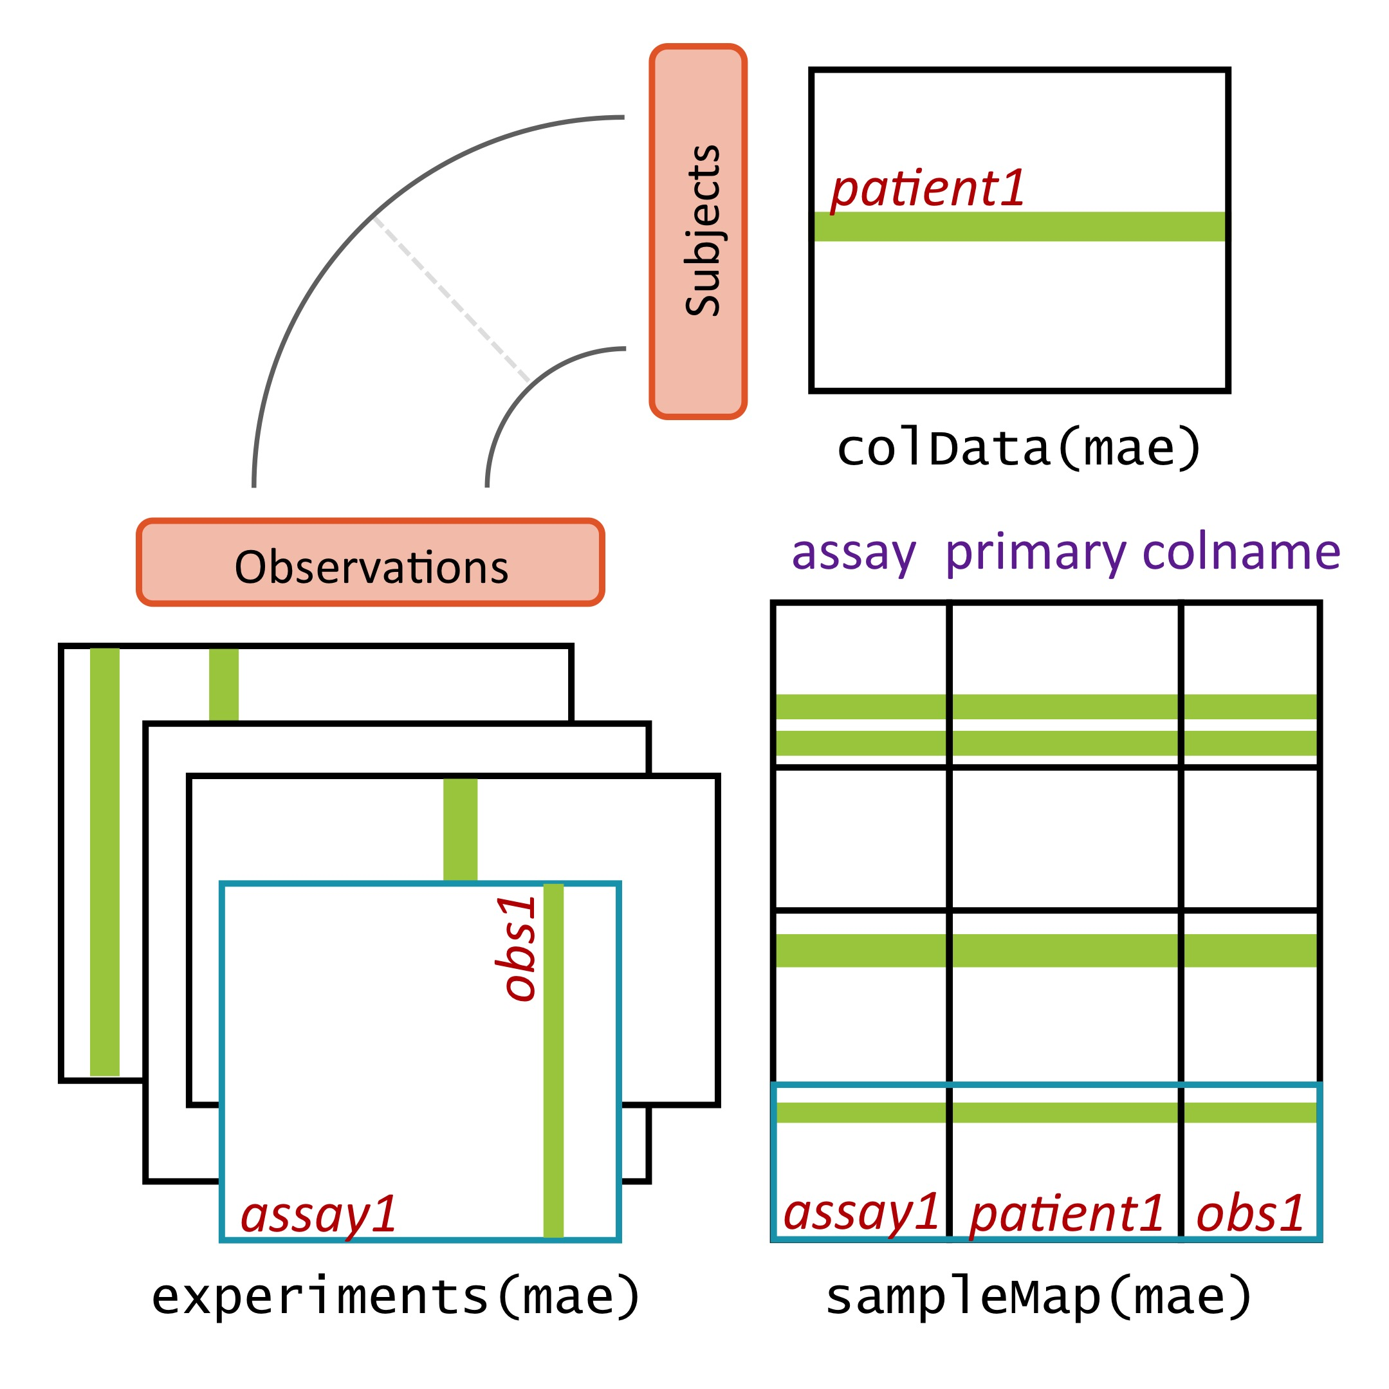
MultiAssayExperiment design
Ramos et al. Cancer Research (In Press)
biorxiv 144774
Notes:
MultiAssayExperiment addresses these challenges by relating a table of information about subjects, say clinical and pathological data, to a series of genomic data sets of arbitrary shape and even non-tabular data, via a map or a network relating these. This sounds complex and it can be, but from the analyst’s perspective, there is an API that will be familiar to users of R, and that abstracts this complexity from the user. Constructing, accessing, subsetting, data management or manipulation, and combining and reshaping into forms usable by standard tools become straightforward.

Slide 3
colData
Comparable to SummarizedExperiment
Class DataFrame
MAE$var1 or colData(MAE)$var1
Ramos et al. Cancer Research (In Press) biorxiv 144774

Slide 4
ExperimentList
Observations stored as class ExperimentList
List of elements that meet a few requirements
Square-bracket subsetting: [i, j]
dimnames() / [ rownames() / colnames() ]
dim()
Optional: assay()
Open-ended set of supported classes, including:
(Ranged)SummarizedExperiment, ExpressionSet, (Ranged)VcfStack, matrix, delayedMatrix, sparseMatrix, RaggedExperiment, …
Subset by IDs or by GRanges
Ramos et al. Cancer Research (In Press) biorxiv 144774

Slide 5
sampleMap
A 3-column edge list graph representation
1 colData row any # of assay columns
1 assay column 1 colData row
exactly
Ramos et al. Cancer Research (In Press) biorxiv 144774

Slide 6
sampleMap
A 3-column edge list graph representation
May have different naming conventions for each assay
Ramos et al. Cancer Research (In Press) biorxiv 144774

Slide 7
sampleMap
For example… single-cell RNA-seq data with 2 samples, 900 and 1100 cells profiled:
colData could have 2 rows or 2000 rows
Profiles in one or two ExperimentList elements
Methylation etc with different # cells as additional ExperimentList elements
Similar decisions to make for:
Pharmacogenomics dose-response
Time series
Nesting possible in colData DataFrame
Ramos et al. Cancer Research (In Press) biorxiv 144774

Slide 8
Considerations in MAE construction
Do you want to use unified colData or per-experiment colData?
How do you want to subset the MAE? “columns” here refer to the MAE pData
[rows, columns, assays]
(How) will you use wideFormat() / longFormat() to integrate & extract?
colDataCols arg copies colData columns
Ramos et al. Cancer Research (In Press) biorxiv 144774

Slide 9
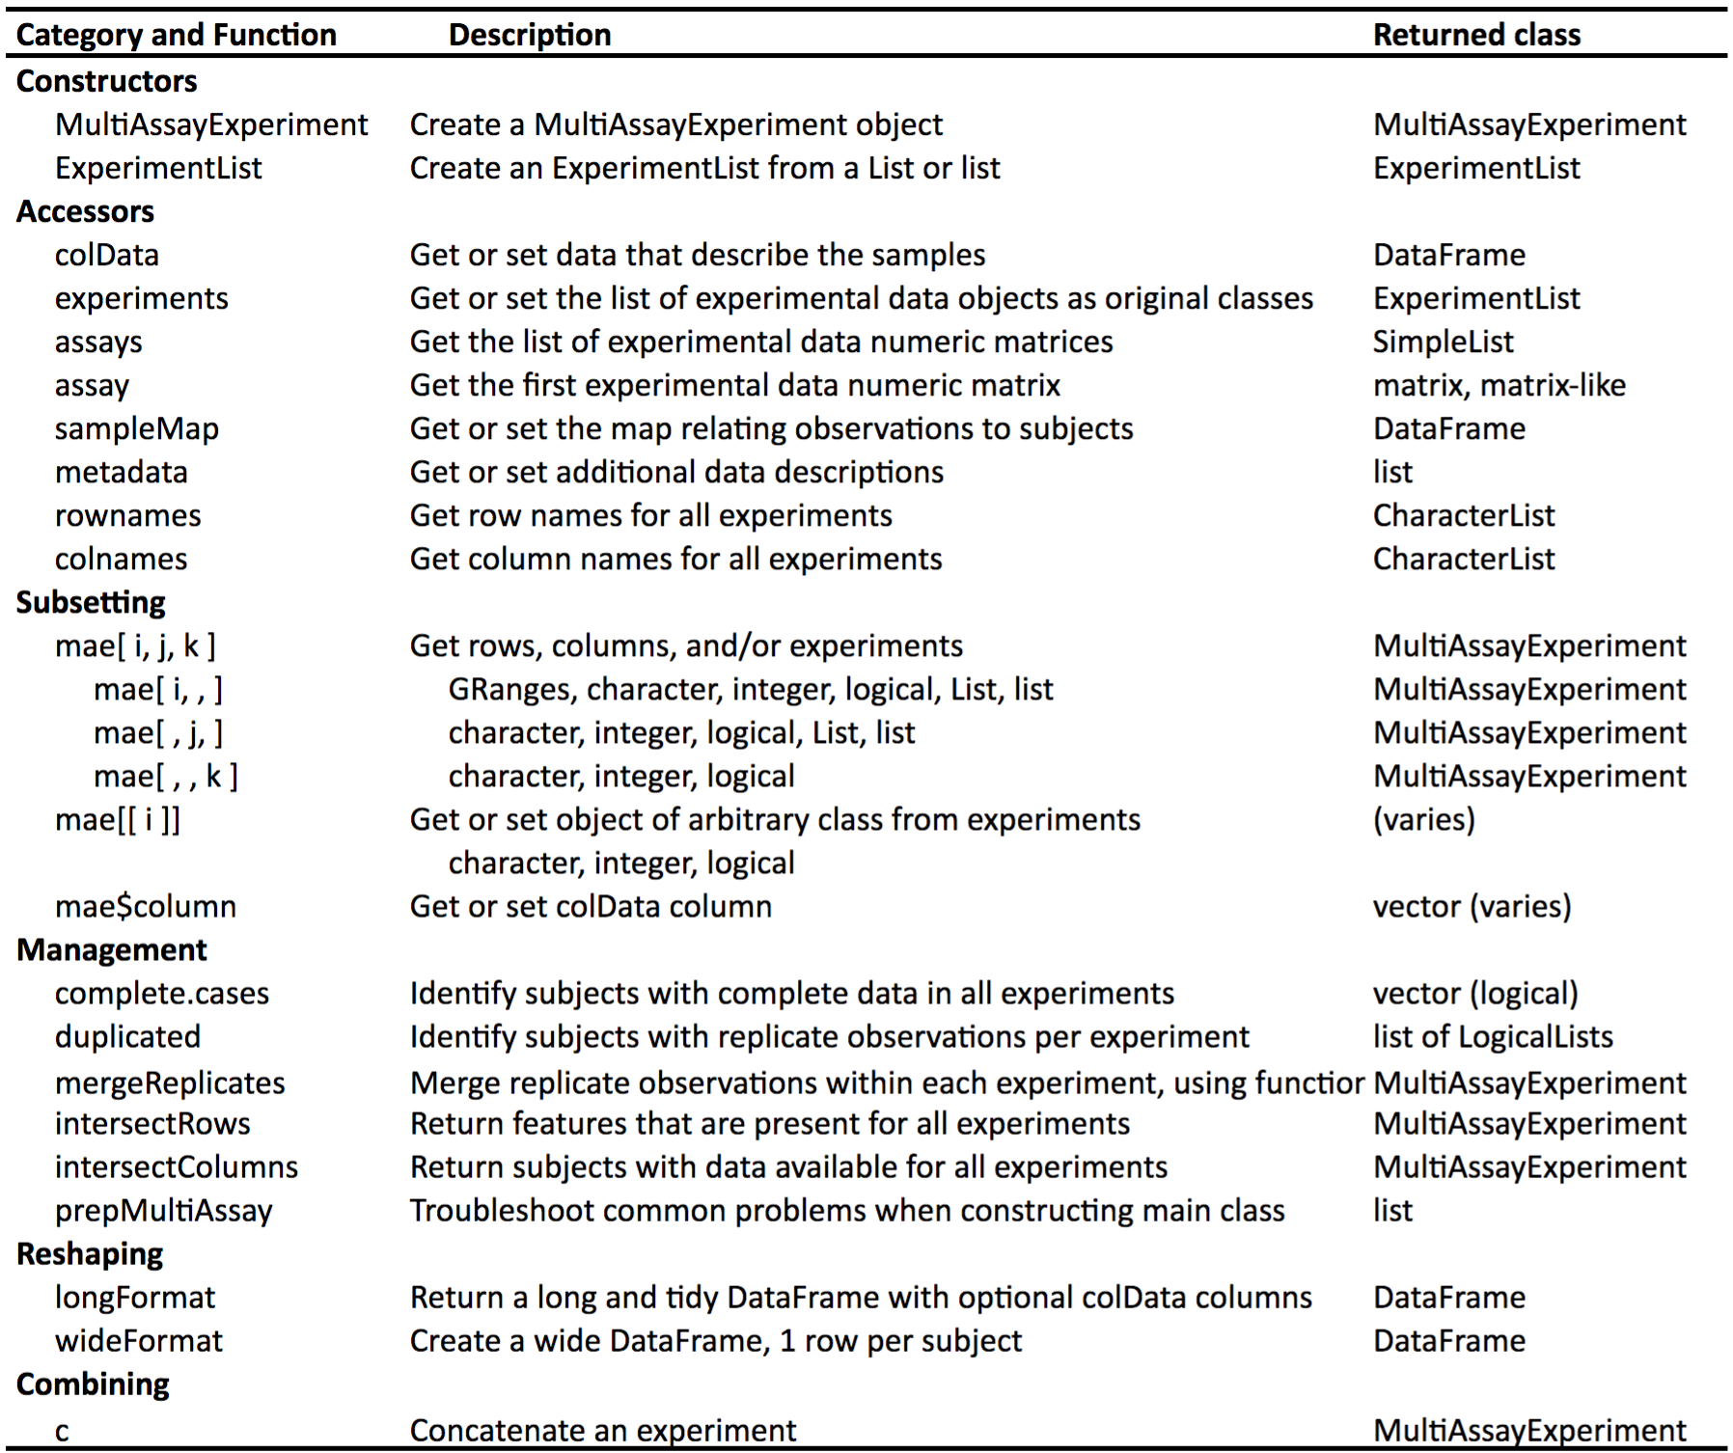
The MultiAssayExperiment API
Credit:
Marcel Ramos
“Packages” -> MultiAssayExperimentWorkshop -> MultiAssayExperiment-cheatsheet

Slide 10
The workshop vignette
www.tinyurl.com/MAEOurls #full-sized TCGA MAE objects
Open the vignettes in your RStudio editor:
> file.edit(system.file(package = ”MultiAssayExperimentWorkshop",
"doc/MultiAssayExperiment-lab.Rmd"))
*** vignette is missing a library(Biobase) ***
To install dependencies on your own RStudio desktop:
> BiocInstaller::biocLite("waldronlab/MultiAssayExperimentWorkshop",
dependencies=TRUE, build_vignettes=TRUE)

