Slide 1
Data Science and Bioinformatics: Exploiting Publicly Available Public Health Data
Levi Waldron, PhD.
CUNY School of Public Health
and Hunter College
December 16, 2015

Slide 2
Overview
Value of Publicly Available Data
Examples of usage
Challenges faced
Integrating data science into our programs

Slide 3
Value of Publicly Available Data
Advances knowledge faster than private data
Tremendous resources can go into public datasets
Encourages creative re-use of data
Data are being generated faster than anyone can analyze it
Allows peer-review of data, reproducible research

Slide 4
Examples
Gene Expression
GEO: Gene Expression Omnibus
Health and Nutrition
NHIS: National Health Interview Survey
NDI: National Death Index
BRFSS: Behavioral Risk Factor Surveillance System
Adverse Drug Events
FDA AERS: Adverse Event Reporting System
Comprehensive cancer genomics
TCGA: The Cancer Genome Atlas

Slide 5
Gene Expression Omnibus (GEO)
A public repository for the archiving and distribution of gene expression data submitted by the scientific community.
MIAME compliant data.
Minimum Information About a Microarray Experiment http://www.mged.org/Workgroups/MIAME/miame.html
Convenient for deposition of gene expression data, as required by funding agencies and journals.
Online resource for gene expression data browsing, query, analysis and retrieval.

Slide 6
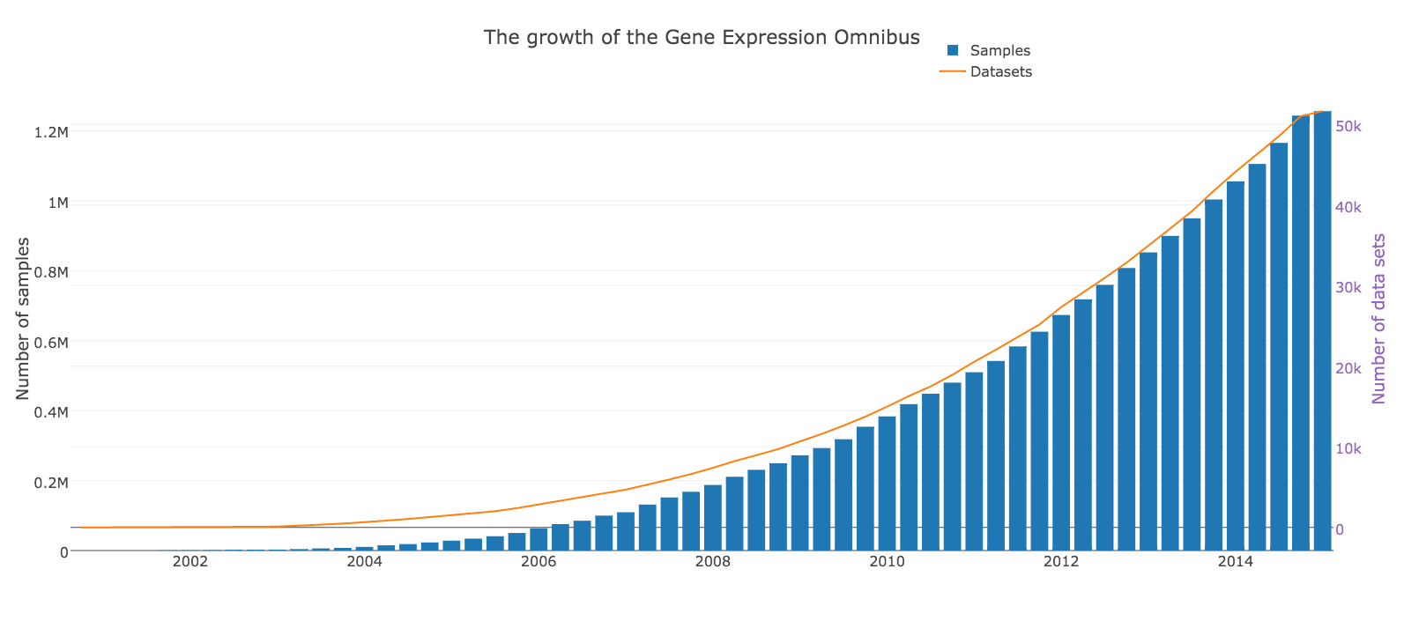
Growth of GEO
Creative Commons image from https://plot.ly/34/~sambucas/

Slide 7
Applications of GEO
Can address specific questions, e.g.
Which of several proposed molecular subtypes of ovarian cancer should we apply in clinical and epidemiological research?
Are health disparities in incidence and outcome of prostate cancer mediated by microRNA-1207-3p?

Slide 8

Meta-analysis of ovarian cancer subtypes
Questions:
Do the methods and results of published ovarian cancer subtyping schemes associate with clinical, pathological, or demographic factors in independent datasets?
Are proposed ovarian subtyping schemes robust across datasets?
Lavanya Kannan
Post-doctoral fellow

Slide 9
Meta-analysis of ovarian cancer subtypes
Methods:
Read published descriptions of subtype classification algorithms
Implement complex subtype definitions as open-source algorithms in R
Generate validation datasets from GEO
Assess subtype definitions and compare to original publication

Slide 10
Using GEO for meta-analysis
25 curated ovarian cancer gene expression datasets
3,500 patients
Original cost ~ $500 / microarray
New cost: ~1 year of curation and “data wrangling” time

Slide 11
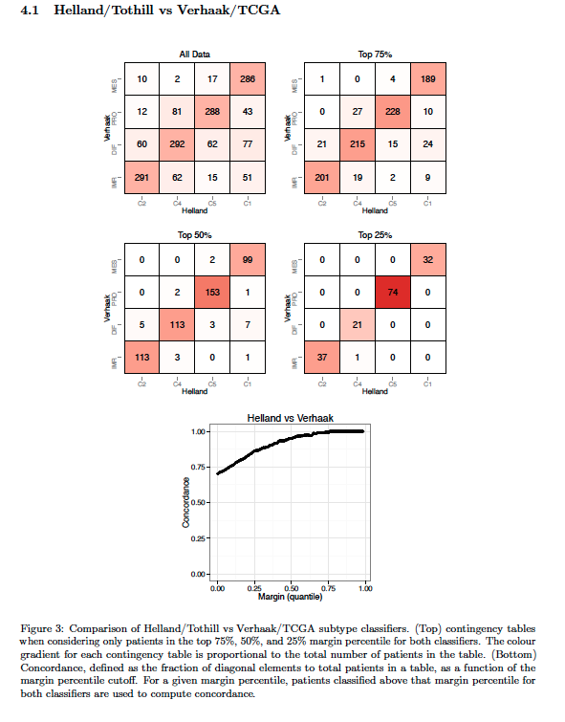
Proposed subtypes have a lot in common!
Top left: contingency table of two 4-subtype schemes
Other panels: removal of “marginal” calls
Bottom: Concordance vs. # marginal calls removed
Summary: except for “marginal cases”, different subtyping algorithms are highly similar

Slide 12

Using GEO to understand the biology of health disparities in prostate cancer
Racial/Ethnic Group | Incidence | Death
All | 168 | 27.9
African American/Black | 255.5 | 62.3
Asian/Pacific Islander | 96.5 | 11.3
Hispanic/Latino | 140.8 | 21.2
American Indian/Alaska Native | 68.2 | 21.5
White | 161.4 | 25.6
Prostate Cancer Incidence and Death Rates. Statistics are for 2000-2004, age-adjusted to the 2000 U.S. standard million population, and represent the number of new cases of invasive cancer (1) and deaths (2) per year per 100,000 men.
Source: Surveillance, Epidemiology, and End Results (SEER) Program (http://www.seer.cancer.gov)
Peter Chernek,
MPH candidate

Slide 13
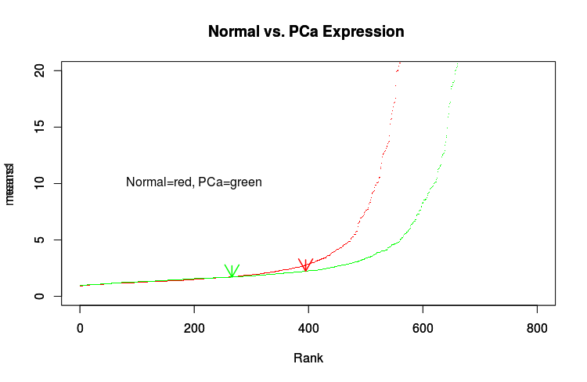
Using GEO to understand the biology of health disparities in prostate cancer
Dataset GSE40026: Expression profiling of prostate cell lines by miRNA array
(934 miRNA profiled)
Mean expression of all miRNA
miRNA-1207-3p
Rank
Collaborator: Olorunseun Ogunwobi, MD, PhD Hunter College

Slide 14

SES based on all-cause mortality
Objective:
Develop a quantitative indicator of Socioeconomic Status (SES) based on non-causal risk factors that is optimally predictive of all-cause mortality
Methods:
Merge National Health Interview Survey (NHIS) data with National Death Index (NDI) data
Predictors: insurance type, education, poverty indicators
Marcel Ramos
MPH graduate

Slide 15
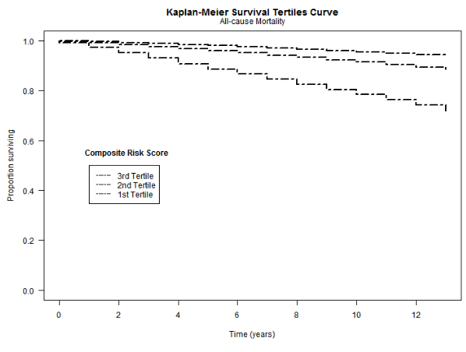
Summary: SES based on all-cause mortality
highly predictive indicator based on non-causal social indicators
Need to compare to existing measures of SES

Slide 16
Mapping obesity in the U.S.
Marcel Ramos, Henry Wang, Jasmine Abdelnabi, Marcel Ramos
MPH graduates
Kezhen Fei
DPH candidate
Ashish Joshi
faculty

Slide 17
Mapping obesity in the U.S.
Objectives:
To represent obesity prevalence proportions by state in an interactive format
Combine BRFSS datasets with Census data for age-standardization
Subset datasets “on-the-fly” for visualization while accounting for complex survey design and age standardization
https://mramos.shinyapps.io/obView

Slide 18
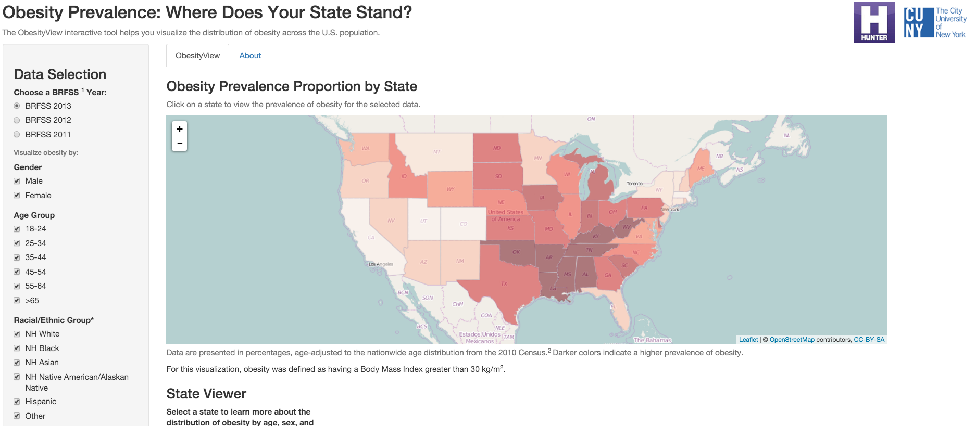
Mapping obesity in the U.S.
https://mramos.shinyapps.io/obView

Slide 19

Adverse Drug Events
Objective:
Predict adverse drug events before they happen
Data sources:
FDA Adverse Event Reporting System
200,000+ records per quarter
provides information on all drugs taken by case
requires complex merging
CDC Wonder Vaccine Adverse Event Reporting System
CMS Medicare Claims
Department of Veteran’s Affairs
Angela Laurio
DPH candidate

Slide 20
The Cancer Genome Atlas
Tiffany Chan, Peter Chernek, Jamie Wood
MPH candidates
Marcel Ramos
MPH graduate
Ahou Eby, Rimsha Azhar, Stephie Louis
City Tech Biomedical Informatics interns

Slide 21
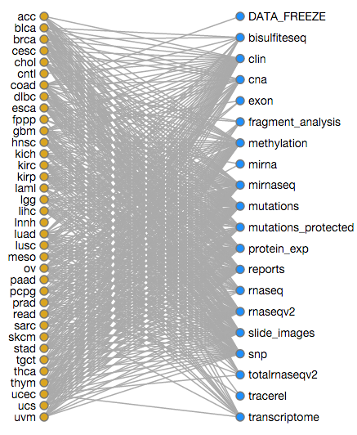
The Cancer Genome Atlas
Comprehensive genomic profiling of 36 cancer types
More than 12 genomic data types for each cancer
Clinical, pathological, demographic data

Slide 22
The Cancer Genome Atlas
Objectives
Determine the minority representation in TCGA and impacts on disease study
Ease the very difficult process of “data wrangling”
109295 files, 2.34 PB of data
Multiple types and “levels” of clinical, pathological, demographic data, with follow-up visits

Slide 23
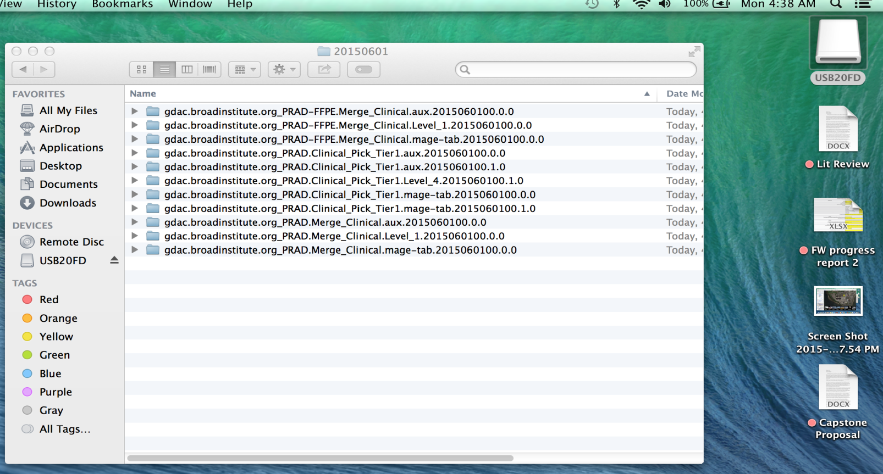

Wrangling TCGA clinical & demographic data
Level 1
Level 4
Level 1
Tiffany Chan, MPH candidate

Slide 24
Reproducible, scalable data merging
EXAMPLE FROM PROSTATE CANCER:
ID | Race | Psa
A- | NA | yes
B- | white | yes
C- | white | yes
D- | white | no
E- | black | yes
F- | white | yes
G- | Asian | no
ID | cqcf.race | Psa_results
A.01 | black | 1
B.01 | white | 1
C.01 | white | 1
D.01 | NA | 0
E.01 | NA | 1
F.01 | white | 1
G.01 | NA | 0

Slide 25
Race variables in prostate cancer
Race using TCGA’s own merging:
Race after our merging:

Slide 26
Representation of minorities in TCGA
Collaborators: Oloreunseun Ogunwobi (Hunter), Joe Osborne (WCMC), Dan Spratt (U Mich)

Slide 27
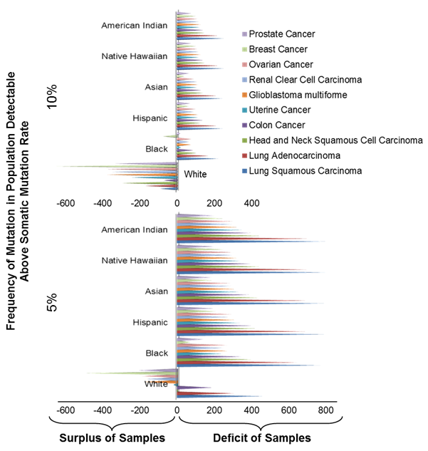
Low representation impacts discovery of minority-specific mutations
# samples needed to detect cancer mutations occurring in 5% and 10% of population
Collaborators: Oloreunseun Ogunwobi (Hunter), Joe Osborne (WCMC), Dan Spratt (U Mich)

Slide 28
Challenges common to utilizing publicly available data
Often not user friendly
Difficulties in identifying appropriate variables
Lengthy / incomplete / machine-unfriendly codebooks
Accessing data is complicated
Data is often distributed in a server across numerous files
Proprietary or specialized data storage formats
Needs to be done reproducibly

Slide 29
What is data science?
“an interdisciplinary field about processes and systems to extract knowledge or insights from data in various forms, either structured or unstructured…” (Wikipedia)
“A data scientist is someone who is better at statistics than any software engineer and better at software engineering than any statistician.” (Josh Wills, http://bit.ly/1peSKvl)
Deals with new and rapidly expanding data sources

Slide 30
Key elements of Data Science
Statistics / Epidemiology knowledge
Comfort with data science tools for data collection, merging, analysis, and visualization
Distributed version control: git/GitHub
Stringing together tools: *nix shell
Data storage and query: SQL
Software development: Python / Java
All-in-one: R

Slide 31
Public Health Data Science at CUNY SPH?
Epidemiology and Biostatistics at SPH
Solid epidemiology, Biostatistics rapidly developing with new faculty
Need better training in software and statistical methods for large / many-variable data (machine learning and clustering)
Significant interest even though unadvertised
Synergy with City College computer science, Hunter bioinformatics?

Slide 32
Thank you
Active lab members (presenting in lab meeting):
Full-time: Marcel Ramos, Lavanya Kannan
Part-time: Ahou Eby, Rimsha Azhar, Stephie Louis
MPH: Tiffany Chan, Jamie Wood, Peter Chernek, Jasmine Nicodemus
Statistical Learning Book Club (presenting members):
Jesica Rodriguez-Lopez, Marcel Ramos, Nastasia Claire, Jennifer Brite, Anna Stachel, Kezhen Fei, Sal Leggio, Patrick Grigsby, Rodrigo Cardozo, Lucas Schiffer, Lavanya Kannan, Eleanore Howe*, Timothy Tickle* (*Broad Institute, all others CUNY)
Currently reading “Data Analysis for the Life Sciences” by Irizarry and Love

