Slide 1
Avoiding disappointment in predictive modeling
Levi Waldron, PhD.
CUNY School of Public Health
U.S. Fulbright awardee to University of Trento, IT
April 28, 2016

Slide 2

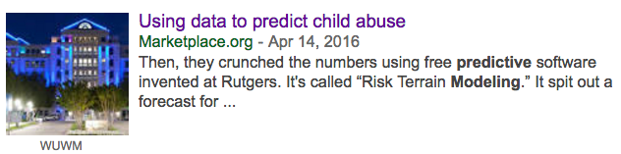
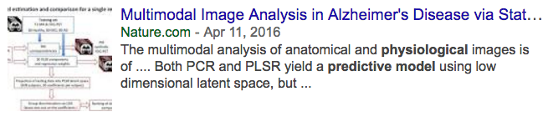
What is predictive modeling?

Slide 3
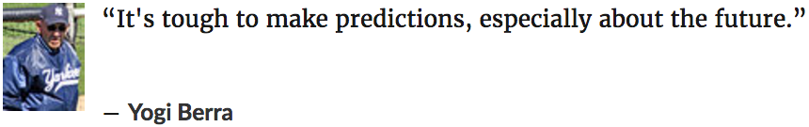
What is predictive modeling?
Almost all published predictive models
make predictions about the past

Slide 4
What is disappointment?
Scenario 1: You spend years collecting precious data and analyzing it to show that FDG-PET and MRI images can provide an early marker of Alzheimers, and find that the predictions are no better than coin flips.
PLoS ONE
Journal of Negative Results

Slide 5
What is disappointment?
Scenario 2: You spend years collecting precious data and analyzing it to show that FDG-PET and MRI images can provide an early marker of Alzheimers, and find your model has 99.9% accuracy. But in follow-up studies, the predictions are no better than coin flips.
Nature, SCIENCE
retraction?
patient harm, field loses credibility

Slide 6
What is disappointment?
Scenario 3: You spend years collecting precious data and analyzing it to show that FDG-PET and MRI images can provide an early marker of Alzheimers, and find your model has 99.9% accuracy. But in follow-up studies, the predictions are not as good, maybe no better than currently available methods.
Nature, SCIENCE
more years and grant money lost
field loses credibility

Slide 7
What is disappointment?
Scenario 4: You spend years collecting precious data and analyzing it to show that FDG-PET and MRI images can provide an early marker of Alzheimers, and find your model has 70% accuracy, not quite as good as currently available methods. But in follow-up studies, the model is refined and predictions improve to the point of clinical value.
discipline-specific journals
follow-up time spent improving on promising leads
eventual benefit to patients

Slide 8
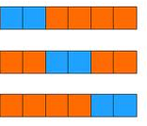

Training + Validation
Cross-validation to estimate
prediction accuracy
Independent Validation
training test
Dataset 2
Dataset 3
Lasso
Ridge
Elastic Net
Random Forests
Support Vector Machine
K Nearest Neighbors
Supervised PCA
Linear Discriminant Analysis
Boosting / Bagging
Insert Favorite Method Here
Need a new cohort of patients
Can use public data
Data are still from the past
“Risk Terrain Modeling”

Slide 9
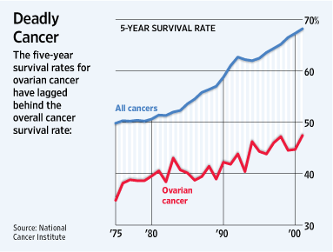
Prognostic gene signatures of ovarian cancer
22,000 new cases each year
14,400 women die each year
Majority late-stage, high-grade, serous disease
Notes:
on ovarian cancer that encompasses all of these. Ovarian cancer is a major cause of mortality, and improvements in prognosis have lagged other cancers. One reason for this is that a majority of patients present with late-stage, high-grade, serous histology – this is a high-risk group with <50% 5-year survival, with little available from a clinical perspective to further refine prognosis.

Slide 10
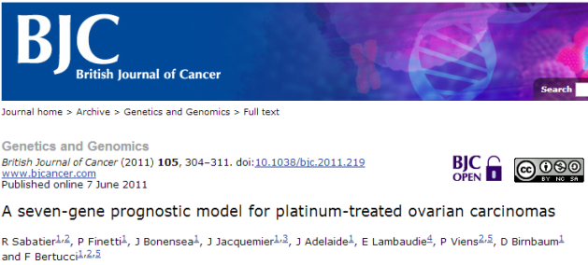
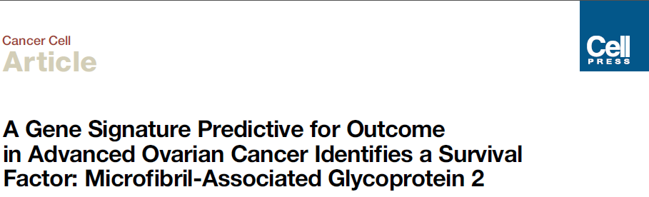
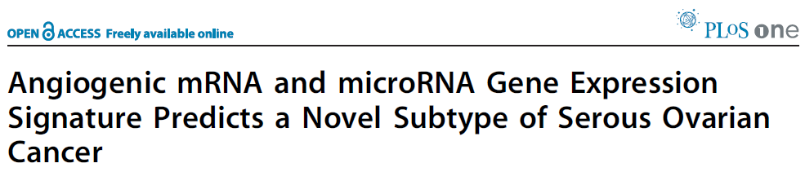
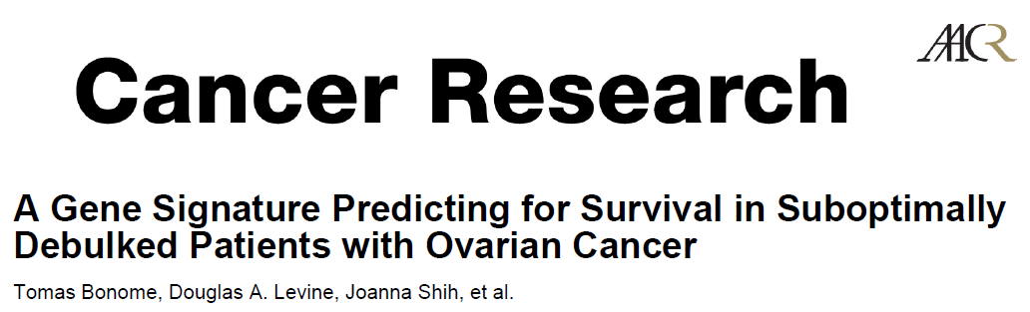
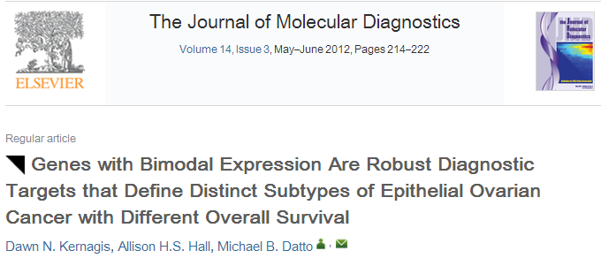
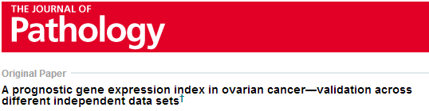
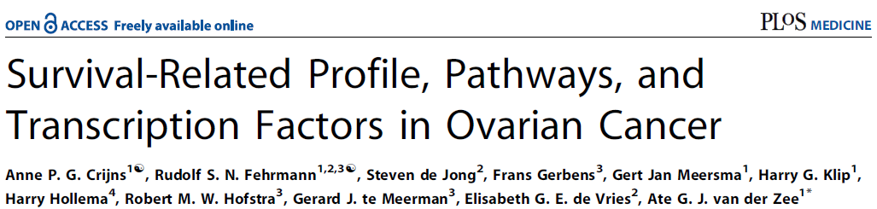
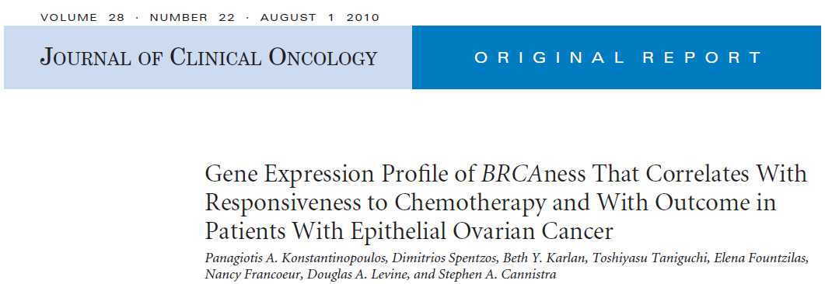
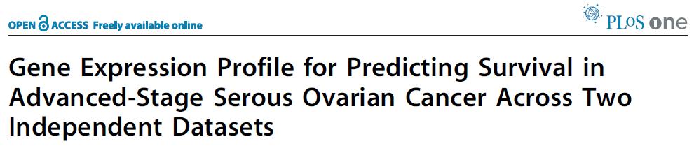
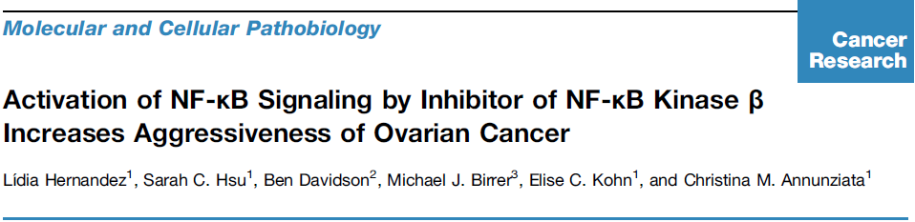
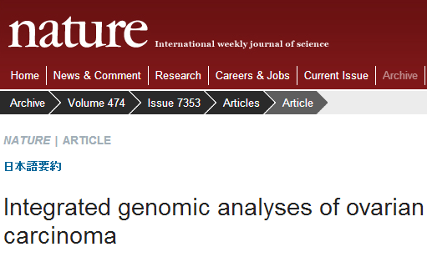
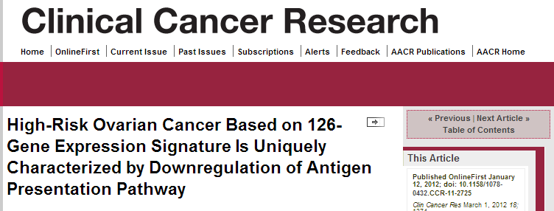
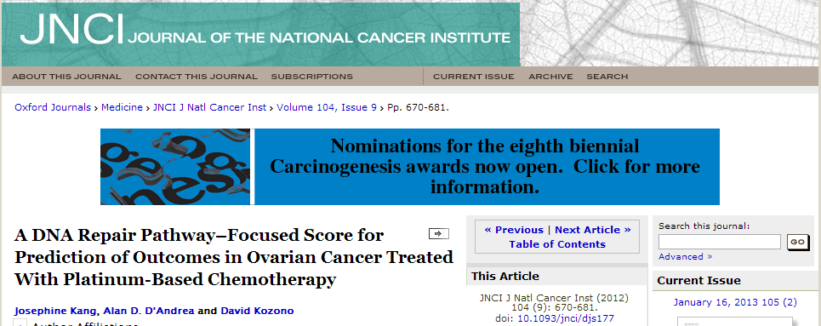
Comparative meta-analysis: prognostic gene signatures of ovarian cancer
Objectives:
Assess the reproducibility of published prognostic gene expression models
Evaluate published models using publicly available data
Improve on models using all publicly available data
Validate promising models in FFPE specimens from GOG-218 bevacizumab phase-III clinical trial
With Michael Birrer, MD (MGH)

Slide 11
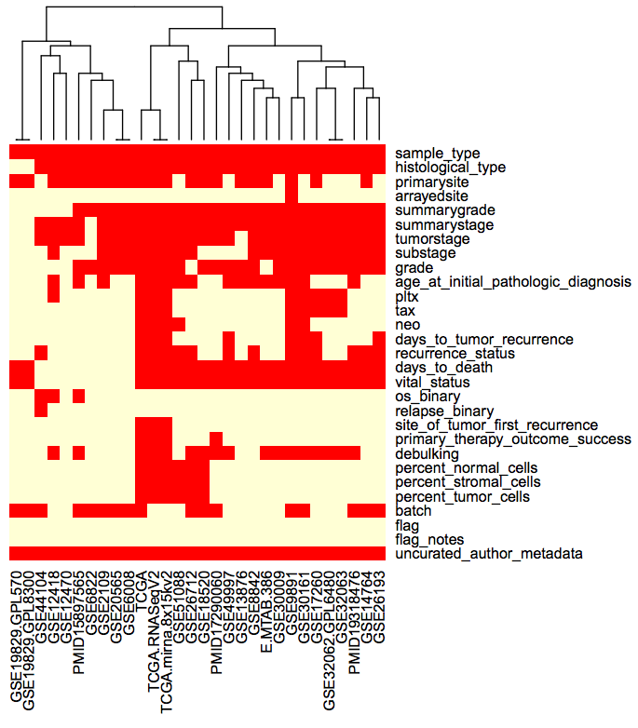
Requirement 1: data curation
curatedOvarianData Bioconductor package
30 datasets, > 3,000 unique samples
B.F. Ganzfried, M. Riester, B. Haibe-Kains, T. Risch, S. Tyekucheva, I. Jazic, X. V. Wang, M. Ahmadifar, M. Birrer, G. Parmigiani, C. Huttenhower, L. Waldron. curatedOvarianData: Clinically Annotated Data for the Ovarian Cancer Transcriptome. DATABASE: The Journal of Biological Databases and Curation (2013).

Slide 12
Requirement 2: re-implement published models
Model | Reproducibility
 | Model Provided | Training Data Available | Validation Data Available | Verified Implementation
TCGA11 [12] | YES | YES | YES | YES
Denkert09 [13] | YES | YES | YES | YES
Bonome08_263genes [14] | YES | YES | YES | YES
Bonome08_572genes [14] | YES | YES | YES | YES
Mok09 [15] | NO | YES | YES | PARTIALLY
Yoshihara12 [16] | YES | - | YES | YES
Yoshihara10 [17] | YES | - | YES | YES
Bentink12 [18] | YES | - | YES | YES
Kang12 [19] | YES | YES | YES | PARTIALLY
Crijns09 [20] | NO | YES | NO | NO
Kernagis12 [21] | PARTIALLY | YES | YES | PARTIALLY
Sabatier11 [22] | PARTIALLY | NO | NO | NO
Konstantinopoulos10 [23] | YES | - | YES | PARTIALLY
Hernandez10 [24] | PARTIALLY | - | YES | PARTIALLY

Slide 13
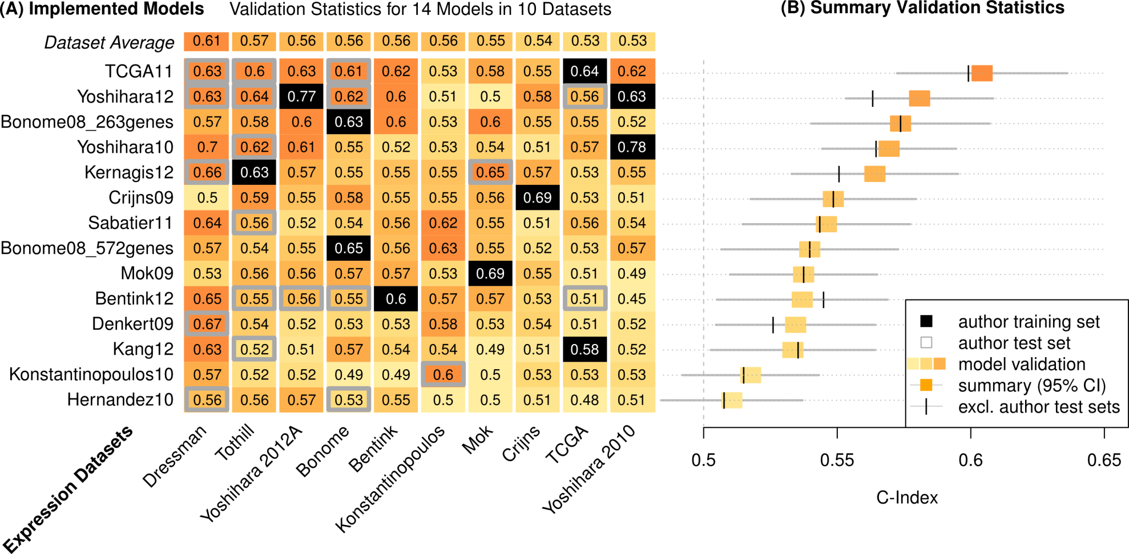
Assessment of prognostic models
Validation Statistics:
14 Models in 10 Datasets
C-Index = Pr(g(Z₁)>g(Z₂) | T₂>T₁)
T₁, T₂ = times to death of two patients
g(Z₁), g(Z₂) = predicted risk scores
C=0.5 expectation for random prediction
C=1 if the exact order of all deaths is predicted
14 prognostic signatures
Waldron L et al. JNCI J Natl Cancer Inst 2014;jnci.dju049
10 microarray datasets

Slide 14
Assessment of prognostic models
Validation Statistics:
14 Models in 10 Datasets
14 prognostic signatures
10 microarray datasets
Notes:
We used a standard meta-analysis approach to summarize the performance of each model across all non-training datasets, shown here with 95% confidence intervals. The vertical hashes show how the summary estimate changes if you exclude validation datasets used by the signature’s authors for validation, which is an interesting story that I won’t get into.
Meta-analysis uses a standard fixed-effects model, which is just a weighted average of the C-Index from each study, weighted by the size of the confidence interval in each study. Fixed-effects assumption of homogeneity was not violated.

Slide 15
Assessment of prognostic models
Validation Statistics:
14 Models in 10 Datasets
Dressman et al. J Clin Oncol. 2007 25(5):517-25. An integrated genomic-based approach to individualized treatment of patients with advanced-stage ovarian cancer.
14 prognostic signatures
Baggerly et al. J Clin Oncol. 2008 26(7):1186-7. Run batch effects potentially compromise the usefulness of genomic signatures for ovarian cancer.
Dressman et al. J Clin Oncol. 2012 30(6):678. Retraction.
10 microarray datasets
Notes:
This Dressman dataset was published by a group at Duke University, in a paper that claimed to provide a signature of chemosensitivity, which was criticized by Baggerly et al. for batch effects confounded with the outcome. The importance of this confounding was disputed by the authors, but the paper was eventually retracted over issues of reproducing the original findings. This dataset has had an important impact on the ovarian cancer literature, independently of this paper, because it has been very popular as an independent validation dataset for other signatures, as you see can see by the number of grey boxes here. Looking at the average C-Index for this dataset of all signatures, compared to other datasets, it provides consistently higher C-Indices than other datasets, in all likelihood due to its pronounced and confounded batch effect.

Slide 16
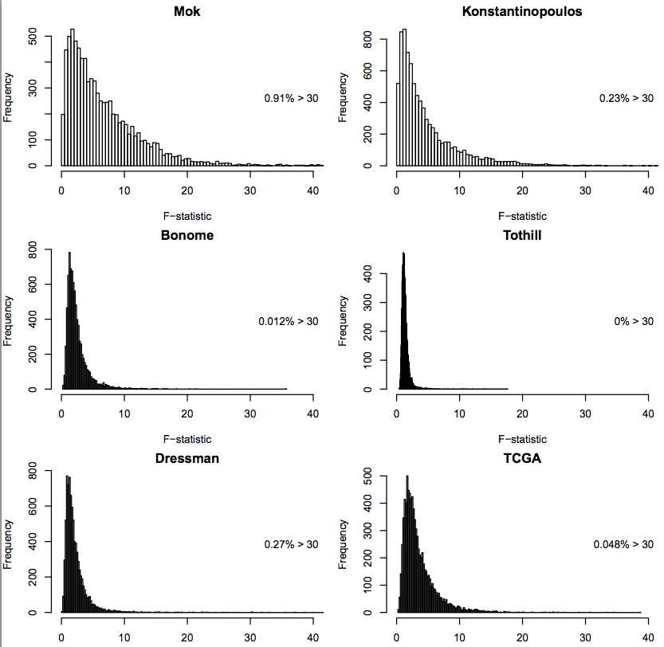
Magnitude of batch effect is not as important as confounding
Histograms shows F-statistic for ANOVA between expression and batch for each gene
The most important batch effects seen were the smallest

Slide 17
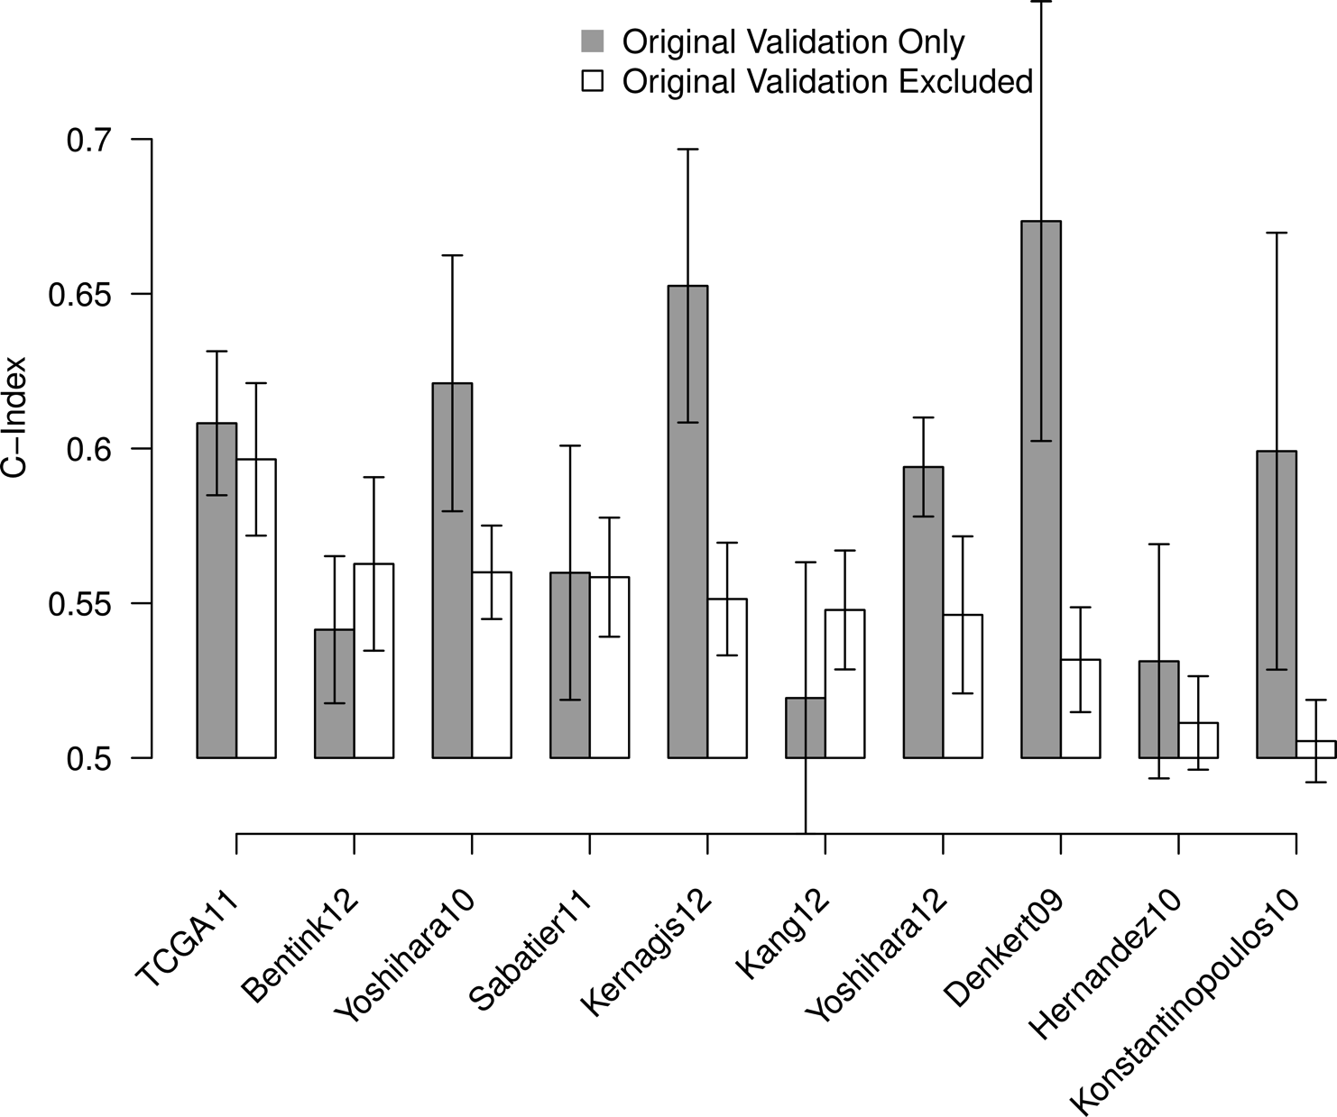
Influence of validation set choice
Waldron L et al. JNCI J Natl Cancer Inst 2014;jnci.dju049

Slide 18
Moving towards Scenario 4
Modest estimation of prediction accuracy
Follow-up time spent improving promising leads
Eventual benefit to patients
How do we do it?

Slide 19
Moving towards Scenario 4: Methodological advances
Studies for validation
1
2
n
Waldron L et al.: Comparative meta-analysis of prognostic gene signatures for late-stage ovarian cancer. J. Natl. Cancer Inst. 2014, 106.
Riester M et al. : Risk prediction for late-stage ovarian cancer by meta-analysis of 1525 patient samples. J. Natl. Cancer Inst. 2014, 106.
Trippa L et al.: Bayesian nonparametric cross-study validation of prediction methods. Ann. Appl. Stat. 2015, 9:402–428.
Zhao SD et al.: Más-o-menos: a simple sign averaging method for discrimination in genomic data analysis. Bioinformatics 2014, 30:3062–3069.
Bernau C et al.: Cross-study validation for the assessment of prediction algorithms. Bioinformatics 2014, 30:i105–12.
1
CV₁
CSV_{1,2}
CSV_{1,n}
2
CSV_{2,1}
CV₂
CSV_{2,n}
Studies for training
Slide credit: Edoardo Pasolli
n
CSV_{n,1}
CSV_{n,2}
CV_{n}
All except
one
looCSV₁
looCSV₂
looCSV_{n}
CV_{t}
Cross-validation
On the t-th study
CSV_{t,k}
Cross-study validation
Training on the t-th study and
validation on the k-th study
looCSV_{t}
Leave-one-out cross-study validation
Training on all except the t-th study and
validation on the t-th study

Slide 20
Cross-study validation for type-II diabetes prediction model from microbiome data
T2D dataset
 | Validation: Stage I | Validation: Stage II
Training: Stage I | 0.737 | 0.689
Training: Stage II | 0.693 | 0.743
Cross-validation
Cross-stage
Cross-study
T2D+WT2D datasets
 | Validation: T2D | Validation: WT2D
Training: T2D | 0.745 | 0.664
Training: WT2D | 0.591 | 0.772
Pasolli et al., PLoS Computational Biology (accepted)
When samples of healthy subjects from unrelated cohorts are
added to construct the model
0.655
0.714

Slide 21
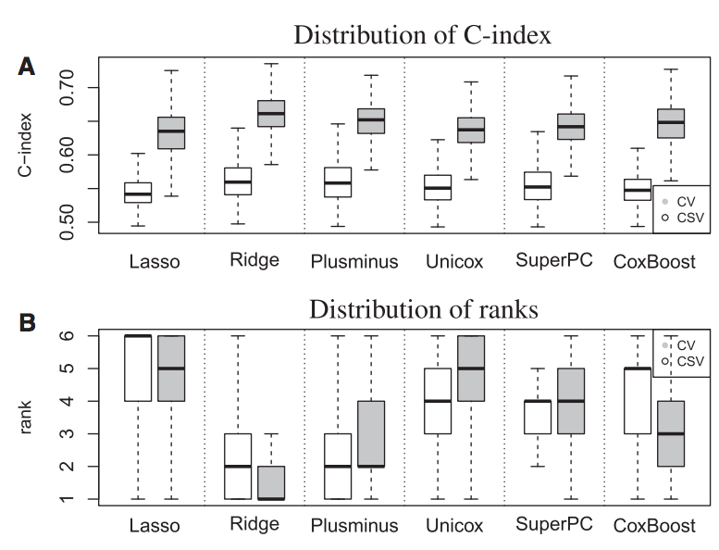
CSV compared to CV in breast cancer
1000 simulations of 8 datasets
median CV, CSV
Specialists?
Generalists?
Bernau, C. et al. Cross-study validation for the assessment of prediction algorithms.
Bioinformatics 30, i105–i112 (2014).
Notes:
Lasso, Ridge, Coxboost have specialist tendencies

Slide 22
Moving towards Scenario 4
How do we do it?
Methodological advances in validation
Public data, transparent implementations
Meticulous application of existing methods
no “information leak” in cross-validation
“double blinding” in laboratory work
Calibration of expectations for model quality from pilot studies
don’t expect AUC=0.99 in a first attempt

Slide 23
What is predictive modeling?
The ultimate goal of predictive modeling is to make accurate predictions about the future
The immediate goal of predictive modeling should be to use historical data to identify promising approaches to predicting the future

Slide 24
Thank you
Lab members:
Post-doctoral fellow: Lavanya Kannan
Research Associates: Marcel Ramos, Lucas Schiffer, Rimsha Azar
MPH students: Tiffany Chan, Jamie Wood, Peter Chernek, Hanish Kodali
Undergraduate interns: Patrick Dorante, Warner Alexis
Collaborators
Nicola Segata, Alessandro Quattrone, Edoardo Pasolli (Trento, Italy)
Benjamin Haibe Kains (University of Toronto)
Giovanni Parmigiani (Dana-Farber Cancer Institute)
Michael Birrer (Massachusetts General Hospital)
Bioconductor: Martin Morgan, Vincent Carey, Kasper Hansen, multi-omics interest group.
Statistical Learning Book Club:
Currently reading “Data Analysis for the Life Sciences” by Irizarry and Love

