Slide 1
Geometrical Transformations (for use with Angel Chapter 3)
CSCI 4631/5631
©2009 Christopher Summa

Slide 2
Translation
We’ve got a point P(x,y) and we want to translate it by (dx, dy)
x’
x
dx
=
+
y’
y
dy
P’
=
P
+
T
©2009 Christopher Summa

Slide 3
Scaling
We’ve got a point P(x,y) and we want to stretch it by s_{x} along
the x axis and by s_{y} along the y axis.
x’
s_{x}
0
.
x
=
y’
0
s_{y}
y
.
P’
=
S
P
If s_{x} = s_{y} this is called “uniform scaling” but if they are different, it’s called “differential scaling”
©2009 Christopher Summa

Slide 4
Rotation
Points can be rotated about the origin through the angle θ.
Mathematically:
x’ = x cos θ - y sin θ and y’ = x sin θ + y cos θ
x’
cos θ
-sin θ
.
x
=
y’
sin θ
cos θ
y
.
P’
=
R
P
Positive angles are measured counterclockwise from x toward y
©2009 Christopher Summa

Slide 5
Homogenous Coordinates
We’ve got a point P(x,y) and we’re going to represent it as the
triplet P(x,y,W)
x
x
y
y
W
Why?
P’
=
P
+
T
P’
=
S
.
P
P’
=
R
.
P
©2009 Christopher Summa

Slide 6
Homogenous Coordinates
In homogenous coordinates, points are the same if their x,y,W
values are multiples of one another
1
2
2
=
4
4
8
At least one must be nonzero: (0,0,0) is not allowed
When W is nonzero: (x,y,W) divide through by W, and
represent as (x/W , y/W, 1 ). This is known as “homogenizing”
©2009 Christopher Summa

Slide 7
Homogenous Coordinates Transformation
Now we can represent a translation within the context of a
3 x 3 transformation matrix:
x’
1
0
dx
x
.
y’
=
0
1
dy
y
1
0
0
1
1
P’ = T(d_{x},d_{y}) • P
©2009 Christopher Summa

Slide 8
Translation Transformations
Translation matrices are additive:
1
0
dx1
1
0
dx2
1
0
dx1 + dx2
0
1
dy1
•
0
1
dy2
=
0
1
dy1 + dy2
0
0
1
0
0
1
0
0
1
T(d_{x1},d_{y1}) • T(d_{x2},d_{y2}) =T(d_{x1}+d_{x2} , d_{y1}+d_{y2})
©2009 Christopher Summa

Slide 9
Scaling Transformations
Scaling matrices are multiplicitive:
s_{x1}
0
0
s_{x2}
0
0
s_{x1}•s_{x2}
0
0
0
s_{y1}
0
•
0
s_{y2}
0
=
0
s_{y1}•s_{y2}
0
0
0
1
0
0
1
0
0
1
S(x1,y1) • S(x2,y2) =S(x1•x2, y1•y2)
©2009 Christopher Summa

Slide 10
Rotational Transformations
Rotation matrices are additive:
cosθ
-sinθ
0
sinθ
cosθ
0
too much to type!!!, but
R(θ) • R(φ) =R(θ+φ)
0
0
1
Properties of rotation matrix: look at upper 2x2 submatrix rows
as vectors.
Each is a unit vector
Each is perpendicular to the other
1st and 2nd vectors will be rotated by R(θ) to lie on positive x and y axes
©2009 Christopher Summa

Slide 11
Rotational Transformations
Rotation matrices are additive:
cosθ
-sinθ
0
sinθ
cosθ
0
0
0
1
Same thing is true if we think of the column vectors.
A matrix with these properties is called “special orthogonal”
What does this mean? It preserves angles and lengths
also known as a “rigid body transformation”
©2009 Christopher Summa

Slide 12
Affine Transformations
Any arbitrary sequence of rotation and translation is going to be
special orthogonal, and therefore, a rigid body transformation.
Once we add scaling operations to the mix, we are no longer
special orthogonal, we are “affine”. Affine transformations preserve
parallel lines, but angles and lengths may change.
1
a
0
Shear transformations are an example of this.
The matrix to the left shears along the x axis
with a nonzero and b zero. It shears along the
y axis with b nonzero and a zero.
b
0
1
0
0
1
©2009 Christopher Summa

Slide 13
Rotations and Scaling
Rotations: Since rotations happen about the origin, in order to
rotate about some arbitrary point, you must first translate the
primitive such that your rotation point is at the origin, rotate, then
translate back
T(x₁, y₁) • R(q) • T(-x1, -y1)
Also, since scaling operations affect the position of
a primitive, you often want to scale around the center
of the primitive, which also involves translating the center
to the origin, scaling, and translating back again
T(x₁, y₁) • S(s_{x},s_{y}) • T(-x1, -y1)
©2009 Christopher Summa

Slide 14
Window-To-Viewport Transformation
It is often the case that you need to transform between coordinate
systems
Example: your primitives may live in the “world” coordinate system), and
you need to transform your “window” to the world into the same
place and shape as your viewport (i.e. the canvas you’re drawing onto)
world coordinates
screen coordinates
©2009 Christopher Summa

Slide 15
Efficiency
r₁₁
r₁₂
t_{x}
A generalized composition of R, T, and S matrices
will look like the matrix to the left.
r₂₁
r₂₂
t_{y}
M • P takes 9 multiplies and 6 adds.
0
0
1
but, we can use the fact that the last row is fixed, and reduce this to 4 mults and 4 adds
Further, in interactive graphics, when we’re rotating, we can take advantage of the fact that successive draws can be thought of as moving through small θ, so we can approximate cos θ as 1, and we get to 2 mults and 2 adds. This can lead to error buildup over successive calculations, however, so you need to be careful
©2009 Christopher Summa

Slide 16
3D Transformations (finally!)
x
We’ve been representing 2D points as 3-space vectors, so now we’re going to represent 3D points as 4-space vectors (also known as quaternions)
x/W
y
y/W
=
z
z/W
W
1
Same properties as before, at least one element must be nonzero. We’re working in a right-handed coordinate system where positive rotations are counterclockwise when looking from a positive axis toward the origin.
©2009 Christopher Summa

Slide 17
Translation in 3D
1
0
0
d_{x}
0
1
0
d_{y}
Easy – as an extension from the 2D case
0
0
1
d_{z}
0
0
0
1
©2009 Christopher Summa

Slide 18
Scaling in 3D
s_{x}
0
0
0
0
s_{y}
0
0
Again easy – as an extension from the 2D case
0
0
s_{z}
0
0
0
0
1
©2009 Christopher Summa

Slide 19
Rotation About Z
cos θ
-sin θ
0
0
sin θ
cos θ
0
0
Again easy – as an extension from the 2D case
0
0
1
0
0
0
0
1
©2009 Christopher Summa

Slide 20
Rotation About X
1
0
0
0
0
cos θ
-sin θ
0
looks like this…. and finally……
0
sin θ
cos θ
0
0
0
0
1
©2009 Christopher Summa

Slide 21
Rotation About Y
cos θ
0
sin θ
0
0
1
0
0
looks like this
-sin θ
0
cos θ
0
0
0
0
1
©2009 Christopher Summa

Slide 22
Generalized Transformation Matrix in 3D
Here’s a generalized representation of a composite rotation, scaling, and translation matrix.
r₁₁
r₁₂
r₁₃
t_{x}
r₂₁
r₂₂
r₂₃
t_{y}
r₃₁
r₃₂
r₃₃
t_{z}
For each of the rotation matrices mentioned in previous slides, the upper 3 x 3 matrix is special orthogonal, as are any combinations of these rotations, and combinations of rotations and translations.
0
0
0
1
©2009 Christopher Summa

Slide 23
Shear Transformation in 3D
Here’s a generalized representation of a composite rotation, scaling, and translation matrix.
1
0
sh_{x}
0
0
1
sh_{y}
0
0
0
1
0
For each of the rotation matrices mentioned in previous slides, the upper 3 x 3 matrix is special orthogonal, as are any combinations of these rotations, and combinations of rotations and translations.
0
0
0
1
©2009 Christopher Summa

Slide 24
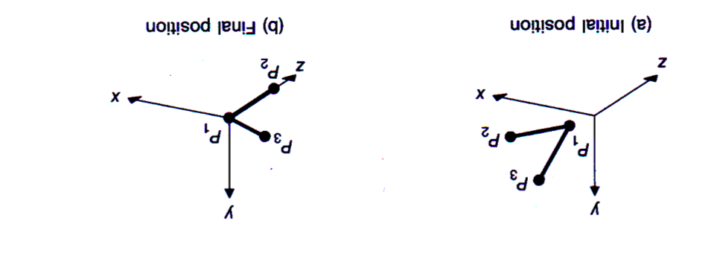
Composition of 3D Transforms
Let’s suppose we want to transform P₁ P₂ and P₂ P₃ line segments
from their original orientation (a) to that shown in (b)
©2009 Christopher Summa

Slide 25
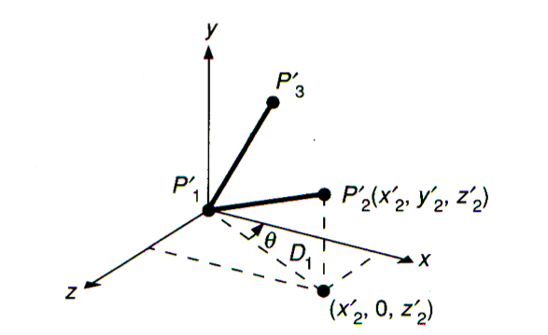
Composition of 3D Transforms
Let’s suppose we want to transform P₁ P₂ and P₂ P₃ line segments
from their original orientation (a) to that shown in (b)
Translate P1 to origin : this one is easy : T(-x₁, -y₁, -z₁)
Rotate about y such that P₁P₂ lies in (y,z) plane
Rotate about x such that P₁P₂ lies on z axis
Rotate about z such that P₁P₃ lies in (x,z) plane
©2009 Christopher Summa

Slide 26
Composition of 3D Transforms
Let’s suppose we want to transform P₁ P₂ and P₂ P₃ line segments
from their original orientation (a) to that shown in (b)
Translate P₁ to origin : this one is easy : T(-x₁, -y₁, -z₁)
©2009 Christopher Summa

Slide 27
Composition of 3D Transforms
Let’s suppose we want to transform P₁ P₂ and P₂ P₃ line segments
from their original orientation (a) to that shown in (b)
Rotate about y such that P₁P₂ lies in (y,z) plane
rotate by –(90-θ) = (θ-90)
cos(θ-90) = sin θ = z₂’/D₁ = (z₂-z₁)/D₁
similarly, solve for sin(θ-90), and substitute into rotation about y matrix
©2009 Christopher Summa

Slide 28
Composition of 3D Transforms
Let’s suppose we want to transform P₁ P₂ and P₂ P₃ line segments
from their original orientation (a) to that shown in (b)
Rotate about x such that P₁P₂ lies on z axis
Rotate about z such that P₁P₃ lies in (x,z) plane
These last 2 transforms use the same basic ideas, and rely on the fact that the rotations preserve lengths and angles between elements
©2009 Christopher Summa

Slide 29
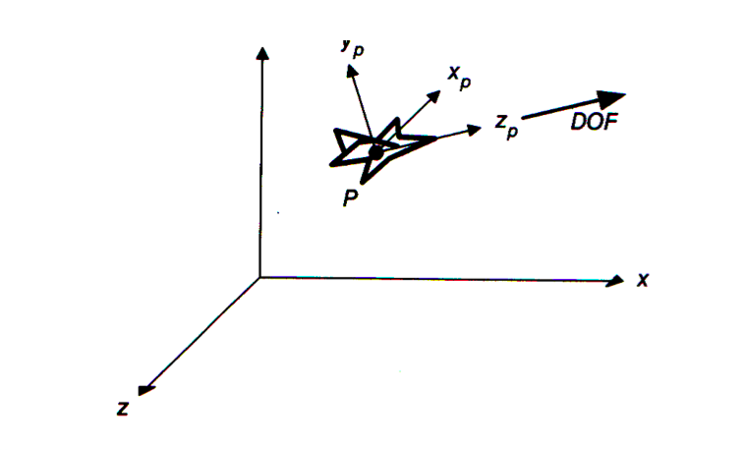
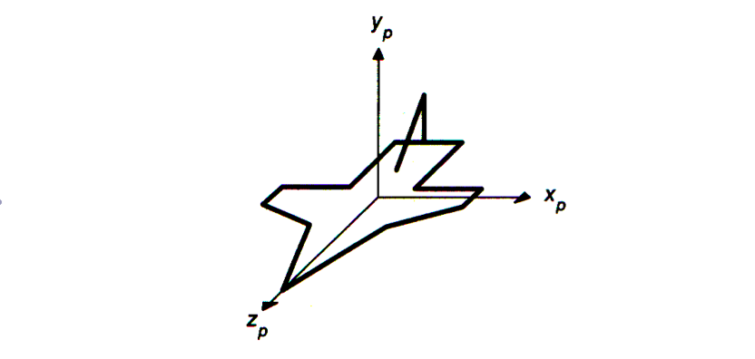
Composition of 3D Transforms
Let’s suppose we want to transform a local coordinate system to
some other one, for example we’ve got a plane that we want to
transform such that it is pointed in some direction DOF, and is
not banked. We need a series of rotations to accomplish this.
©2009 Christopher Summa

Slide 30
Composition using properties of Orthogonal matrices
r_{1x}
r_{2x}
r_{3x}
0
Unit row vectors of R rotate into the principal axes
r_{1y}
r_{2y}
r_{3y}
0
r_{1z}
r_{2z}
r_{3z}
0
The rows of R represent the coordinates in the original space of unit vectors along the
coordinate axes of the rotated space.
The columns of R represent the coordinates in the rotated space of unit vectors along the
axes of the original space.
0
0
0
1
Determine in what direction each of x_{p}, y_{p} and z_{p} axes is heading, normalize them, and use them as column vectors in the rotation matrix.

Slide 31
Composition of 3D Transforms
Let’s suppose we want to transform a local coordinate system to
some other one, for example we’ve got a plane that we want to
transform such that it is pointed in some direction DOF, and is
not banked. We need a series of rotations to accomplish this.
©2009 Christopher Summa

Slide 32
Composition of 3D Transforms
What we need is the z_{p} axis transformed in the DOF direction, with
the x_{p} axis transformed into a horizontal vector perpendicular to DOF.
Hmmm… y x DOF is in the right direction! Finally y_{p} should point in
the direction that is orthogonal to x_{p} and z_{p}, or (DOF x (y x DOF))
©2009 Christopher Summa

Slide 33
Composition of 3D Transforms
0
|y x DOF|
|DOF x (y x DOF)|
|DOF|
0
0
0
0
0
1
Replacing the column vectors in the upper 3 x 3 matrix gives
the proper rotation matrix
©2009 Christopher Summa

Slide 34
Transformation as a change in coordinate systems
It is often useful to think of your primitives as existing in their own
coordinate system, and what you need to to is “map” them onto a
different coordinate system (the screen perhaps) via transformations
y(2)
y(1)
x(2)
x(1)
©2009 Christopher Summa

Slide 35
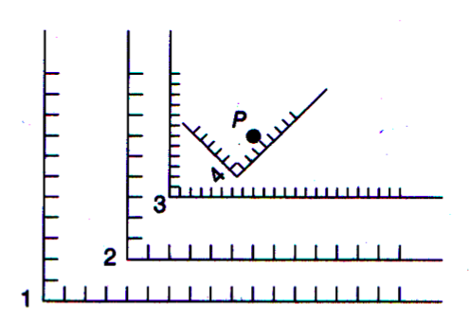
Transformation as a change in coordinate systems
It is often useful to think of your primitives as existing in their own
coordinate system, and what you need to to is “map” them onto a
different coordinate system (the screen perhaps) via transformations
P^{(i)} = M_{i←j} • P^{(j)}
and
P^{(j)} = M_{j←k} • P^{(k)}
P^{(i)} = M_{i←k} • P^{(k)}
M_{1←2} = T(4,2)
M_{2←3} = T(2,3) • S(0.5, 0.5)
M_{3←4} = T(6.7, 1.8) • R(-45˚)
©2009 Christopher Summa

Slide 36
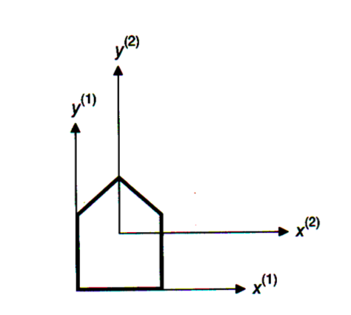
Transformation as a change in coordinate systems
It is often useful to think of your primitives as existing in their own
coordinate system, and what you need to to is “map” them onto a
different coordinate system (the screen perhaps) via transformations
M_{1←2} = T(x₁, y₁)
M_{2←1} = T(x₁, y₁)⁻¹ = T(-x₁, -y₁)
©2009 Christopher Summa

Slide 37
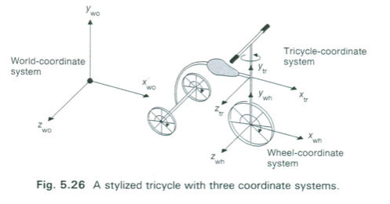
Transformation as a change in coordinate systems
Suppose Q^{(j)} is some transformation in coordinate system j, and
we want to find some transformation Q^{(i)} in coordinate system i.
Imagine applying Q^{(j)} to points P^{(j)} in system j. How to find
the Q^{(i)} in system i that will produce the same set of transformed
points?
Mathematically: Q^{(i)} • P^{(i)} = M_{i←j} • Q^{(j)} • P^{(j)}
Substituting and Simplifying: Q^{(i)} = M_{i←j} • Q^{(j)} • M_{i←j}⁻¹
©2009 Christopher Summa

Slide 38
Transformation as a change in coordinate systems
Moving coordinate systems – front wheel moves about z_{wh} – how does
whole bike move in the world coordinate system?
Image a point on the wheel P^{(wh)}
©2009 Christopher Summa

Slide 39
Transformation as a change in coordinate systems
As wheel rotates through angle α about z_{wh} – a point on the wheel P^{(wh)}
moves through a distance αr (r is radius of wheel) and tricycle moves
forward a distance αr
P’^{(wh)} = T(αr,0,0) • R_{z}(α) • P^{(wh)}
P’^{(wh’)} = R_{z}(α) • P^{(wh’)}
©2009 Christopher Summa

Slide 40
Transformation as a change in coordinate systems
As wheel rotates through angle α about z_{wh} – a point on the wheel P^{(wh)}
moves through a distance αr (r is radius of wheel) and tricycle moves
forward a distance αr
P’^{(wh)} = T(αr,0,0) • R_{z}(α) • P^{(wh)}
P’^{(wh’)} = R_{z}(α) • P^{(wh’)}
Transforming to world coordinate system:
P^{(wo)} = M_{wo←wh} • P^{(wh)} = M_{wo←tr} • M_{tr←wh} • P^{(wh)}
P’^{(wo)} = M_{wo←wh} • P’^{(wh)} = M_{wo←wh} • T(αr,0,0) • R_{z}(α) • P^{(wh)}
P’^{(wo)} = M_{wo←wh’} • P’^{(wh’)} = (M_{wo←wh} • M_{wh←wh’}) • (R_{z}(α) • P^{(wh)})
©2009 Christopher Summa

