Slide 1
Programming with OpenGL
Part 3: Shaders
Ed Angel
Professor of Emeritus of Computer Science
University of New Mexico
E. Angel and D. Shreiner: Interactive Computer Graphics 6E © Addison-Wesley 2012

Slide 2
Objectives
Simple Shaders
  Vertex shader
  Fragment shaders
Programming shaders with GLSL
Finish first program
E. Angel and D. Shreiner: Interactive Computer Graphics 6E © Addison-Wesley 2012

Slide 3
Vertex Shader Applications
Moving vertices
  Morphing
  Wave motion
  Fractals
Lighting
  More realistic models
  Cartoon shaders
E. Angel and D. Shreiner: Interactive Computer Graphics 6E © Addison-Wesley 2012

Slide 4
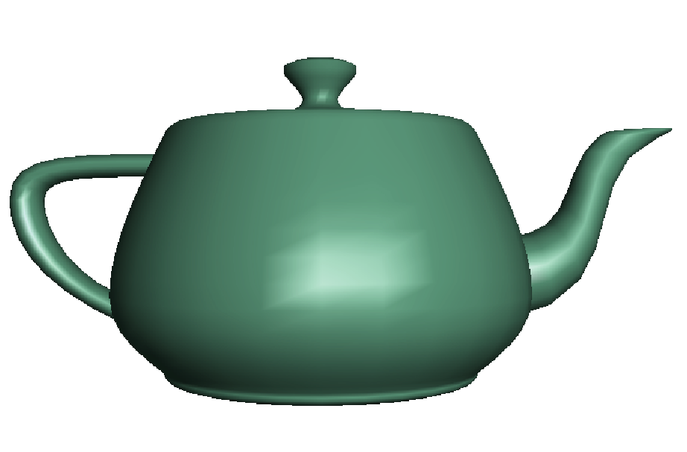
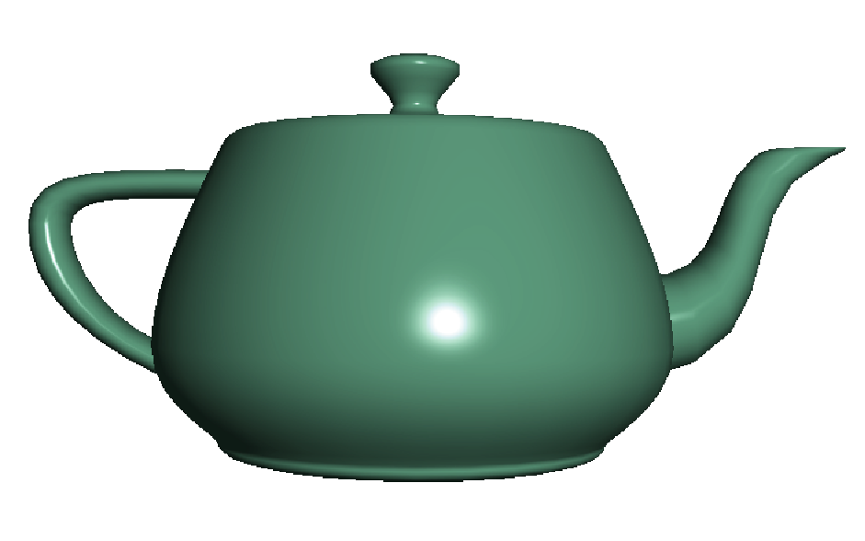
Fragment Shader Applications
Per fragment lighting calculations
per vertex lighting
per fragment lighting
E. Angel and D. Shreiner: Interactive Computer Graphics 6E © Addison-Wesley 2012

Slide 5



Fragment Shader Applications
Texture mapping
smooth shading
environment
mapping
bump mapping
E. Angel and D. Shreiner: Interactive Computer Graphics 6E © Addison-Wesley 2012

Slide 6
Writing Shaders
First programmable shaders were programmed in an assembly-like manner
OpenGL extensions added for vertex and fragment shaders
Cg (C for graphics) C-like language for programming shaders
  Works with both OpenGL and DirectX
  Interface to OpenGL complex
OpenGL Shading Language (GLSL)
E. Angel and D. Shreiner: Interactive Computer Graphics 6E © Addison-Wesley 2012

Slide 7
GLSL
OpenGL Shading Language
Part of OpenGL 2.0 and up
High level C-like language
New data types
  Matrices
  Vectors
  Samplers
As of OpenGL 3.1, application must provide shaders
E. Angel and D. Shreiner: Interactive Computer Graphics 6E © Addison-Wesley 2012

Slide 8



Simple Vertex Shader
in vec4 vPosition;
void main(void)
{
gl_Position = vPosition;
}
E. Angel and D. Shreiner: Interactive Computer Graphics 6E © Addison-Wesley 2012

Slide 9
Execution Model
Vertex data
Shader Program
GPU
Application
Program
Vertex
Shader
Primitive
Assembly
glDrawArrays
Vertex
E. Angel and D. Shreiner: Interactive Computer Graphics 6E © Addison-Wesley 2012

Slide 10
Simple Fragment Program
void main(void)
{
gl_FragColor = vec4(1.0, 0.0, 0.0, 1.0);
}
E. Angel and D. Shreiner: Interactive Computer Graphics 6E © Addison-Wesley 2012

Slide 11
Execution Model
Application
Shader Program
Rasterizer
Fragment
Shader
Frame Buffer
Fragment
Fragment
Color
E. Angel and D. Shreiner: Interactive Computer Graphics 6E © Addison-Wesley 2012

Slide 12
Data Types
C types: int, float, bool
Vectors:
  float vec2, vec3, vec4
  Also int (ivec) and boolean (bvec)
Matrices: mat2, mat3, mat4
  Stored by columns
  Standard referencing m[row][column]
C++ style constructors
  vec3 a =vec3(1.0, 2.0, 3.0)
  vec2 b = vec2(a)
E. Angel and D. Shreiner: Interactive Computer Graphics 6E © Addison-Wesley 2012

Slide 13
Pointers
There are no pointers in GLSL
We can use C structs which
can be copied back from functions
Because matrices and vectors are basic types they can be passed into and output from GLSL functions, e.g.
mat3 func(mat3 a)
E. Angel and D. Shreiner: Interactive Computer Graphics 6E © Addison-Wesley 2012

Slide 14
Qualifiers
GLSL has many of the same qualifiers such as const as C/C++
Need others due to the nature of the execution model
Variables can change
  Once per primitive
  Once per vertex
  Once per fragment
  At any time in the application
Vertex attributes are interpolated by the rasterizer into fragment attributes
E. Angel and D. Shreiner: Interactive Computer Graphics 6E © Addison-Wesley 2012

Slide 15
Attribute Qualifier
Attribute-qualified variables can change at most once per vertex
There are a few built in variables such as gl_Position but most have been deprecated
User defined (in application program)
  Use in qualifier to get to shader
  in float temperature
  in vec3 velocity
E. Angel and D. Shreiner: Interactive Computer Graphics 6E © Addison-Wesley 2012

Slide 16
Uniform Qualified
Variables that are constant for an entire primitive
Can be changed in application and sent to shaders
Cannot be changed in shader
Used to pass information to shader such as the bounding box of a primitive
E. Angel and D. Shreiner: Interactive Computer Graphics 6E © Addison-Wesley 2012

Slide 17
Varying Qualified
Variables that are passed from vertex shader to fragment shader
Automatically interpolated by the rasterizer
Old style used the varying qualifier
  varying vec4 color;
Now use out in vertex shader and in in the fragment shader
  out vec4 color;
E. Angel and D. Shreiner: Interactive Computer Graphics 6E © Addison-Wesley 2012

Slide 18
Example: Vertex Shader
const vec4 red = vec4(1.0, 0.0, 0.0, 1.0);
out vec3 color_out;
void main(void)
{
gl_Position = vPosition;
color_out = red;
}
E. Angel and D. Shreiner: Interactive Computer Graphics 6E © Addison-Wesley 2012

Slide 19
Required Fragment Shader
in vec3 color_out;
void main(void)
{
gl_FragColor = color_out;
}
// in latest version use form
// out vec4 fragcolor;
// fragcolor = color_out;
E. Angel and D. Shreiner: Interactive Computer Graphics 6E © Addison-Wesley 2012

Slide 20
Passing values
call by value-return
Variables are copied in
Returned values are copied back
Three possibilities
  in
  out
  inout (deprecated)
E. Angel and D. Shreiner: Interactive Computer Graphics 6E © Addison-Wesley 2012

Slide 21
Operators and Functions
Standard C functions
  Trigonometric
  Arithmetic
  Normalize, reflect, length
Overloading of vector and matrix types
  mat4 a;
  vec4 b, c, d;
  c = b*a; // a column vector stored as a 1d array
  d = a*b; // a row vector stored as a 1d array
E. Angel and D. Shreiner: Interactive Computer Graphics 6E © Addison-Wesley 2012

Slide 22
Swizzling and Selection
Can refer to array elements by element using [] or selection (.) operator with
  x, y, z, w
  r, g, b, a
  s, t, p, q
  a[2], a.b, a.z, a.p are the same
Swizzling operator lets us manipulate components
  vec4 a;
  a.yz = vec2(1.0, 2.0);
E. Angel and D. Shreiner: Interactive Computer Graphics 6E © Addison-Wesley 2012

