Slide 1
Classical Viewing
Ed Angel
Professor Emeritus of Computer Science
University of New Mexico
E. Angel and D. Shreiner : Interactive Computer Graphics 6E © Addison-Wesley 2012

Slide 2
Objectives
Introduce the classical views
Compare and contrast image formation by computer with how images have been formed by architects, artists, and engineers
Learn the benefits and drawbacks of each type of view
E. Angel and D. Shreiner : Interactive Computer Graphics 6E © Addison-Wesley 2012

Slide 3
Classical Viewing
Viewing requires three basic elements
  One or more objects
  A viewer with a projection surface
  Projectors that go from the object(s) to the projection surface
Classical views are based on the relationship among these elements
  The viewer picks up the object and orients it how she would like to see it
Each object is assumed to constructed from flat principal faces
  Buildings, polyhedra, manufactured objects
E. Angel and D. Shreiner : Interactive Computer Graphics 6E © Addison-Wesley 2012

Slide 4
Planar Geometric Projections
Standard projections project onto a plane
Projectors are lines that either
  converge at a center of projection
  are parallel
Such projections preserve lines
  but not necessarily angles
Nonplanar projections are needed for applications such as map construction
E. Angel and D. Shreiner : Interactive Computer Graphics 6E © Addison-Wesley 2012

Slide 5
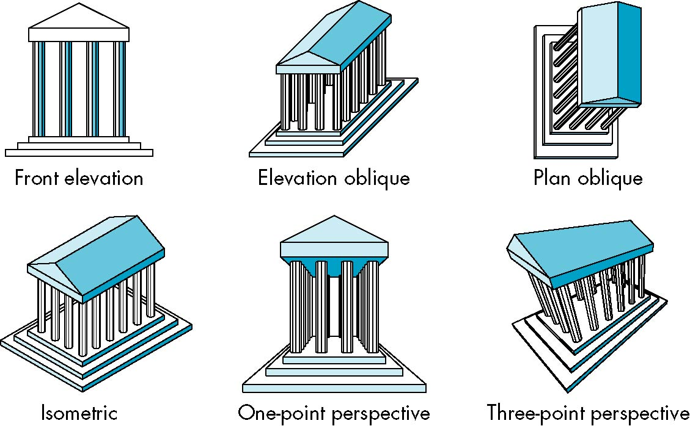
Classical Projections
E. Angel and D. Shreiner : Interactive Computer Graphics 6E © Addison-Wesley 2012

Slide 6
Perspective vs Parallel
Computer graphics treats all projections the same and implements them with a single pipeline
Classical viewing developed different techniques for drawing each type of projection
Fundamental distinction is between parallel and perspective viewing even though mathematically parallel viewing is the limit of perspective viewing
E. Angel and D. Shreiner : Interactive Computer Graphics 6E © Addison-Wesley 2012

Slide 7
Taxonomy of Planar Geometric Projections
planar geometric projections
parallel
perspective
1 point
2 point
3 point
multiview
orthographic
axonometric
oblique
isometric
dimetric
trimetric
E. Angel and D. Shreiner : Interactive Computer Graphics 6E © Addison-Wesley 2012

Slide 8
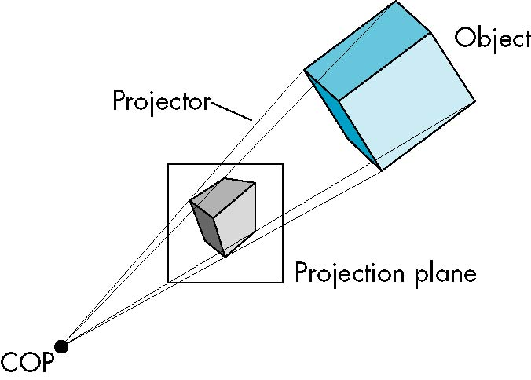
Perspective Projection
E. Angel and D. Shreiner : Interactive Computer Graphics 6E © Addison-Wesley 2012

Slide 9
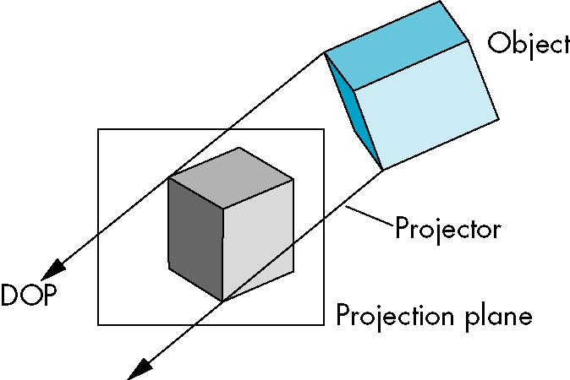
Parallel Projection
E. Angel and D. Shreiner : Interactive Computer Graphics 6E © Addison-Wesley 2012

Slide 10
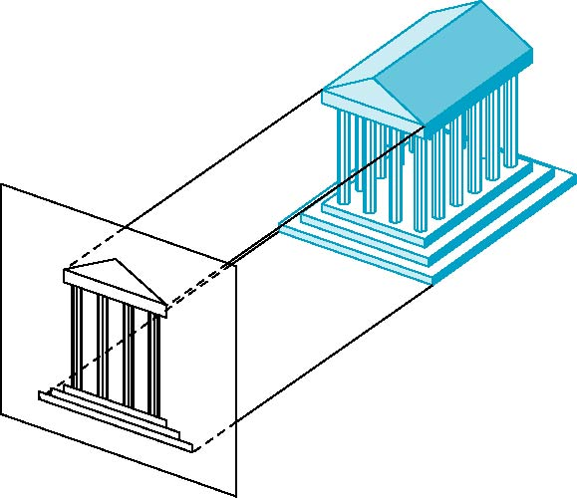
Orthographic Projection
Projectors are orthogonal to projection surface
E. Angel and D. Shreiner : Interactive Computer Graphics 6E © Addison-Wesley 2012

Slide 11

Multiview Orthographic Projection
Projection plane parallel to principal face
Usually form front, top, side views
isometric (not multiview
orthographic view)
front
in CAD and architecture,
we often display three
multiviews plus isometric
side
top
E. Angel and D. Shreiner : Interactive Computer Graphics 6E © Addison-Wesley 2012

Slide 12
Advantages and Disadvantages
Preserves both distances and angles
  Shapes preserved
  Can be used for measurements
    Building plans
    Manuals
Cannot see what object really looks like because many surfaces hidden from view
  Often we add the isometric
E. Angel and D. Shreiner : Interactive Computer Graphics 6E © Addison-Wesley 2012

Slide 13
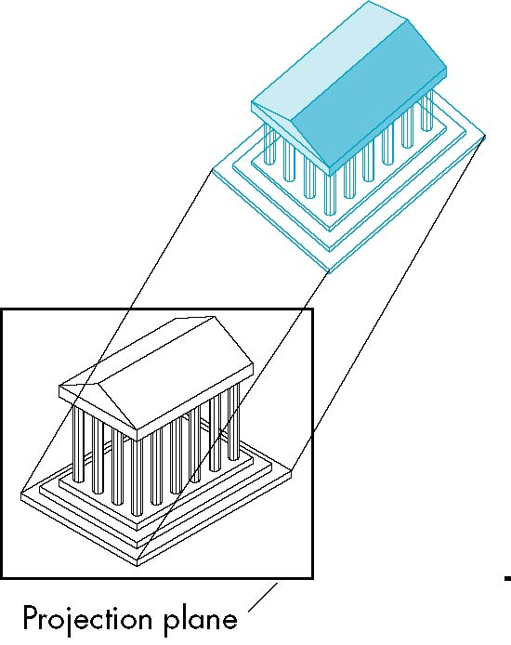
Axonometric Projections
Allow projection plane to move relative to object
classify by how many angles of
a corner of a projected cube are
the same
none: trimetric
two: dimetric
three: isometric
θ ₁
θ ₂
θ ₃
E. Angel and D. Shreiner : Interactive Computer Graphics 6E © Addison-Wesley 2012

Slide 14
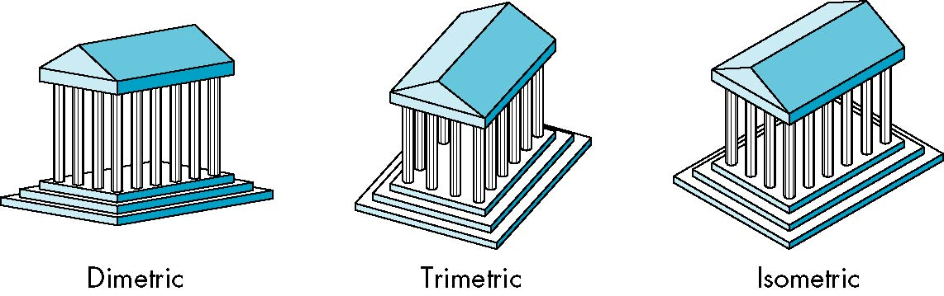
Types of Axonometric Projections
E. Angel and D. Shreiner : Interactive Computer Graphics 6E © Addison-Wesley 2012

Slide 15
Advantages and Disadvantages
Lines are scaled (foreshortened) but can find scaling factors
Lines preserved but angles are not
  Projection of a circle in a plane not parallel to the projection plane is an ellipse
Can see three principal faces of a box-like object
Some optical illusions possible
  Parallel lines appear to diverge
Does not look real because far objects are scaled the same as near objects
Used in CAD applications
E. Angel and D. Shreiner : Interactive Computer Graphics 6E © Addison-Wesley 2012

Slide 16
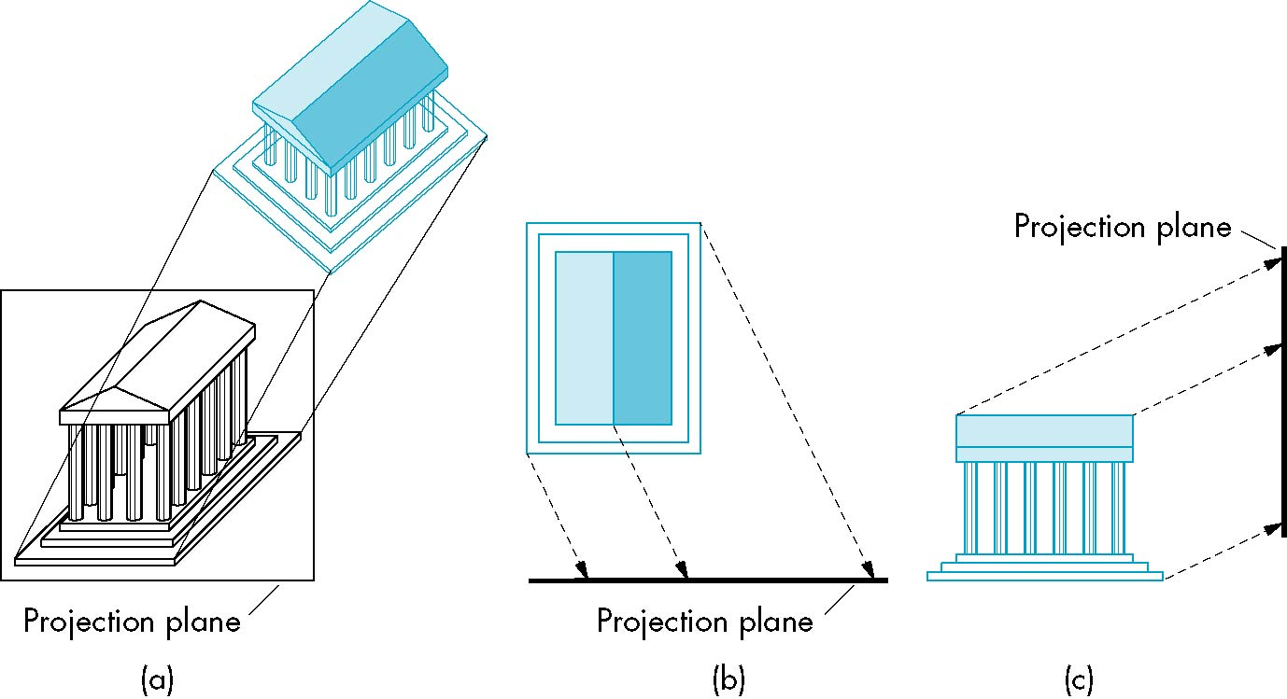
Oblique Projection
Arbitrary relationship between projectors and projection plane
E. Angel and D. Shreiner : Interactive Computer Graphics 6E © Addison-Wesley 2012

Slide 17
Advantages and Disadvantages
Can pick the angles to emphasize a particular face
  Architecture: plan oblique, elevation oblique
Angles in faces parallel to projection plane are preserved while we can still see “around” side
In physical world, cannot create with simple camera; possible with bellows camera or special lens (architectural)
E. Angel and D. Shreiner : Interactive Computer Graphics 6E © Addison-Wesley 2012

Slide 18
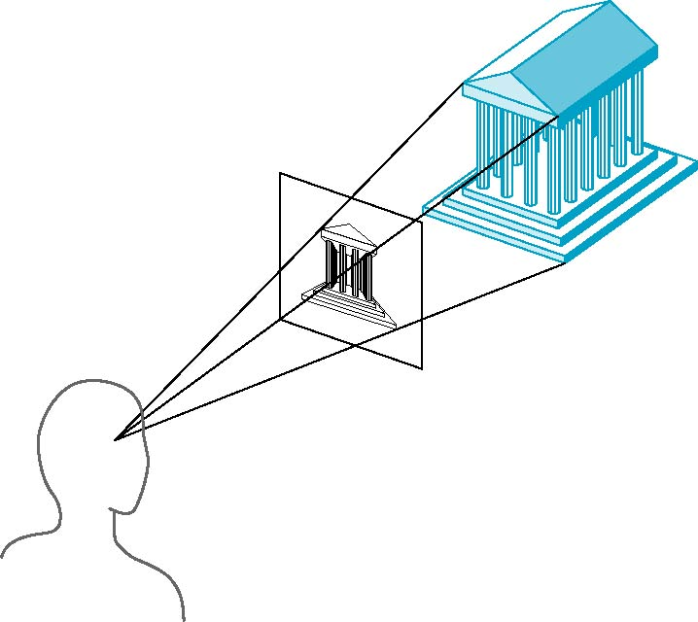
Perspective Projection
Projectors coverge at center of projection
E. Angel and D. Shreiner : Interactive Computer Graphics 6E © Addison-Wesley 2012

Slide 19
Vanishing Points
Parallel lines (not parallel to the projection plan) on the object converge at a single point in the projection (the vanishing point)
Drawing simple perspectives by hand uses these vanishing point(s)
vanishing point
E. Angel and D. Shreiner : Interactive Computer Graphics 6E © Addison-Wesley 2012

Slide 20
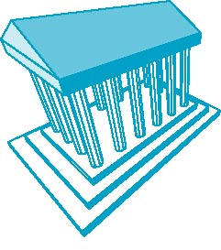
Three-Point Perspective
No principal face parallel to projection plane
Three vanishing points for cube
E. Angel and D. Shreiner : Interactive Computer Graphics 6E © Addison-Wesley 2012

Slide 21
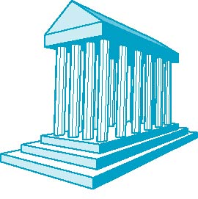
Two-Point Perspective
On principal direction parallel to projection plane
Two vanishing points for cube
E. Angel and D. Shreiner : Interactive Computer Graphics 6E © Addison-Wesley 2012

Slide 22
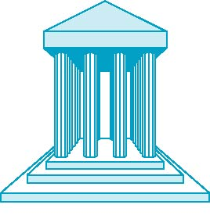
One-Point Perspective
One principal face parallel to projection plane
One vanishing point for cube
E. Angel and D. Shreiner : Interactive Computer Graphics 6E © Addison-Wesley 2012

Slide 23
Advantages and Disadvantages
Objects further from viewer are projected smaller than the same sized objects closer to the viewer (diminution)
  Looks realistic
Equal distances along a line are not projected into equal distances (nonuniform foreshortening)
Angles preserved only in planes parallel to the projection plane
More difficult to construct by hand than parallel projections (but not more difficult by computer)
E. Angel and D. Shreiner : Interactive Computer Graphics 6E © Addison-Wesley 2012

