Slide 1
Shading in OpenGL
Ed Angel
Professor Emeritus of Computer Science
University of New Mexico
E. Angel and D. Shreiner: Interactive Computer Graphics 6E © Addison-Wesley 2012

Slide 2
Objectives
Introduce the OpenGL shading methods
  per vertex vs per fragment shading
  Where to carry out
Discuss polygonal shading
  Flat
  Smooth
  Gouraud
E. Angel and D. Shreiner: Interactive Computer Graphics 6E © Addison-Wesley 2012

Slide 3
OpenGL shading
Need
  Normals
  material properties
  Lights
State-based shading functions have been deprecated (glNormal, glMaterial, glLight)
Compute in application or send attributes to shaders
E. Angel and D. Shreiner: Interactive Computer Graphics 6E © Addison-Wesley 2012

Slide 4
Normalization
Cosine terms in lighting calculations can be computed using dot product
Unit length vectors simplify calculation
Usually we want to set the magnitudes to have unit length but
  Length can be affected by transformations
  Note that scaling does not preserved length
GLSL has a normalization function
E. Angel and D. Shreiner: Interactive Computer Graphics 6E © Addison-Wesley 2012

Slide 5
Normal for Triangle
n
plane n ·(p - p₀ ) = 0
p₂
n = (p₁ - p₀ ) ×(p₂ - p₀ )
p
p₁
normalize n ← n/ |n|
p₀
Note that right-hand rule determines outward face
E. Angel and D. Shreiner: Interactive Computer Graphics 6E © Addison-Wesley 2012

Slide 6
Specifying a Point Light Source
For each light source, we can set an RGBA for the diffuse, specular, and ambient components, and for the position
vec4 diffuse0 =vec4(1.0, 0.0, 0.0, 1.0);
vec4 ambient0 = vec4(1.0, 0.0, 0.0, 1.0);
vec4 specular0 = vec4(1.0, 0.0, 0.0, 1.0);
vec4 light0_pos =vec4(1.0, 2.0, 3,0, 1.0);
E. Angel and D. Shreiner: Interactive Computer Graphics 6E © Addison-Wesley 2012

Slide 7
Distance and Direction
The source colors are specified in RGBA
The position is given in homogeneous coordinates
  If w =1.0, we are specifying a finite location
  If w =0.0, we are specifying a parallel source with the given direction vector
The coefficients in distance terms are usually quadratic (1/(a+b*d+c*d*d)) where d is the distance from the point being rendered to the light source
E. Angel and D. Shreiner: Interactive Computer Graphics 6E © Addison-Wesley 2012

Slide 8
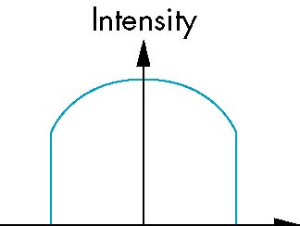
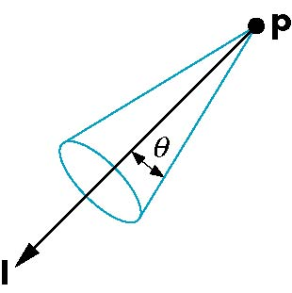
Spotlights
Derive from point source
  Direction
  Cutoff
  Attenuation Proportional to cos^{α}φ
−θ
φ
θ
E. Angel and D. Shreiner: Interactive Computer Graphics 6E © Addison-Wesley 2012

Slide 9
Global Ambient Light
Ambient light depends on color of light sources
  A red light in a white room will cause a red ambient term that disappears when the light is turned off
A global ambient term that is often helpful for testing
E. Angel and D. Shreiner: Interactive Computer Graphics 6E © Addison-Wesley 2012

Slide 10
Moving Light Sources
Light sources are geometric objects whose positions or directions are affected by the model-view matrix
Depending on where we place the position (direction) setting function, we can
  Move the light source(s) with the object(s)
  Fix the object(s) and move the light source(s)
  Fix the light source(s) and move the object(s)
  Move the light source(s) and object(s) independently
E. Angel and D. Shreiner: Interactive Computer Graphics 6E © Addison-Wesley 2012

Slide 11
Material Properties
Material properties should match the terms in the light model
Reflectivities
w component gives opacity
vec4 ambient = vec4(0.2, 0.2, 0.2, 1.0);
vec4 diffuse = vec4(1.0, 0.8, 0.0, 1.0);
vec4 specular = vec4(1.0, 1.0, 1.0, 1.0);
GLfloat shine = 100.0
E. Angel and D. Shreiner: Interactive Computer Graphics 6E © Addison-Wesley 2012

Slide 12
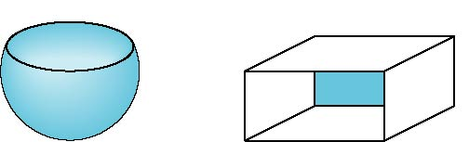

Front and Back Faces
Every face has a front and back
For many objects, we never see the back face so we don’t care how or if it’s rendered
If it matters, we can handle in shader
back faces not visible
back faces visible
E. Angel and D. Shreiner: Interactive Computer Graphics 6E © Addison-Wesley 2012

Slide 13
Emissive Term
We can simulate a light source in OpenGL by giving a material an emissive component
This component is unaffected by any sources or transformations
E. Angel and D. Shreiner: Interactive Computer Graphics 6E © Addison-Wesley 2012

Slide 14
Transparency
Material properties are specified as RGBA values
The A value can be used to make the surface translucent
The default is that all surfaces are opaque regardless of A
Later we will enable blending and use this feature
E. Angel and D. Shreiner: Interactive Computer Graphics 6E © Addison-Wesley 2012

Slide 15
Polygonal Shading
In per vertex shading, shading calculations are done for each vertex
  Vertex colors become vertex shades and can be sent to the vertex shader as a vertex attribute
  Alternately, we can send the parameters to the vertex shader and have it compute the shade
By default, vertex shades are interpolated across an object if passed to the fragment shader as a varying variable (smooth shading)
We can also use uniform variables to shade with a single shade (flat shading)
E. Angel and D. Shreiner: Interactive Computer Graphics 6E © Addison-Wesley 2012

Slide 16
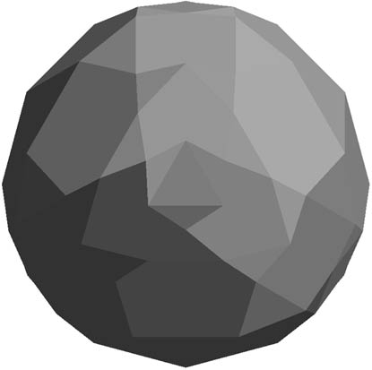
Polygon Normals
Triangles have a single normal
  Shades at the vertices as computed by the Phong model can be almost same
  Identical for a distant viewer (default) or if there is no specular component
Consider model of sphere
Want different normals at
each vertex even though
this concept is not quite
correct mathematically
E. Angel and D. Shreiner: Interactive Computer Graphics 6E © Addison-Wesley 2012

Slide 17
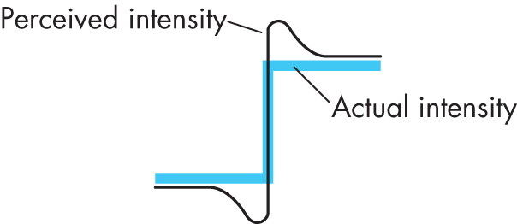

Lateral Inhibition
Human visual system extremely sensitive to small differences in light intensity
  Lateral inhibition – we perceive changes as overshooting or undershooting
  Results in “mach bands”
E. Angel and D. Shreiner: Interactive Computer Graphics 6E © Addison-Wesley 2012

Slide 18
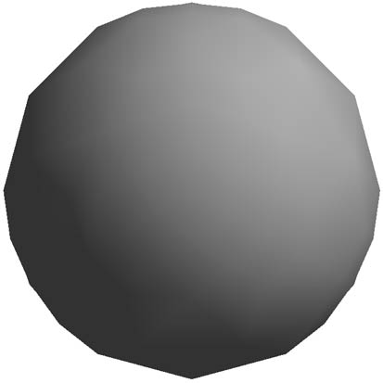
Smooth Shading
We can set a new normal at each vertex
Easy for sphere model
  If centered at origin n = p
Now smooth shading works
Note silhouette edge
E. Angel and D. Shreiner: Interactive Computer Graphics 6E © Addison-Wesley 2012

Slide 19
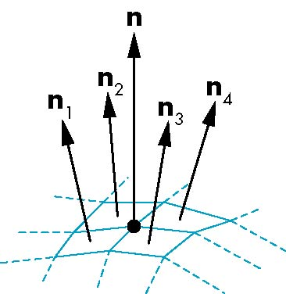
Mesh Shading
The previous example is not general because we knew the normal at each vertex analytically
For polygonal models, Gouraud proposed we use the average of the normals around a mesh vertex
n = (n₁+n₂+n₃+n₄)/ |n₁+n₂+n₃+n₄|
E. Angel and D. Shreiner: Interactive Computer Graphics 6E © Addison-Wesley 2012

Slide 20
Gouraud and Phong Shading
Gouraud Shading
  Find average normal at each vertex (vertex normals)
  Apply modified Phong model at each vertex
  Interpolate vertex shades across each polygon
Phong shading
  Find vertex normals
  Interpolate vertex normals across edges
  Interpolate edge normals across polygon
  Apply modified Phong model at each fragment
E. Angel and D. Shreiner: Interactive Computer Graphics 6E © Addison-Wesley 2012

Slide 21
Comparison
If the polygon mesh approximates surfaces with a high curvatures, Phong shading may look smooth while Gouraud shading may show edges
Phong shading requires much more work than Gouraud shading
  Until recently not available in real time systems
  Now can be done using fragment shaders
Both need data structures to represent meshes so we can obtain vertex normals
E. Angel and D. Shreiner: Interactive Computer Graphics 6E © Addison-Wesley 2012

Slide 22
Vertex Lighting Shaders I
// vertex shader
in vec4 vPosition;
in vec3 vNormal;
out vec4 color; //vertex shade
// light and material properties
uniform vec4 AmbientProduct, DiffuseProduct, SpecularProduct;
uniform mat4 ModelView;
uniform mat4 Projection;
uniform vec4 LightPosition;
uniform float Shininess;
E. Angel and D. Shreiner: Interactive Computer Graphics 6E © Addison-Wesley 2012

Slide 23
Vertex Lighting Shaders II
void main()
{
// Transform vertex position into eye coordinates
vec3 pos = (ModelView * vPosition).xyz;
vec3 L = normalize( LightPosition.xyz - pos );
vec3 E = normalize( -pos );
vec3 H = normalize( L + E );
// Transform vertex normal into eye coordinates
vec3 N = normalize( ModelView*vec4(vNormal, 0.0) ).xyz;
E. Angel and D. Shreiner: Interactive Computer Graphics 6E © Addison-Wesley 2012

Slide 24
Vertex Lighting Shaders III
// Compute terms in the illumination equation
vec4 ambient = AmbientProduct;
float Kd = max( dot(L, N), 0.0 );
vec4 diffuse = Kd*DiffuseProduct;
float Ks = pow( max(dot(N, H), 0.0), Shininess );
vec4 specular = Ks * SpecularProduct;
if( dot(L, N) < 0.0 ) specular = vec4(0.0, 0.0, 0.0, 1.0);
gl_Position = Projection * ModelView * vPosition;
color = ambient + diffuse + specular;
color.a = 1.0;
}
E. Angel and D. Shreiner: Interactive Computer Graphics 6E © Addison-Wesley 2012

Slide 25
Vertex Lighting Shaders IV
// fragment shader
in vec4 color;
void main()
{
gl_FragColor = color;
}
E. Angel and D. Shreiner: Interactive Computer Graphics 6E © Addison-Wesley 2012

Slide 26
Fragment Lighting Shaders I
// vertex shader
in vec4 vPosition;
in vec3 vNormal;
// output values that will be interpolatated per-fragment
out vec3 fN;
out vec3 fE;
out vec3 fL;
uniform mat4 ModelView;
uniform vec4 LightPosition;
uniform mat4 Projection;
E. Angel and D. Shreiner: Interactive Computer Graphics 6E © Addison-Wesley 2012

Slide 27
Fragment Lighting Shaders II
void main()
{
fN = vNormal;
fE = vPosition.xyz;
fL = LightPosition.xyz;
if( LightPosition.w != 0.0 ) {
fL = LightPosition.xyz - vPosition.xyz;
}
gl_Position = Projection*ModelView*vPosition;
}
E. Angel and D. Shreiner: Interactive Computer Graphics 6E © Addison-Wesley 2012

Slide 28
Fragment Lighting Shaders III
// fragment shader
// per-fragment interpolated values from the vertex shader
in vec3 fN;
in vec3 fL;
in vec3 fE;
uniform vec4 AmbientProduct, DiffuseProduct, SpecularProduct;
uniform mat4 ModelView;
uniform vec4 LightPosition;
uniform float Shininess;
E. Angel and D. Shreiner: Interactive Computer Graphics 6E © Addison-Wesley 2012

Slide 29
Fragment Lighting Shaders IV
void main()
{
// Normalize the input lighting vectors
vec3 N = normalize(fN);
vec3 E = normalize(fE);
vec3 L = normalize(fL);
vec3 H = normalize( L + E );
vec4 ambient = AmbientProduct;
E. Angel and D. Shreiner: Interactive Computer Graphics 6E © Addison-Wesley 2012

Slide 30
Fragment Lighting Shaders V
float Kd = max(dot(L, N), 0.0);
vec4 diffuse = Kd*DiffuseProduct;
float Ks = pow(max(dot(N, H), 0.0), Shininess);
vec4 specular = Ks*SpecularProduct;
// discard the specular highlight if the light's behind the vertex
if( dot(L, N) < 0.0 )
specular = vec4(0.0, 0.0, 0.0, 1.0);
gl_FragColor = ambient + diffuse + specular;
gl_FragColor.a = 1.0;
}
E. Angel and D. Shreiner: Interactive Computer Graphics 6E © Addison-Wesley 2012

