Slide 1
Shader Applications
Ed Angel
Professor Emeritus of Computer Science
University of New Mexico
E. Angel and D. Shreiner: Interactive Computer Graphics 6E © Addison-Wesley 2012

Slide 2
Objectives
Shader Applications
Texture Mapping Applications
Reflection Maps
Bump Maps
E. Angel and D. Shreiner: Interactive Computer Graphics 6E © Addison-Wesley 2012

Slide 3
Vertex Shader Applications
Moving vertices
  Morphing
  Wave motion
  Fractals
Lighting
  More realistic models
  Cartoon shaders
E. Angel and D. Shreiner: Interactive Computer Graphics 6E © Addison-Wesley 2012

Slide 4
Wave Motion Vertex Shader
uniform float time;
uniform float xs, zs, // frequencies
uniform float h; // height scale
uniform mat4 ModelView, Projection;
in vec4 vPosition;
void main() {
vec4 t =vPosition;
t.y = vPosition.y
+ h*sin(time + xs*vPosition.x)
+ h*sin(time + zs*vPosition.z);
gl_Position = Projection*ModelView*t;
}
E. Angel and D. Shreiner: Interactive Computer Graphics 6E © Addison-Wesley 2012

Slide 5
Particle System
uniform vec3 init_vel;
uniform float g, m, t;
uniform mat4 Projection, ModelView;
in vPosition;
void main(){
vec3 object_pos;
object_pos.x = vPosition.x + vel.x*t;
object_pos.y = vPosition.y + vel.y*t
+ g/(2.0*m)*t*t;
object_pos.z = vPosition.z + vel.z*t;
gl_Position = Projection*
ModelView*vec4(object_pos,1);
}
E. Angel and D. Shreiner: Interactive Computer Graphics 6E © Addison-Wesley 2012

Slide 6



Fragment Shader Applications
Texture mapping
smooth shading
environment
mapping
bump mapping
E. Angel and D. Shreiner: Interactive Computer Graphics 6E © Addison-Wesley 2012

Slide 7
Cube Maps
We can form a cube map texture by defining six 2D texture maps that correspond to the sides of a box
Supported by OpenGL
Also supported in GLSL through cubemap sampler
  vec4 texColor = textureCube(mycube, texcoord);
Texture coordinates must be 3D
E. Angel and D. Shreiner: Interactive Computer Graphics 6E © Addison-Wesley 2012

Slide 8
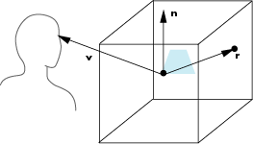
Environment Map
Use reflection vector to locate texture in cube map
E. Angel and D. Shreiner: Interactive Computer Graphics 6E © Addison-Wesley 2012

Slide 9
Environment Maps with Shaders
Environment map usually computed in world coordinates which can differ from object coordinates because of modeling matrix
  May have to keep track of modeling matrix and pass it shader as a uniform variable
Can also use reflection map or refraction map (for example to simulate water)
E. Angel and D. Shreiner: Interactive Computer Graphics 6E © Addison-Wesley 2012

Slide 10
Reflection Map Vertex Shader
uniform mat4 Projection, ModelView, NormalMatrix;
in vec4 vPosition;
in vec4 normal;
out vec3 R;
void main(void)
{
gl_Position = Projection*ModelView*vPosition;
vec3 N = normalize(NormalMatrix*normal);
vec4 eyePos = ModelView*gvPosition;
R = reflect(-eyePos.xyz, N);
}
E. Angel and D. Shreiner: Interactive Computer Graphics 6E © Addison-Wesley 2012

Slide 11
Reflection Map Fragment Shader
in vec3 R;
uniform samplerCube texMap;
void main(void)
{
gl_FragColor = textureCube(texMap, R);
}
E. Angel and D. Shreiner: Interactive Computer Graphics 6E © Addison-Wesley 2012

Slide 12
Bump Mapping
Perturb normal for each fragment
Store perturbation as textures
E. Angel and D. Shreiner: Interactive Computer Graphics 6E © Addison-Wesley 2012

Slide 13
Normalization Maps
Cube maps can be viewed as lookup tables 1-4 dimensional variables
Vector from origin is pointer into table
Example: store normalized value of vector in the map
  Same for all points on that vector
  Use “normalization map” instead of normalization function
  Lookup replaces sqrt, mults and adds
E. Angel and D. Shreiner: Interactive Computer Graphics 6E © Addison-Wesley 2012

Slide 14
Introduction
Let’s consider an example for which a fragment program might make sense
Mapping methods
  Texture mapping
  Environmental (reflection) mapping
    Variant of texture mapping
  Bump mapping
    Solves flatness problem of texture mapping
E. Angel and D. Shreiner: Interactive Computer Graphics 6E © Addison-Wesley 2012

Slide 15
Modeling an Orange
Consider modeling an orange
Texture map a photo of an orange onto a surface
  Captures dimples
  Will not be correct if we move viewer or light
  We have shades of dimples rather than their correct orientation
Ideally we need to perturb normal across surface of object and compute a new color at each interior point
E. Angel and D. Shreiner: Interactive Computer Graphics 6E © Addison-Wesley 2012

Slide 16
Bump Mapping (Blinn)
Consider a smooth surface
n
p
E. Angel and D. Shreiner: Interactive Computer Graphics 6E © Addison-Wesley 2012

Slide 17
Rougher Version
n’
p’
p
E. Angel and D. Shreiner: Interactive Computer Graphics 6E © Addison-Wesley 2012

Slide 18
Equations
p(u,v) = [x(u,v), y(u,v), z(u,v)]^{T}
p_{u}=[ ∂x/ ∂u, ∂y/ ∂u, ∂z/ ∂u]^{T}
p_{v}=[ ∂x/ ∂v, ∂y/ ∂v, ∂z/ ∂v]^{T}
n = (p_{u} × p_{v} ) / | p_{u} × p_{v} |
E. Angel and D. Shreiner: Interactive Computer Graphics 6E © Addison-Wesley 2012

Slide 19
Tangent Plane
p_{v}
n
p_{u}
E. Angel and D. Shreiner: Interactive Computer Graphics 6E © Addison-Wesley 2012

Slide 20
Displacement Function
p’ = p + d(u,v) n
d(u,v) is the bump or displacement function
|d(u,v)| << 1
E. Angel and D. Shreiner: Interactive Computer Graphics 6E © Addison-Wesley 2012

Slide 21
Perturbed Normal
n’ = p’_{u} × p’_{v}
p’_{u} = p_{u} + (∂d/∂u)n + d(u,v)n_{u}
p’_{v} = p_{v} + (∂d/∂v)n + d(u,v)n_{v}
If d is small, we can neglect last term
E. Angel and D. Shreiner: Interactive Computer Graphics 6E © Addison-Wesley 2012

Slide 22
Approximating the Normal
n’ = p’_{u} × p’_{v}
≈ n + (∂d/∂u)n × p_{v} + (∂d/∂v)n × p_{u}
The vectors n × p_{v} and n × p_{u} lie
in the tangent plane
Hence the normal is displaced in the tangent plane
Must precompute the arrays ∂d/ ∂u and ∂d/ ∂v
Finally,we perturb the normal during shading
E. Angel and D. Shreiner: Interactive Computer Graphics 6E © Addison-Wesley 2012

Slide 23
Image Processing
Suppose that we start with a function d(u,v)
We can sample it to form an array D=[d_{ij}]
Then ∂d/ ∂u ≈ d_{ij} – d_{i-1,j}
and ∂d/ ∂v ≈ d_{ij} – d_{i,j-1}
Embossing: multipass approach using floating point buffer
E. Angel and D. Shreiner: Interactive Computer Graphics 6E © Addison-Wesley 2012

Slide 24
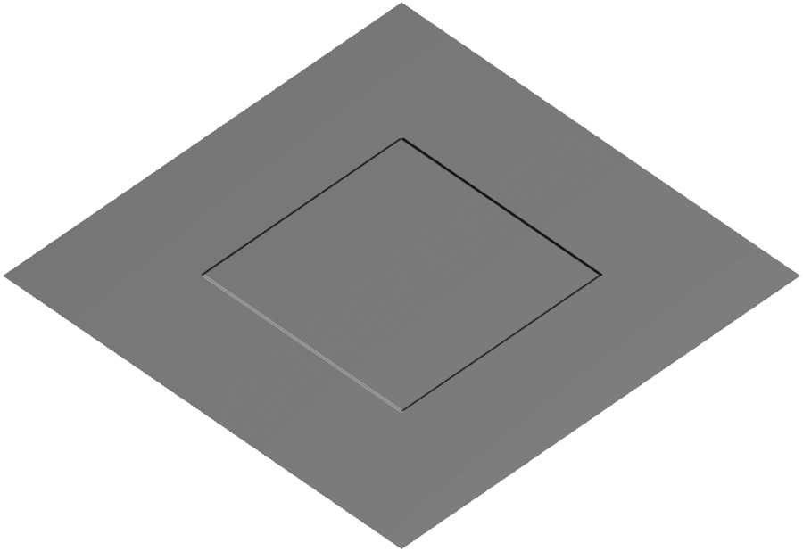
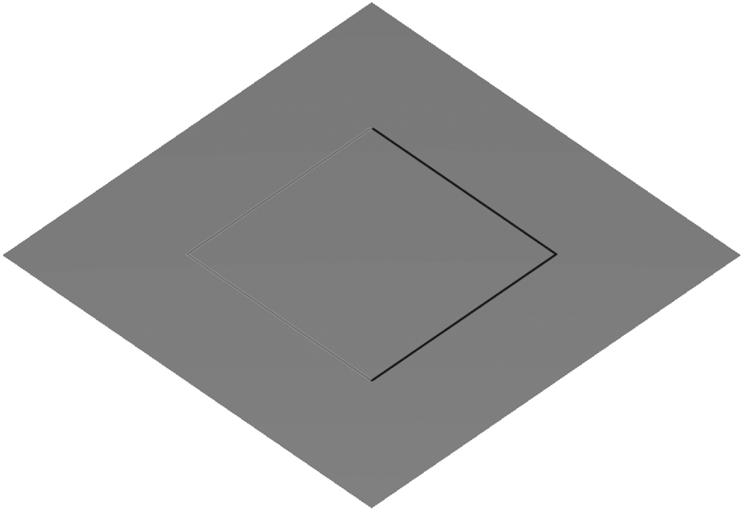
Example
Single Polygon and a Rotating Light Source
E. Angel and D. Shreiner: Interactive Computer Graphics 6E © Addison-Wesley 2012

Slide 25
How to do this?
The problem is that we want to apply the perturbation at all points on the surface
Cannot solve by vertex lighting (unless polygons are very small)
Really want to apply to every fragment
Can’t do that in fixed function pipeline
But can do with a fragment program!!
E. Angel and D. Shreiner: Interactive Computer Graphics 6E © Addison-Wesley 2012

