Slide 1
Bezier and Spline Curves and Surfaces
Ed Angel
Professor Emeritus of Computer Science
University of New Mexico
E. Angel and D. Shreiner: Interactive Computer Graphics 6E © Addison-Wesley 2012

Slide 2
Objectives
Introduce the Bezier curves and surfaces
Derive the required matrices
Introduce the B-spline and compare it to the standard cubic Bezier
E. Angel and D. Shreiner: Interactive Computer Graphics 6E © Addison-Wesley 2012

Slide 3
Bezier’s Idea
In graphics and CAD, we do not usually have derivative data
Bezier suggested using the same 4 data points as with the cubic interpolating curve to approximate the derivatives in the Hermite form
E. Angel and D. Shreiner: Interactive Computer Graphics 6E © Addison-Wesley 2012

Slide 4
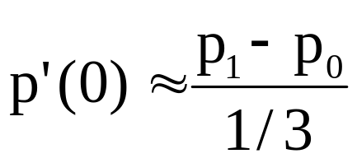
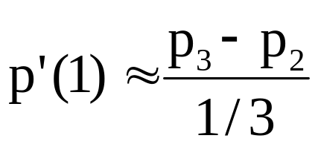
Approximating Derivatives
p₁
p₂
p₁ located at u=1/3
p₂ located at u=2/3
slope p’(0)
slope p’(1)
p₀
p₃
u
E. Angel and D. Shreiner: Interactive Computer Graphics 6E © Addison-Wesley 2012

Slide 5
Equations
Interpolating conditions are the same
p(0) = p₀ = c₀
p(1) = p₃ = c₀+c₁+c₂+c₃
Approximating derivative conditions
p’(0) = 3(p₁- p₀) = c₀
p’(1) = 3(p₃- p₂) = c₁+2c₂+3c₃
Solve four linear equations for c=M_{B}p
E. Angel and D. Shreiner: Interactive Computer Graphics 6E © Addison-Wesley 2012

Slide 6
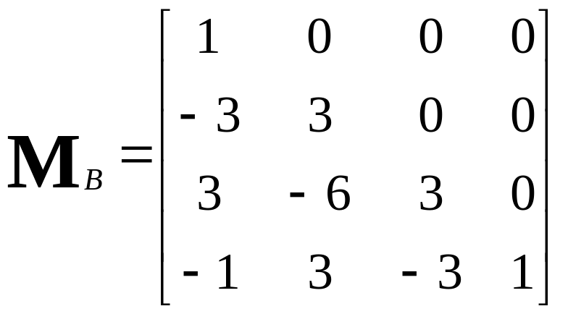
Bezier Matrix
p(u) = u^{T}M_{B}p = b(u)^{T}p
blending functions
E. Angel and D. Shreiner: Interactive Computer Graphics 6E © Addison-Wesley 2012

Slide 7
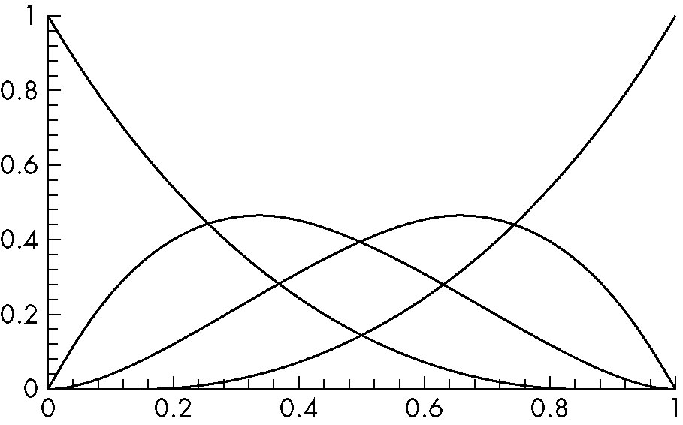
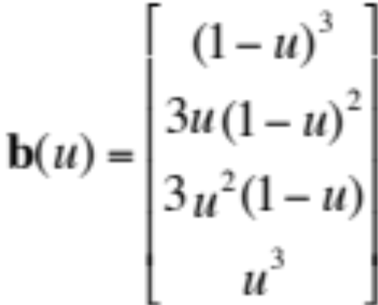
Blending Functions
Note that all zeros are at 0 and 1 which forces
the functions to be smooth over (0,1)
E. Angel and D. Shreiner: Interactive Computer Graphics 6E © Addison-Wesley 2012

Slide 8
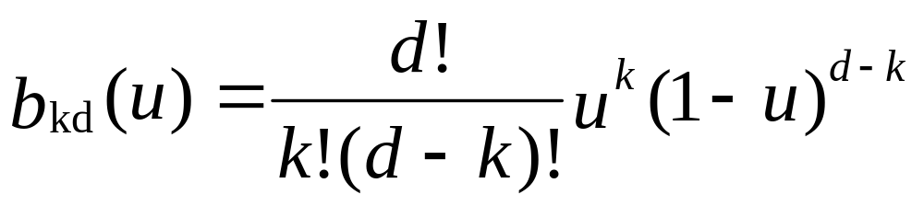
Bernstein Polynomials
The blending functions are a special case of the Bernstein polynomials
These polynomials give the blending polynomials for any degree Bezier form
  All zeros at 0 and 1
  For any degree they all sum to 1
  They are all between 0 and 1 inside (0,1)
E. Angel and D. Shreiner: Interactive Computer Graphics 6E © Addison-Wesley 2012

Slide 9
Convex Hull Property
The properties of the Bernstein polynomials ensure that all Bezier curves lie in the convex hull of their control points
Hence, even though we do not interpolate all the data, we cannot be too far away
p₁
p₂
convex hull
Bezier curve
p₀
p₃
E. Angel and D. Shreiner: Interactive Computer Graphics 6E © Addison-Wesley 2012

Slide 10
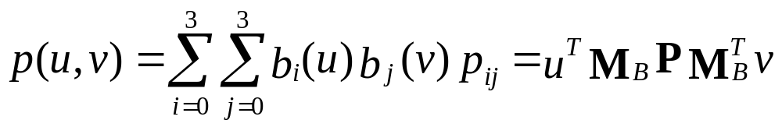
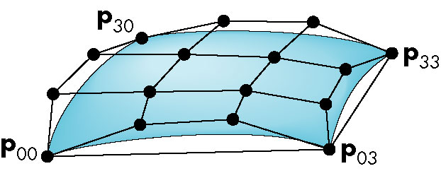
Bezier Patches
Using same data array P=[p_{ij}] as with interpolating form
Patch lies in
convex hull
E. Angel and D. Shreiner: Interactive Computer Graphics 6E © Addison-Wesley 2012

Slide 11
Analysis
Although the Bezier form is much better than the interpolating form, we have the derivatives are not continuous at join points
Can we do better?
  Go to higher order Bezier
    More work
    Derivative continuity still only approximate
    Supported by OpenGL
  Apply different conditions
    Tricky without letting order increase
E. Angel and D. Shreiner: Interactive Computer Graphics 6E © Addison-Wesley 2012

Slide 12
B-Splines
Basis splines: use the data at p=[p_{i-2} p_{i-1} p_{i} p_{i+1}]^{T} to define curve only between p_{i-1} and p_{i}
Allows us to apply more continuity conditions to each segment
For cubics, we can have continuity of function, first and second derivatives at join points
Cost is 3 times as much work for curves
  Add one new point each time rather than three
For surfaces, we do 9 times as much work
E. Angel and D. Shreiner: Interactive Computer Graphics 6E © Addison-Wesley 2012

Slide 13
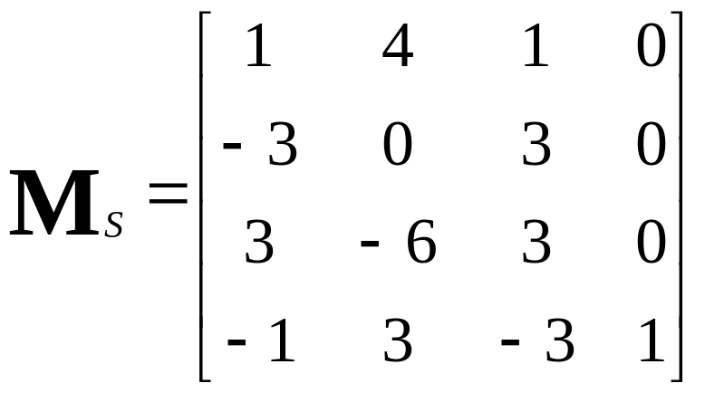
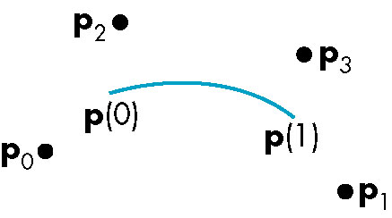
Cubic B-spline
p(u) = u^{T}M_{S}p = b(u)^{T}p
E. Angel and D. Shreiner: Interactive Computer Graphics 6E © Addison-Wesley 2012

Slide 14
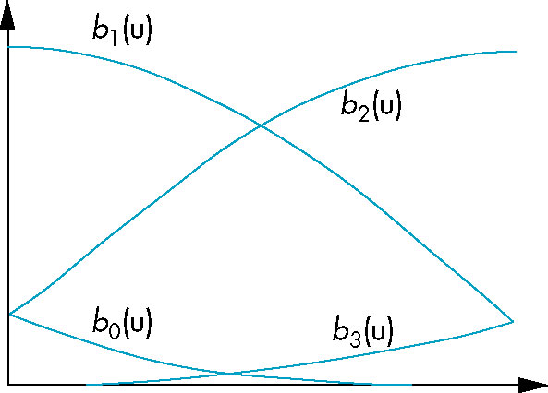
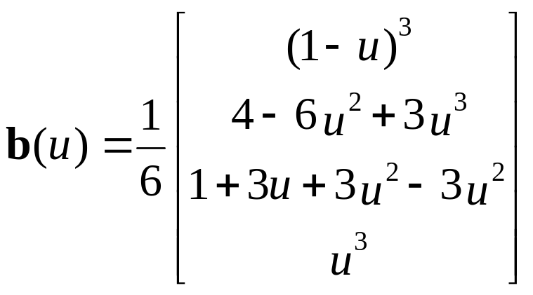
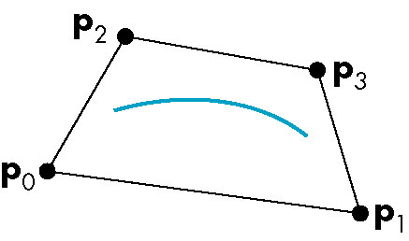
Blending Functions
convex hull property
E. Angel and D. Shreiner: Interactive Computer Graphics 6E © Addison-Wesley 2012

Slide 15

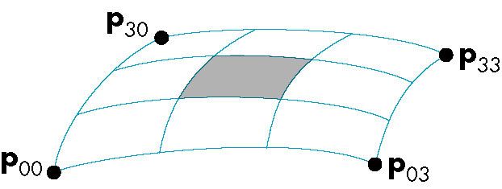
B-Spline Patches
defined over only 1/9 of region
E. Angel and D. Shreiner: Interactive Computer Graphics 6E © Addison-Wesley 2012

Slide 16
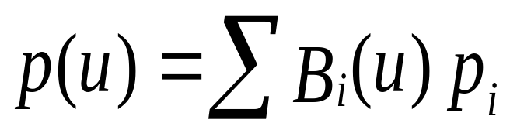
Splines and Basis
If we examine the cubic B-spline from the perspective of each control (data) point, each interior point contributes (through the blending functions) to four segments
We can rewrite p(u) in terms of the data points as
defining the basis functions {B_{i}(u)}
E. Angel and D. Shreiner: Interactive Computer Graphics 6E © Addison-Wesley 2012

Slide 17
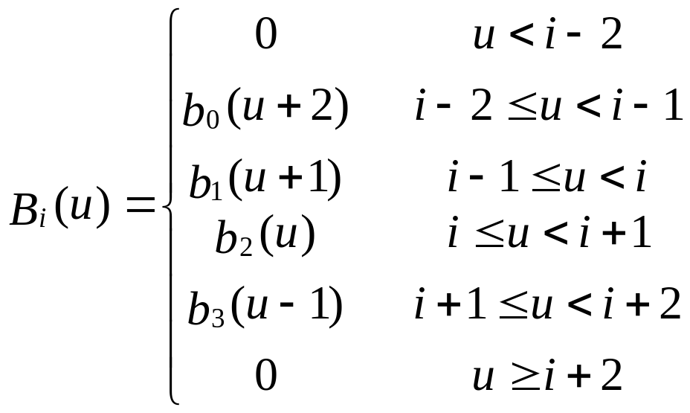
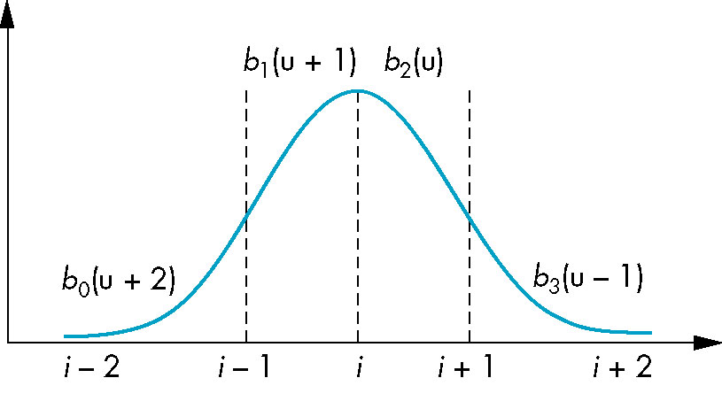
Basis Functions
In terms of the blending polynomials
E. Angel and D. Shreiner: Interactive Computer Graphics 6E © Addison-Wesley 2012

Slide 18
Generalizing Splines
We can extend to splines of any degree
Data and conditions to not have to given at equally spaced values (the knots)
  Nonuniform and uniform splines
  Can have repeated knots
    Can force spline to interpolate points
Cox-deBoor recursion gives method of evaluation
E. Angel and D. Shreiner: Interactive Computer Graphics 6E © Addison-Wesley 2012

Slide 19
NURBS
Nonuniform Rational B-Spline curves and surfaces add a fourth variable w to x,y,z
  Can interpret as weight to give more importance to some control data
  Can also interpret as moving to homogeneous coordinate
Requires a perspective division
  NURBS act correctly for perspective viewing
Quadrics are a special case of NURBS
E. Angel and D. Shreiner: Interactive Computer Graphics 6E © Addison-Wesley 2012

