Slide 1
Shading II
Ed Angel
Professor Emeritus of Computer Science
University of New Mexico
E. Angel and D. Shreiner: Interactive Computer Graphics 6E © Addison-Wesley 2012

Slide 2
Objectives
Continue discussion of shading
Introduce modified Phong model
Consider computation of required vectors
E. Angel and D. Shreiner: Interactive Computer Graphics 6E © Addison-Wesley 2012

Slide 3
Ambient Light
Ambient light is the result of multiple interactions between (large) light sources and the objects in the environment
Amount and color depend on both the color of the light(s) and the material properties of the object
Add k_{a} I_{a} to diffuse and specular terms
reflection coef
intensity of ambient light
E. Angel and D. Shreiner: Interactive Computer Graphics 6E © Addison-Wesley 2012

Slide 4
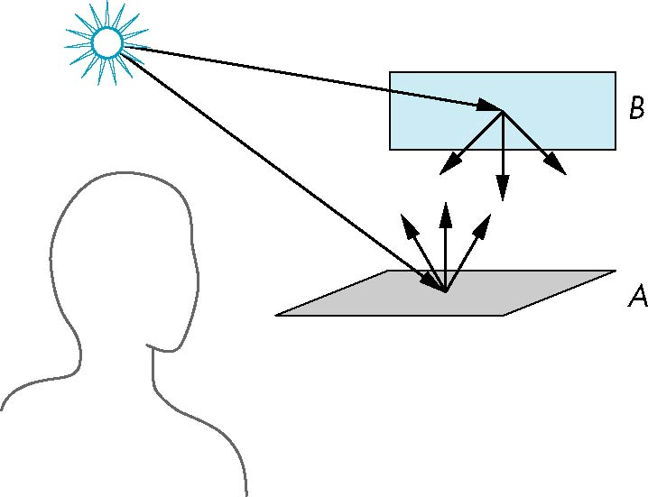
Distance Terms
The light from a point source that reaches a surface is inversely proportional to the square of the distance between them
We can add a factor of the
form 1/(a + bd +cd²) to
the diffuse and specular
terms
The constant and linear terms soften the effect of the point source
E. Angel and D. Shreiner: Interactive Computer Graphics 6E © Addison-Wesley 2012

Slide 5
Light Sources
In the Phong Model, we add the results from each light source
Each light source has separate diffuse, specular, and ambient terms to allow for maximum flexibility even though this form does not have a physical justification
Separate red, green and blue components
Hence, 9 coefficients for each point source
  I_{dr}, I_{dg}, I_{db}, I_{sr}, I_{sg}, I_{sb}, I_{ar}, I_{ag}, I_{ab}
E. Angel and D. Shreiner: Interactive Computer Graphics 6E © Addison-Wesley 2012

Slide 6
Material Properties
Material properties match light source properties
  Nine absorbtion coefficients
    k_{dr}, k_{dg}, k_{db}, k_{sr}, k_{sg}, k_{sb}, k_{ar}, k_{ag}, k_{ab}
  Shininess coefficient α
E. Angel and D. Shreiner: Interactive Computer Graphics 6E © Addison-Wesley 2012

Slide 7
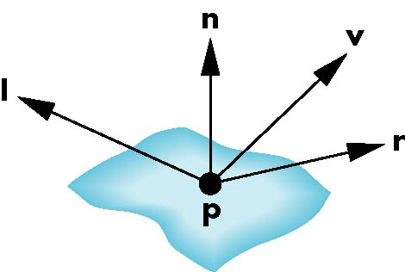
Adding up the Components
For each light source and each color component, the Phong model can be written (without the distance terms) as
I =k_{d} I_{d} l · n + k_{s} I_{s} (v · r )^{α} + k_{a} I_{a}
For each color component
we add contributions from
all sources
E. Angel and D. Shreiner: Interactive Computer Graphics 6E © Addison-Wesley 2012

Slide 8
Modified Phong Model
The specular term in the Phong model is problematic because it requires the calculation of a new reflection vector and view vector for each vertex
Blinn suggested an approximation using the halfway vector that is more efficient
E. Angel and D. Shreiner: Interactive Computer Graphics 6E © Addison-Wesley 2012

Slide 9
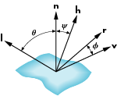
The Halfway Vector
h is normalized vector halfway between l and v
h = ( l + v )/ | l + v |
E. Angel and D. Shreiner: Interactive Computer Graphics 6E © Addison-Wesley 2012

Slide 10
Using the halfway vector
Replace (v · r )^{α} by (n · h )^{β}
β is chosen to match shineness
Note that halfway angle is half of angle between r and v if vectors are coplanar
Resulting model is known as the modified Phong or Blinn lighting model
  Specified in OpenGL standard
E. Angel and D. Shreiner: Interactive Computer Graphics 6E © Addison-Wesley 2012

Slide 11
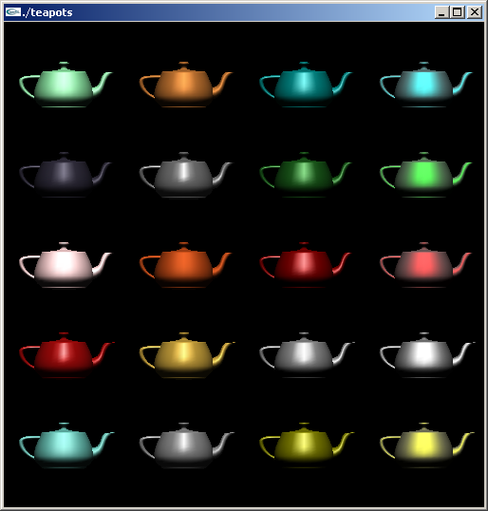
Example
Only differences in
these teapots are
the parameters
in the modified
Phong model
E. Angel and D. Shreiner: Interactive Computer Graphics 6E © Addison-Wesley 2012

Slide 12
Computation of Vectors
l and v are specified by the application
Can computer r from l and n
Problem is determining n
For simple surfaces is can be determined but how we determine n differs depending on underlying representation of surface
OpenGL leaves determination of normal to application
  Exception for GLU quadrics and Bezier surfaces was deprecated
E. Angel and D. Shreiner: Interactive Computer Graphics 6E © Addison-Wesley 2012

Slide 13
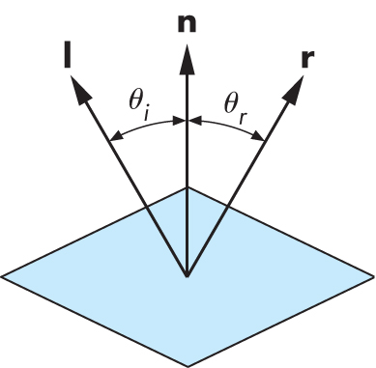
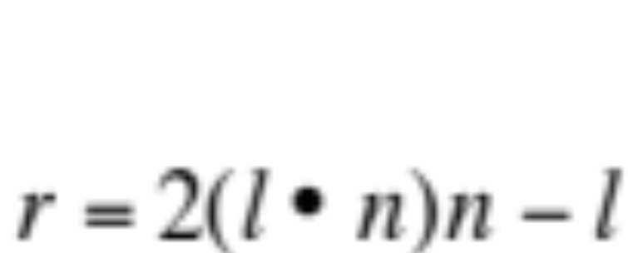
Computing Reflection Direction
Angle of incidence = angle of reflection
Normal, light direction and reflection direction are coplaner
Want all three to be unit length
E. Angel and D. Shreiner: Interactive Computer Graphics 6E © Addison-Wesley 2012

Slide 14
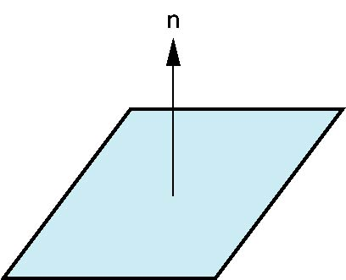
Plane Normals
Equation of plane: ax+by+cz+d = 0
From Chapter 3 we know that plane is determined by three points p₀, p₂, p₃ or normal n and p₀
Normal can be obtained by
n = (p₂-p₀) × (p₁-p₀)
E. Angel and D. Shreiner: Interactive Computer Graphics 6E © Addison-Wesley 2012

Slide 15

Normal to Sphere
Implicit function f(x,y.z)=0
Normal given by gradient
Sphere f(p)=p·p-1
n = [∂f/∂x, ∂f/∂y, ∂f/∂z]^{T}=p
E. Angel and D. Shreiner: Interactive Computer Graphics 6E © Addison-Wesley 2012

Slide 16
Parametric Form
For sphere
Tangent plane determined by vectors
Normal given by cross product
x=x(u,v)=cos u sin v
y=y(u,v)=cos u cos v
z= z(u,v)=sin u
∂p/∂u = [∂x/∂u, ∂y/∂u, ∂z/∂u]T
∂p/∂v = [∂x/∂v, ∂y/∂v, ∂z/∂v]T
n = ∂p/∂u × ∂p/∂v
E. Angel and D. Shreiner: Interactive Computer Graphics 6E © Addison-Wesley 2012

Slide 17
General Case
We can compute parametric normals for other simple cases
  Quadrics
  Parameteric polynomial surfaces
    Bezier surface patches (Chapter 10)
E. Angel and D. Shreiner: Interactive Computer Graphics 6E © Addison-Wesley 2012

