Slide 1
Hierarchical Modeling I
Ed Angel
Professor Emeritus of Computer Science,
University of New Mexico
E. Angel and D. Shreiner: Interactive Computer Graphics 6E © Addison-Wesley 2012

Slide 2
Objectives
Examine the limitations of linear modeling
  Symbols and instances
Introduce hierarchical models
  Articulated models
  Robots
Introduce Tree and DAG models
E. Angel and D. Shreiner: Interactive Computer Graphics 6E © Addison-Wesley 2012

Slide 3
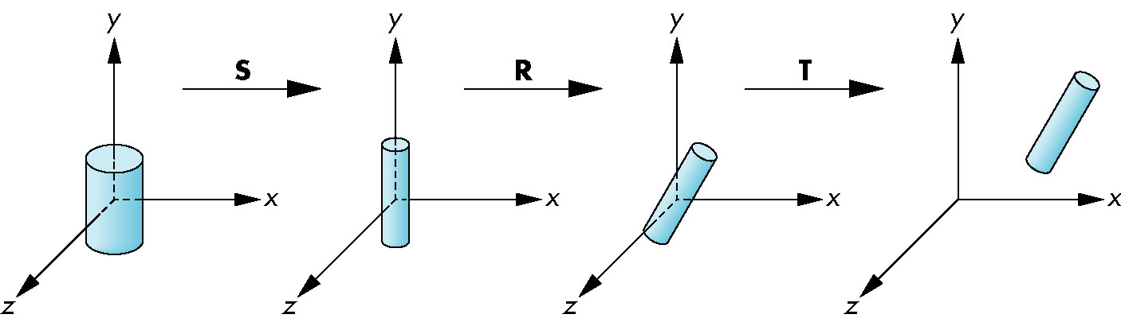
Instance Transformation
Start with a prototype object (a symbol)
Each appearance of the object in the model is an instance
  Must scale, orient, position
  Defines instance transformation
E. Angel and D. Shreiner: Interactive Computer Graphics 6E © Addison-Wesley 2012

Slide 4
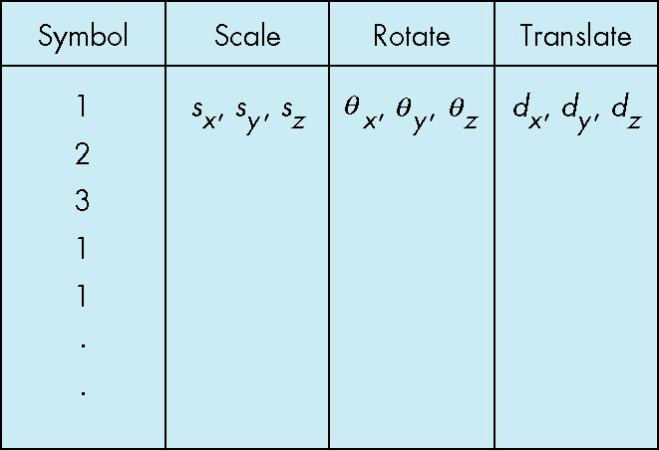
Symbol-Instance Table
Can store a model by assigning a number to each symbol and storing the parameters for the instance transformation
E. Angel and D. Shreiner: Interactive Computer Graphics 6E © Addison-Wesley 2012

Slide 5
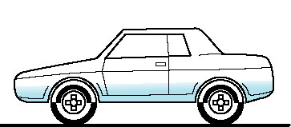
Relationships in Car Model
Symbol-instance table does not show relationships between parts of model
Consider model of car
  Chassis + 4 identical wheels
  Two symbols
Rate of forward motion determined by rotational speed of wheels
E. Angel and D. Shreiner: Interactive Computer Graphics 6E © Addison-Wesley 2012

Slide 6
Structure Through Function Calls
car(speed)
{
chassis()
wheel(right_front);
wheel(left_front);
wheel(right_rear);
wheel(left_rear);
}
Fails to show relationships well
Look at problem using a graph
E. Angel and D. Shreiner: Interactive Computer Graphics 6E © Addison-Wesley 2012

Slide 7
Graphs
Set of nodes and edges (links)
Edge connects a pair of nodes
  Directed or undirected
Cycle: directed path that is a loop
loop
E. Angel and D. Shreiner: Interactive Computer Graphics 6E © Addison-Wesley 2012

Slide 8
Tree
Graph in which each node (except the root) has exactly one parent node
  May have multiple children
  Leaf or terminal node: no children
root node
leaf node
E. Angel and D. Shreiner: Interactive Computer Graphics 6E © Addison-Wesley 2012

Slide 9
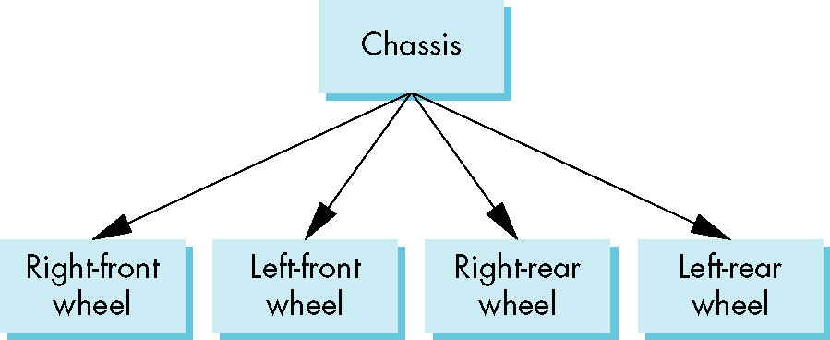
Tree Model of Car
E. Angel and D. Shreiner: Interactive Computer Graphics 6E © Addison-Wesley 2012

Slide 10
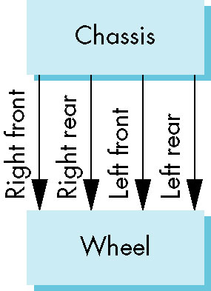
DAG Model
If we use the fact that all the wheels are identical, we get a directed acyclic graph
  Not much different than dealing with a tree
E. Angel and D. Shreiner: Interactive Computer Graphics 6E © Addison-Wesley 2012

Slide 11
Modeling with Trees
Must decide what information to place in nodes and what to put in edges
Nodes
  What to draw
  Pointers to children
Edges
  May have information on incremental changes to transformation matrices (can also store in nodes)
E. Angel and D. Shreiner: Interactive Computer Graphics 6E © Addison-Wesley 2012

Slide 12
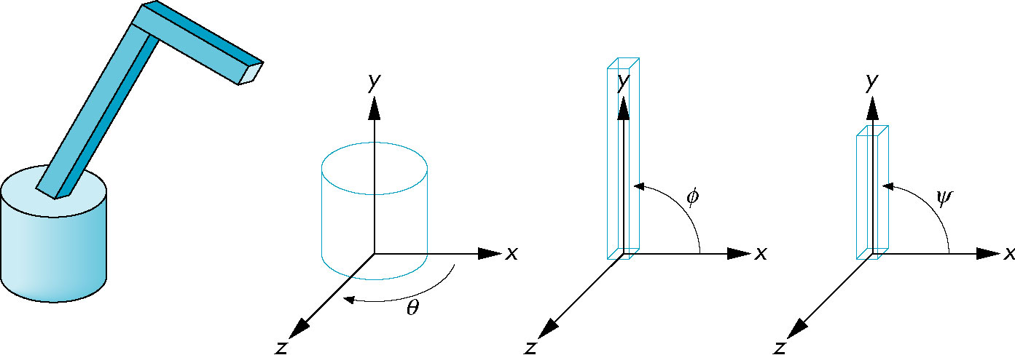
Robot Arm
parts in their own
coodinate systems
robot arm
E. Angel and D. Shreiner: Interactive Computer Graphics 6E © Addison-Wesley 2012

Slide 13
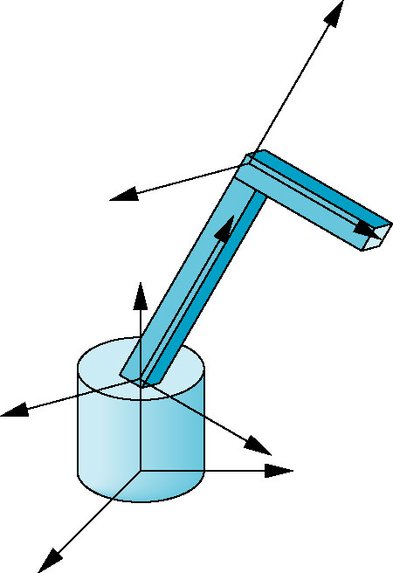
Articulated Models
Robot arm is an example of an articulated model
  Parts connected at joints
  Can specify state of model by
  giving all joint angles
E. Angel and D. Shreiner: Interactive Computer Graphics 6E © Addison-Wesley 2012

Slide 14
Relationships in Robot Arm
Base rotates independently
  Single angle determines position
Lower arm attached to base
  Its position depends on rotation of base
  Must also translate relative to base and rotate about connecting joint
Upper arm attached to lower arm
  Its position depends on both base and lower arm
  Must translate relative to lower arm and rotate about joint connecting to lower arm
E. Angel and D. Shreiner: Interactive Computer Graphics 6E © Addison-Wesley 2012

Slide 15
Required Matrices
Rotation of base: R_{b}
  Apply M = R_{b} to base
Translate lower arm relative to base: T_{lu}
Rotate lower arm around joint: R_{lu}
  Apply M = R_{b} T_{lu} R_{lu} to lower arm
Translate upper arm relative to upper arm: T_{uu}
Rotate upper arm around joint: R_{uu}
  Apply M = R_{b} T_{lu} R_{lu} T_{uu} R_{uu} to upper arm
E. Angel and D. Shreiner: Interactive Computer Graphics 6E © Addison-Wesley 2012

Slide 16
OpenGL Code for Robot
mat4 ctm;
robot_arm()
{
ctm = RotateY(theta);
base();
ctm *= Translate(0.0, h1, 0.0);
ctm *= RotateZ(phi);
lower_arm();
ctm *= Translate(0.0, h2, 0.0);
ctm *= RotateZ(psi);
upper_arm();
}
E. Angel and D. Shreiner: Interactive Computer Graphics 6E © Addison-Wesley 2012

Slide 17
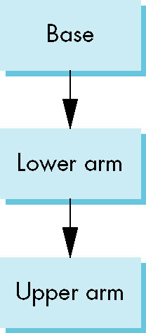
Tree Model of Robot
Note code shows relationships between parts of model
  Can change “look” of parts easily without altering relationships
Simple example of tree model
Want a general node structure
for nodes
E. Angel and D. Shreiner: Interactive Computer Graphics 6E © Addison-Wesley 2012

Slide 18
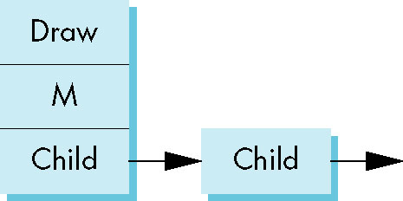
Possible Node Structure
Code for drawing part or
pointer to drawing function
linked list of pointers to children
matrix relating node to parent
E. Angel and D. Shreiner: Interactive Computer Graphics 6E © Addison-Wesley 2012

Slide 19
Generalizations
Need to deal with multiple children
  How do we represent a more general tree?
  How do we traverse such a data structure?
Animation
  How to use dynamically?
  Can we create and delete nodes during execution?
E. Angel and D. Shreiner: Interactive Computer Graphics 6E © Addison-Wesley 2012

