Slide 1
Designing Parametric Cubic Curves
Ed Angel
Professor Emeritus of Computer Science
University of New Mexico
E. Angel and D. Shreiner: Interactive Computer Graphics 6E © Addison-Wesley 2012

Slide 2
Objectives
Introduce the types of curves
  Interpolating
  Hermite
  Bezier
  B-spline
Analyze their performance
E. Angel and D. Shreiner: Interactive Computer Graphics 6E © Addison-Wesley 2012

Slide 3
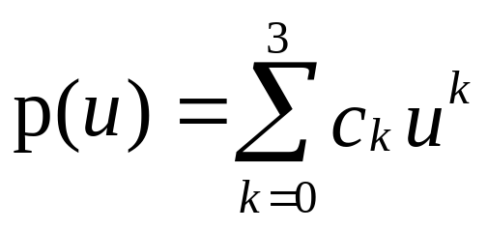
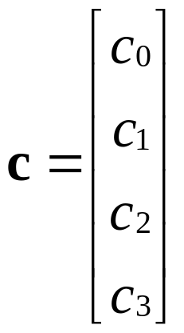
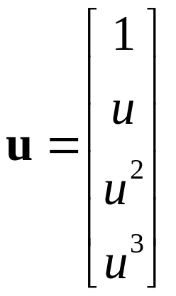
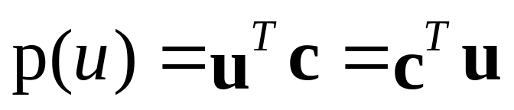
Matrix-Vector Form
define
then
E. Angel and D. Shreiner: Interactive Computer Graphics 6E © Addison-Wesley 2012

Slide 4
Interpolating Curve
p₁
p₃
p₀
p₂
Given four data (control) points p₀ , p₁ ,p₂ , p₃
determine cubic p(u) which passes through them
Must find c₀ ,c₁ ,c₂ , c₃
E. Angel and D. Shreiner: Interactive Computer Graphics 6E © Addison-Wesley 2012

Slide 5
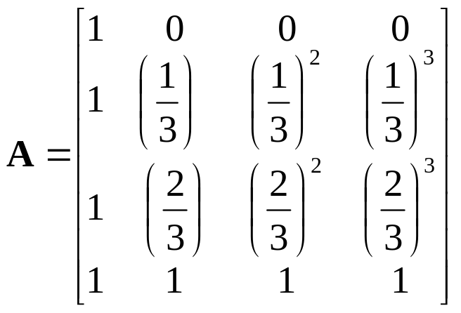
Interpolation Equations
apply the interpolating conditions at u=0, 1/3, 2/3, 1
p₀=p(0)=c₀
p₁=p(1/3)=c₀+(1/3)c₁+(1/3)²c₂+(1/3)³c₃
p₂=p(2/3)=c₀+(2/3)c₁+(2/3)²c₂+(2/3)³c₃
p₃=p(1)=c₀+c₁+c₂+c₃
or in matrix form with p = [p₀ p₁ p₂ p₃]^{T}
p=Ac
E. Angel and D. Shreiner: Interactive Computer Graphics 6E © Addison-Wesley 2012

Slide 6
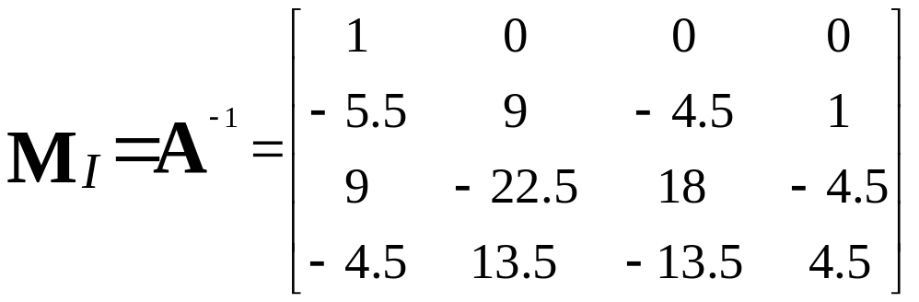
Interpolation Matrix
Solving for c we find the interpolation matrix
c=M_{I}p
Note that M_{I} does not depend on input data and
can be used for each segment in x, y, and z
E. Angel and D. Shreiner: Interactive Computer Graphics 6E © Addison-Wesley 2012

Slide 7
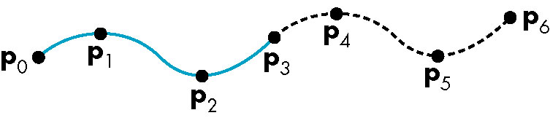
Interpolating Multiple Segments
use p = [p₃ p₄ p₅ p₆]^{T}
use p = [p₀ p₁ p₂ p₃]^{T}
Get continuity at join points but not
continuity of derivatives
E. Angel and D. Shreiner: Interactive Computer Graphics 6E © Addison-Wesley 2012

Slide 8
Blending Functions
Rewriting the equation for p(u)
p(u)=u^{T}c=u^{T}M_{I}p = b(u)^{T}p
where b(u) = [b₀(u) b₁(u) b₂(u) b₃(u)]^{T} is
an array of blending polynomials such that
p(u) = b₀(u)p₀+ b₁(u)p₁+ b₂(u)p₂+ b₃(u)p₃
b₀(u) = -4.5(u-1/3)(u-2/3)(u-1)
b₁(u) = 13.5u (u-2/3)(u-1)
b₂(u) = -13.5u (u-1/3)(u-1)
b₃(u) = 4.5u (u-1/3)(u-2/3)
E. Angel and D. Shreiner: Interactive Computer Graphics 6E © Addison-Wesley 2012

Slide 9
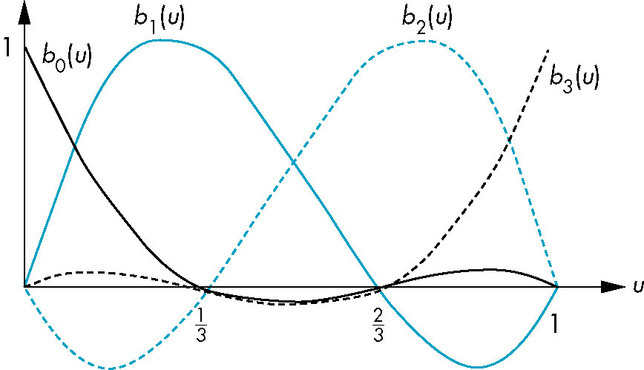
Blending Functions
These functions are not smooth
  Hence the interpolation polynomial is not smooth
E. Angel and D. Shreiner: Interactive Computer Graphics 6E © Addison-Wesley 2012

Slide 10
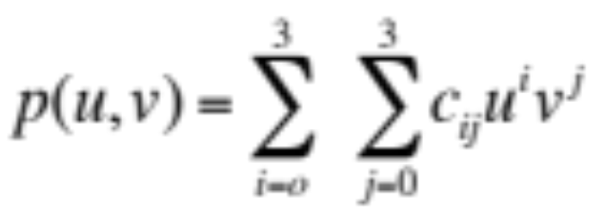
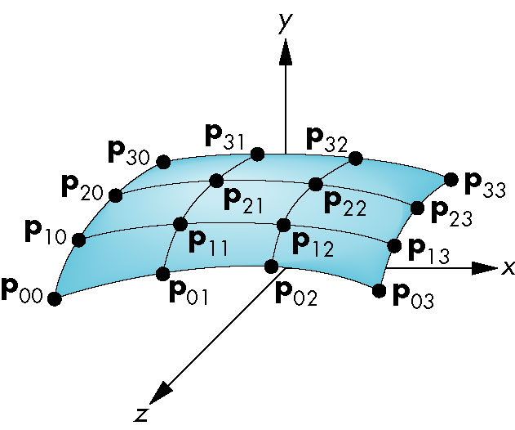
Interpolating Patch
Need 16 conditions to determine the 16 coefficients c_{ij}
Choose at u,v = 0, 1/3, 2/3, 1
E. Angel and D. Shreiner: Interactive Computer Graphics 6E © Addison-Wesley 2012

Slide 11
Matrix Form
Define v = [1 v v² v³]^{T}
C = [c_{ij}] P = [p_{ij}]
p(u,v) = u^{T}Cv
If we observe that for constant u (v), we obtain
interpolating curve in v (u), we can show
C=M_{I}PM_{I}
p(u,v) = u^{T}M_{I}PM_{I}^{T}v
E. Angel and D. Shreiner: Interactive Computer Graphics 6E © Addison-Wesley 2012

Slide 12
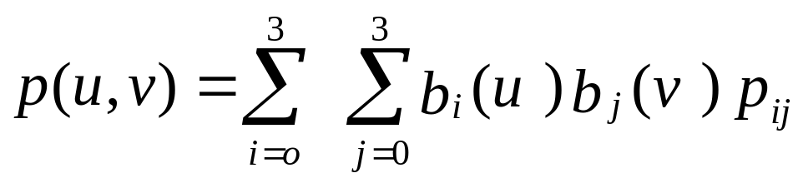
Blending Patches
Each b_{i}(u)b_{j}(v) is a blending patch
Shows that we can build and analyze surfaces
from our knowledge of curves
E. Angel and D. Shreiner: Interactive Computer Graphics 6E © Addison-Wesley 2012

Slide 13
Other Types of Curves and Surfaces
How can we get around the limitations of the interpolating form
  Lack of smoothness
  Discontinuous derivatives at join points
We have four conditions (for cubics) that we can apply to each segment
  Use them other than for interpolation
  Need only come close to the data
E. Angel and D. Shreiner: Interactive Computer Graphics 6E © Addison-Wesley 2012

Slide 14
Hermite Form
p’(0)
p’(1)
p(0)
p(1)
Use two interpolating conditions and
two derivative conditions per segment
Ensures continuity and first derivative
continuity between segments
E. Angel and D. Shreiner: Interactive Computer Graphics 6E © Addison-Wesley 2012

Slide 15
Equations
Interpolating conditions are the same at ends
p(0) = p₀ = c₀
p(1) = p₃ = c₀+c₁+c₂+c₃
Differentiating we find p’(u) = c₁+2uc₂+3u²c₃
Evaluating at end points
p’(0) = p’₀ = c₁
p’(1) = p’₃ = c₁+2c₂+3c₃
E. Angel and D. Shreiner: Interactive Computer Graphics 6E © Addison-Wesley 2012

Slide 16
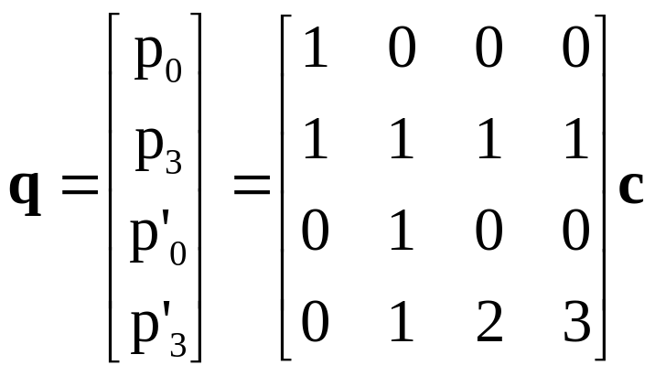
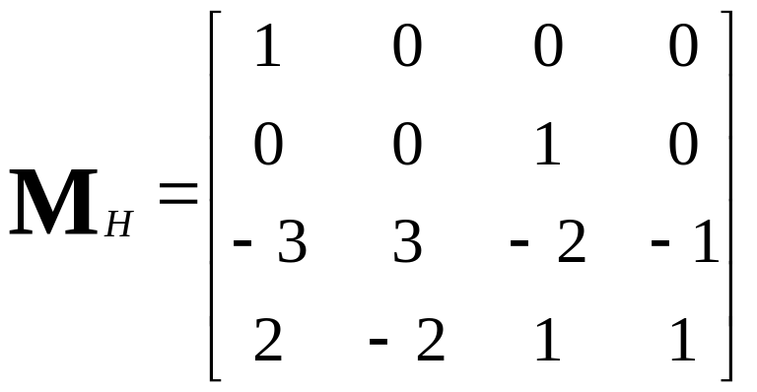
Matrix Form
Solving, we find c=M_{H}q where M_{H} is the Hermite matrix
E. Angel and D. Shreiner: Interactive Computer Graphics 6E © Addison-Wesley 2012

Slide 17
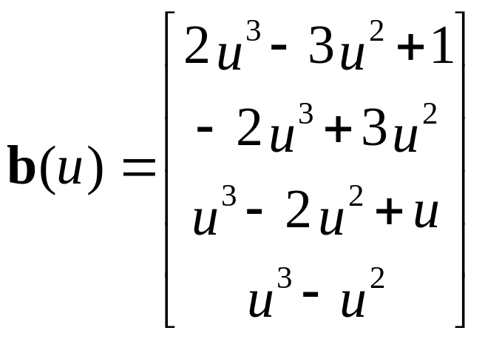
Blending Polynomials
p(u) = b(u)^{T}q
Although these functions are smooth, the Hermite form
is not used directly in Computer Graphics and CAD
because we usually have control points but not derivatives
However, the Hermite form is the basis of the Bezier form
E. Angel and D. Shreiner: Interactive Computer Graphics 6E © Addison-Wesley 2012

Slide 18
Parametric and Geometric Continuity
We can require the derivatives of x, y,and z to each be continuous at join points (parametric continuity)
Alternately, we can only require that the tangents of the resulting curve be continuous (geometry continuity)
The latter gives more flexibility as we have need satisfy only two conditions rather than three at each join point
E. Angel and D. Shreiner: Interactive Computer Graphics 6E © Addison-Wesley 2012

Slide 19
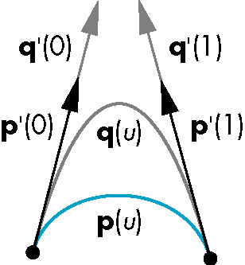
Example
Here the p and q have the same tangents at the ends of the segment but different derivatives
Generate different
Hermite curves
This techniques is used
in drawing applications
E. Angel and D. Shreiner: Interactive Computer Graphics 6E © Addison-Wesley 2012

Slide 20
Higher Dimensional Approximations
The techniques for both interpolating and Hermite curves can be used with higher dimensional parametric polynomials
For interpolating form, the resulting matrix becomes increasingly more ill-conditioned and the resulting curves less smooth and more prone to numerical errors
In both cases, there is more work in rendering the resulting polynomial curves and surfaces
E. Angel and D. Shreiner: Interactive Computer Graphics 6E © Addison-Wesley 2012

