Slide 1
Real time traffic flow control with image processing
By Biruk Tesfaw and Dawit Samuel
Advisor : Belayneh Melka
Co Advisor : Nebyou yonas

Slide 2
outline
Introduction
Vision based traffic control
Background
Methodology
Results

Slide 3
Introduction
The need for land based transport is increasing at a rate the infrastructure simply can not keep up with.
Appropriate utilization of resources may go a long way in to solving the problems caused by traffic congestion namely ; wastage of time, waste of fuel, more pollution …
Intelligent traffic system is an advanced application which with out embodying intelligence as such aims to provide innovative real time control solutions to traffic management problems and enables users to be better informed and make safer more coordinated use of transport networks

Slide 4
Vision based traffic control system
An intelligent traffic system could be built using multiple techniques however, making it vision based has the following benefits
Real-time response (>timers)
Maintainable and upgradable (> sensors)
Flexible – able to adopt itself to ever changing circumstances
Possible to Implement different strategies

Slide 5
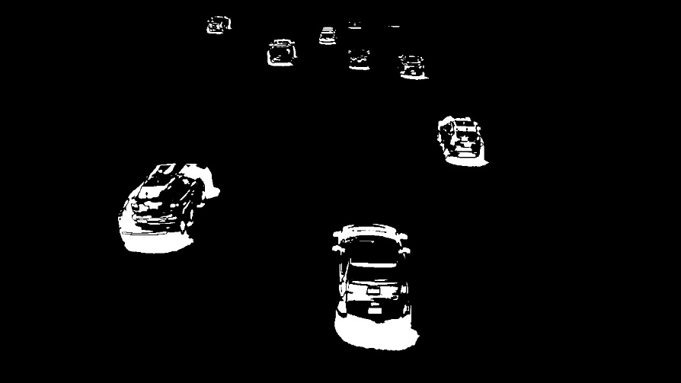
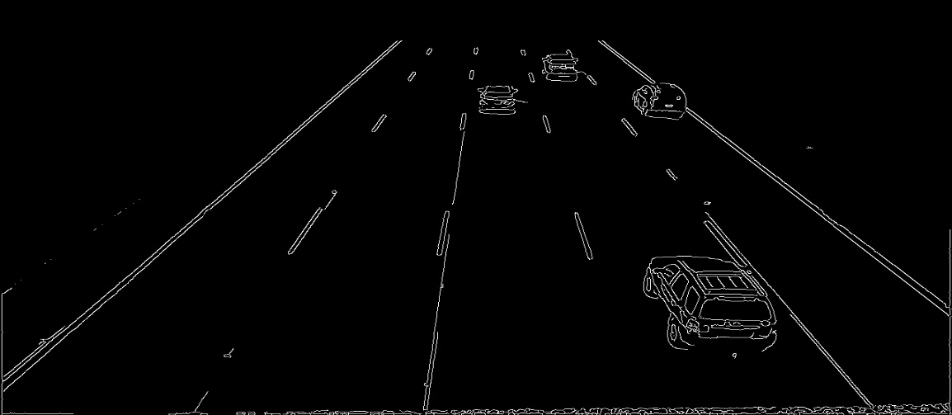
Image processing Background
Motion tracking
process of subtracting two subsequent frames in image series to segment the foreground object (moving object) from the background frame image.
Edge detection
Edges consist of meaningful features and contain significant information.

Slide 6
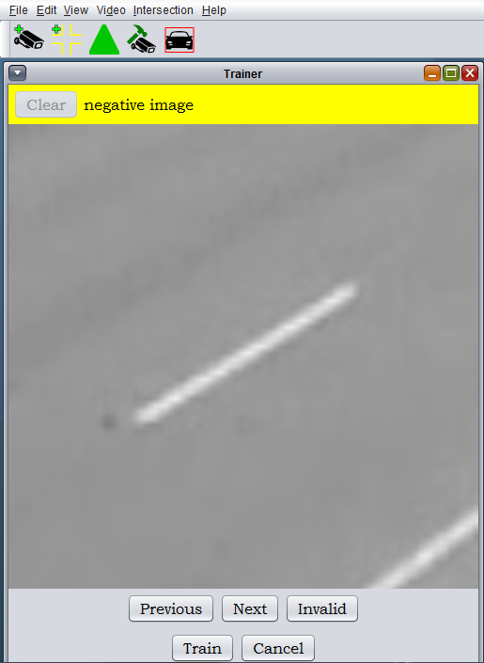
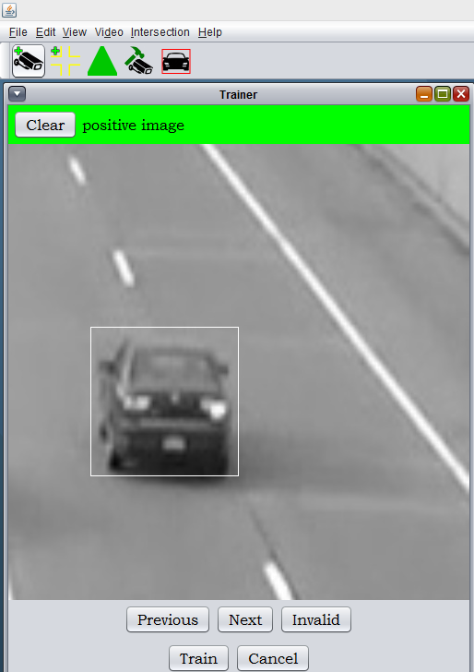
Haar features
First, a classifier is trained with a few hundred sample views of cars, called positive examples, that are scaled to the same size (say, 48x48), and negative examples - arbitrary images of the same size.

Slide 7
METHODOLOGY

Slide 8
Architecture
Server
Traffic Control Panel
Traffic Client
Microcontroller

Slide 9
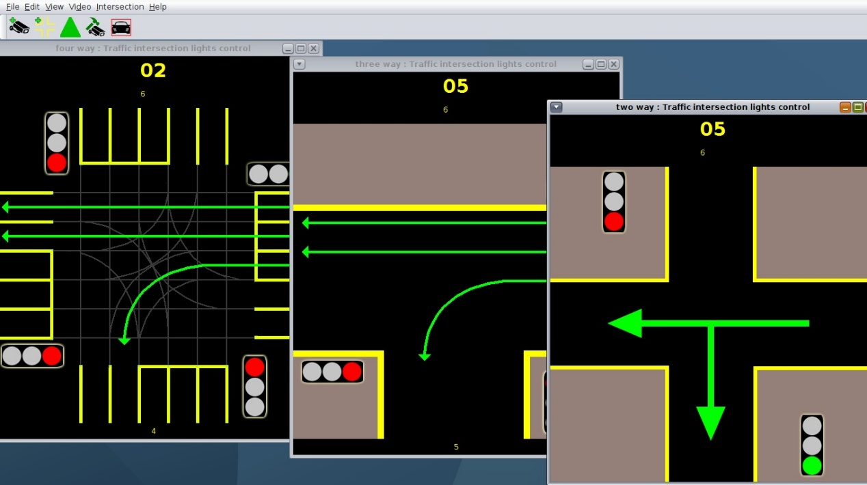
Traffic Client
A mix of java and C++ that uses opencv for video analysis and java for presentation and logic implementation.

Slide 10
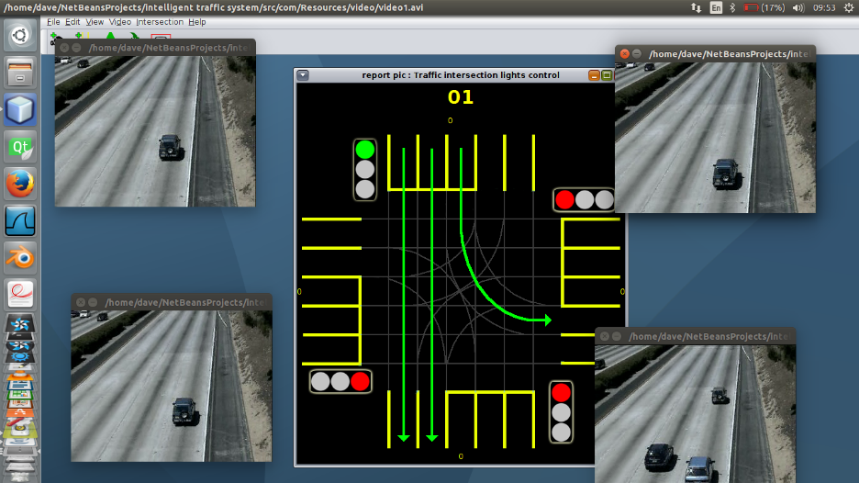
Traffic Client
An intersection is the implementation of analysis of four videos simultaneously to make decisions about which lane to open

Slide 11
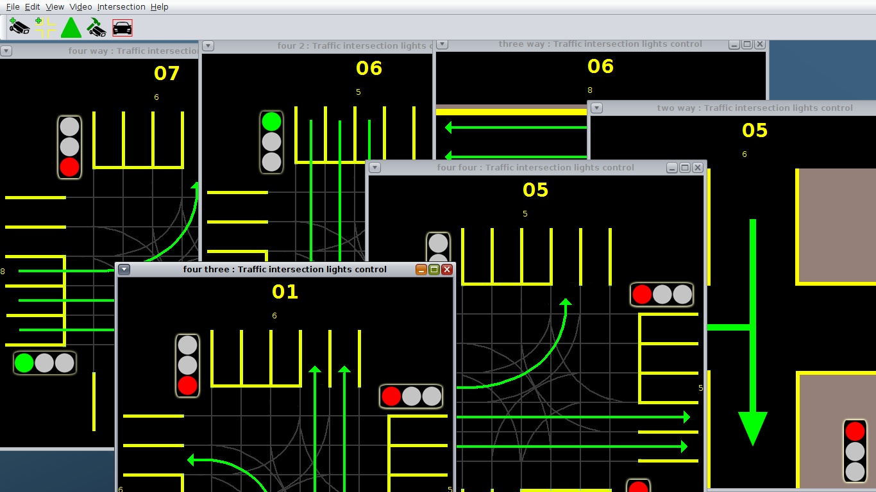
RESULTS
Our system is capable of analyzing 40 video feeds simultaneously on a 4GB RAM core i5 computer. Since the only other resource is cameras the system is currently implementable.

