Slide 1
DS Tool Private zone User Manual
DS Interface User Manual for Editors

Slide 2
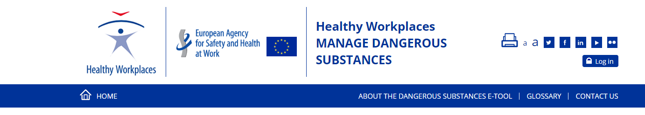
Login in DS Interface
Access to the DS eguide: https://eguides.osha.europa.eu/dangerous-substances/ and click on the login button
on the top right-hand side of the screen to access to the DS interface.

Slide 3
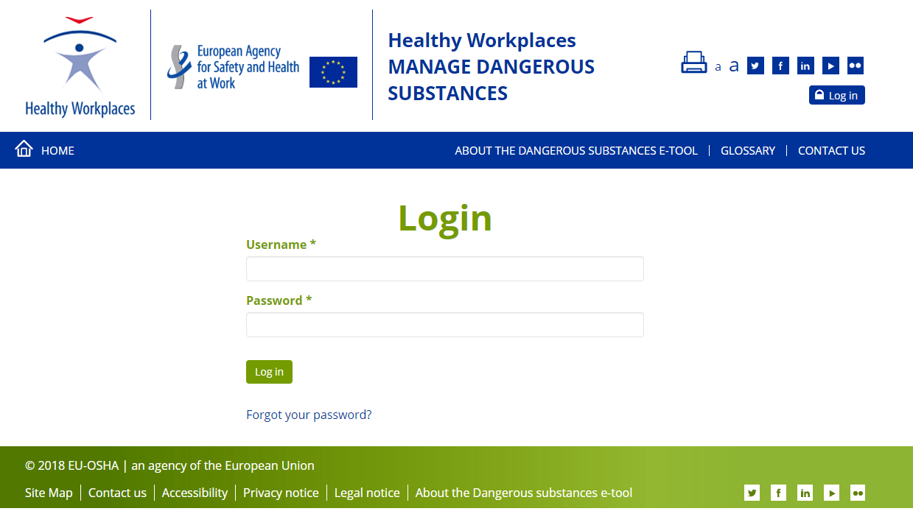
Login
Enter your email and password and
click on login button to access to
the DS Interface.
Click on the link: “Forgot your password” on the bottom if you don’t remember your password.

Slide 4
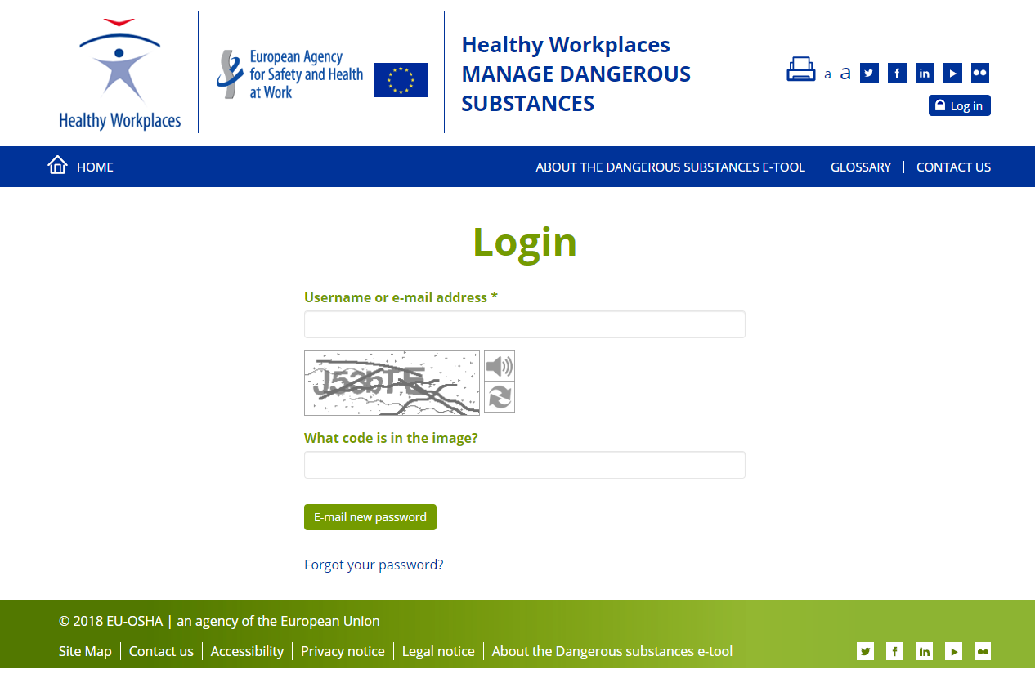
Reset password
Enter your email and the Captcha and click on the “Email new password” on the bottom.
An email with the instructions to reset the password will be sent to you.

Slide 5
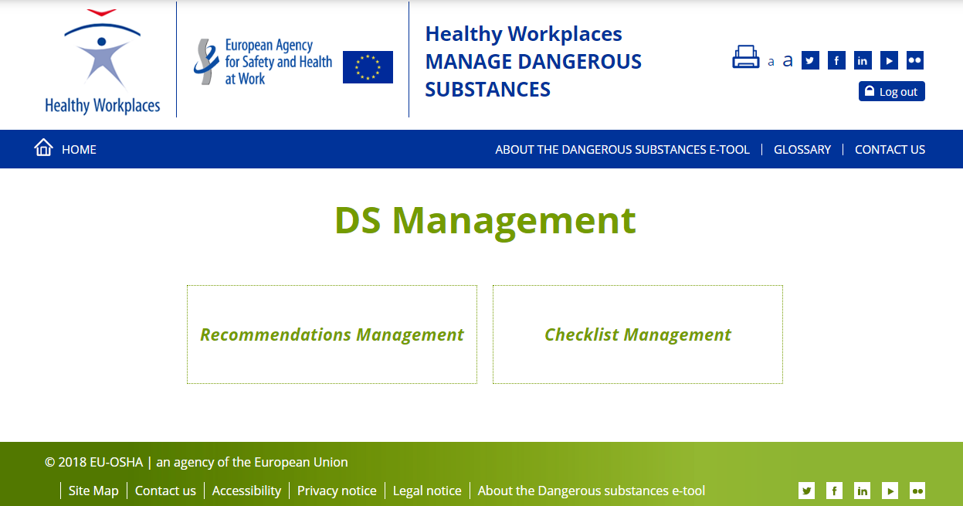
DS Management
Click on the Log out button to
log out of the DS interface
Click on Checklist Management to manage DS Checklist.
Click on Recommendations Management button to access to manage DS recommendations

Slide 6
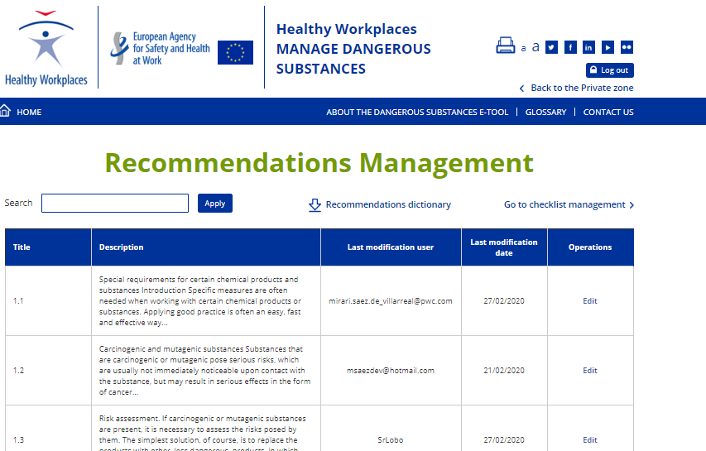
Recommendations management
Click on the link: Back to the Private zone to go back to the
Click on the Apply button. Search engine will retrieve the list of the recommendations that contain this word in the title or in the description.
Click on the button: Recommendation dictionary to download the complete list of the recommendations in English.
Click on the link: Go to the Checklist management to manage Checklist.
Click on Edit link to modify the language version of the corresponding recommendation.

Slide 7
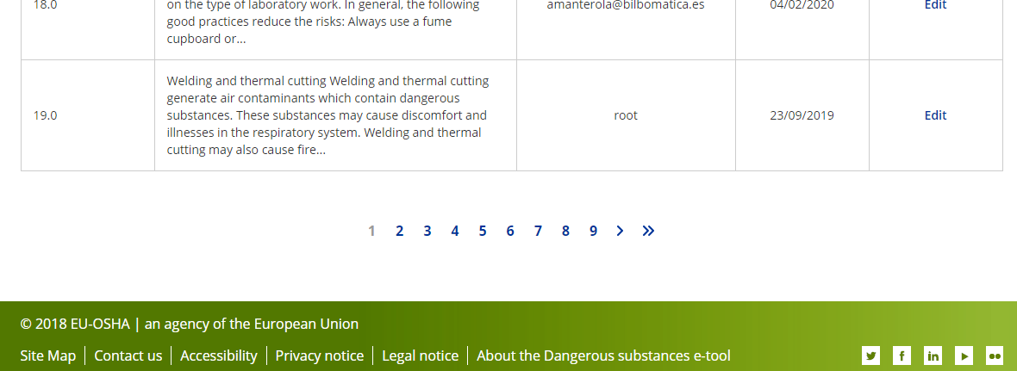
Recommendations management - Pagination
Click on the numbers or arrows to navigate through the list of the recommendations

Slide 8
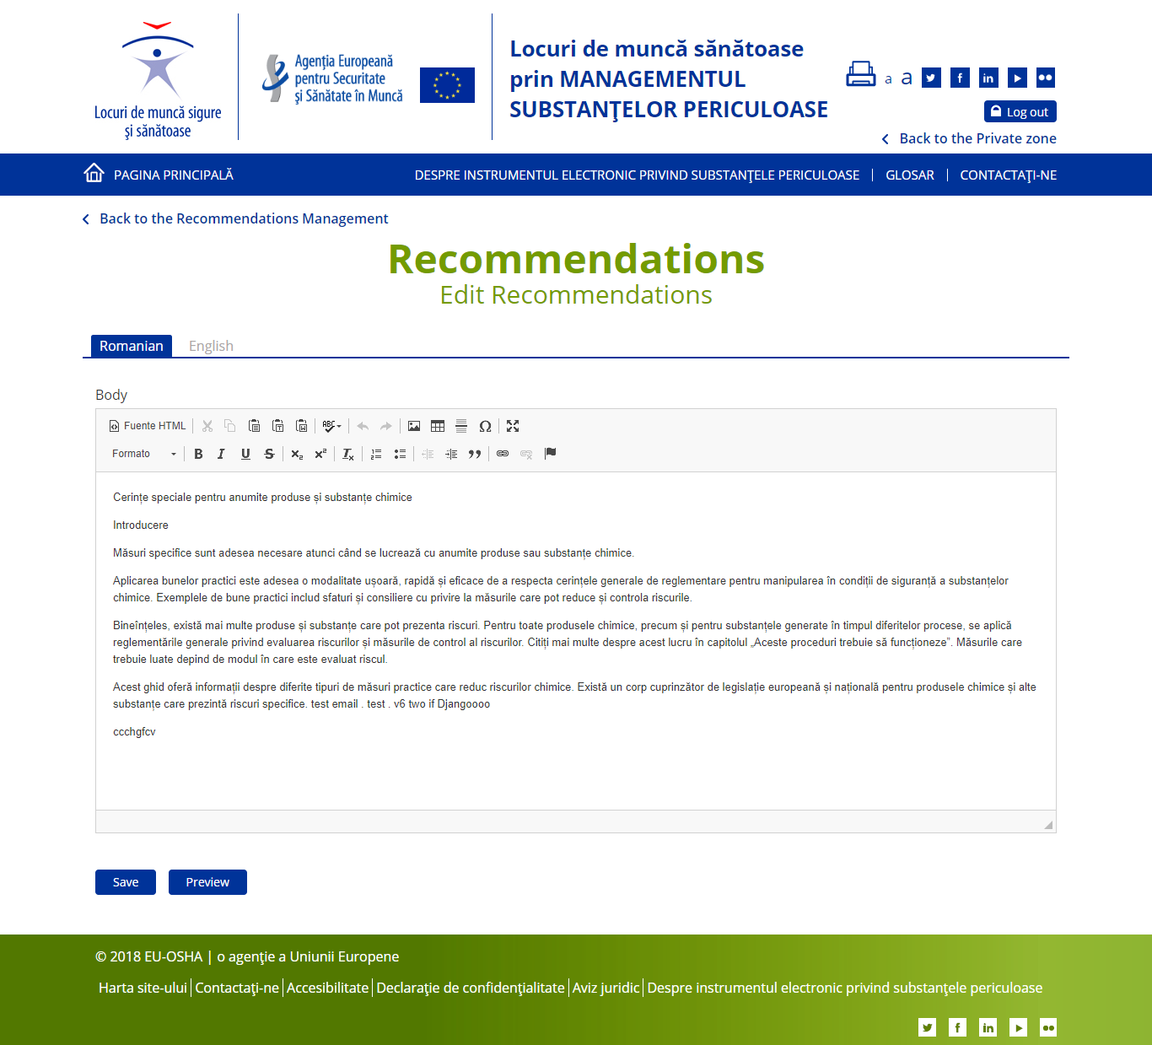
Edit Recommendations (Editors)
By default the English version of the recommendation is displayed, you can check it but you can not modify it.
Click on the link: Back to the Recommendations Management to go back to the list of the recommendations
The list of languages you can manage will displayed as a tabs.
The active tab will displayed in blue.
Use the Toolbar to add styles to the content.
Click on Save to save the recommendation. Once the recommendation is saved, it will be available for public users
Click on the Preview to see how the recommendation will display before saving it.
The review manager receives a notification of your change(s). In cases of doubt, the review manager will contact you.

Slide 9
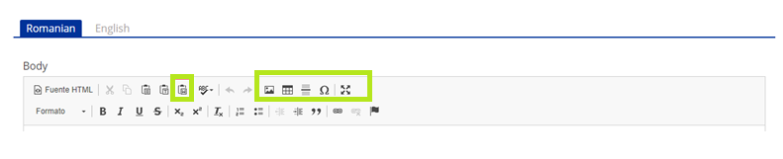
Edit Recommendations (Toolbar)
It’s important to use this button in green when you copy and paste from external editor such as : Microsoft Word.
Add links and images to the recommendation clicking on the corresponding tool
Select the text and click to give the recommendation the format you desire.

Slide 10
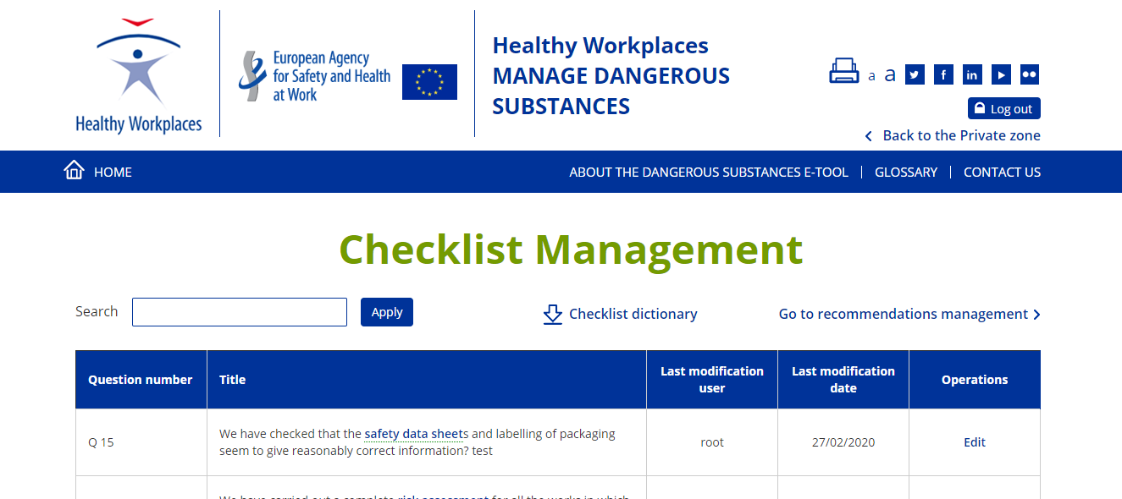
Checklist management
Click on the link: Back to the Private zone to back to the DS management page.
Enter the word you are interested in and click on the Apply button. Search engine will retrieve the list of the checklist that contain this word in the question.
Click on the button: Checklist dictionary to download the complete list of the Checklist in English.
Click on the link: Go to the Recommendations management to manage recommendations.
Click on Edit link to modify the language version of the corresponding checklist

Slide 11
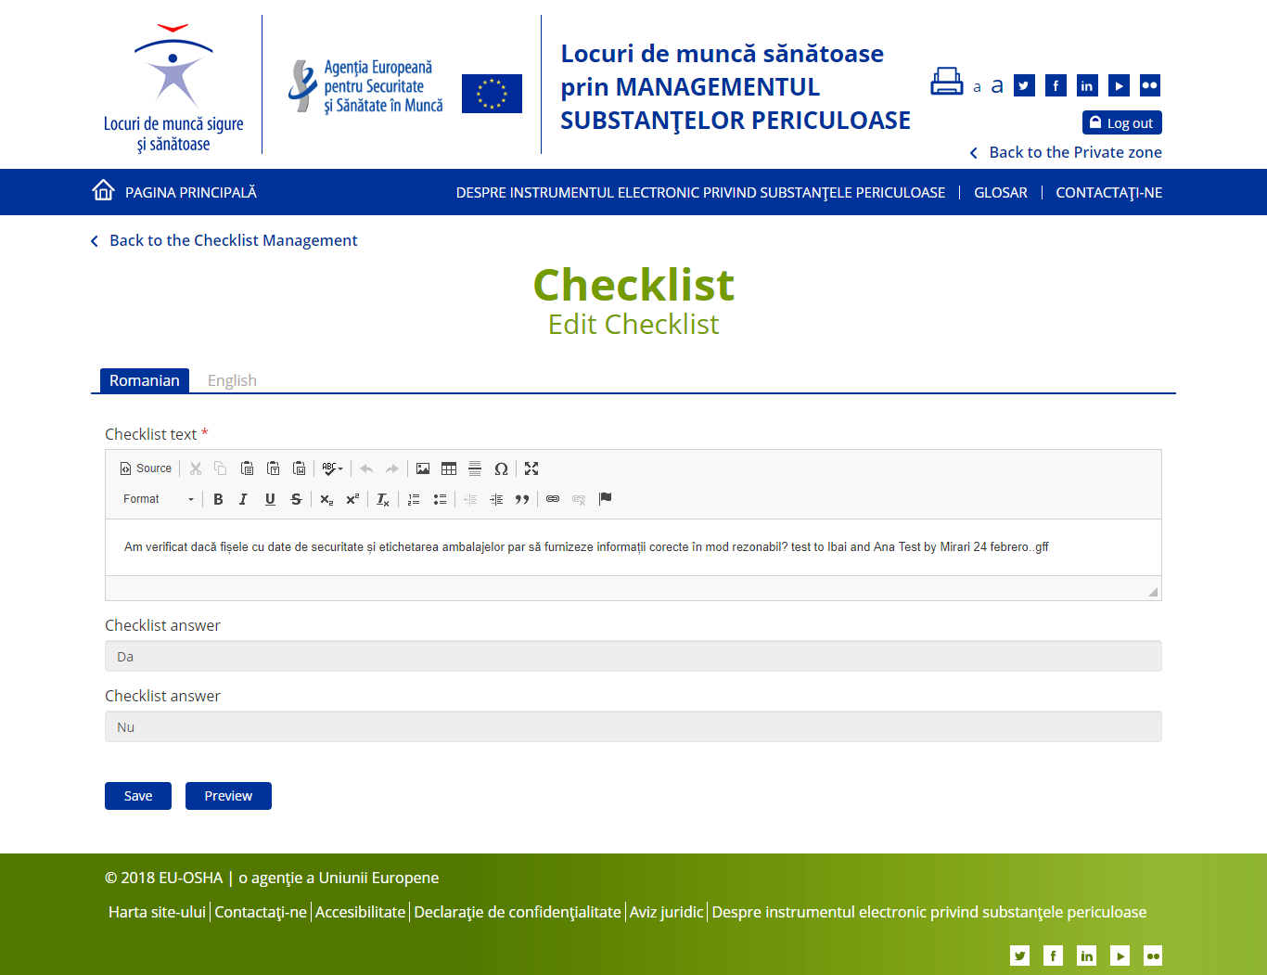
Checklist edit
By default the English version of the recommendation is displayed, you can check it but you can not modify it.
Click on the link: Back to the Checklist Management to go back to the list of the checklist
Use the Toolbar to add styles to the content.
The list of languages you can manage will displayed as a tabs.
The active tab will displayed in blue.
Answers are disabled, because it’s not possible to modify them
Click on Save to save the checklist. Once the checklist is saved, it will be available for public users
Click on the Preview to see how the recommendation will display before saving it.
The review manager receives a notification of your change(s). In cases of doubt, the review manager will contact you.

