Slide 1
Healthy Workplaces Campaign 2018-19
Manage dangerous substances in the workplace

Slide 2
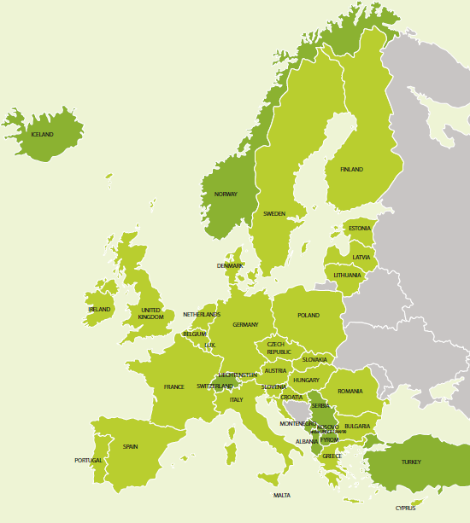
Introduction to the campaign
Coordinated by the European Agency for Safety and Health at Work (EU-OSHA)
Organised in more than 30 countries
Supported by a network of partners:
National focal points
Official campaign partners
European social partners
Media partners
Enterprise Europe Network
EU institutions
Other EU agencies

Slide 3

Key objectives
Raise awareness of the risks posed by dangerous substances in the workplace
Promote a culture of prevention to eliminate or effectively manage risks
Improve understanding of the risks associated with carcinogens
Target workers with specific needs and vulnerabilities
Provide information on policy developments and
relevant legislation

Slide 4
What is the issue?
Many workers are exposed to dangerous substances in European workplaces
The awareness of this issue is often low
Dangerous substances can lead to:
acute and long-term health problems — for example skin irritation, respiratory diseases and cancer
safety risks such as fire, explosion and suffocation
substantial costs to businesses for protective measures and liability

Slide 5

What are dangerous substances?
Any substance (gas, liquid or solid) that poses a risk to workers’ safety and health:
chemicals, e.g. in paints, glues, disinfectants, cleaning products or pesticides
process-generated contaminants, e.g. welding fumes, silica dust or combustion products like diesel exhausts
materials of natural origin such as grain dust, asbestos or crude oil and its constituents
Dangerous substances are likely to be present in almost all workplaces
Harm can arise from both short- and long-term exposures and long-term accumulation in the body

Slide 6

Definitions from the Chemical Agents Directive
(a) ‘Chemical agent’ means any chemical element or compound, on its own or admixed, as it occurs in the natural state or as produced, used or released, including release as waste, by any work activity, whether or not produced intentionally and whether or not placed on the market;
(b) ‘Hazardous chemical agent’ means:
(i) any chemical agent which meets the criteria for classification as hazardous within any physical and/or health hazard classes laid down in Regulation (EC) No 1272/2008l, … whether or not that chemical agent is classified under that Regulation;
(iii) any chemical agent which, whilst not meeting the criteria for classification as hazardous…… may, because of its physico-chemical, chemical or toxicological properties and the way it is used or is present in the workplace, present a risk to the safety and health of workers, including any chemical agent that is assigned an occupational exposure limit value under Article 3.
‘Activity involving chemical agents’ means any work in which chemical agents are used, or are intended to be used, in any process, including production, handling, storage, transport or disposal and treatment, or which result from such work.

Slide 7

Facts and figures
Chemical or biological substances are present in 38 % of enterprises according to EU-OSHA’s enterprise survey¹
Large companies often use more than 1,000 different chemical products
A single worker can come into contact with hundreds of different chemical substances
17 % of EU workers report handling or being in skin contact with chemical products or substances for at least 25 % of their working time² and 11% breathing in smoke, fumes (such as welding or exhaust fumes), powder or dust (such as wood dust or mineral dust)
New risks are emerging all the time
1) Summary — Second European Survey of Enterprises on New and Emerging Risks (ESENER-2), EU-OSHA, 2015, p. 5. Available at: https://osha.europa.eu/sites/default/files/publications/documents/esener-ii-summary-en.PDF
2) Sixth European Working Conditions Survey, Overview Report, Eurofound, 2016, p. 43. Available at: https://www.eurofound.europa.eu/sites/default/files/ef_publication/field_ef_document/ef1634en.pdf

Slide 8

Facts and figures
Sectors with high prevalence of dangerous substances include agriculture (62 %), manufacturing (52 %) and construction (51 %)¹
In many sectors, the use of chemicals has grown as chemical-based technologies have replaced traditional ways of working (pesticides, plastics, insulation etc.)
3.7 tonnes of dangerous substances were used per citizen in Sweden in 2014
1) ESENER-2 — Overview Report: Managing Safety and Health at Work, EU-OSHA, 2016, p. 18. Available at: https://osha.europa.eu/sites/default/files/ESENER2-Overview_report.pdf

Slide 9
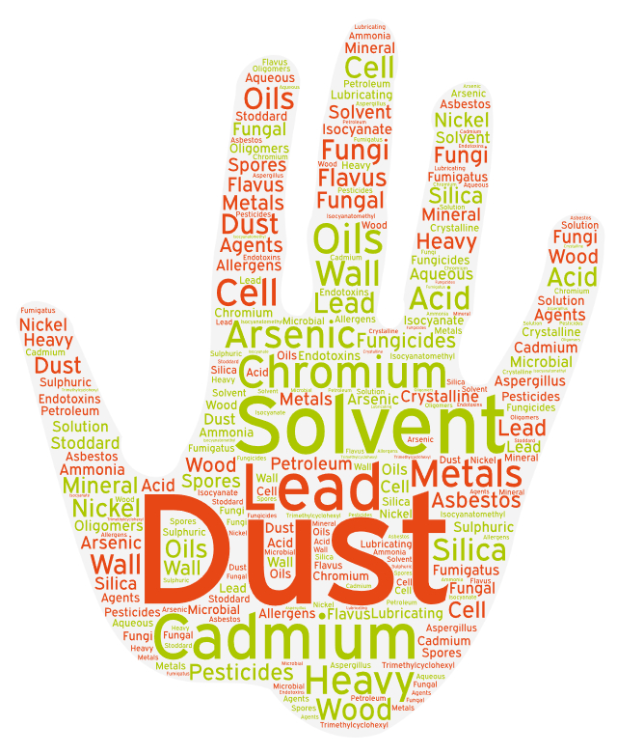
Exposure to dangerous substances in Europe
EU-OSHA study to better estimate the exposure to dangerous substances at European workplaces
The study applied a new methodology to combine publicly available data from ECHA, SPIN, PRODCOM, Eurostat Business Statistics and the European Working Conditions Survey
An expert scoring was applied to identify the most relevant substances and main sectors of occurrence

Slide 10

How to manage dangerous substances?
Creating a prevention culture and raising awareness is key
Legislation on dangerous substances is already in place in the EU — employers must be aware of their legal obligations
Risk assessment is essential for effective prevention
Putting in place effective preventive and protective measures
Workers should be kept informed about
the findings of risk assessment
the hazards they are exposed to and how they may be affected
what they have to do to keep themselves and others safe
what to do in case of an accident or when things go wrong
Practical tools and guidance can help businesses manage the risks and ensure safe and healthy workplaces

Slide 11
Risk assessment
Risk assessment must be carried out to identify all safety and health risks
Everyone — employers, managers, OSH services, and workers — should be involved
Should cover all groups of workers and contractors, and also exceptional work situations, e.g. maintenance and repair
It is essential that any work to eliminate, substitute or control risks is prioritised.
Should be kept up to date and revised when incidents occur
Workers should be well informed about the results and trained to apply the prevention measures
Tools and instruments are available to help enterprises carry out the risk assessment

Slide 12
3 steps to manage dangerous substances
Identify hazards:
Make an inventory of substances/chemical products used and generated in the workplace
Collect information about the harm they can cause and how this can happen, for example through labels and safety data sheets
Assess whether carcinogens or mutagens, for which more stringent rules apply, are used
Assess exposure:
Identify those who may be exposed, including cleaners and maintenance workers
Assess workers’ exposure looking at the type, intensity, length, frequency of exposure including combinations of exposures
Consider combined effects with other risks, for example fire risks, skin uptake, or wet work
Set measures:
A hazard list can then be used to draw up an action plan, including who has to implement it
Control the implementation and impact of the measures

Slide 13

The STOP principle
Employers need to set effective preventive and protective measures
Dangerous substances and processes should be completely eliminated from workplaces (e.g. designing new work processes)
If elimination is not possible, risks must be managed based on a hierarchy of prevention measures — the STOP principle
Substitution (safe or less harmful alternatives)
Technological measures (e.g. closed system, local exhaust ventilation)
Organisational measures (e.g. limiting the number of exposed workers or the exposure time)
Personal protection (wearing PPE)

Slide 14

Legislation
The employer is legally responsible for ensuring workplace safety and health
Occupational safety and health regulation, including
Directive 89/391/EEC (the OSH Framework Directive)
Directive 98/24/EC (the Chemical Agents Directive, CAD)
Directive 2004/37/EC (the Carcinogens and Mutagens Directive, CMD)
Complete overview on relevant OSH legislation: https://osha.europa.eu/en/safety-and-health-legislation
Some useful information from the chemicals legislation:
Regulation (EC) No 1907/2006 (REACH Regulation)
Regulation (EC) No 1272/2008 (CLP Regulation)

Slide 15

Carcinogens
Carcinogens cause the majority of fatal occupational diseases in the EU
Every year, occupational exposure to carcinogens causes:
Range between 91,500 - 150,500 people to develop cancer
Range between 57,700 - 106,500 deaths (RIVM, 2016)
Many cases of occupational cancer are preventable
Stricter measures apply to carcinogens than to other dangerous substances, e.g. working in a closed system, restricting workers‘ access and record-keeping
The Roadmap on Carcinogens aims to support policy, and help share information and good practices

Slide 16

Specific groups at risk
Certain groups of workers can be particularly at risk from dangerous substances, including:
women
young workers
migrant workers
temporary workers
untrained or inexperienced staff
cleaners and contractors
This may be because of particular sensitivity, inexperience or because of a lack of training or information
The risks to these workers should be considered in risk assessment

Slide 17

Getting involved
Organisations of all sizes and sectors, as well as individuals, can get involved by:
disseminating and publicising campaign materials
taking part in or organising events and activities
using and promoting dangerous substances
management tools
becoming a campaign partner
keeping up to date via social media

Slide 18

Campaign partnership offer
Successful partnerships between EU-OSHA and key stakeholders are crucial for the success of the campaign
Pan-European and international organisations can become official campaign partners
Campaign media partners promote the campaign
Benefits include:
a welcome pack
a partner certificate
promotion at EU level and in the media
networking opportunities and exchange of good practice with other campaign partners
invitation to EU-OSHA events

Slide 19
Healthy Workplaces Good Practice Awards
Recognition of innovative safety and health practices in the workplace
Organisations are rewarded for successful and sustainable initiatives to managing dangerous substances in the workplace
Open to organisations in:
EU Member States
candidate countries
potential candidate countries
European Free Trade Association (EFTA) countries
Winners are announced at an awards ceremony

Slide 20

Campaign resources
Campaign guide
Practical e-tool
Reports
Series of info sheets on priority topics
Database of resources and tools
Case study and audio-visual database
OSHwiki: updated section and new articles
Napo films
Promotion material
Campaign leaflet
Good Practice Awards flyer
Poster
Videos
Online banner
Email signature
Links to useful sites

Slide 21

Key dates
Campaign launch: April 2018
Good Practice Awards Competition in Member States and at European level: 2018 and 2019
Healthy Workplaces Good Practice Exchange event: 2nd quarter 2019
European Weeks for Safety and Health at Work:
October 2018 and 2019
Healthy Workplaces Summit and Good Practice Awards Ceremony:
November 2019

Slide 22




Further information
Learn more at the campaign website:
www.healthy-workplaces.eu
Subscribe to our campaign newsletter:
https://healthy-workplaces.eu/en/healthy-workplaces-newsletter
Keep up to date with activities and events through social media:
Find out about events in your country from your focal point:
www.healthy-workplaces.eu/fops

