Slide 2
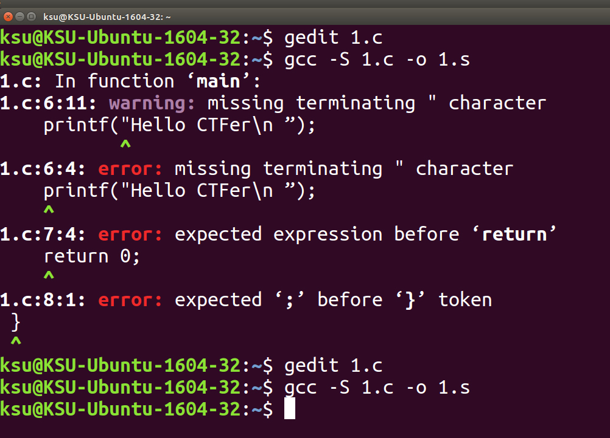

Slide 3
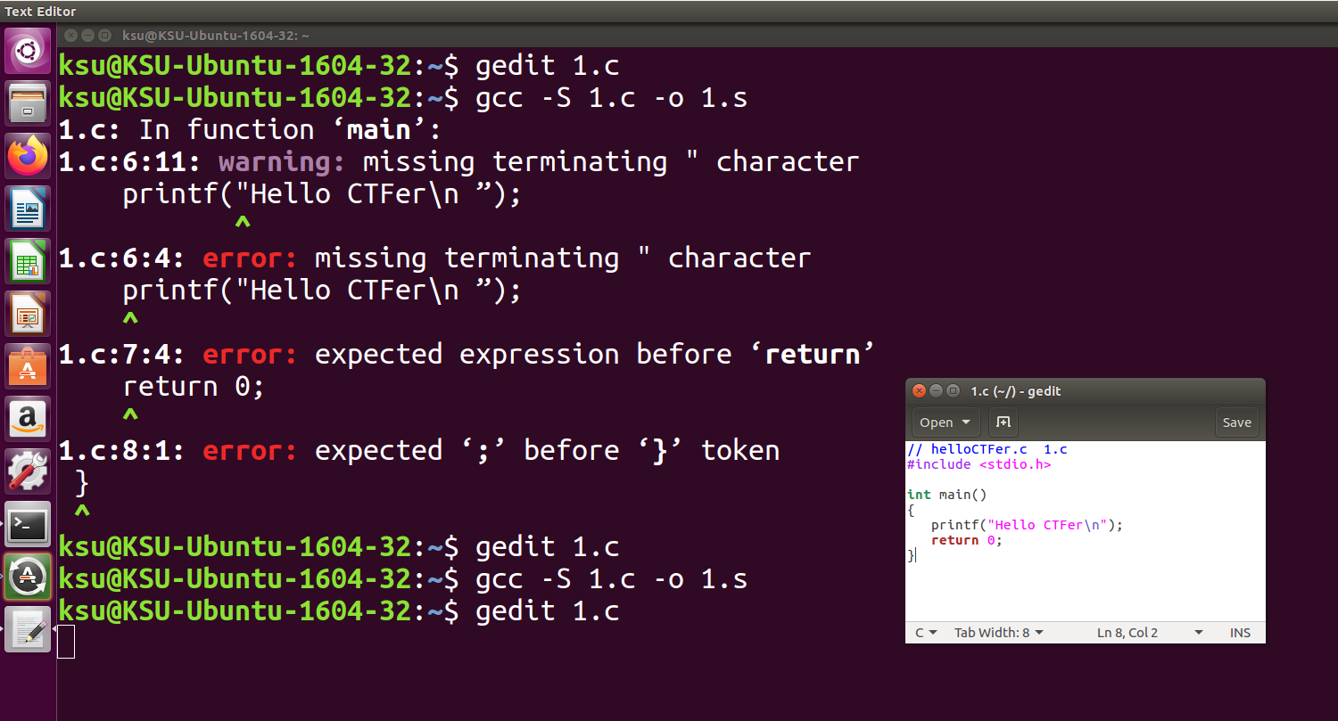

Slide 5
gcc -S -masm=intel 1.c
-o 1_intel.s

Slide 6
gcc -S -masm=intel func1.c
-o func1_intel.s
-fno-asynchronous-unwind-table

