Slide 1

Exploratory Data Analysis (EDA) Project
Project Name : Used Car Sales
By
EUGIN P

Slide 2

About Us:
Discover unbeatable deals on quality pre-owned cars with Car App, South India's premier destination for trusted used car sales!

Slide 3
Introduction: Buying a used car offers a cost-effective alternative to purchasing new, providing excellent value for money. With a wide range of models available, consumers can find reliable, affordable vehicles that suit their needs and preferences.
Studies Suggest Purchasing Used Cars
Cost Savings: Studies indicate that used cars typically depreciate less quickly than new cars, offering significant savings.
Lower Insurance Premiums: Used cars generally cost less to insure compared to new cars.
Greater Value for Money: You can often afford a higher-end model with more features when buying used compared to buying new.
How to Buy a Used Car
Research: Investigate different models, prices, and market conditions to understand what suits your budget and requirements.
Inspection and Test Drive: Always inspect the car thoroughly and take it for a test drive to ensure it meets your expectations.
Verify Documentation: Check the car’s history, including service records, ownership, and accident history, to ensure a transparent and secure purchase.

Slide 4
Problem Statement :
Used Cars Sales Trend in Recent Years :
Rising Demand: The demand for used cars has been steadily increasing, driven by economic factors and a growing preference for affordable options.
Market Growth: The used car market has seen robust growth, with more consumers opting for pre-owned vehicles due to their cost-effectiveness and improved reliability.
CARAPP :
CARAPP are known for their Trustworthiness, Customer Centric Approach, Quality Assurance, Diverse Inventory, Competitive Pricing, Flexible Financing, After-Sales Service and Innovative Marketing.
In recent years, Car App has been focusing on enhancing its sales and marketing strategy to regain a strong foothold in the market.

Slide 5
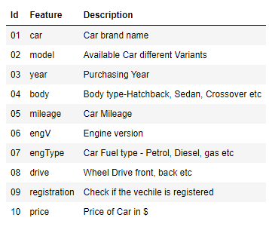
Data Description:

Slide 6
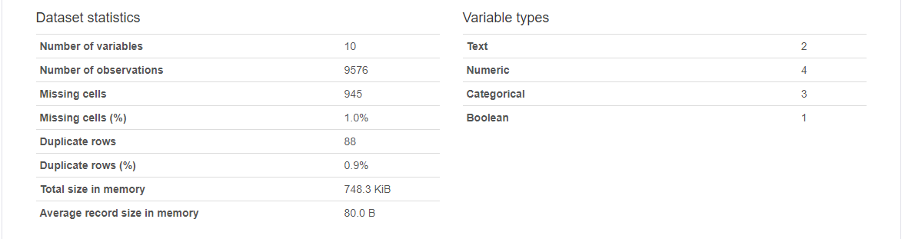
Pandas : Pre - Profiling Report

Slide 7
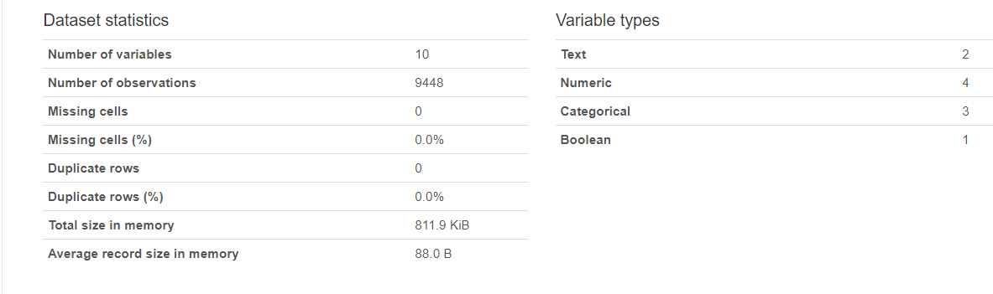
Pandas : Post – Profiling Report

Slide 8
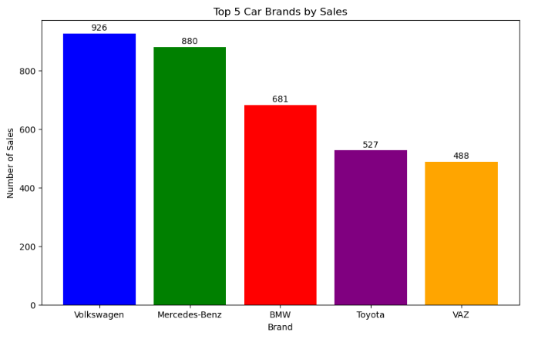
Top 5 Cars Brand by Sales
The bar graph visually represents the sales distribution among the top 5 car brands.
Volkswagen leads with the highest number of sales, closely followed by Mercedes-Benz.
There is a noticeable drop in sales figures from Mercedes-Benz to BMW, indicating that the top two brands dominate the market significantly.
Toyota and VAZ have similar sales figures but are clearly behind the top three brands.
This suggests that while Volkswagen and Mercedes-Benz are the most popular among consumers, there is a competitive gap that BMW, Toyota, and VAZ have yet to bridge.

Slide 9
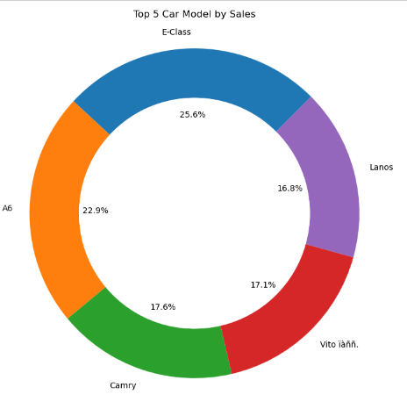
Top 5 Car Models by Sales :
The Mercedes-Benz E-Class leads with the highest sales at 25.6%, making it the most popular model among the top 5.
The Audi A6 follows closely with 22.9%, indicating strong sales but still behind the E-Class by a notable margin. The Toyota Camry (17.6%) and Mercedes-Benz Vito (17.1%) have similar sales figures, showing moderate popularity but are significantly behind the top two models.
The Daewoo Lanos has the lowest sales among the top 5 models at 16.8%, though it is not far behind the Vito and Camry.
The chart shows a clear leader (Mercedes-Benz E-Class) and a close competition among the other models, with each capturing a substantial but smaller market share compared to the E-Class. The differences in percentage points help highlight the varying levels of popularity and market presence of each car model.

Slide 10
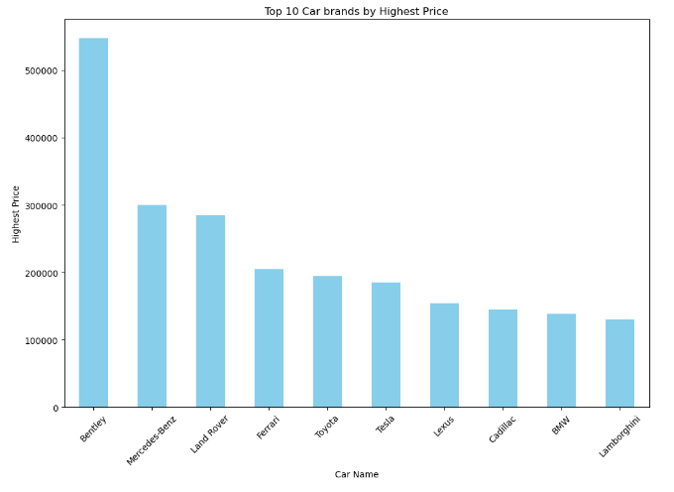
Top 10 Cars by Price
Price Range Analysis:
Bentley stands out significantly with the highest price, exceeding $500,000.Mercedes-Benz and Land Rover follow but at a much lower price point, around $300,000.Ferrari, Toyota, Tesla, and Lexus have prices in the range of approximately $200,000 to $250,000.Cadillac, BMW, and Lamborghini are positioned at the lower end among the top 10, with prices around $100,000 to $150,000.
Diverse Brand Representation:
The chart includes a mix of traditional luxury brands (Bentley, Mercedes-Benz, Land Rover), sports car brands (Ferrari, Lamborghini), and premium brands (Lexus, Cadillac).
Market Positioning:
Bentley’s high price point suggests a strategy focused on exclusivity and high-net-worth individuals. The presence of brands like Toyota and Tesla in the top 10 indicates successful diversification into higher-end models beyond their typical market segments.

Slide 11
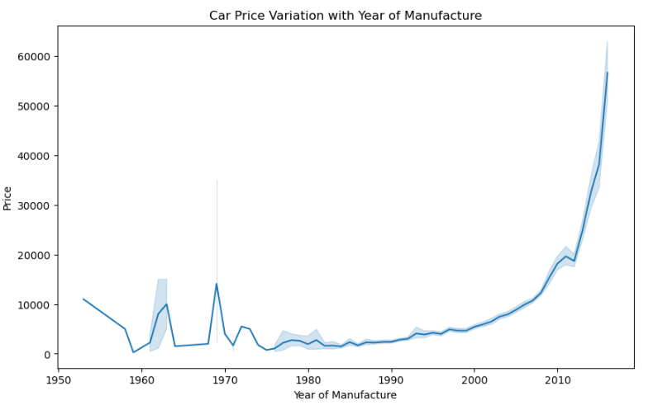
Car Price and Year of Manufacture
Rapid Price Surge Post-2000s: There is a noticeable and dramatic increase in car prices starting from the early 2000s, peaking sharply around the 2010s. This could be attributed to advancements in car technology, and increased demand for newer models.
Historical Low Prices: The period from the mid-1970s to the late 1990s shows relatively stable and low car prices, suggesting either a slower rate of innovation or market stability during these years.
1960s Volatility: The 1960s exhibit significant volatility in car prices, with several sharp peaks and troughs. This could indicate economic fluctuations, changes in car manufacturing practices, or major technological shifts during that era.
Post-War Dip: Notice the dip in car prices in the early 1950s, likely reflecting the post-World War II economic adjustments where the automotive industry was recovering and ramping up production again.

Slide 12
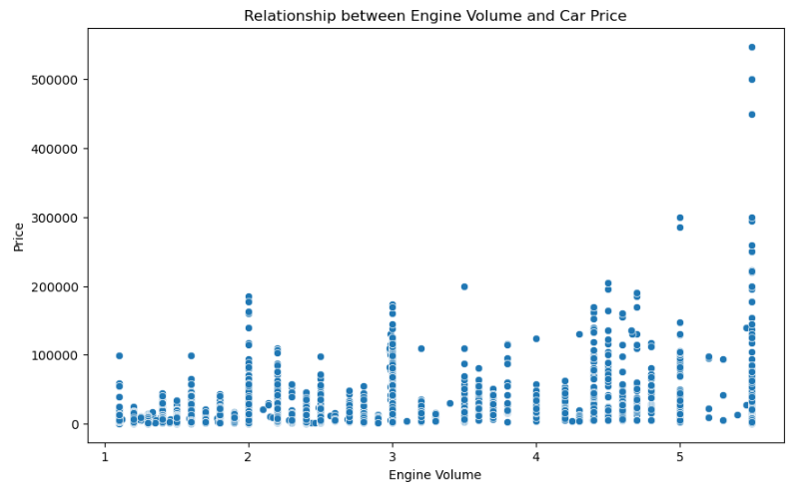
Engine Volume vs Car Price
Premium Peaks at Higher Volumes: The scatter plot reveals that cars with engine volumes around 5 liters have some of the highest prices, reaching over $500,000. These likely represent high-end luxury or performance vehicles with powerful engines.
Diverse Price Range in Mid-Sized Engines: Cars with engine volumes between 2 and 4 liters show a wide range of prices, indicating that this engine size bracket includes a variety of car types, from affordable family sedans to premium models.
Economy Cars at Lower Volumes: Cars with smaller engines (around 1 to 2 liters) generally cluster at the lower end of the price spectrum. This suggests that economy cars, which prioritize fuel efficiency, tend to have smaller engine volumes and lower prices.
Price Disparity at Similar Volumes: There are noticeable disparities in prices for cars with similar engine volumes. For instance, some cars with 2-liter engines are priced significantly higher than others, indicating the influence of other factors such as brand, features, and model year.
Clustered Affordability: The plot shows a significant clustering of cars priced below $100,000, particularly those with engine volumes up to 3 liters. This suggests that most cars in the market aim to balance performance with affordability, catering to a broader audience.

Slide 13
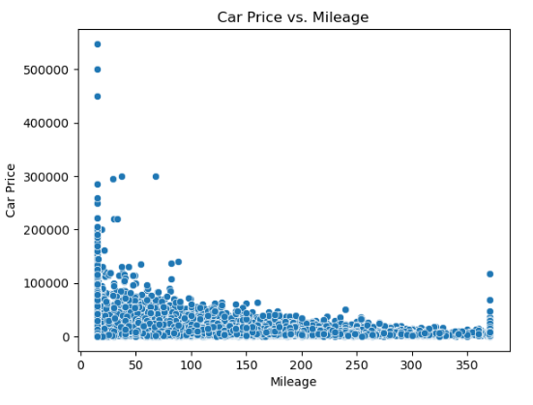
Mileage vs Car Price
Dramatic Price Drop with Mileage Increase: The plot shows a clear trend where car prices sharply decline as mileage increases. This indicates that cars with lower mileage are significantly more valuable, reflecting their relatively new condition and less wear and tear..
Cluster of Affordable Cars with High Mileage: A dense cluster of cars is observed in the lower price range (below $50,000) as mileage increases. This suggests that high-mileage cars are generally more affordable, catering to budget-conscious buyers looking for functional vehicles without a hefty price tag.
Sweet Spot for Mid-Mileage: Vehicles with mileage between 50,000 to 150,000 show a moderate price range. This suggests that these cars balance between being relatively new and affordable, often representing good value for buyers.
Value Depreciation: The plot illustrates the rapid depreciation of car value with mileage, reinforcing the importance of mileage as a key factor in determining a used car's price. Newer cars with lower mileage are perceived as more reliable and hence command higher prices.

Slide 14
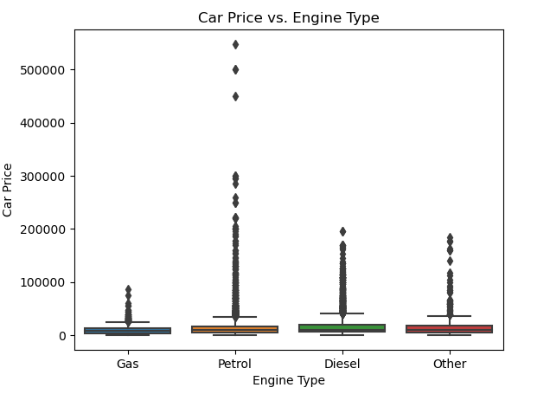
Engine Type vs Car Price
Petrol-Powered Cars: Petrol engines exhibit a wider range of car prices, including some of the highest prices observed in the dataset. This indicates that petrol engines are commonly found in a variety of vehicles, from budget-friendly models to high-end luxury cars, thus driving the broad price range.
Diesel Engines: Diesel cars also display a relatively wide price range, suggesting their presence in both economical and premium market segments. However, their price range does not reach the extreme high values seen in petrol engines.
Gas and Other Engines: Cars with gas engines and those classified under "Other" tend to have lower price ranges with fewer extreme outliers. This could imply that these engine types are more prevalent in budget-friendly or mid-range vehicles.
Price Consistency: The consistency of lower prices in gas and other engine types suggests these engines are likely favored in markets or models where affordability and cost-efficiency are prioritized.
Outliers: The presence of outliers, especially in the petrol and diesel categories, highlights that there are exceptional vehicles (likely high-performance or luxury models) that significantly drive up the prices within these segments.

Slide 15
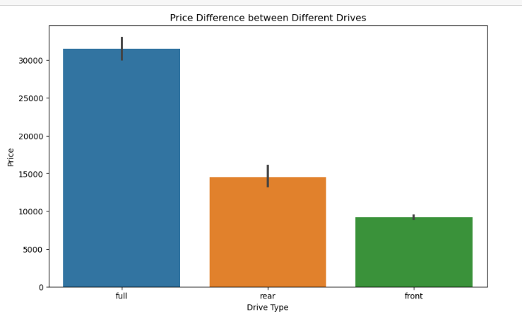
Price difference between different Drive
Full (All-Wheel Drive): Cars with full drive (AWD) have the highest average price, exceeding $30,000. This suggests that AWD vehicles are typically positioned in the higher-end market segments, likely due to their advanced technology, superior traction, and enhanced performance, which are highly valued in luxury and off-road capable vehicles.
Rear-Wheel Drive (RWD): Vehicles with rear-wheel drive have a moderate average price, around $15,000. This indicates that RWD cars occupy a middle ground, often found in both sporty and premium cars but not as widely adopted as AWD systems for high-end luxury or off-road models.
Front-Wheel Drive (FWD): Cars with front-wheel drive are the most economical, with an average price slightly above $10,000. FWD systems are commonly found in budget-friendly, compact, and mid-sized vehicles, where cost-efficiency and fuel economy are prioritized over performance and advanced driving capabilities.

Slide 16
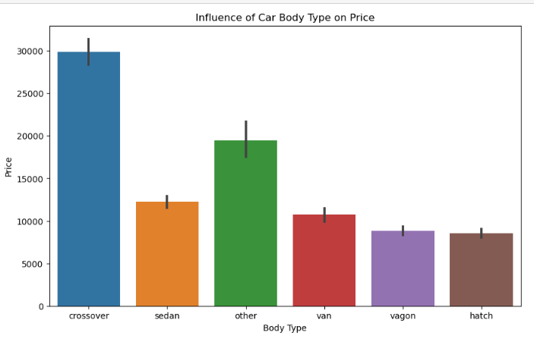
Body Type of Car influence the Price
Crossover: Crossovers have the highest average price, exceeding $30,000. This reflects their popularity as versatile vehicles that combine features of SUVs and passenger cars. Crossovers often come with advanced features, higher comfort levels, and are marketed as premium vehicles, justifying their higher price point.
Sedan: Sedans have a moderate average price, around $15,000. As one of the most common body types, sedans offer a balance between affordability, comfort, and utility, making them appealing to a broad range of consumers.
Other Body Types: The category labeled "Other" shows a higher average price, around $20,000, indicating that this group might include niche or specialized vehicles with unique features or luxury variants that command higher prices.
Van: Vans have a slightly lower average price, approximately $13,000. Vans are typically used for utility purposes, family transport, and cargo, which can justify their moderate pricing due to their functional design and space efficiency.
Wagon: Wagons have a price slightly below that of vans, around 12,000. Wagons offer a balance of cargo space and passenger comfort, often appealing to families and those needing more storage without opting for a larger SUV or crossover.
Hatchback: Hatchbacks have the lowest average price, just below $12,000. Hatchbacks are compact, economical, and efficient, making them the most budget-friendly option. They are popular among urban drivers and first-time car buyers due to their affordability and practical design.

Slide 17
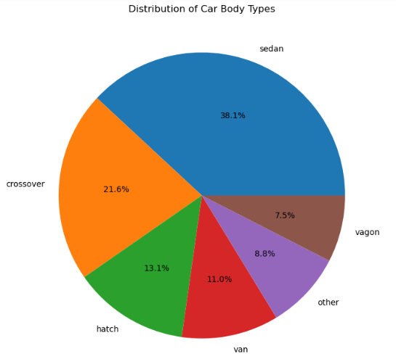
Trend between Car Price and Body Type
Sedan Dominance: Sedans constitute the largest segment, making up 38.1% of the cars. Despite their moderate average price around $15,000, their prevalence indicates a strong consumer preference for this body type due to its balance of affordability, comfort, and practicality.
Crossover Popularity: Crossovers represent 21.6% of the cars, the second-largest segment. Given that crossovers also have the highest average price (over $30,000), this suggests a growing trend and consumer willingness to invest in versatile and feature-rich vehicles, reflecting their premium market appeal.
Hatchbacks and Vans: Hatchbacks (13.1%) and vans (11.0%) together form a significant portion of the market, indicating strong demand for affordable and practical vehicles. Whereas vans, priced moderately around 13,000, cater to those needing more space and utility.
Other and Wagon Segments: The Other category (8.8%) and wagons (7.5%) are smaller segments. The Other category, with its higher average price around 20,000, likely includes niche or specialized vehicles, while wagons, averaging around 12,000, appeal to those needing additional cargo space without opting for larger vehicles like SUVs or crossovers.
Higher Prices and Lower Proportions: Crossovers, despite having the highest average price, make up a smaller proportion compared to sedans. This trend suggests that while crossovers are more expensive, their premium features and versatility attract a significant, though not majority, segment of buyers.

Slide 18
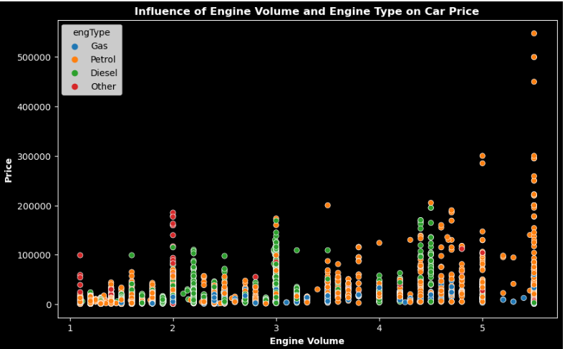
Engine Volume & Engine Type vs Car Price
Engine Volume: As the engine volume increases, there is a general upward trend in car prices. Higher engine volumes (larger engines) are associated with higher car prices, indicating that vehicles with more powerful engines tend to be more expensive.
Gas Engines: Represented by blue dots, gas engines generally have lower prices and are less frequently associated with high engine volumes.
Petrol Engines: Represented by orange dots, petrol engines cover a wide range of prices and engine volumes. They are prevalent across all engine volumes but show a significant number of high-priced vehicles, especially in higher engine volumes.
Diesel Engines: Represented by green dots, diesel engines also span various engine volumes and prices. They tend to cluster in the mid-range engine volumes (around 2 to 3 liters) but include some high-priced outliers.
Other Engines: Represented by red dots, other types of engines exhibit a wide price range and are found across different engine volumes. This category includes some high-priced vehicles even at lower engine volumes.
Clustering Patterns: Cars with smaller engine volumes (1 to 2 liters) predominantly cluster at lower price ranges, regardless of engine type. This suggests that smaller engines are typically found in more economical vehicles. As engine volumes increase, especially above 3 liters, there is greater price dispersion, indicating a mix of standard and high-end models with large engines.

Slide 19
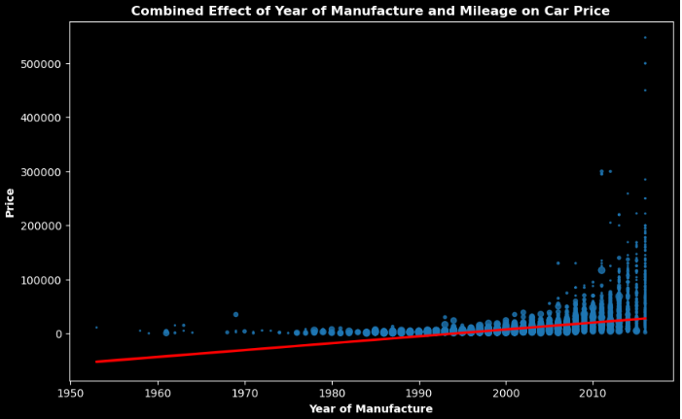
Trend between Year & Mileage on Car Price
Trend Over Time:
There is a clear upward trend in car prices as the year of manufacture increases. The red line indicates a positive correlation between the year of manufacture and the price of cars, suggesting that newer cars generally have higher prices.
Price Distribution:
Older cars (manufactured before 2000) tend to have a wider range of prices, with many priced lower.
From around the year 2000 onward, car prices show more significant variation and generally higher maximum prices.
Mileage Impact:
The plot suggests that mileage, represented by the size of the blue dots (presumably, larger dots indicate higher mileage), does not have a simple linear relationship with price.
In more recent years, cars with both high and low prices have higher mileage, indicating that factors other than just mileage may significantly influence car prices.
Outliers:
There are notable outliers, especially in recent years, where some cars have extremely high prices despite possibly high mileage. These could be rare or luxury models that hold value or appreciate over time.

Slide 20
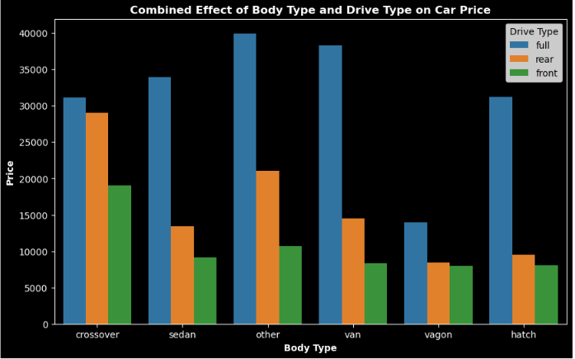
Effect of Body Type & Drive Type on Price
Across all body types, cars with a full drive type consistently have the highest prices.
Rear drive type cars generally have moderate prices.
Front drive type cars tend to have the lowest prices across most body types.
The price variation is more pronounced in body types like "other" and "van".
Wagon:
Full drive type wagons have the highest prices.
Rear and front drive type wagons have similar, lower prices compared to full drive type.
These observations suggest that the drive type significantly affects car prices within each body type, with full drive types commanding higher prices overall.

Slide 21
Summarization
High Price Segment: Bentley leads the high price segment, with prices exceeding $500,000, followed by Mercedes-Benz and Land Rover around $300,000, highlighting a strong market for ultra-luxury cars.
Mileage Impact on Price: There is a clear trend where car prices decline sharply as mileage increases, indicating that lower mileage cars are significantly more valuable due to their newer condition and lesser wear.
Drive Type Influence: Cars with full drive (AWD) consistently command the highest prices across all body types, reflecting the premium associated with advanced traction and performance capabilities.
Body Type and Pricing: Crossovers, with their average price exceeding $30,000, represent the highest-priced body type, followed by sedans around $15,000, and hatchbacks being the most economical at under $12,000.
Engine Volume Correlation: Higher engine volumes correlate with higher car prices, especially for petrol engines, indicating that vehicles with larger, more powerful engines are more expensive.
Recent Year Manufacturing Trend: There is an upward trend in car prices for models manufactured after 2000, peaking around the 2010s, driven by advancements in technology and increased demand.
Historical Price Trends: From the mid-1970s to late 1990s, car prices were relatively stable and low, suggesting market stability or slower innovation during these years, with a dramatic price surge post-2000.

Slide 22
Actionable Insight
Acquire High-Demand Models: Focus on acquiring and promoting high-demand luxury brands like Bentley, Mercedes-Benz, and Land Rover.
Acquire High-Demand Car Body Types and Drive Mode: Focus on promoting Sedan Type and Front Drive budget cars with different brands as these are most preferred by the customer
Acquire High-Demand Engine Types: Focus on promoting usage of gas and other types engines
Customer Insights: Use data analytics to gain insights into customer preferences, buying patterns, and market trends, enabling informed inventory and pricing decisions.
Predictive Analytics: Implement predictive analytics to forecast demand for specific models and adjust inventory and marketing strategies accordingly.
Extended Warranties and Maintenance Plans: Provide extended warranties, maintenance plans, and other value-added services to enhance customer satisfaction and loyalty.
Flexible Financing Options: Offer flexible financing options to make high-end models more accessible to a broader range of customers.

Slide 23

The Growth Continues...

