Slide 1
Arrays 数组

Slide 2
One-dimensional arrays Two-dimensional arrays

Slide 3
Definition
In computer science, an array is a data structure consisting of a collection of elements.
314 | 4 | 65 | 5 | 567 | 64 | 564 | 976
234.5 | 53.2 | 564.75 | 45.64 | 46.7 | 456.0 | 456.44 | 76.6
true | false | false | true | true | false | false | true
shzfh | sdjfh8se | ashfjsa | Rwilegp’] | tfhe46 | Rtjty]\ | .,.,.g | dhesg

Slide 4
One-dimensional Array

Slide 5
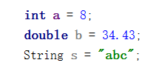
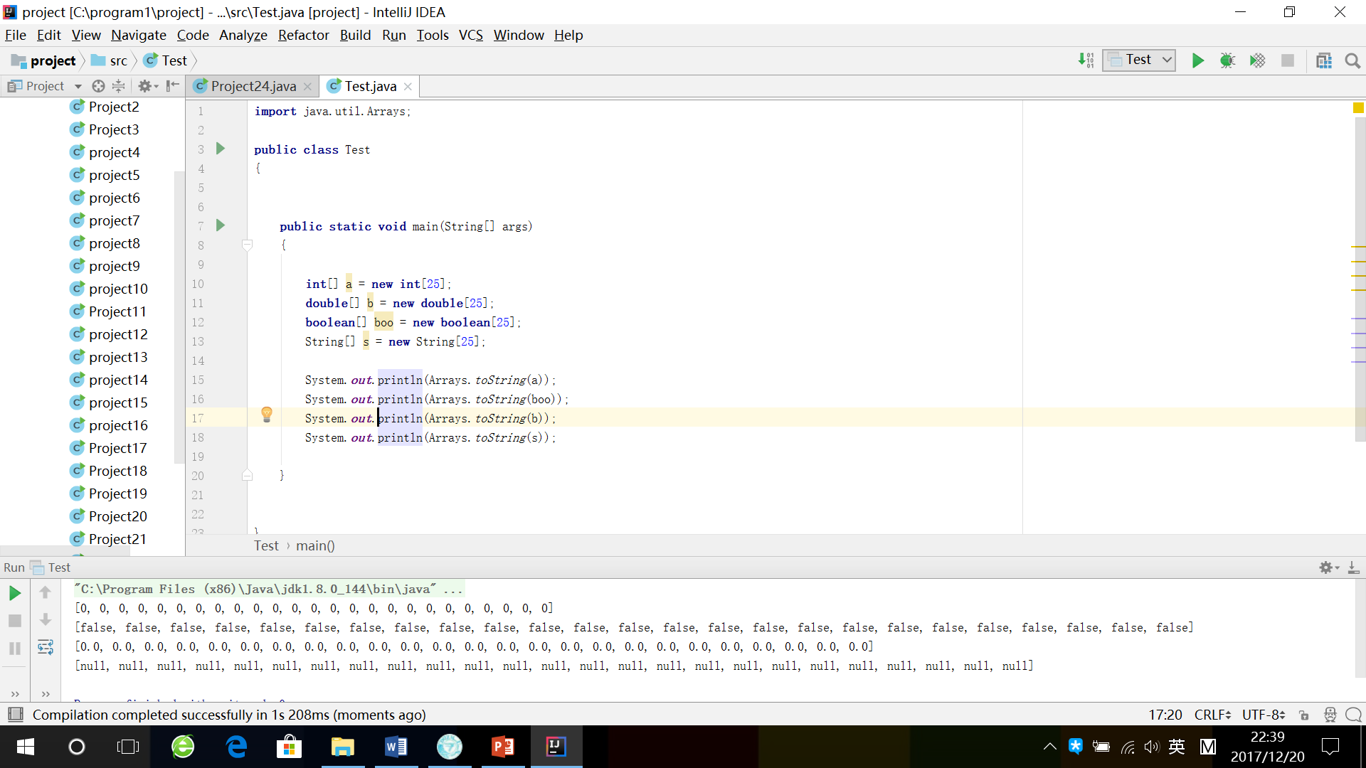
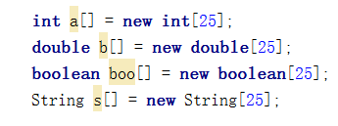
Declaration & Initialization
Type of array
Name of array
Length of array

Slide 6
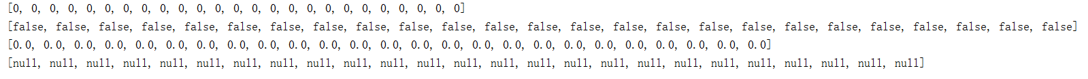
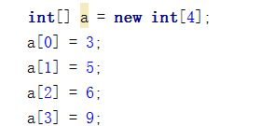
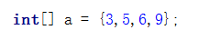
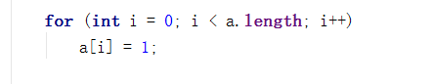

Slide 7
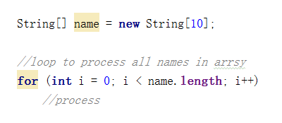
Length of Array
Length of array
return length of array

Slide 8
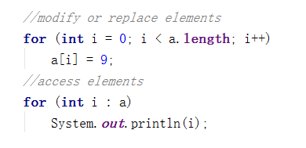
Traversing an Array
Represents one element in a each time

Slide 9
Practice
Input 10 integers and store them in an array.
Sort the array in the increasing order.
Output the array

Slide 10
Two-dimensional Array

Slide 11
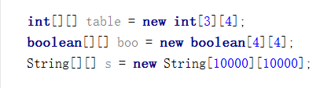
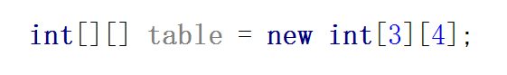
Declaration & Initialization
table[][0]
table[][1]
table[][2]
table[][3]
0 0 0 0
0 0 0 0
0 0 0 0
A rectangular array that has 3 rows and 4 columns

Slide 12
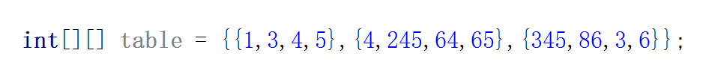
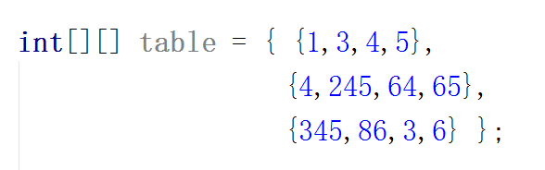
Specify a two-dimensional array

Slide 13
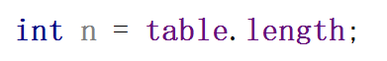
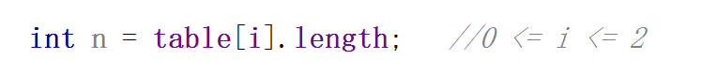
Length of Array
?

Slide 14
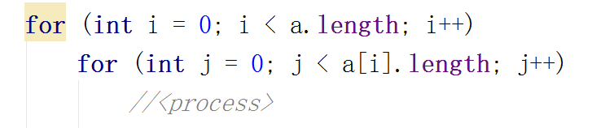
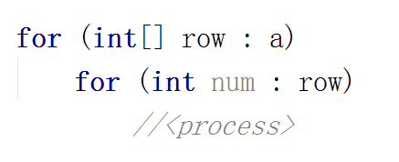
Traversing a two-dimensional Array

Slide 15
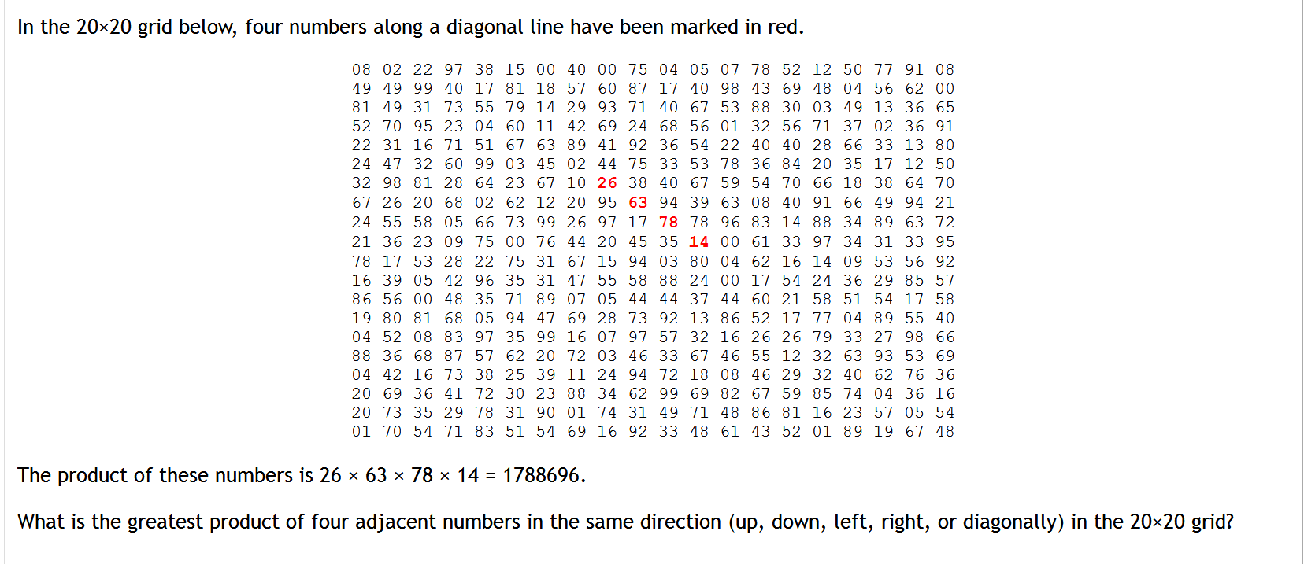
Practice

Slide 16
00 00 00
00 00 00
00 00 00
00 00 00
00 00 00
00 00 00
00 00 00
00 00 00
00 00 00
00 00 00
00 00 00
00 00 00
00 00 00
00 00 00
00 00 00
00 00 00
00 00 00
00 00 00
00 00 00
00 00 00
08 02 22 97 38 15 00 40 00 75 04 05 07 78 52 12 50 77 91 08 49 49 99 40 17 81 18 57 60 87 17 40 98 43 69 48 04 56 62 00 81 49 31 73 55 79 14 29 93 71 40 67 53 88 30 03 49 13 36 65 52 70 95 23 04 60 11 42 69 24 68 56 01 32 56 71 37 02 36 91 22 31 16 71 51 67 63 89 41 92 36 54 22 40 40 28 66 33 13 80 24 47 32 60 99 03 45 02 44 75 33 53 78 36 84 20 35 17 12 50 32 98 81 28 64 23 67 10 26 38 40 67 59 54 70 66 18 38 64 70 67 26 20 68 02 62 12 20 95 63 94 39 63 08 40 91 66 49 94 21 24 55 58 05 66 73 99 26 97 17 78 78 96 83 14 88 34 89 63 72 21 36 23 09 75 00 76 44 20 45 35 14 00 61 33 97 34 31 33 95 78 17 53 28 22 75 31 67 15 94 03 80 04 62 16 14 09 53 56 92 16 39 05 42 96 35 31 47 55 58 88 24 00 17 54 24 36 29 85 57 86 56 00 48 35 71 89 07 05 44 44 37 44 60 21 58 51 54 17 58 19 80 81 68 05 94 47 69 28 73 92 13 86 52 17 77 04 89 55 40 04 52 08 83 97 35 99 16 07 97 57 32 16 26 26 79 33 27 98 66 88 36 68 87 57 62 20 72 03 46 33 67 46 55 12 32 63 93 53 69 04 42 16 73 38 25 39 11 24 94 72 18 08 46 29 32 40 62 76 36 20 69 36 41 72 30 23 88 34 62 99 69 82 67 59 85 74 04 36 16 20 73 35 29 78 31 90 01 74 31 49 71 48 86 81 16 23 57 05 54 01 70 54 71 83 51 54 69 16 92 33 48 61 43 52 01 89 19 67 48
00 00 00
00 00 00
00 00 00
00 00 00
00 00 00
00 00 00
00 00 00
00 00 00
00 00 00
00 00 00
00 00 00
00 00 00
00 00 00
00 00 00
00 00 00
00 00 00
00 00 00
00 00 00
00 00 00
00 00 00
00 00 00 00 00 00 00 00 00 00 00 00 00 00 00 00 00 00 00 00
00 00 00 00 00 00 00 00 00 00 00 00 00 00 00 00 00 00 00 00
00 00 00 00 00 00 00 00 00 00 00 00 00 00 00 00 00 00 00 00

Slide 17
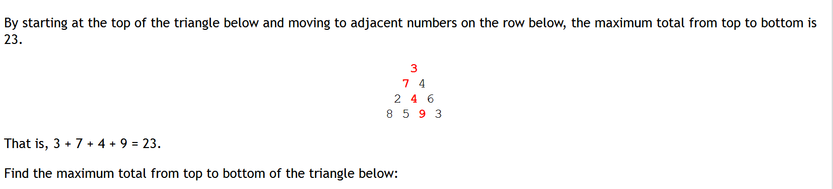
Challenge question
75 95 64 17 47 82 18 35 87 10 20 04 82 47 65 19 01 23 75 03 34 88 02 77 73 07 63 67 99 65 04 28 06 16 70 92 41 41 26 56 83 40 80 70 33 41 48 72 33 47 32 37 16 94 29 53 71 44 65 25 43 91 52 97 51 14 70 11 33 28 77 73 17 78 39 68 17 57 91 71 52 38 17 14 91 43 58 50 27 29 48 63 66 04 68 89 53 67 30 73 16 69 87 40 31 04 62 98 27 23 09 70 98 73 93 38 53 60 04 23

