Slide 1
Reference

Slide 2
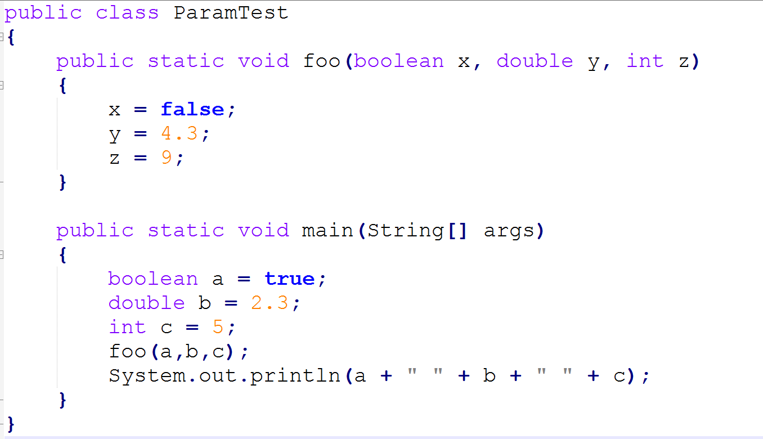
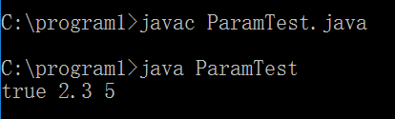
PASSING PRIMITIVE TYPES AS PARAMETERS

Slide 3
Just before the foo(a,b,c) method call:
At the time of the foo(a,b,c) method call:
a b c
a b c
true 2.3 5
true 2.3 5
x y z
true 2.3 5
Just before exiting the method:
After exiting the method:
a b c
a b c
true 2.3 5
true 2.3 5
x y z
false 4.3 9

Slide 4
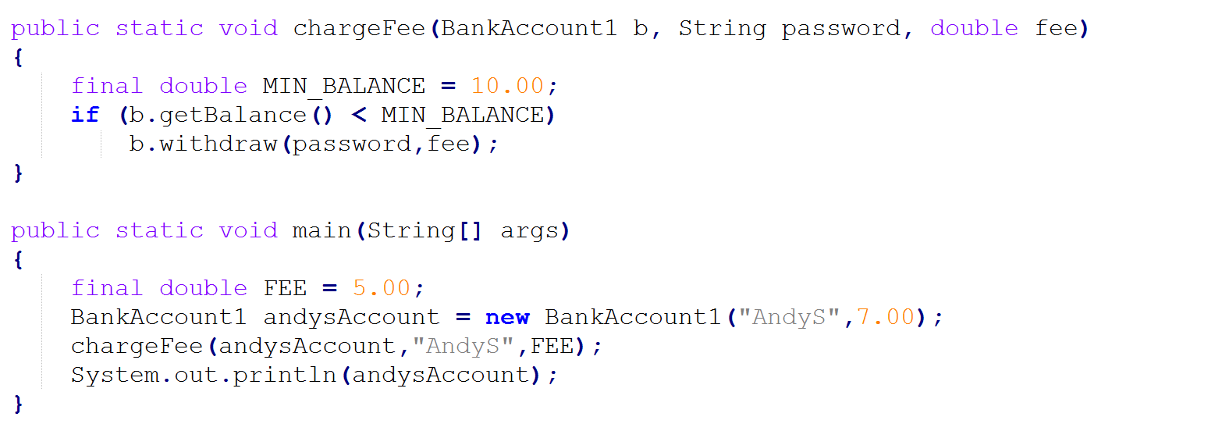
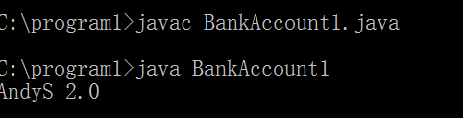
PASSING OBJECTS AS PARAMETERS

Slide 5
Before the chargeFee method call:
FEE andysAccount
BankAccount
5
password
“AndyS””
balance
7

Slide 6
At the time of the chargeFee method call:
FEE andysAccount
BankAccount
5
password
“AndyS””
fee b
balance
7
5
password
“AndyS”

Slide 7
Just before exiting the method:
FEE andysAccount
BankAccount
5
password
“AndyS””
fee b
balance
2
5
password
“AndyS”

Slide 8
After exiting the method:
FEE andysAccount
BankAccount
5
password
“AndyS””
balance
2

Slide 9
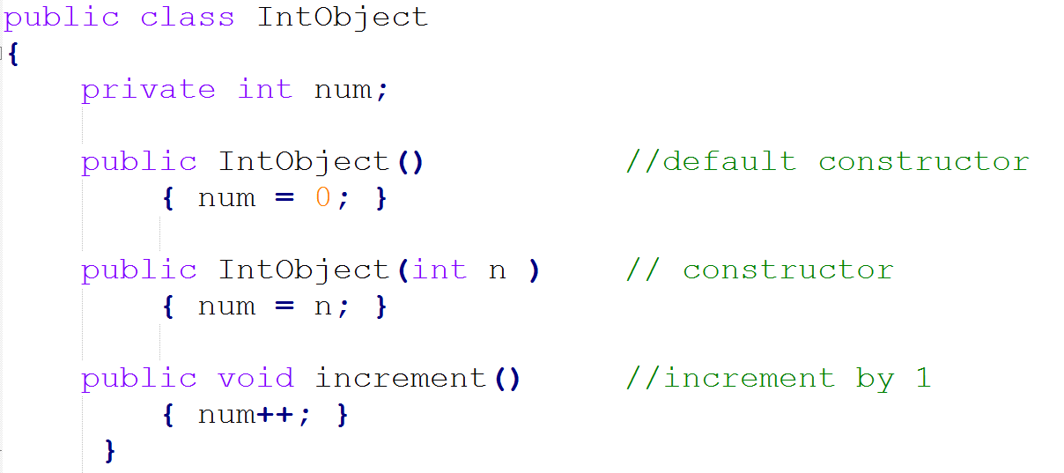
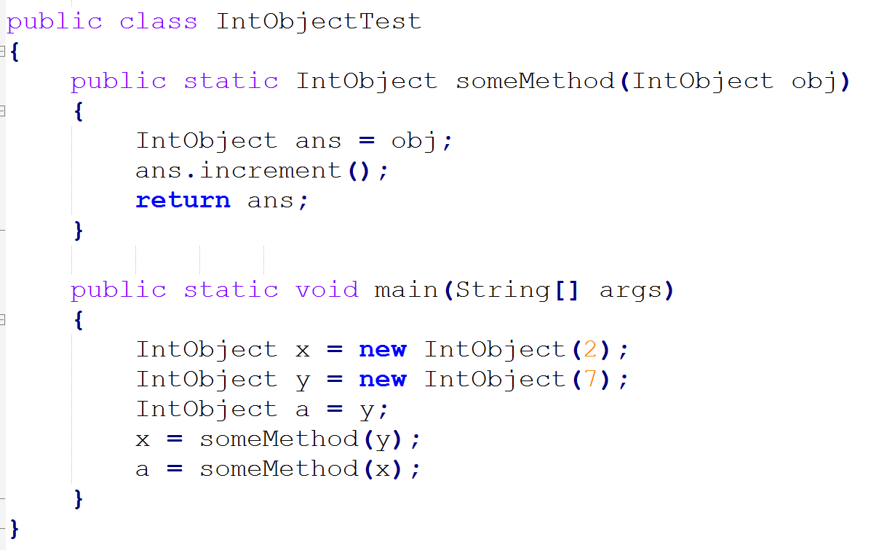
Practice
This question refers to the following the class:
Here is a client program that uses this class:
Just before exiting this program, what are the object values of x,y,and a,respectively?
(A) 9,9,9
(B) 2,9,9
(C) 2,8,9
(D) 3,8,9
(E) 7,8,9

Slide 10
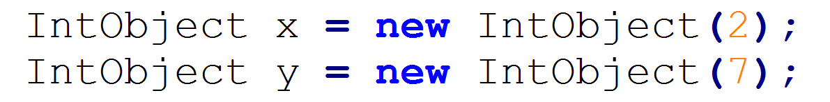
x
y
num:2
num:7

Slide 11
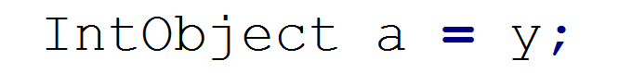
x
y a
num:2
num:7

Slide 12
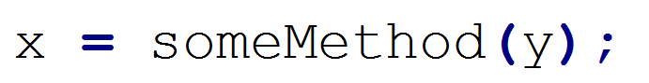
x
ans
y a
num:8
num:2
num:7

Slide 13
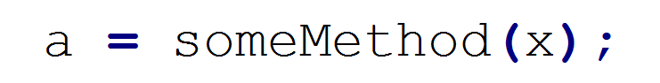
x
ans
y a
num:9
num:8
num:2
num:7

Slide 14
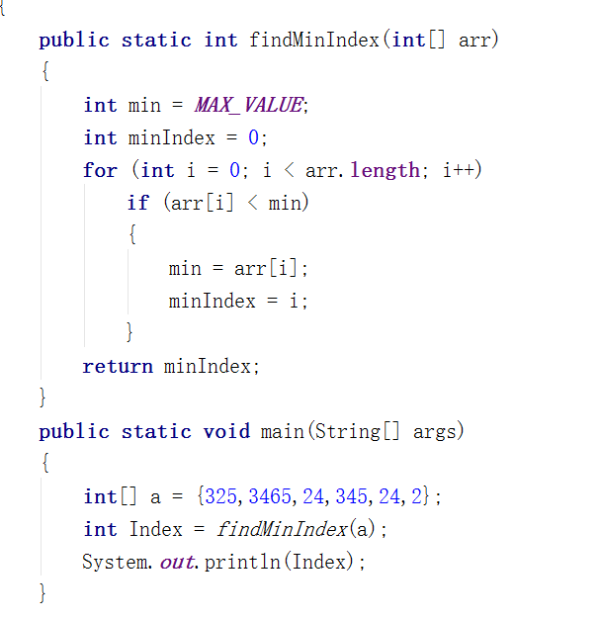
PASSING ARRAYS AS PARAMETERS
Access but not modify

Slide 15
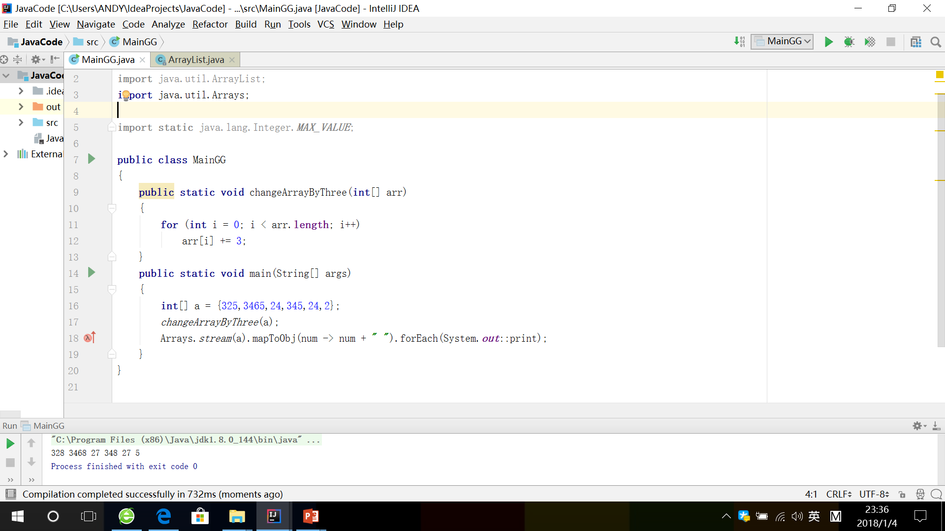

Slide 16
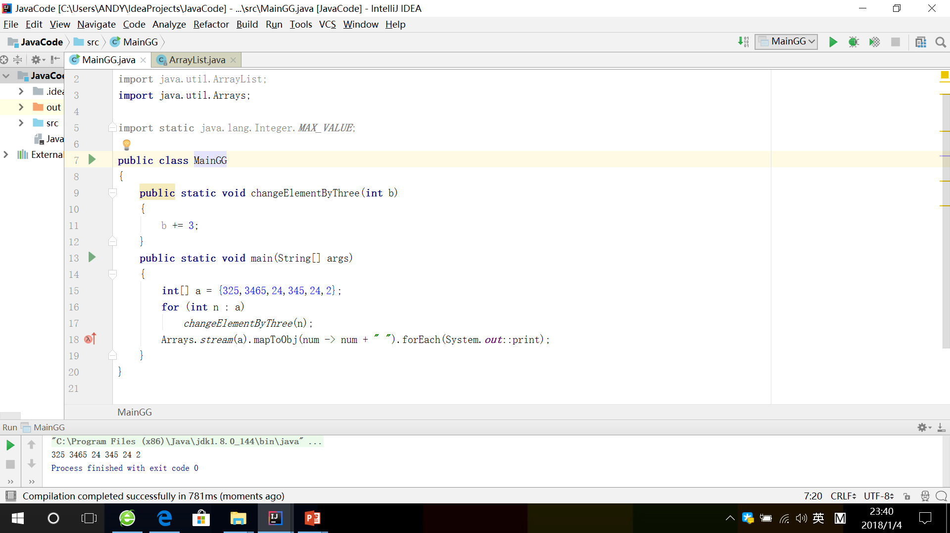

Slide 17
