Slide 1
#@rfluxmtx h=kf u=Z o=images/vmx/window_%03d.hdr
void glow windowglow
0
0
4 1 1 1 0
windowglow polygon window
0
0
12 0.5 -.15 1
0.5 -.15 2
3.5 -.15 2
3.5 -.15 1
#@rfluxmtx h=kf u=Z
void glow windowglow
0
0
4 1 1 1 0
windowglow polygon window
0
0
12 0.5 -.15 1
0.5 -.15 2
3.5 -.15 2
3.5 -.15 1

Slide 2
#@rfluxmtx h=u u=Y
void glow ground_glow
0
0
4 1 1 1 0
ground_glow source ground
0
0
4 0 0 -1 180
#@rfluxmtx h=r1 u=Y
void glow sky_glow
0
0
4 1 1 1 0
sky_glow source sky
0
0
4 0 0 1 180
#@rfluxmtx h=kf u=Z
void glow windowglow
0
0
4 1 1 1 0
windowglow polygon window
0
0
12 0.5 -.15 1
0.5 -.15 2
3.5 -.15 2
3.5 -.15 1

Slide 3
#objects/window_south.rad
void glow window_south
0
0
4 1 1 1 0
window_south polygon window1
0
0
12 0.5 -.15 1
0.5 -.15 2
2 -.15 2
2 -.15 1
window_south polygon window2
0
0
12 2.5 -.15 1
2 .5 -.15 2
4 -.15 2
4 -.15 1
#objects/window_south.rad
void glow window_south
0
0
4 1 1 1 0
window_south polygon window
0
0
12 0.5 -.15 1
0.5 -.15 2
3.5 -.15 2
3.5 -.15 1
#objects/win.vd
1 # number of windows
window_south 0 1 0 0 0 1
modifier
vd
vu

Slide 4
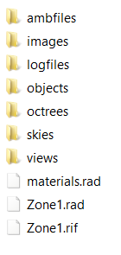
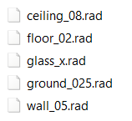
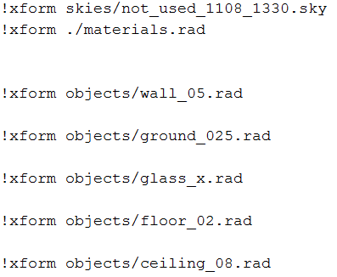
su2rad export
objects
Zone1.rad

Slide 5
# box.rad
!xform skies/not_used_1108_1430.sky
!xform ./materials.rad
!xform objects/ceiling.rad
!xform objects/ext_ wall.rad
!xform objects/floor.rad
!xform objects/forniture.rad
!xform objects/ground.rad
!xform objects/int_wall.rad
!xform objects/window_south.rad

Slide 6
 |  | Sender | Receiver
VMX |  | Points [y] | cfs.rad [kf]
BSDF |  | 145 | 145
DMX |  | cfs.rad [kf] | sky.rad [rN] N=1,2,4
SMX |  | gendaymtx –m N N=1,2,4 | 8760

Slide 7
vu (0 0 1)
inside
vd (0 1 0)
N
E

Slide 8
 | Matrices dimension
VMX | Points [y] y = number of sensors | cfs.rad [kf]
BSDF | 145 | 145
DMX | cfs.rad [kf] | sky.rad [rN] N=1,2,4
SMX | gendaymtx –m N N=1,2,4 | 8760

Slide 9
 | Matrices dimension
I | Points [y] | 8760
V [VMX] | Points [y] y = number of sensors | window.rad [kf] kf=145
T [BSDF] | 145 | 145
D [DMX] | window.rad [kf] kf=145 | sky.rad [rN] N=1,2,4
S [SMX] | gendaymtx –m N N=1,2,4 | 8760

Slide 11
 | Reflectance
Ceiling | 0.9
Floor | 0.2
Wall | 0.5
Ground | 0.35

